Slide 1
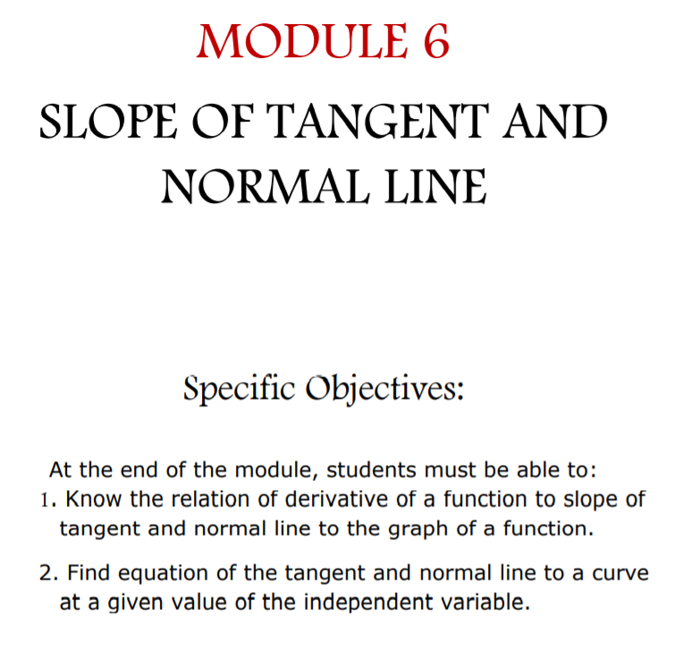

Slide 2
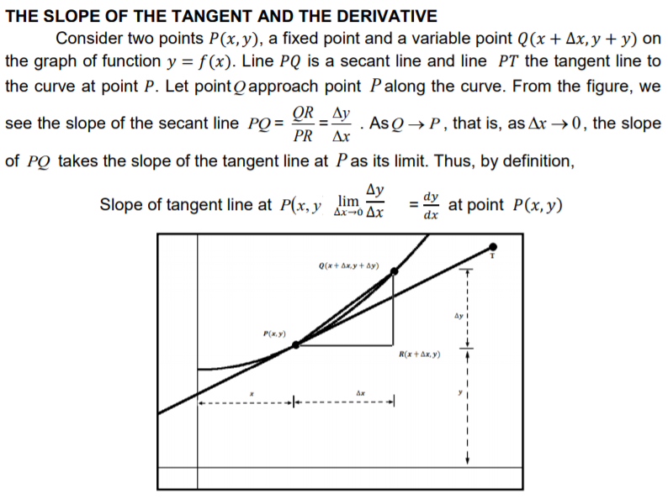

Slide 3
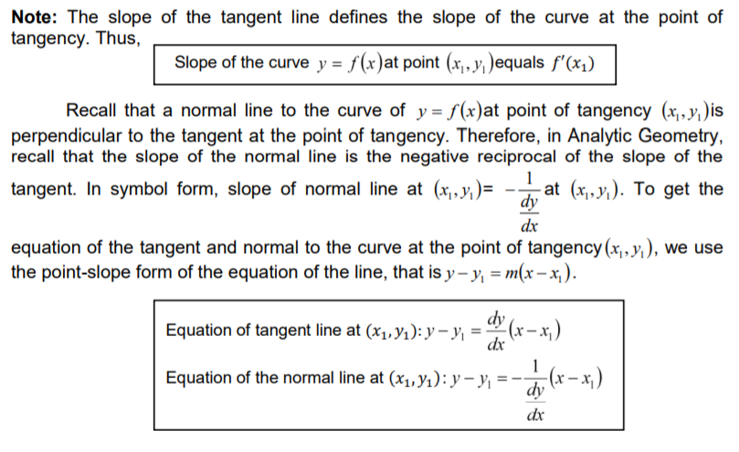

Slide 4

EXAMPLES
1. Ans: 32

Slide 5

Ans: 0

Slide 6


Slide 7


Slide 8


Slide 9
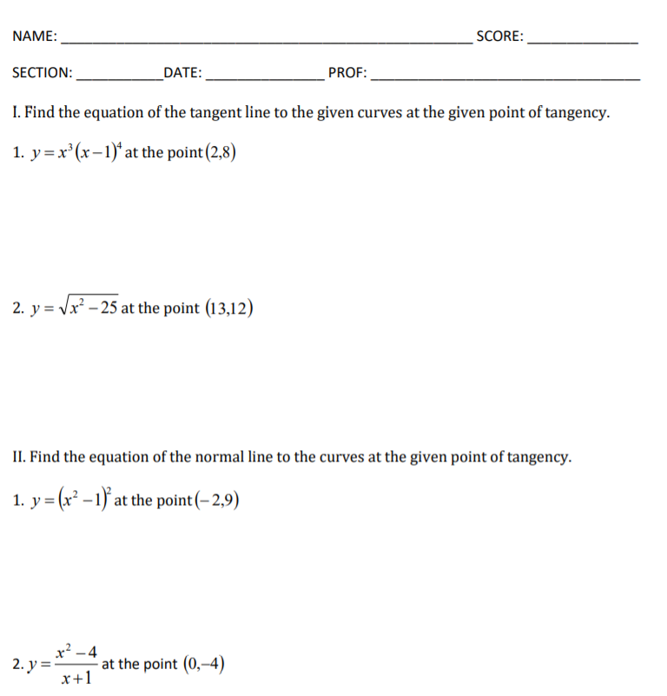
Assignment 10

Slide 10
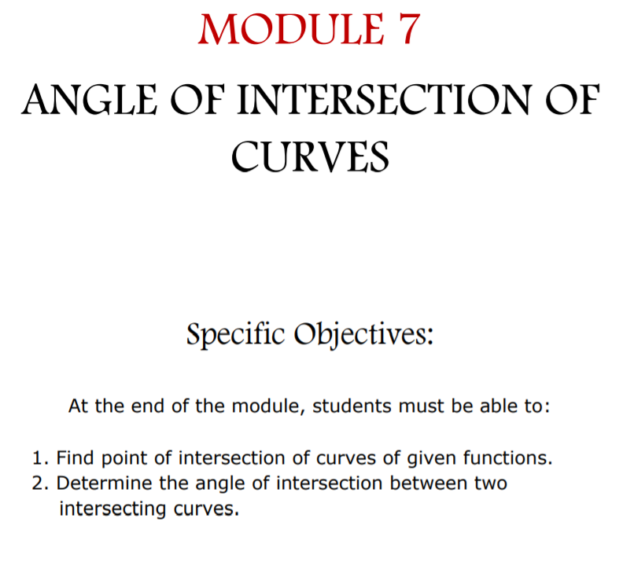

Slide 11
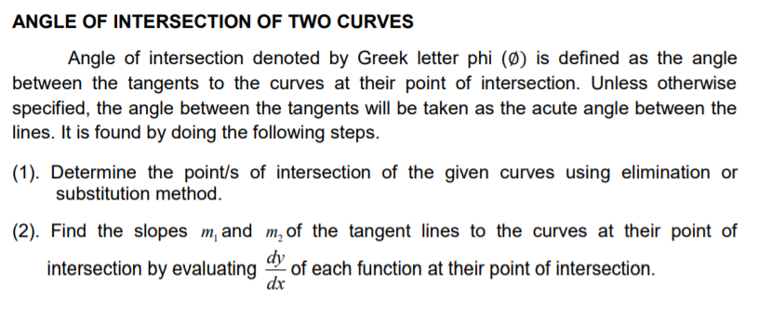

Slide 12


Slide 14


Slide 15
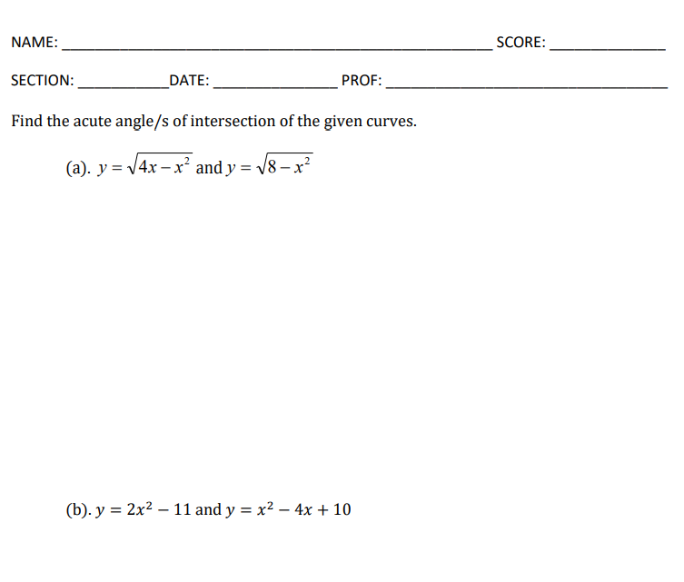
ASSIGNMENT NUMBER 11

Slide 16
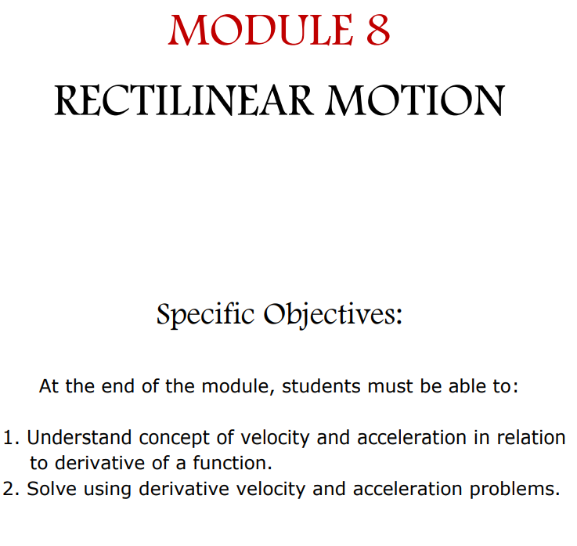

Slide 17
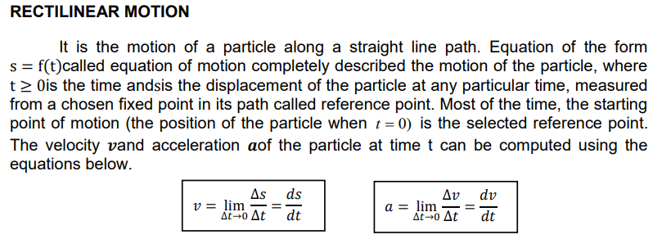

Slide 18
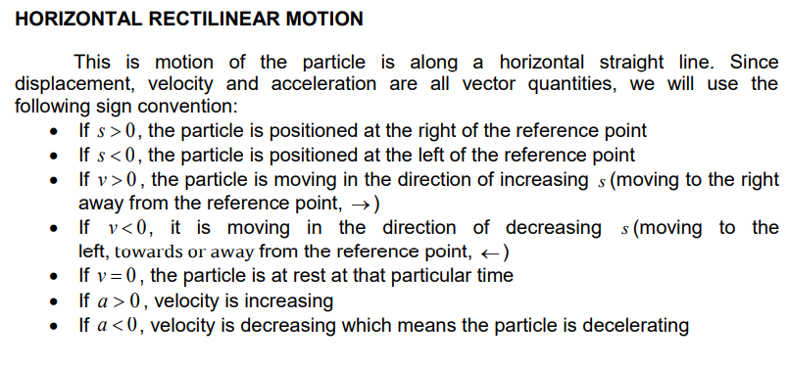

Slide 19
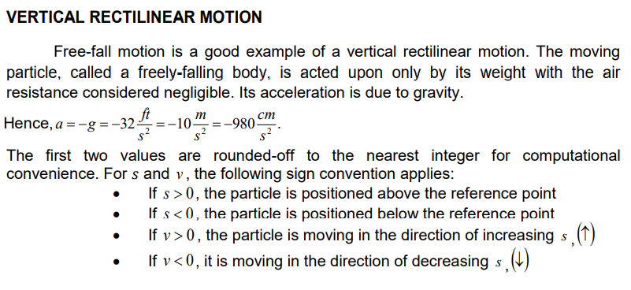

Slide 20


Slide 21


Slide 24


Slide 26


Slide 27
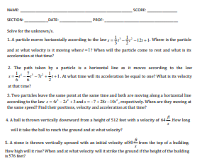
ASSIGNMENT NUMBER 12

