Slide 1
Final Project
By: Sebastian Santiago

Slide 2


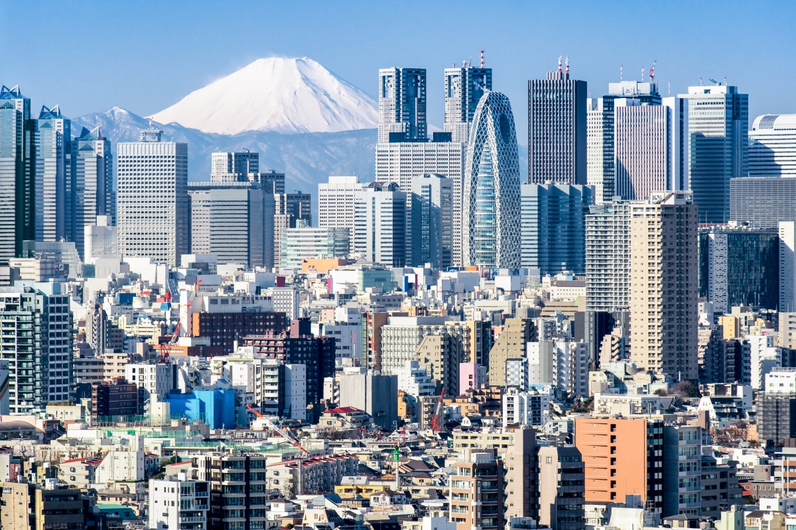


Japan
z

Slide 3
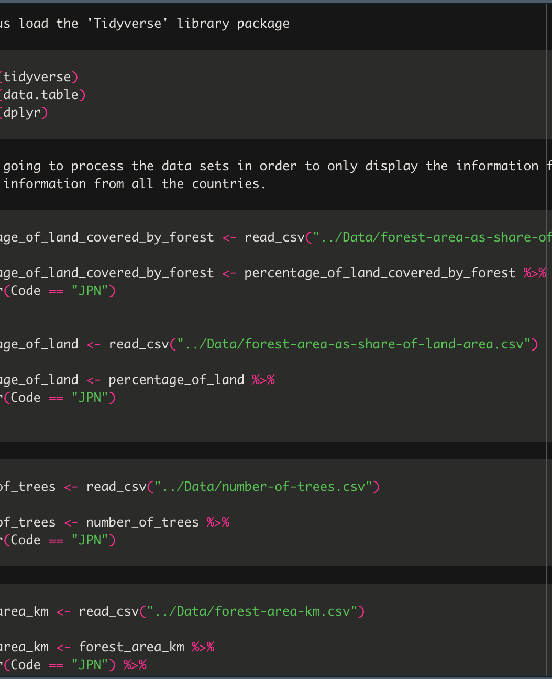
Data Sets
All data sets were extracted from Our World in a Data Article that talks about deforestation and forests.
It analyzes not only data from Japan but from the whole world.

Slide 4
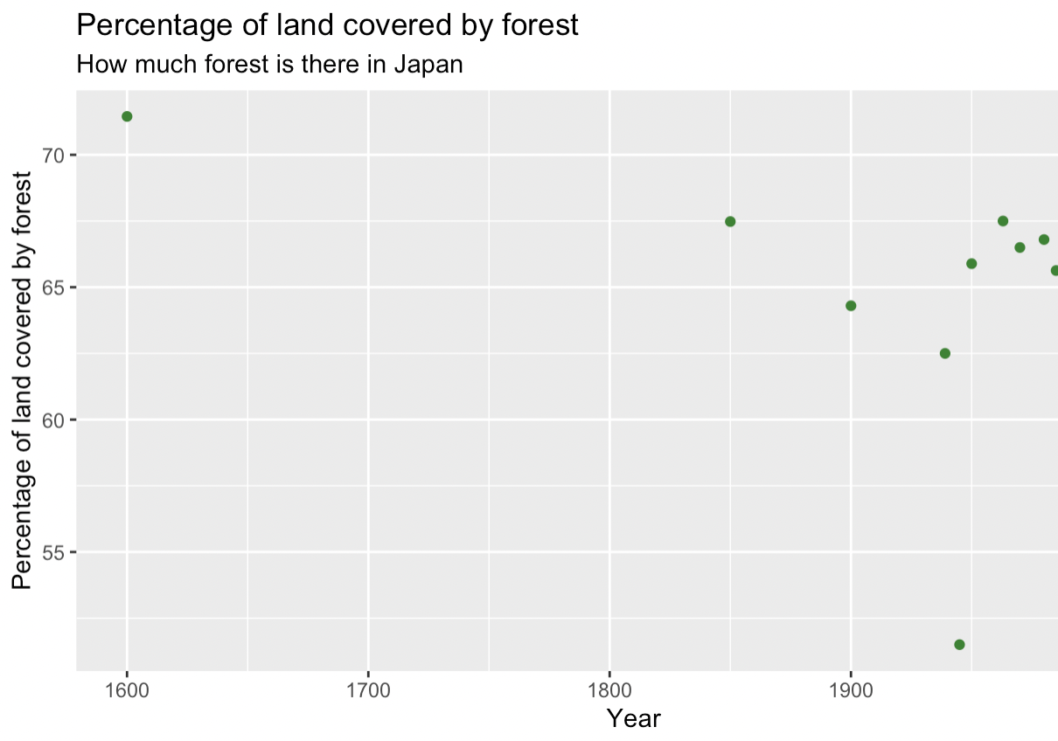
How many forests are there in Japan.
We can assume that there was probably an anomaly in the data given the chart with little data.

Slide 5
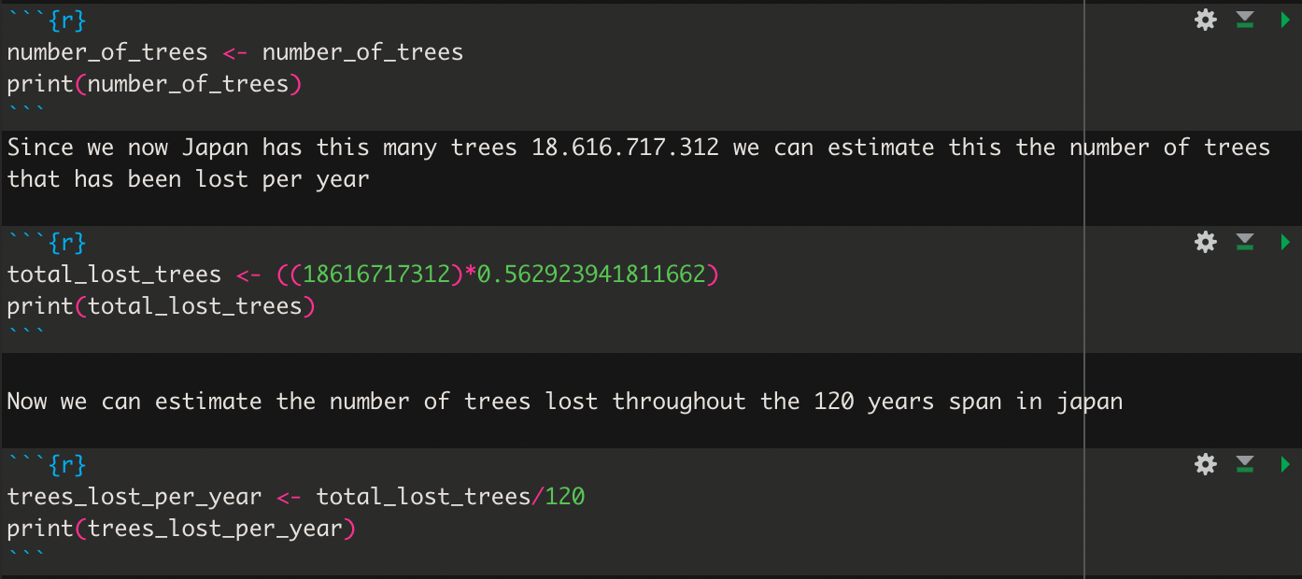
How much is that in trees
We see that we have roughly 18 billion trees. We can also estimate how many we lose.
There was an estimated 87 million lost per year.

Slide 6

The End
After analyzing the data sets, we see that Japan has been losing 0.563% forest a year. We can also say that more than half of Japan is covered by forest. The losses of trees and forest have grown exponentially over the years.

