Slide 1

NETRAX
AI for PPE compliance, fire and smoke safety
See. Sense. Safeguard.
Team ZENTRIX · Team ID BH26PS06T044
BPUT Hackathon 2026 · Problem Statement 6 · Final round
Notes:
NETRAX comes from Netra (eye) and technology. One line: ordinary cameras become a safety officer that never looks away, and fire is confirmed by camera and sensors together.

Slide 2
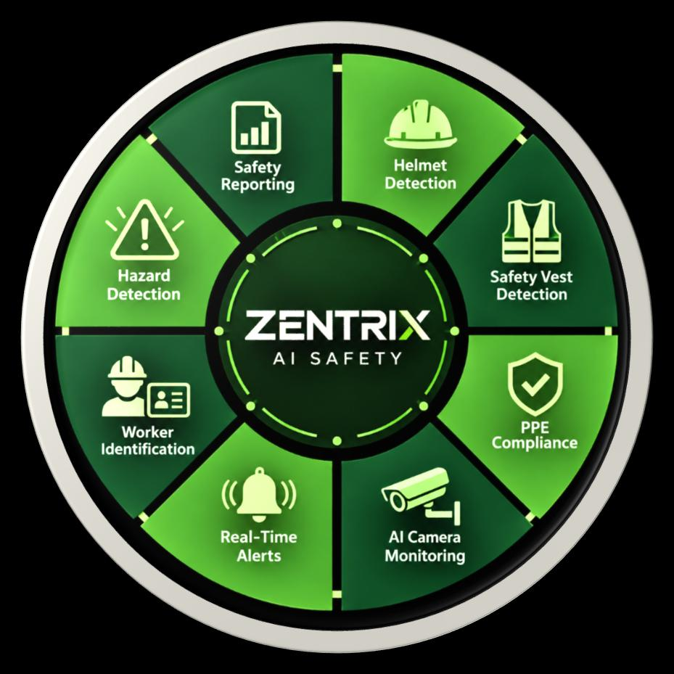
The problem: safety depends on someone noticing
Manual watching
Noisy, vague alarms
A supervisor cannot watch every camera for a whole shift. Inspections miss what happens in between.
“Violation detected” with no who, what or where. Orange shirts and lamps trigger fire alarms, so people stop trusting them.
Slow, cloud-heavy systems
Hazards go unnoticed
Streaming every camera to the cloud costs bandwidth, adds delay and stops when the internet drops.
Early smoke or a small flame is easy to miss, which delays the emergency response.
Notes:
Problem Statement 6: a prototype AI system that detects safety gear compliance. These are the four gaps we saw in how factories do it today.

Slide 3
NETRAX: who, what, where, within seconds
An edge-AI system: cameras + AI on a local computer + sensors + dashboards. It tells the supervisor exactly who is missing which safety item in which zone, and confirms fire with camera and sensors together.
PPE per worker, per zone
One clear alert
Fire and smoke, 3 levels
Helmet, vest, gloves, goggles, mask, safety shoes. Worn, missing or “cannot tell”.
“W-006 · no goggles · Welding bay · cam_01” with snapshot and video clip.
Camera AI confirmed by flame, gas and temperature sensors. Warning, critical, evacuate.
Restricted zone + entrance
Alerts that reach people
Runs on site
Only listed workers in the welding bay. PPE and identity check at the gate.
Dashboard, voice call-out, Telegram, e-mail, phone call for fire.
Video never leaves the factory. Keeps working offline.
Notes:
Stress the alert quality: per person, per item, per zone. And that everything runs on site.

Slide 4
What is new since the mid evaluation
At mid evaluation
Added for the final round
PPE detection per worker with our own trained models
Fire and smoke detection with look-alike filter
ESP32 safety station and RFID attendance
Restricted welding bay
One supervisor dashboard and a hardware page
PDF / CSV reports
New control room: separate fire box and PPE box, live camera wall
Entrance gate check: verified / not permitted / manual
Fire levels 1–3 with siren, and a phone call for every fire or smoke
Telegram + e-mail with provider-confirmed delivery, escalation
Login with viewer / supervisor / admin roles and an audit log
Short face-blurred video clip for every incident
Smooth video: 4 cameras at 15–19 pictures per second
Zentrix AI: typed or spoken commands, only on command
Safety Intelligence page: sensors, map, workers, forecast
Report generator for any time range
Camera on / off from the dashboard
130 automated checks passing
Notes:
Left: what the jury saw at mid evaluation. Right: what we added for the final round. Everything on the right works in the system today.

Slide 5
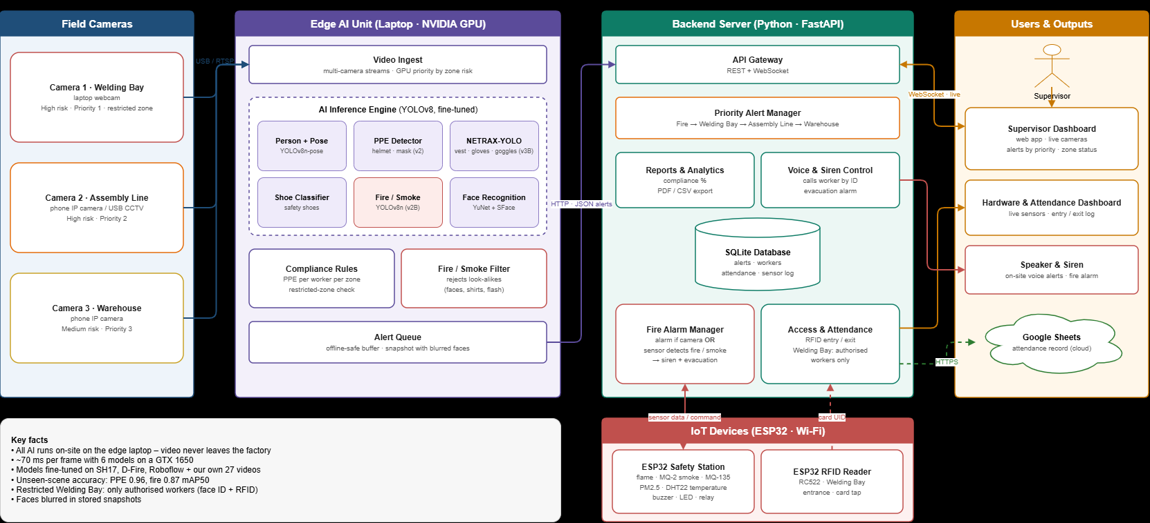
System architecture
Notes:
Four parts: cameras (eyes), edge AI on the laptop GPU (brain), FastAPI backend with SQLite (memory), dashboards, speaker and ESP32 outputs (voice). The edge sends only a small alert, about 42 KB, never the video.

Slide 6
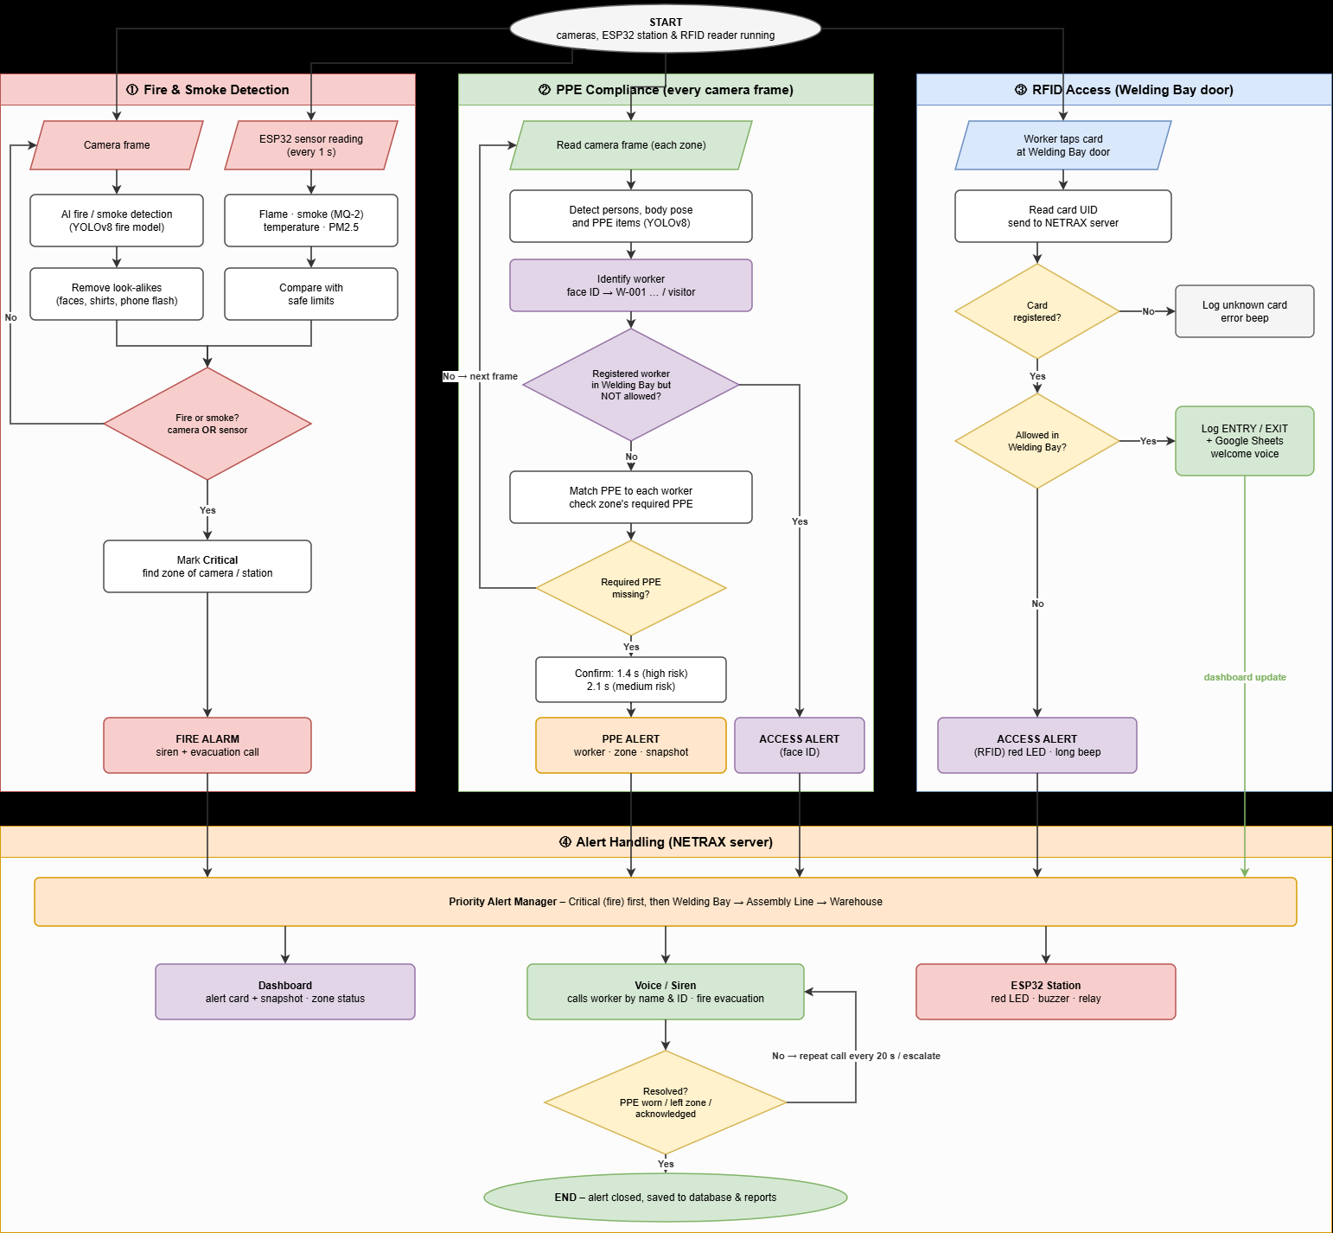
Workflow: from camera frame to alert
1
Capture the newest frame from each camera
2
Detect people, 17 body points and PPE items
3
Match each item to the right person
4
Identify: worker ID by face or RFID, else visitor
5
Judge each item: worn, missing or cannot tell
6
Confirm over 6 of 10 frames
7
One alert per person with all missing items
8
Dashboard, voice, Telegram, e-mail; escalate if ignored
Notes:
Walk through the helmet example in the numbered steps. Fire follows the same idea with colour, flicker and growth checks, then sensor confirmation.

Slide 7
Small specialist models, not one big model
Model | Type | Job in NETRAX | Source
Person + pose | YOLOv8n-pose | Finds people and 17 body points | Ready-made (COCO)
PPE main (v2) | YOLOv8s | Helmet, mask | Trained by us
NETRAX-YOLO (v3B) | YOLOv8s + extra P2 head | Vest, gloves, goggles; head, face, hand, foot | Trained by us, 2 stages
Fire / smoke (v2B) | YOLOv8n | Flame and smoke | Trained by us, 2 stages
Shoe classifier | YOLOv8n-cls | Safety shoe or other footwear | Trained by us
YuNet + SFace | Face models (OpenCV) | Worker identity, face blurring | Ready-made
Extra P2 head
The “bare hand” rule
A fourth, finer detection level that keeps detail for small objects such as gloves and goggles.
An item is “missing” only when the uncovered body part is seen. Hidden hands give “cannot tell”, never an alert.
Notes:
Two PPE models work together because we measured which is better per item: v2 for helmets on far people, v3B for vests and small items. The bare-hand idea: we say 'no gloves' only when we see a bare hand.

Slide 8
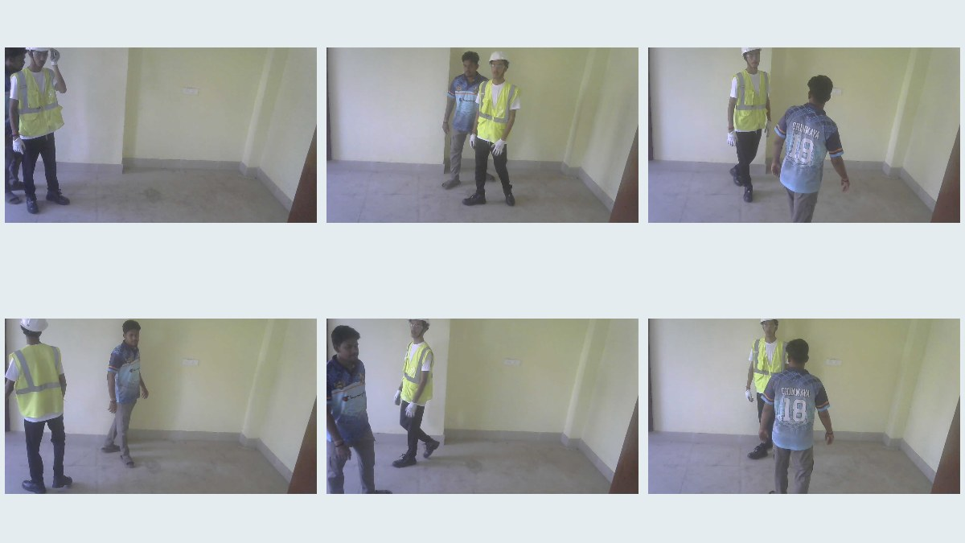
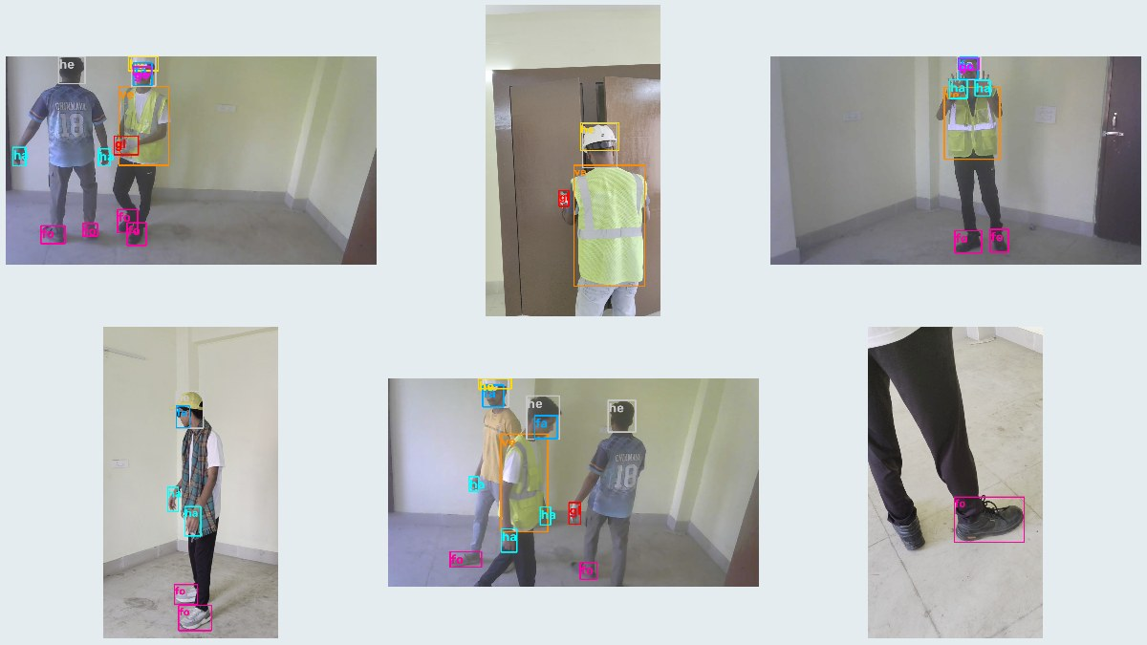
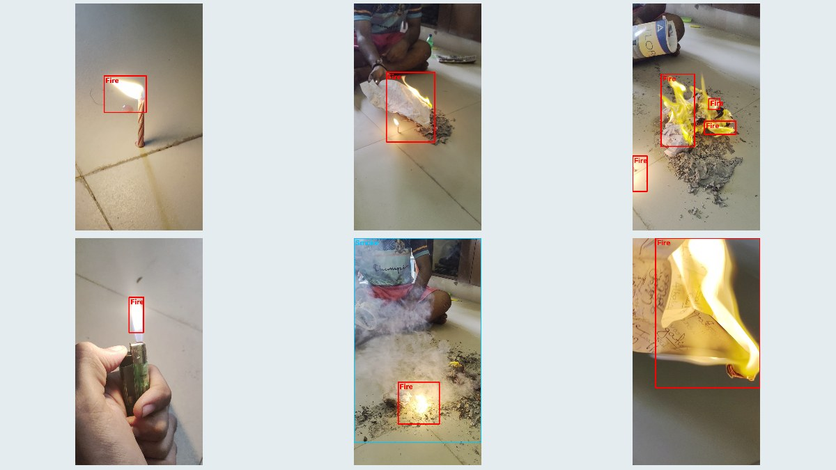
Our own data made the difference
27
1,314
2
videos recorded by the team
labelled frames
training stages on a Colab T4 GPU
Public sets: SH17, D-Fire, Roboflow construction PPE
Own scenes: full kit, each item off, look-alikes, backlit, far, overhead
“No fire” on purpose: phone flash, white T-shirt, steam, red cloth
Split by whole video: test scenes never seen in training
Stage A: public + dark / haze / blur copies. Stage B: + own data ×3
Labels: drafted by our models, fixed by scene rules, then reviewed
Our recorded frames (top) and labels for PPE and fire (bottom)
Notes:
Public data: SH17, D-Fire, Roboflow sets. Then 27 videos recorded by us, including look-alikes and deliberate no-fire scenes. Split by whole video so test scenes were never seen in training. Be honest: labels are machine-drafted, rule-corrected and reviewed.

Slide 9
Results on scenes the models never saw
0.959
PPE mAP50
precision 0.926 · recall 0.936
0.870
Fire mAP50
precision 0.955 · recall 0.772
0.99
Helmet
goggles 0.77 is the weakest item
Test sets are small (123 PPE images, 142 fire images) and the labels are machine-made plus reviewed: indicative, not a certified benchmark.
Notes:
PPE: 123 images from 3 unseen scenes. Fire: 142 images, a lighter flame plus a white T-shirt look-alike. The fire story: public data alone forgot small indoor flames (0.16); our own data fixed it (0.87). Say clearly that the test sets are small and labels are machine-made plus reviewed.

Slide 10
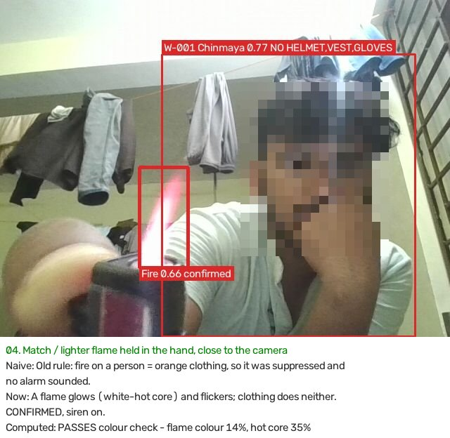
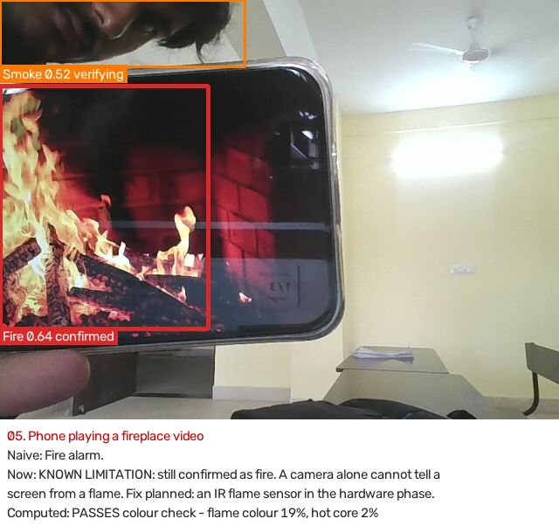
Why the alerts can be trusted
6 of 10 frames must agree
Evidence rule
One bad frame cannot raise an alert.
Missing only if the bare body part is seen.
One decision per person
Fire look-alike filter
One alert with all items, no repeats.
Rejects faces, hair, lamps, flashes, white shirts, steam.
Camera + sensor fusion
Never “safe” when blind
A camera fire waits for the station to confirm.
Offline camera or station is shown as not monitored.
Real tests: a lighter flame is confirmed (left); a fire video on a phone is the known limit that sensors solve (right)
Notes:
Most of our engineering is the logic around the models. 31 of 31 recorded smoke false alarms were rejected in our tests while real incense smoke still alarmed. Known limit: a phone playing a fire video fools a camera, so the sensor station has the final word.

Slide 11
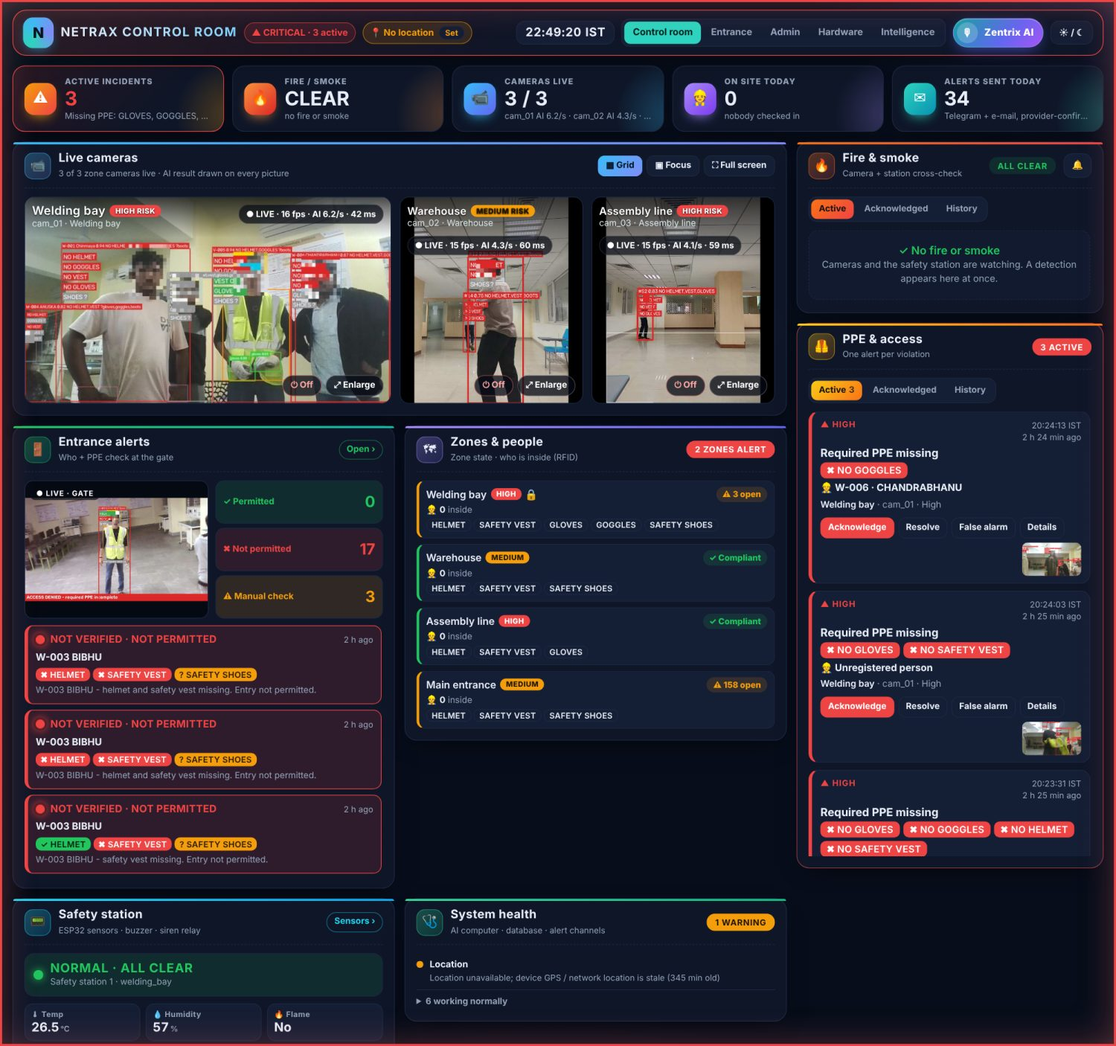
Control room: everything on one screen
Welding bay (highest risk) shown largest
Each tile: picture rate, AI checks per second, delay
New alert slides into its own box with a tone
Card: who, what, where, snapshot, video clip
Acknowledge · Resolve · Escalate · False alarm
Resolve while still non-compliant → the camera re-checks
Notes:
Top numbers, live cameras with AI boxes, entrance, zones and people, safety station, system health. Right side: one box for fire and smoke, one for PPE and access, each with Active / Acknowledged / History. Screens were captured from our real pages on a copy of our database; camera tiles are stored face-blurred snapshots.

Slide 12
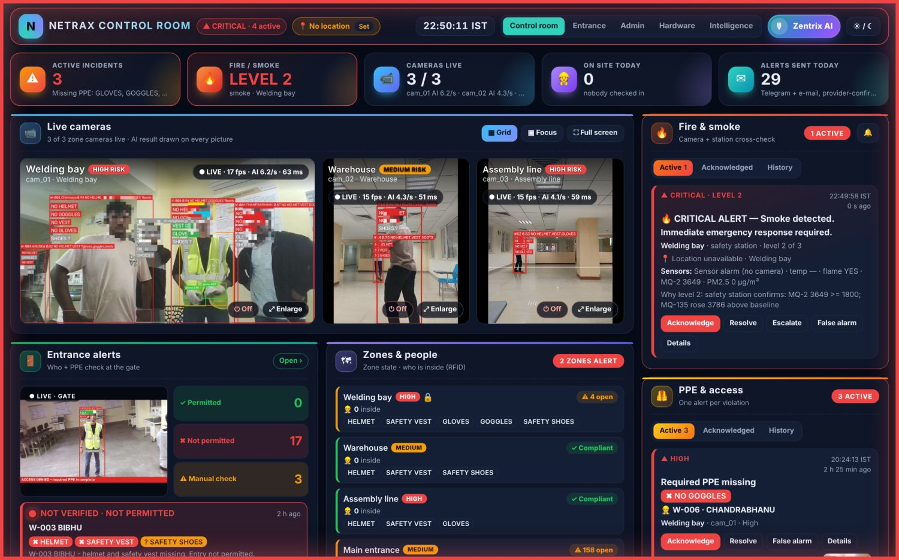
Fire and smoke: three levels, two witnesses
Level 1 · Warning
Voice warning, yellow panel, Telegram + e-mail
Level 2 · Critical
Siren, red LED + buzzer + relay, phone call
Level 3 · Evacuate
Full-screen evacuate overlay, call again
Camera fire is confirmed by the zone’s sensor station within 8 s
Station offline → the camera alone decides
15 camera detections were suppressed by the station in our records
Notes:
Level depends on flame size, growth, duration, sensors and number of sources; it only goes up. Siren from level 2. Phone call to the supervisor for every fire or smoke. The picture shows a recorded sensor alarm played back.

Slide 13
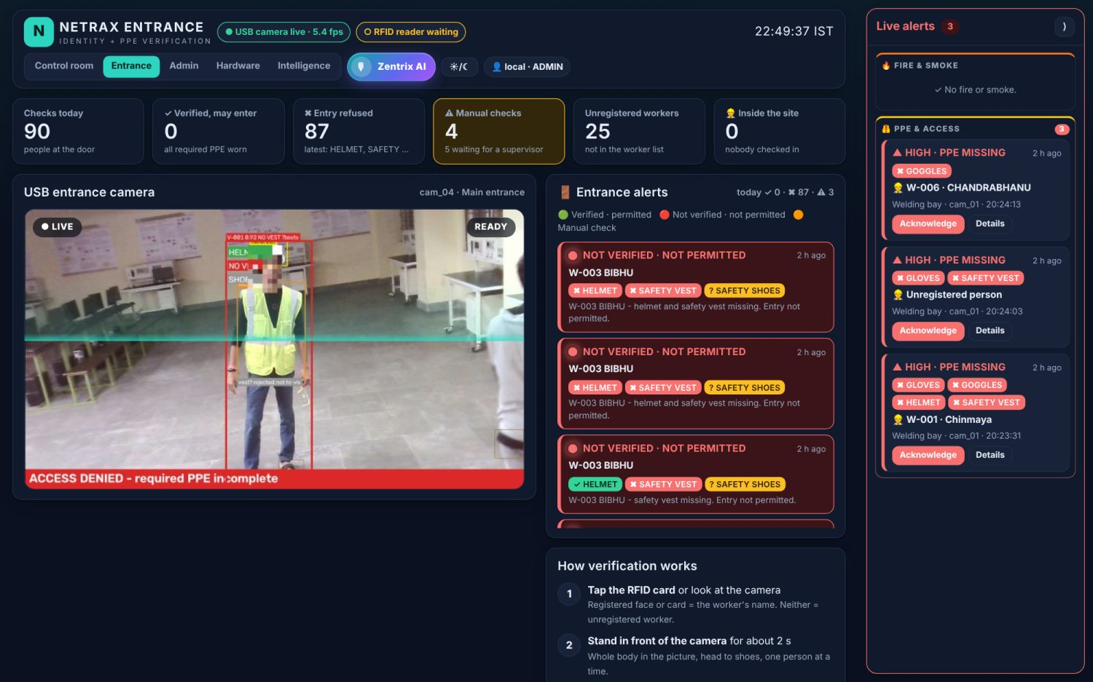
Entrance check and restricted zone
Verified · permitted
All required PPE worn: may enter
Not verified · not permitted
The missing item is named
Manual check
View unclear or more than one person
Welding bay: only listed workers; others raise “unauthorised entry”
RFID tap records entry and exit and shows who is inside
Card and face disagree → manual check, never auto-approved
Notes:
One person at a time at the gate; identity from face or RFID card. Three results. In the welding bay only listed workers are allowed; camera and card alerts for the same person are merged. No lock is connected yet: the gate output stays closed until a controller is added.

Slide 14
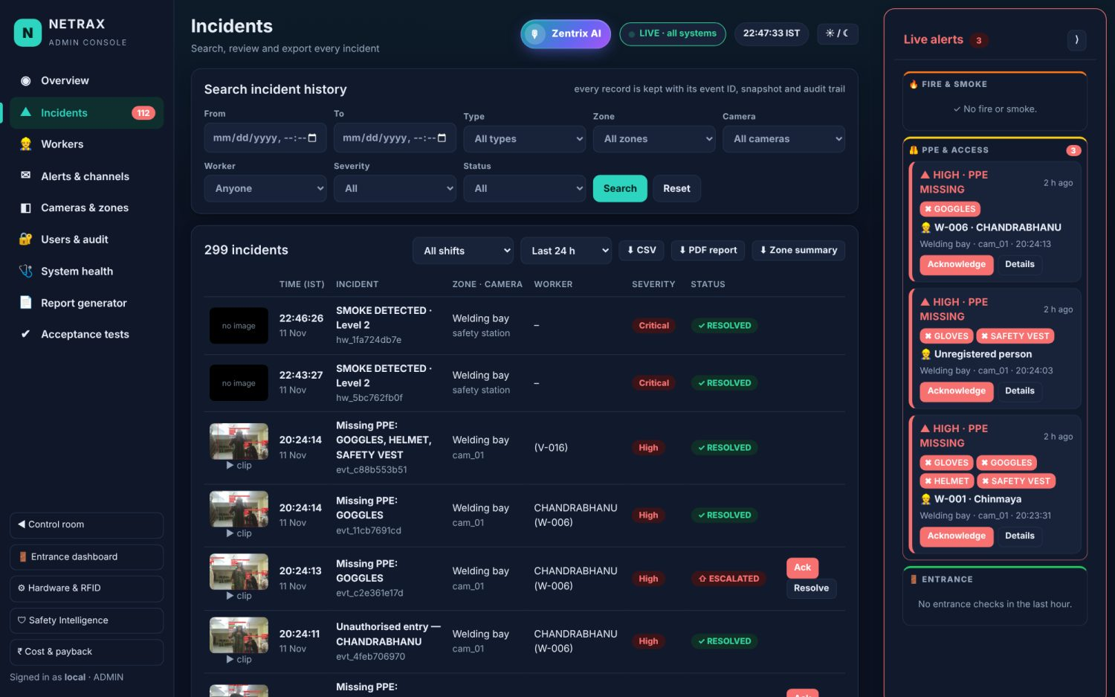
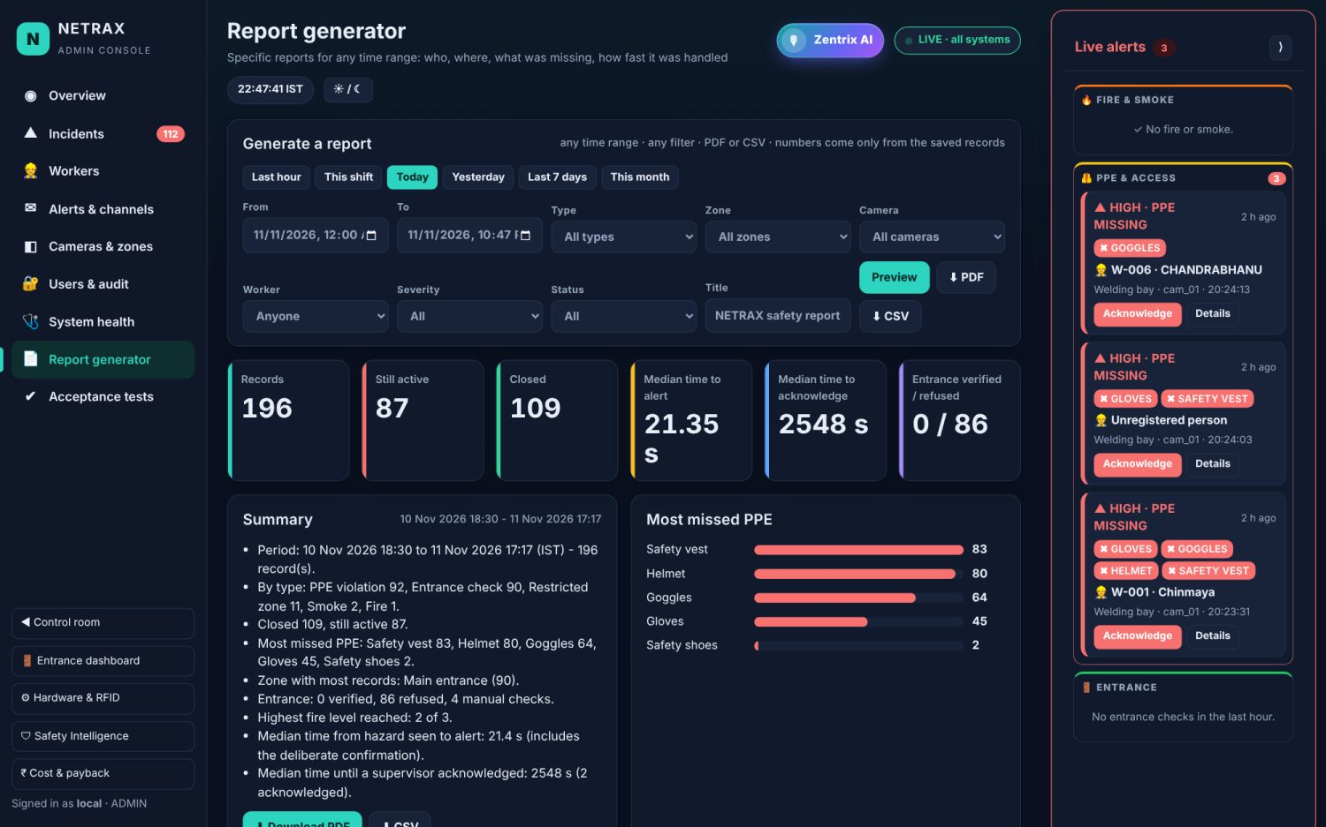
Admin console: records, reports, proof
Incident search with snapshot, clip, worker and status
Report generator: any time range, PDF or CSV
1,178
728
429
3
incidents recorded
Telegram messages delivered
e-mails sent
login roles + audit log
Notes:
Every incident is searchable with snapshot and clip. Reports for any time range as PDF or CSV. Roles: viewer sees no names, supervisor acts, admin manages. Every action is in the audit log.

Slide 15
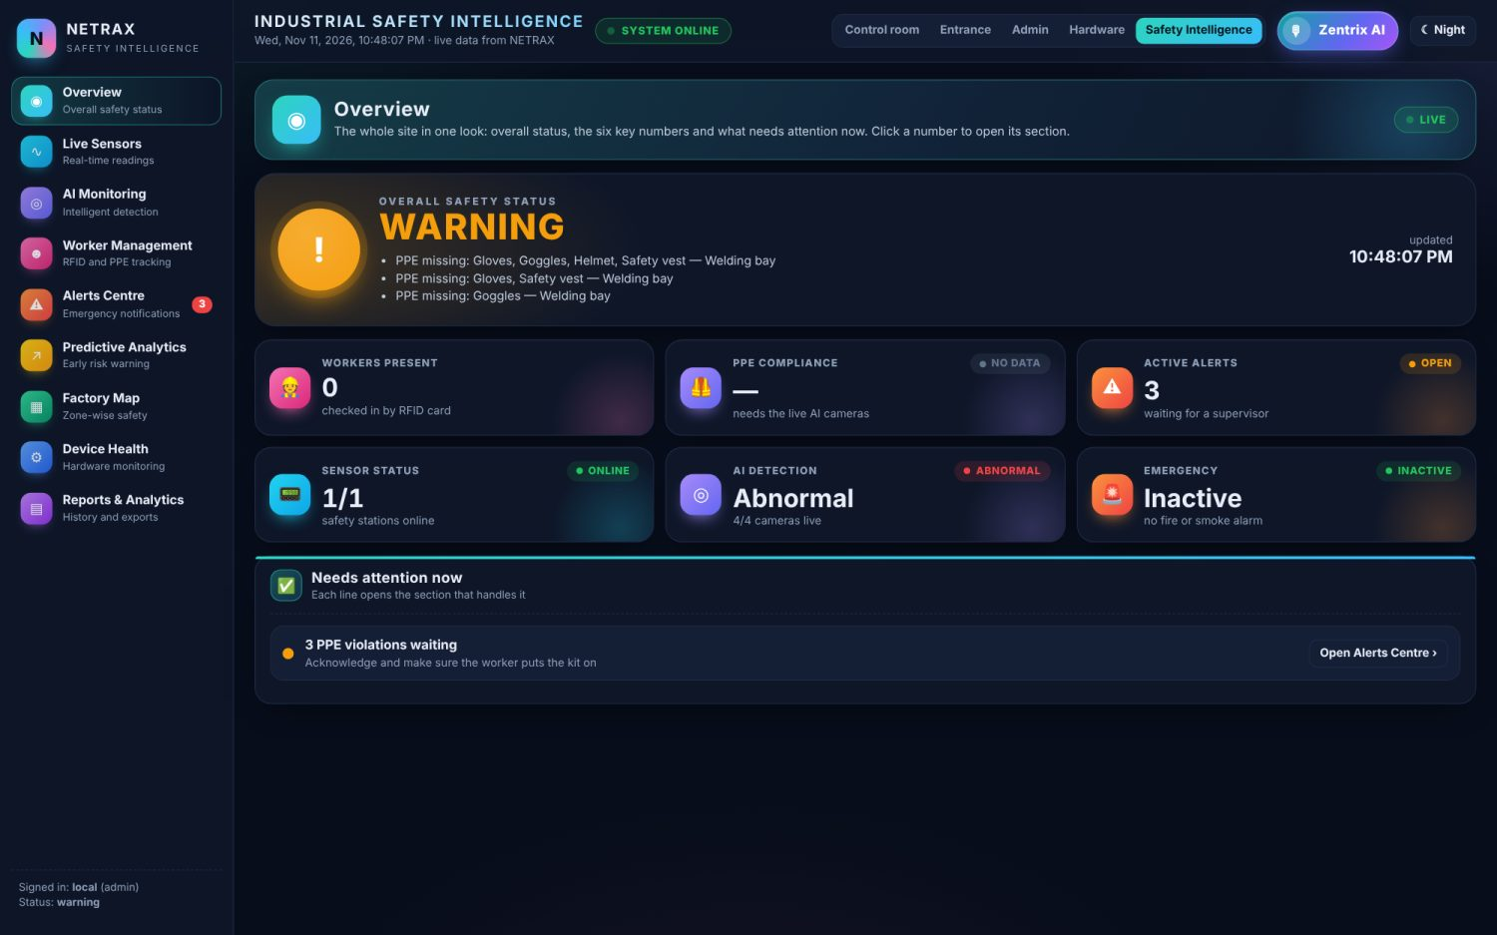
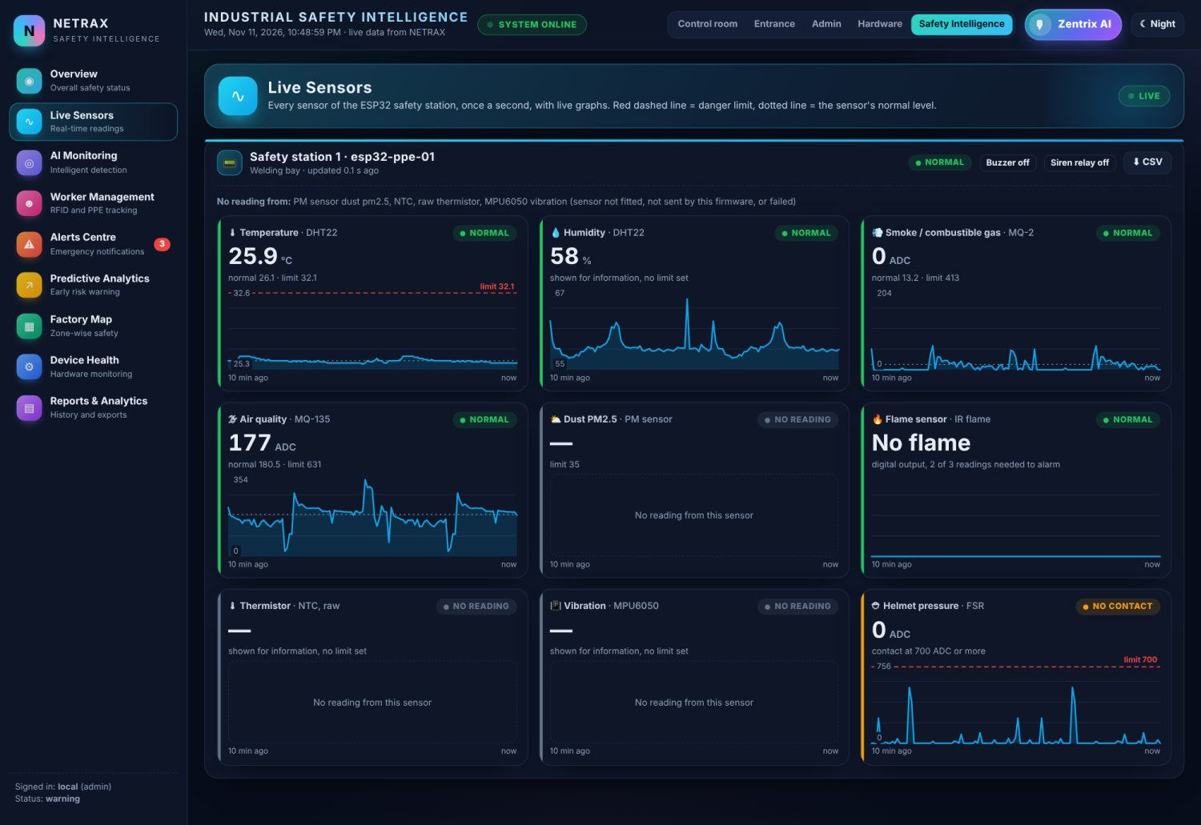
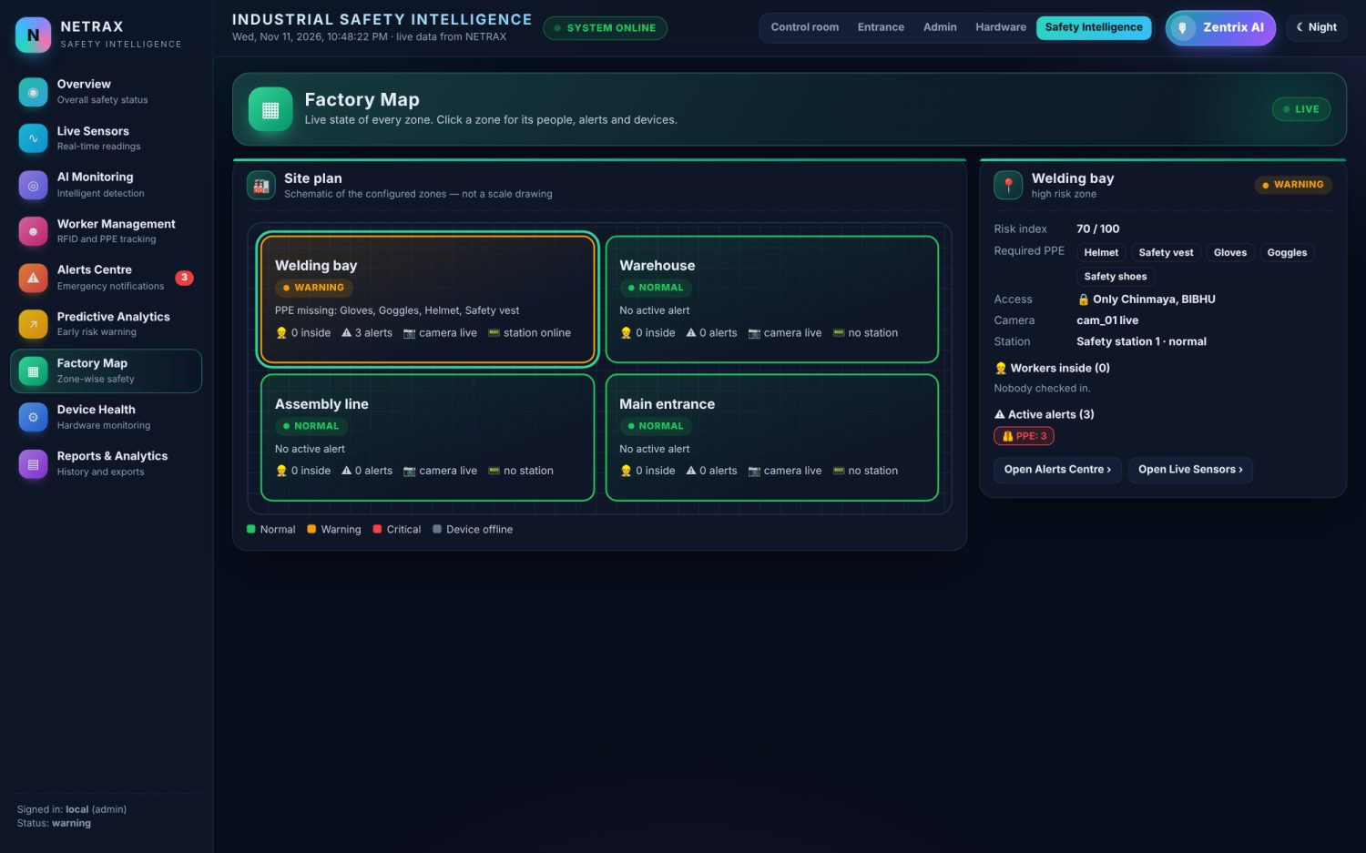
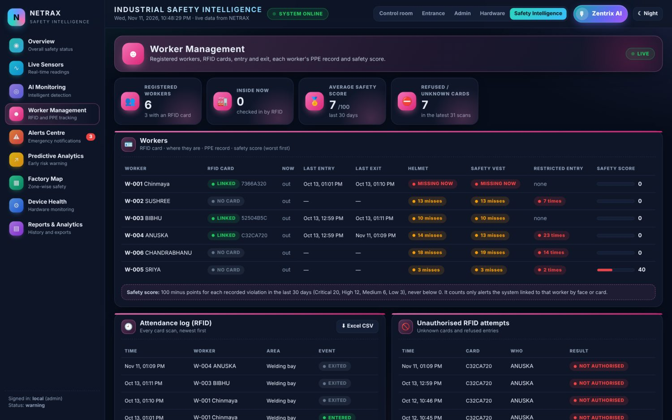
Safety Intelligence: one page for the whole site
Overall status: safe, warning, critical or not monitored
10-minute sensor graphs with limit and normal level
Workers: RFID card, entry / exit, safety score
Factory map of the zones (schematic)
Forecast = trend line, not a trained ML model
Overview
Live sensors
Factory map
Worker management
Notes:
Overview status (offline is never shown as safe), live sensor graphs, AI monitoring, worker management, factory map, forecast. Be honest: the forecast is a trend line over 3 minutes projected 5 minutes, not a trained ML model.

Slide 16
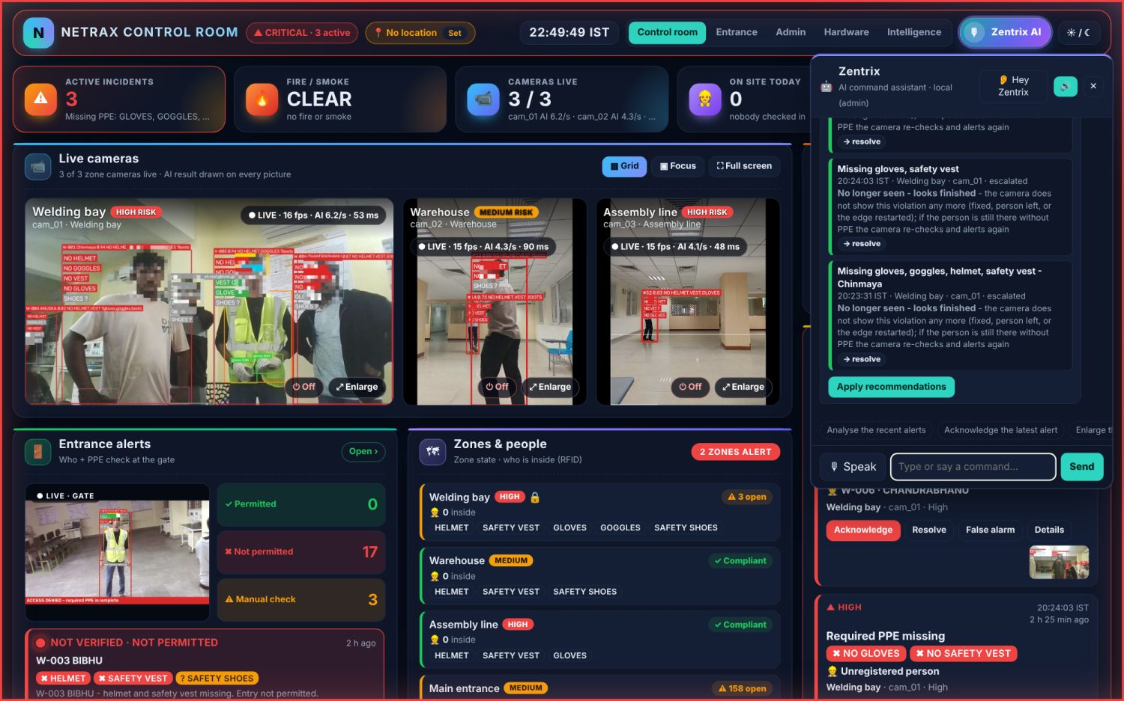
Zentrix AI: the dashboard by voice or text
You say
“Analyse the active alerts”
“Show PPE history”
“Enlarge the welding bay camera”
“Turn off camera 2”
Built to be safe
Acts only on a command, never by itself
Confirms before bulk or fire actions
Viewers can only ask and navigate
Every command is in the audit log
Notes:
Our teacher asked for a portal the AI can run when the supervisor is busy, but only on command. Zentrix is a rule-based command parser, offline, tolerant of spelling mistakes; history answers come only from database records. It never acts by itself and asks before risky actions.

Slide 17
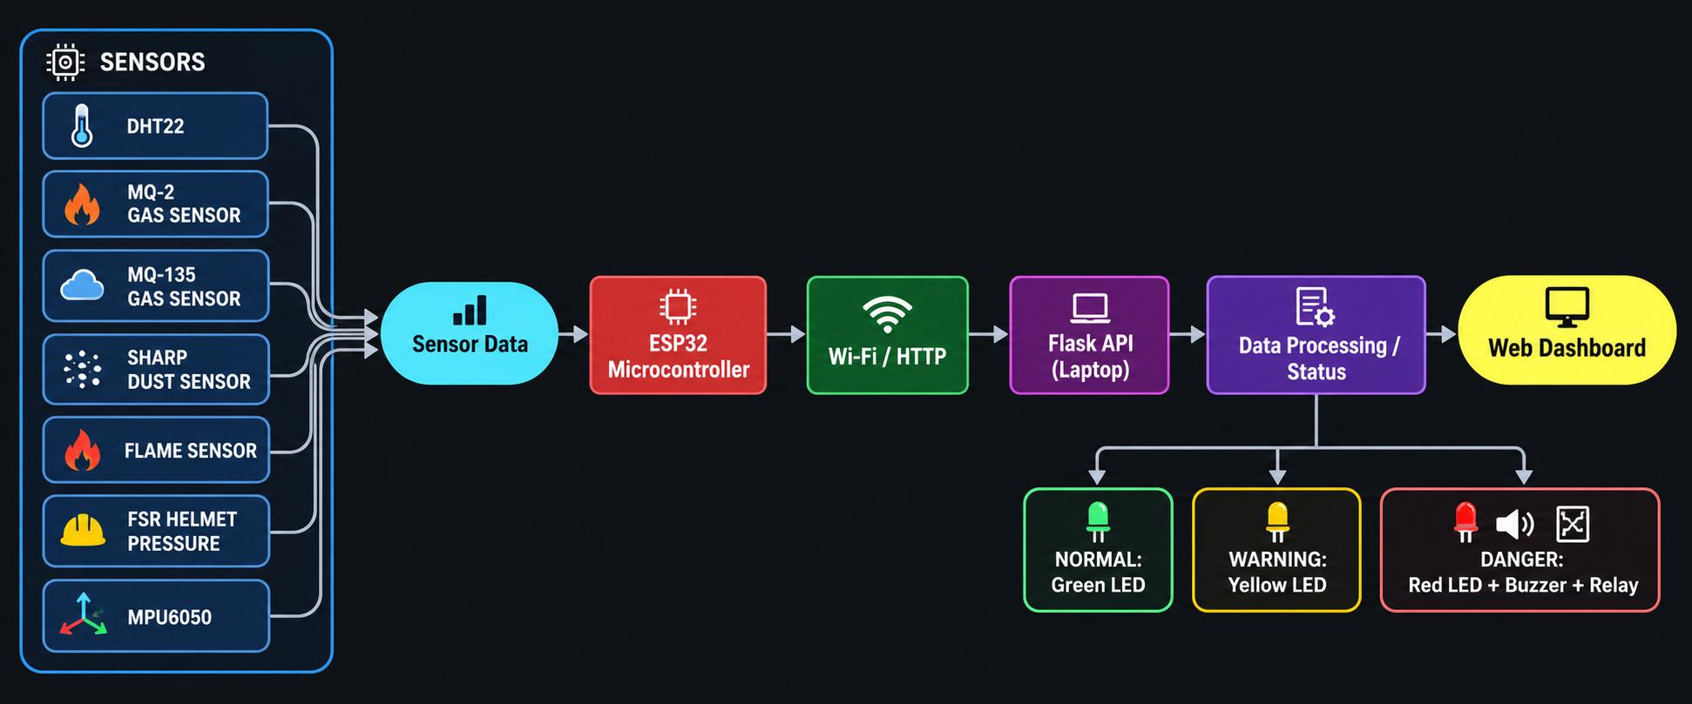
Hardware: ESP32 safety station and RFID reader
Sensors on the station
DHT22: temperature, humidity
IR flame sensor
MQ-2 smoke / gas, MQ-135 air quality
FSR: helmet actually on the head
Dust sensor, MPU6050 vibration
Green · normal
Orange · warning
Red + buzzer + relay · danger
3,349 station readings stored during the project
RFID: an RC522 reader on a second ESP32 sends each card tap; the server decides entry, exit or “not authorised” and keeps the attendance.
Notes:
The station sends readings every second and gets back the LED and alarm state. The FSR pressure sensor inside the helmet confirms by contact that it is on the head. Thresholds are prototype values and must be calibrated on site.

Slide 18
Measured on our laptop, not estimated
4
15–19
4–7
0.28 s
cameras live on one 4 GB GPU
pictures per second on the dashboard
AI checks per second per camera
frame to alert on the dashboard (median)
Model | ms per frame
Person + body points | 10.0
PPE main (v2) | 20.9
NETRAX-YOLO (v3B) | 27.9
Fire / smoke (v2B) | 8.4
All models together | about 70
PPE taken off → alert in about 1.4–2.3 s (includes the deliberate confirmation wait)
One alert with snapshot is about 42 KB; video never leaves the site
Keeps detecting when the internet is down; messages are retried
Not tested, so not claimed: TensorRT, FP16, Jetson
Notes:
All numbers are from our GTX 1650 laptop. Four cameras: laptop webcam, two phones, USB webcam, measured 6 Nov. Frame to dashboard measured live on 5 Nov. Keep the charger in during the demo: on battery the GPU slows down.

Slide 19
Technology stack: what we used for what
AI
Backend
Python 3.11 · Ultralytics YOLOv8 · PyTorch (CUDA) · OpenCV (YuNet, SFace) · ByteTrack tracking
FastAPI + Uvicorn · SQLite · WebSocket for live alerts and video · ReportLab PDFs
Dashboards
Hardware
HTML, CSS, plain JavaScript · SVG charts · works offline in any browser
ESP32 (Arduino C++) · DHT22, MQ-2, MQ-135, flame, FSR, dust, MPU6050 · RC522 RFID
Alerts
Training
Telegram Bot API · e-mail (SMTP) · Twilio phone call · Windows voice and siren
Google Colab T4 GPU · SH17, D-Fire, Roboflow sets + our own 27 videos
Notes:
Everything is open source except the message providers. No licence fees, no build step for the dashboards, one-file database.

Slide 20
Tested, and honest about the limits
130
automated checks passed in the final self-test (11 Nov 2026)
Known limits
A fire video on a screen fools a camera → sensors confirm real fire
Our test sets are small and machine-labelled plus reviewed
Smoke on our own footage is not yet measured
Goggles are the weakest PPE item (0.77)
Sensor thresholds are prototype values, not calibrated
No gate lock connected yet
Trained on our room and public data, not a real factory
Acceptance tests 01–14 of the final-round brief
Edge logic, hardware fusion and access suites
Fake message providers and a scratch database: tests never send or alter real data
Every bug fixed got its own test
Notes:
130 checks passed in the saved final self-test run on 11 Nov, plus edge, hardware and access suites. Every bug fixed got a test. Then name the limits yourself before the jury asks.

Slide 21
Who gains, and what comes next
Workers
Supervisors
Safety officers
Management
Warned within seconds; protection before an incident, not a fine after it.
One screen; alerts say who, what and where.
Entry / exit logs, trends per zone, audit-ready reports.
Fewer false alarms, existing CCTV reused, no video leaves the site.
1 · Now
2 · Pilot
3 · Product
4 · Integrate
5 · Scale
Working prototype, own dataset, sensors, RFID, tested end to end
Local factory or MSME: real-site data, sensor calibration
Edge box + software per camera, with installation
Existing CCTV / NVR, HR attendance, gate lock
Multi-site view, Jetson edge boxes, UHF RFID gates
From “someone should have noticed” to “the system spotted it, identified the worker and verified it with sensors”.
Notes:
Workers are warned before an incident. Supervisors get one screen. Safety officers get records and reports. Management gets fewer false alarms and reuses existing CCTV. Roadmap from prototype to pilot to product.

Slide 22
Thank you
Questions are welcome
NETRAX · See. Sense. Safeguard.
Team ZENTRIX · BH26PS06T044
Notes:
Close with the tagline. Likely questions and short answers are in section 18 of the project report.

