Slide 1
Analysis of
NYC Service Request CALLS to 311
Outline
▪ Data ETL
▪ MVA
▪ CA, PCA, MCA
▪ Clustering, Tree classification
▪ Conclusions
By: Cedric Bhihe <cedric.bhihe@gmail.com> Santi Calvo <s.calvo93@gmail.com>

Slide 2
Data from:
- NYC OpenData
- NYPD DB
- IRS
- US Census Office
All material and code available at:
https://www.github.com/Cbhihe/nyc311

Slide 3
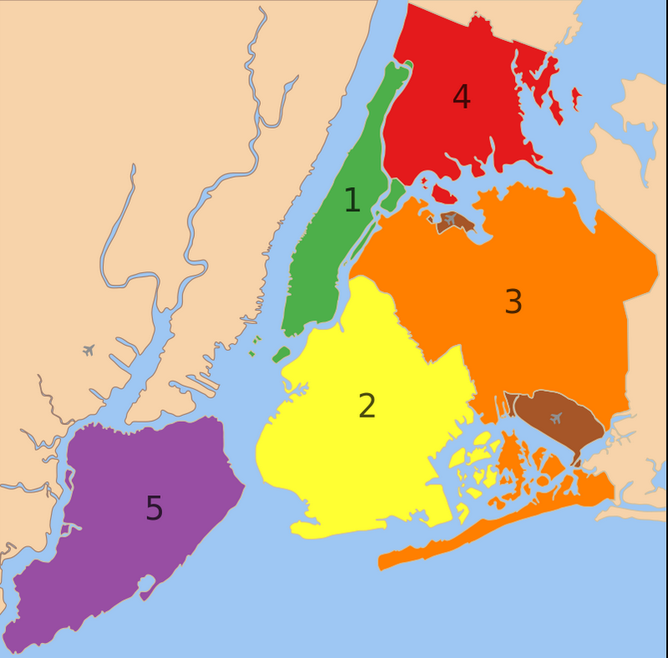
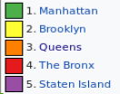
5 boroughs:
⇒ > 200 ZIPs
⇒ 8.7 M. people
⇒ 100,000 SRC
to 311 /month

Slide 4
Objective(s):
▪ to explore data with MVA tools
▪ to extract features and descriptive
information, so we may:
- detect trends
- optimize urban resources

Slide 5
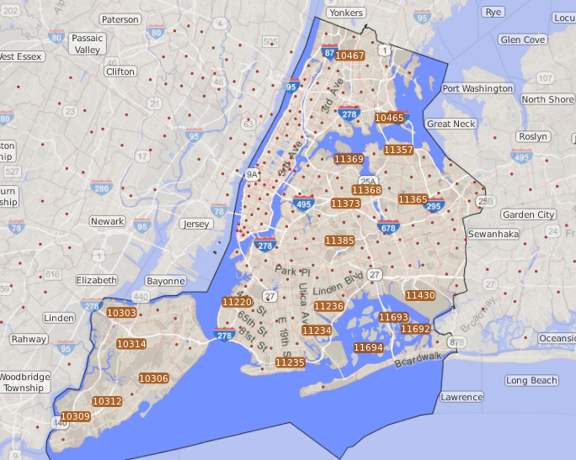

Slide 6
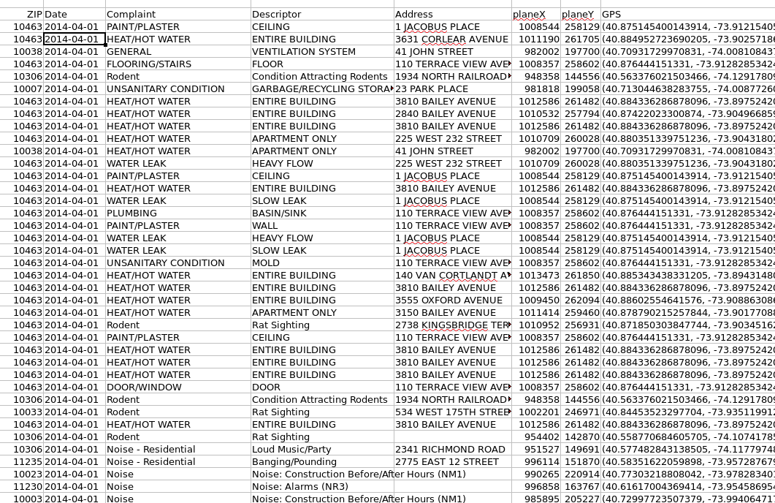
Data ETL – extract

Slide 7
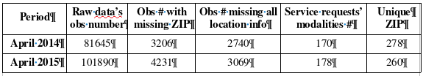
Data ETL – reduce
▪ Between 150 and 200 different SRCs’ raw features
▪ Reduce to 13 features by consolidating calls’ objects

Slide 8
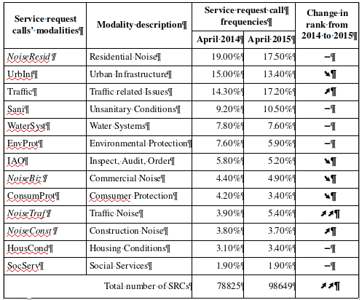
Data ETL
– reduce

Slide 9
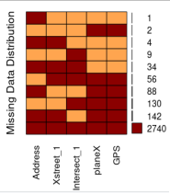
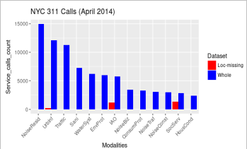
Data ETL – impute missings

Slide 10
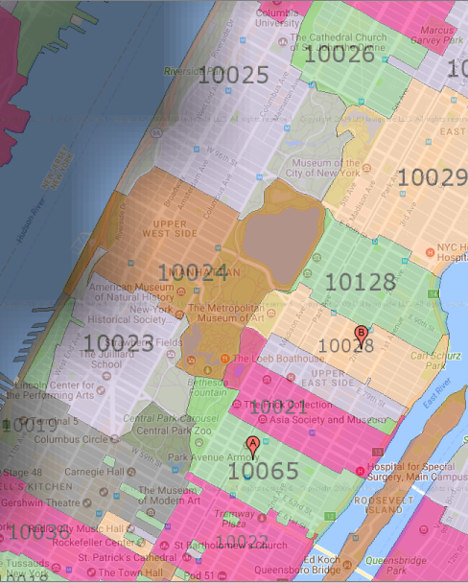
Data ETL – clean
ZIP code: 00083

Slide 11
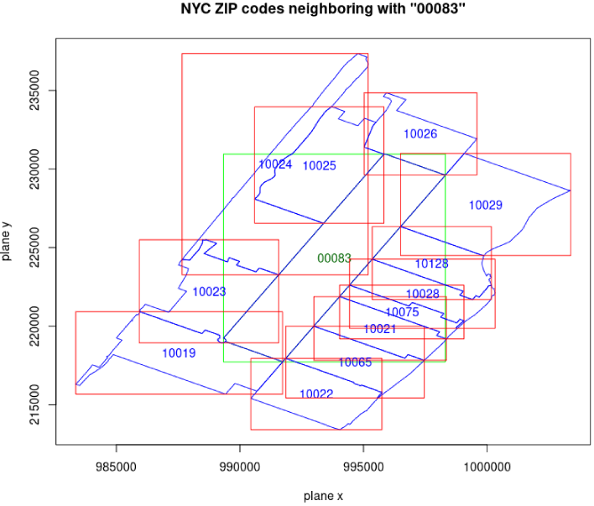
Data ETL – clean
ZIP code: 00083

Slide 12
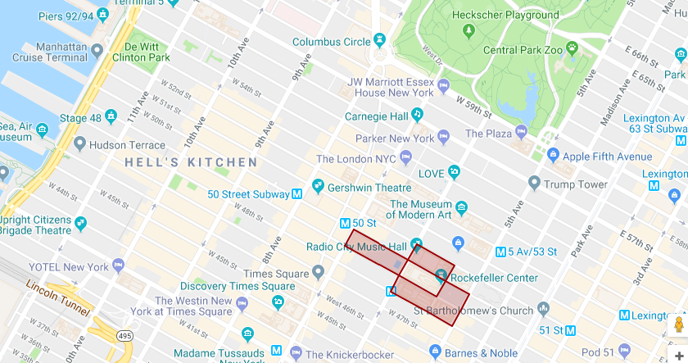
Data ETL – impute / clean
ZIP code: 10020

Slide 13
MVA – ZIP-SRC contingency table
(April 2014)
▪ Build frequency table
(row profiles for ZIPs, column profiles for SRCs)
▪ Observe how 26 row marginals < 5 / nbr_calls
→ Can we suppress them ? (… χ²-test of independence)
▪ Run CA with row marginals as row profile weights
( χ²-metric)

Slide 14
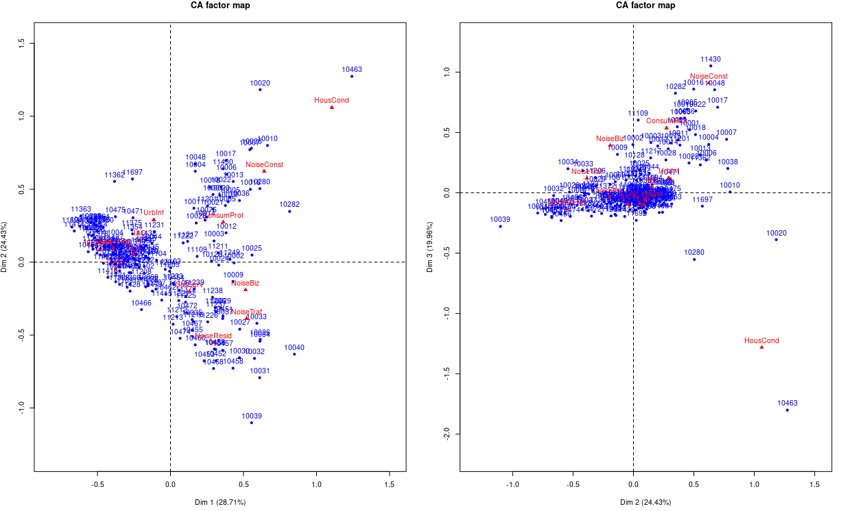
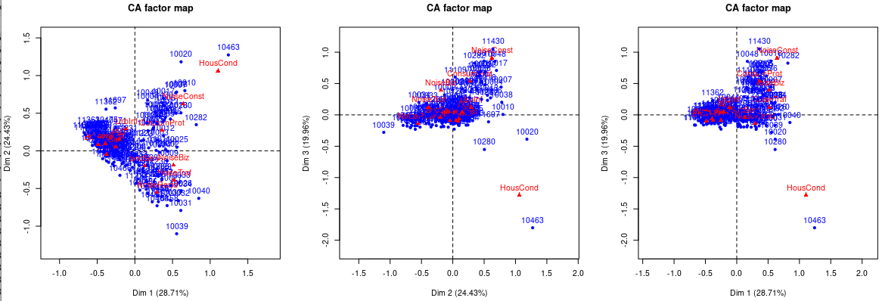
MVA – CA
(April 2014)

Slide 15
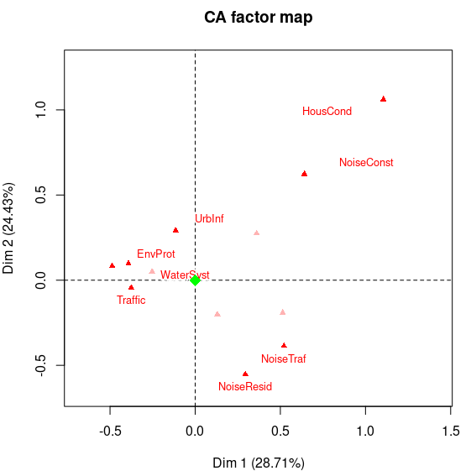
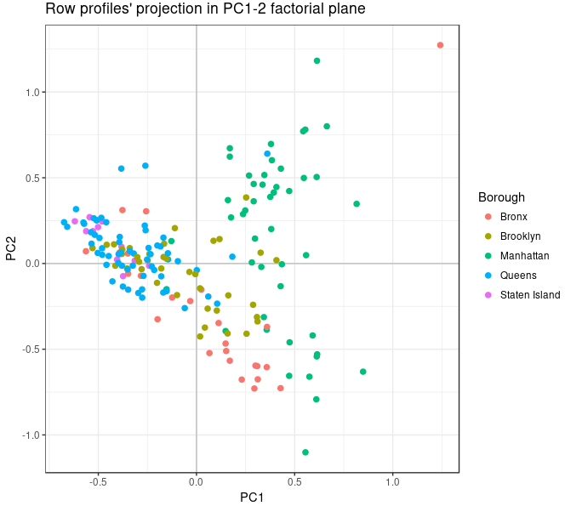
column profiles (labeled
only for cos2>0.4.

Slide 16
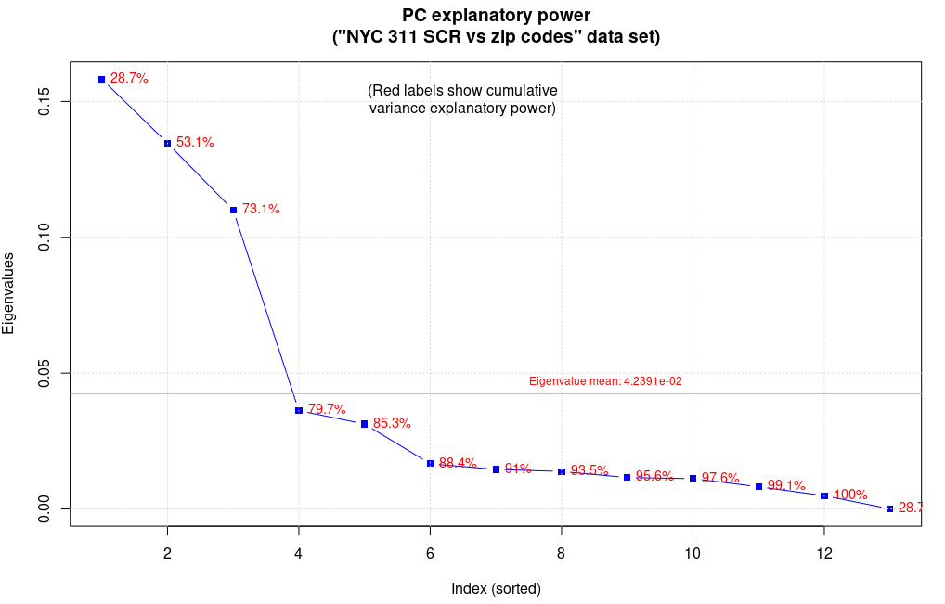
MVA – PCA
 | Dim 1 |  | Dim 2 |  | Dim 3
 | ctr | cos2 | ctr | cos2 | ctr | cos2
HousCond | 23.7 | 0.30 | 25.7 | 0.29 | 45.9 | 0.41
NoiseResid | 10.4 | 0.20 | 43.2 | 0.69 | - | -
NoiseConst | - | - | 11.0 | 0.22 | 28.4 | 0.46
Traffic | 12.8 | 0.50 | - | - | - | -
ConsumProt | - | - | - | - | 10.7 | 0.37
EnvProt | 11.4 | 0.51 | - | - | - | -

Slide 17
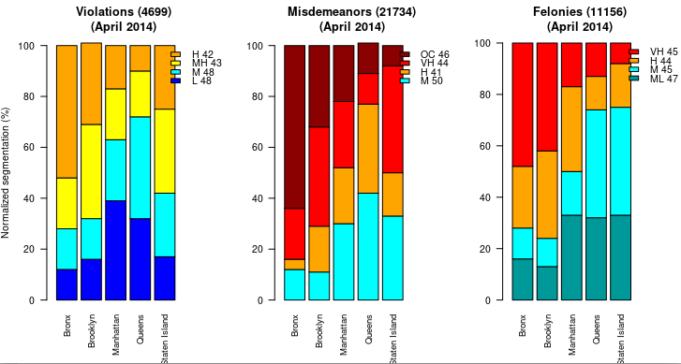
MVA – MCA

Slide 18
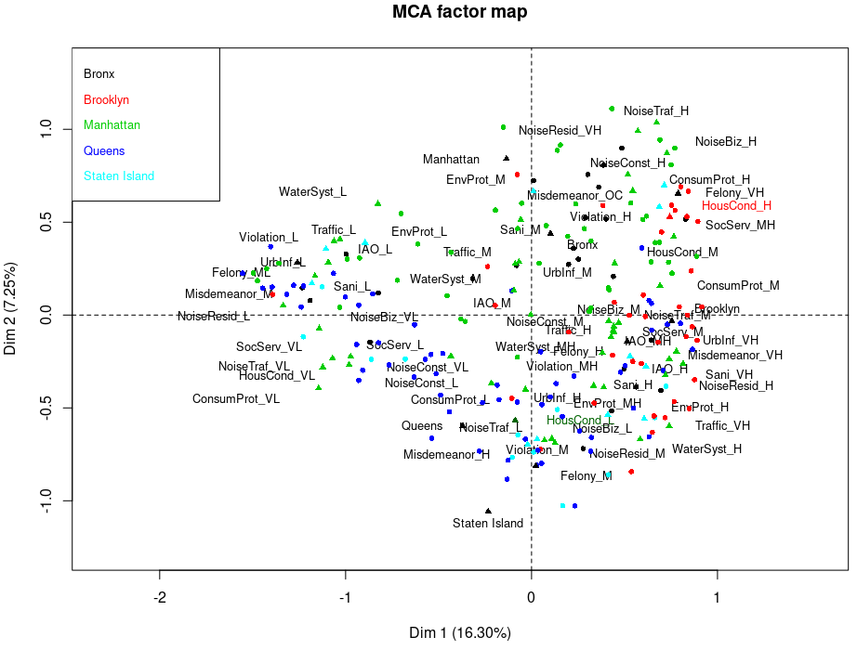

Slide 19
