Slide 1
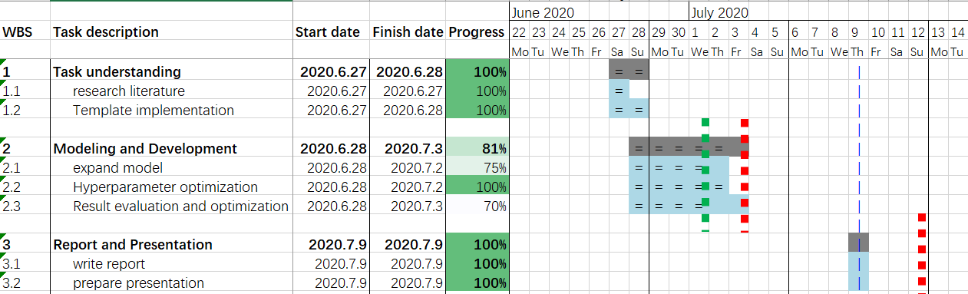

Deep Learning for NLP 2020
Shared Task
Group 30, Yi Cui, Zixuan Chen

Slide 2
Agenda
Task
Model
Result

Slide 3
Task
Semantic similarity:
a metric defined over a set of documents or terms, where the idea of distance between items is based on the likeness of their meaning or semantic content as opposed to lexicographical similarity ^{[1]}
Adversarial attacks:
disemvoweling: Some of the vowels have been removed. ^{[2]}
visual attacks: Similar-looking characters have been replaced by each other. ^{[2]}
Three dgs playing in th snow.
0.84
Ɂhreϵ ʚogs run in the snoѠ.
Notes:
Semantic similarity is a metric defined over a set of documents or terms, where the idea of distance between items is based on the likeness of their meaning or semantic content as opposed to lexicographical similarity. These are mathematical tools used to estimate the strength of the semantic relationship between units of language, concepts or instances, through a numerical description obtained according to the comparison of information supporting their meaning or describing their nature.^{[1][2]} The term semantic similarity is often confused with semantic relatedness. Semantic relatedness includes any relation between two terms, while semantic similarity only includes "is a" relations.^{[3]} For example, "car" is similar to "bus", but is also related to "road" and "driving".

Slide 4
Task
Approach
Preprocessing
inverse adversarial attacks → reduce OOV
Word vector → Embedding words with wiki-news-300d-1M.vec
Processing
apply MLP with Random Search → find appropriate mapping
extend MLP with LSTM → prognosticate semantic similarity with context

Slide 5
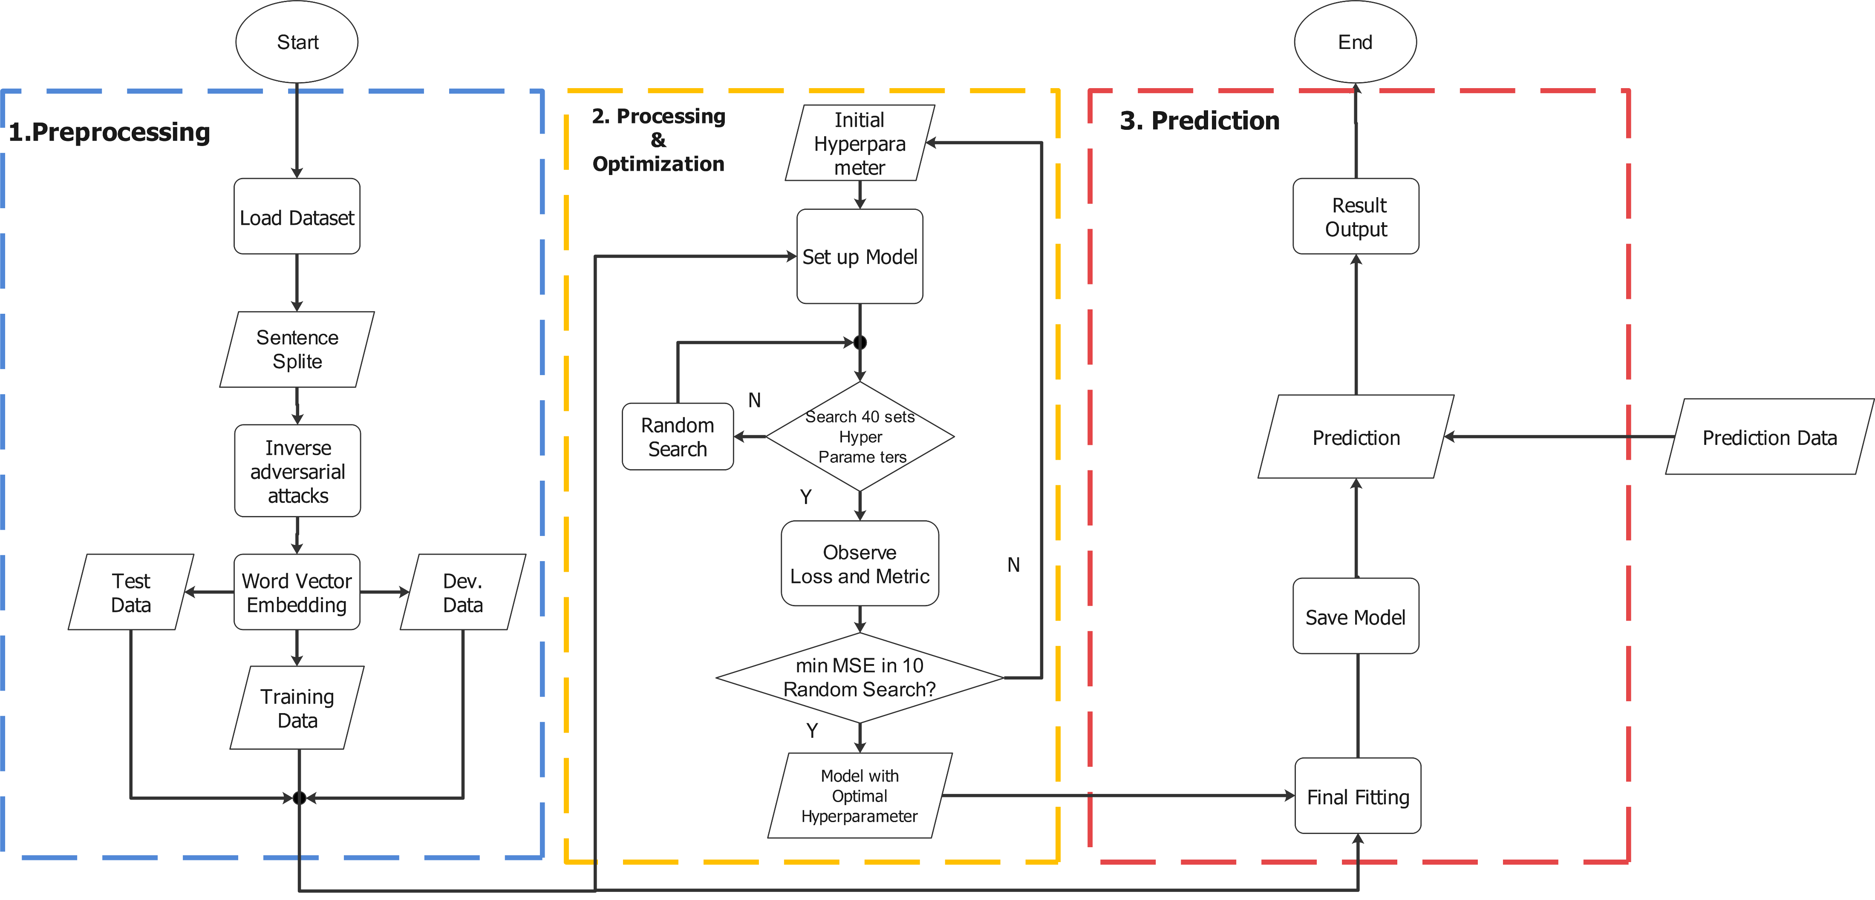
Model (Chart Flow)

Slide 6
Model (MLP)
Hyper Parameter
Sentence 1
Type | Value
Dense size | 337, 171
Dropout rate | 0.5, 0.1, 0.2
Activation | ‘relu’, ‘selu’, ‘selu’
Loss | MSE
Metric | MSE
mean
concate(y1, y2)
v1
v2
v3
Dropout
word1
word2
word3
Sentence 2
MLP
mean
Dense
v4
v5
v6
Dropout
word4
word5
word6
semantic similarity

Slide 7
Model (LSTM and Bi-LSTM)
Hyper Parameter
Type | Value
Emb_size | 56
LSTM Units | 300
Dense size | 440, 201, 107, 58,
Dropout rate | 0.2, 0.2, 0.1, 0.2, 0.2
Activation | ‘selu’, ‘hard sigmoid’, ‘relu’, ‘hard sigmoid’,
Loss | MSLE
Metric | MSE
LSTM_1 / Bi-LSTM_1
h1
h2
h3
concate(y1, y2)
x1
x2
x3
MLP
Dropout
word1
word2
word3
LSTM_2 / Bi-LSTM_2
BatchNormalization
h1
h2
h3
x1
x2
x3
Dense
word4
word5
word6
semantic similarity
Notes:
Dropout
BatchNormalization

Slide 8
Overview of result
Score from CodaLab:
MLP > LSTM > Bi-LSTM
Hidden Layer (Dense) less than 3 → Otherwise Overfitting
Model is sensitive to Data (OOV) → inverse attacks are more important than modeling
Time management are essential
 | MLP | LSTM + MLP | Bi-LSTM + MLP
Development | 0.3982 | 0.3092 | 0.2844
Test | 0.2960 | None | None

Slide 9
Reference
[1]: https://en.wikipedia.org/wiki/Semantic_similarity
[2]: Deep Learning for NLP 2020 Shared Task Organization

Slide 10
Thanks for your attention

Slide 11

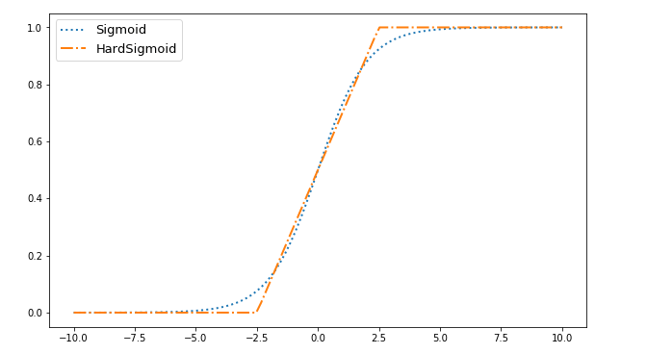
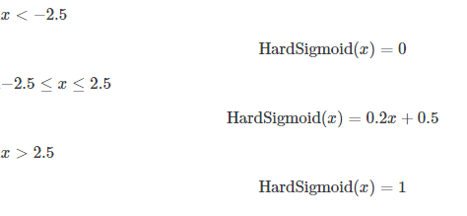
Back Up

Slide 12
Back up
LSTM_1
h1
h2
h3
x1
x2
x3
word1
word2
word3
LSTM_2
h1
h2
h3
x1
x2
x3
word4
word5
word6

