Slide 1

Clinical Trial Analysis Data-Driven Insights for CNS Drug Trials
This project explores how data-driven methods can help identify high-risk trials and guide smarter resource allocation across CNS drug development pipelines.

Slide 2
Overview
This project investigates late-stage clinical trials for central nervous system (CNS) drugs, focusing on key performance indicators such as adverse events, retention rate, and enrollment progress.
The goal is to identify high-risk trials and provide data-driven guidance for resource allocation and FDA approval readiness.
Tools Used: SQL, Python, Tableau, Google sheet

Slide 3
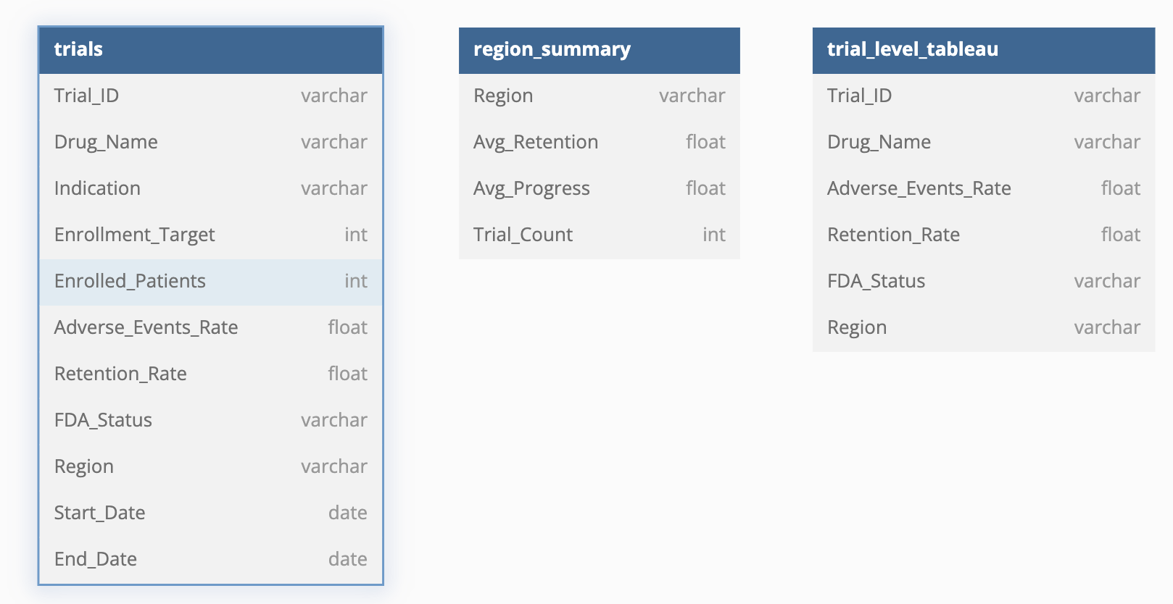
Dataset Overview The dataset simulates Phase 3 clinical trials of CNS drugs across different regions. It was custom-built to reflect real-world variables such as adverse events, retention rate, and FDA status.

Slide 4
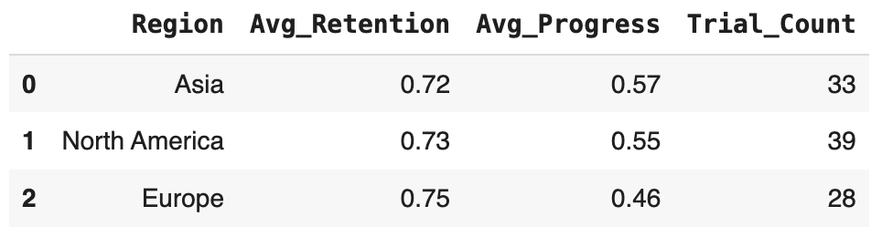
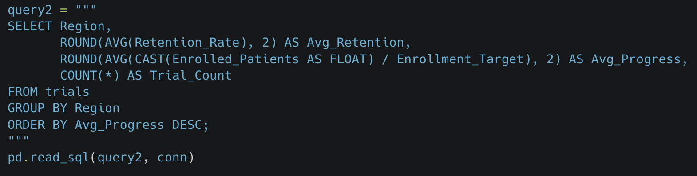
Regional Trials Summary via SQL
📍 North America has the largest number of trials (39), with a balanced profile: retention rate at 0.73 and progress at 0.55
📍 Asia shows the highest enrollment progress (0.57)
📍 Europe leads in average retention rate (0.75), but has the lowest enrollment progress (0.46)
Notes:
Europe shows excellent trial engagement but lags behind in recruitment, which may impact timeline feasibility.

Slide 5
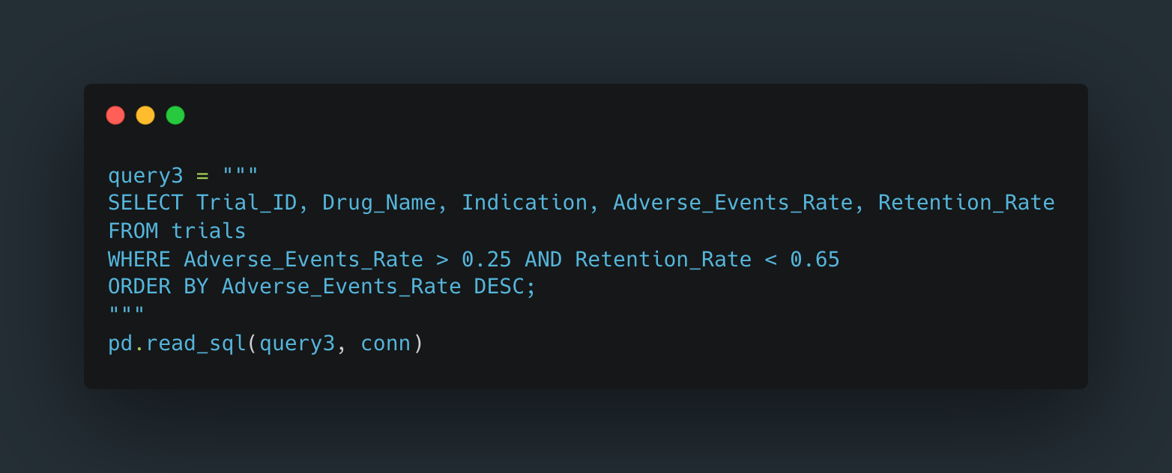
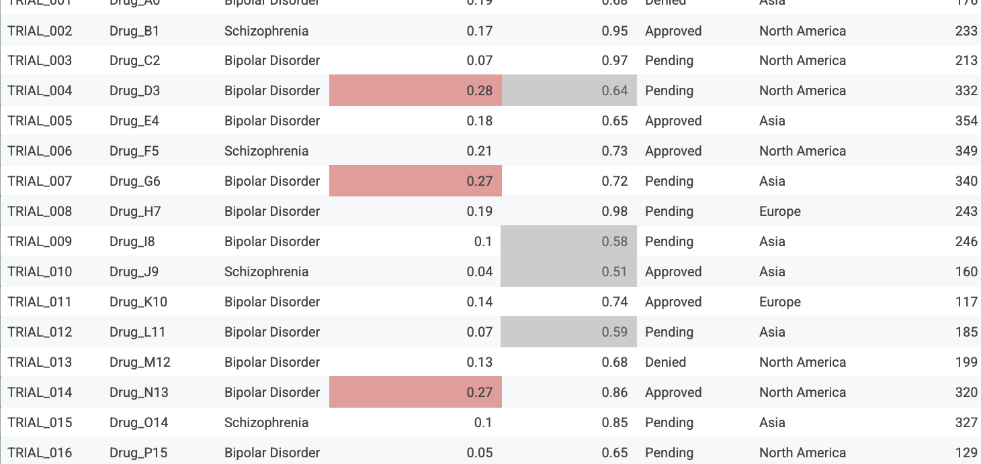
Identifying High-Risk Trials Using SQL + Python
Most trials with both high adverse event rates (>0.25) and low retention rates (<0.65) remain in the pending stage, rather than being directly denied by the FDA.
Among the denied trials, a few exhibited relatively low adverse event rates but still failed to meet retention benchmarks. This suggests that while safety concerns may influence FDA outcomes, low retention rates may play a stronger role in denial decisions.
Overall, FDA denials tend to align more closely with poor retention than with adverse event rates alone, indicating that participant engagement and trial execution quality could be critical factors in final approval outcomes.
Notes:
Pending trials with both high AE and low retention warrant close monitoring, while low-retention denied trials reveal risks beyond safety concerns.

Slide 6
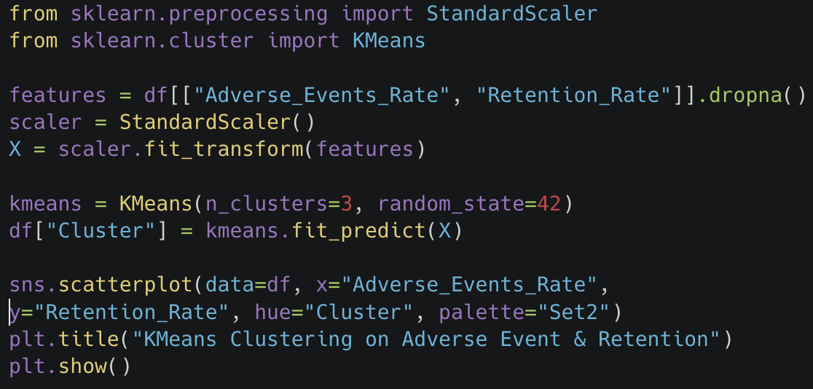
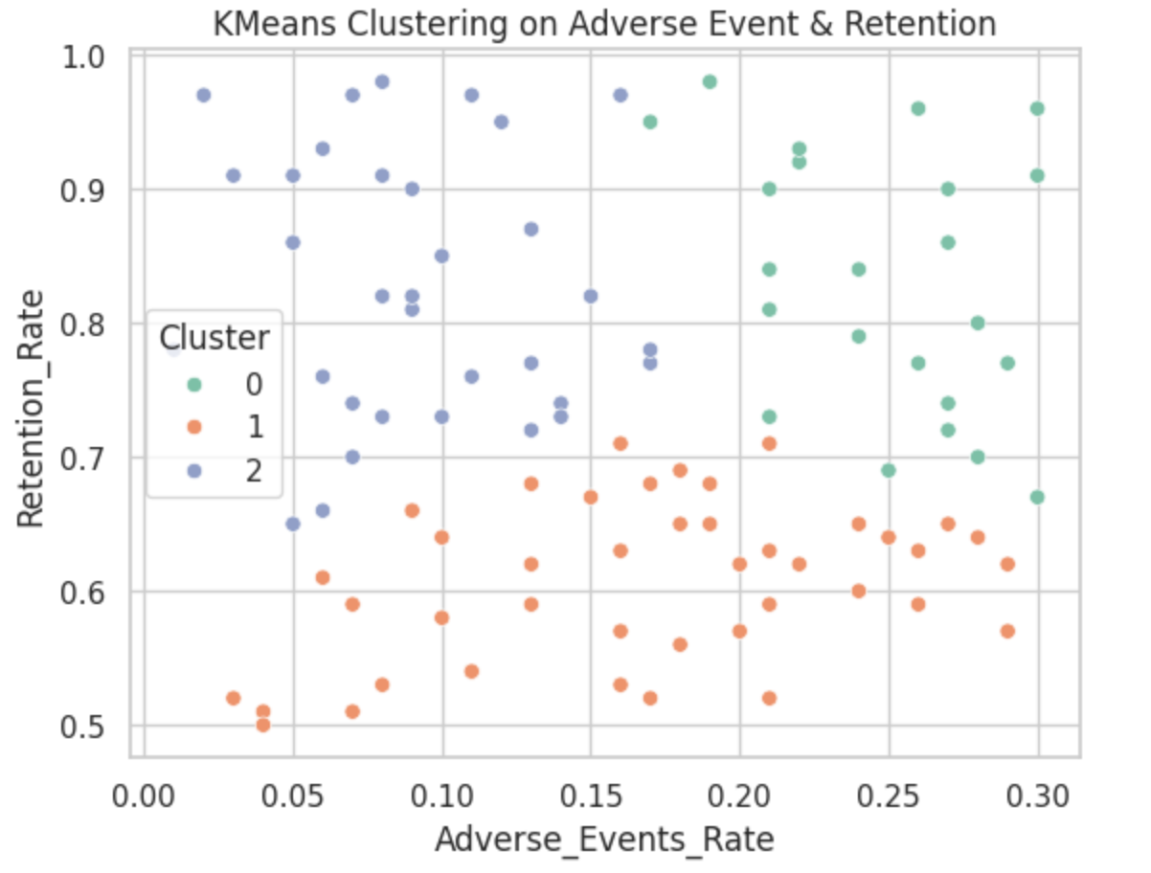
K-means Clustering CNS Drug Trials to Identify High-Potential Candidates
🎯 Goal
Segment trials to guide prioritization and reduce risk.
🔍 Method
K-Means (k=3) on Retention Rate + AE Rate
🧠 Key Finding
- Cluster 0: High-retention, low-AE → prioritize
- Cluster 1: Low-retention → high-risk
Notes:
“We used K-Means clustering on adverse events and retention rates to segment all Phase 3 CNS drug trials into three groups. One of them showed both low safety issues and high patient retention — ideal for prioritizing and pushing forward. This allowed the team to focus budget and operational resources where the probability of success was higher.”
- **Cluster 0**: Low AE + High Retention → best candidates for acceleration
- **Cluster 1**: High risk of dropout → requires review or redesign
- **Cluster 2**: Mid-risk group, needs further investigation
💡 **Impact**
Enables data-driven decisions on trial prioritization and budget planning.

Slide 7
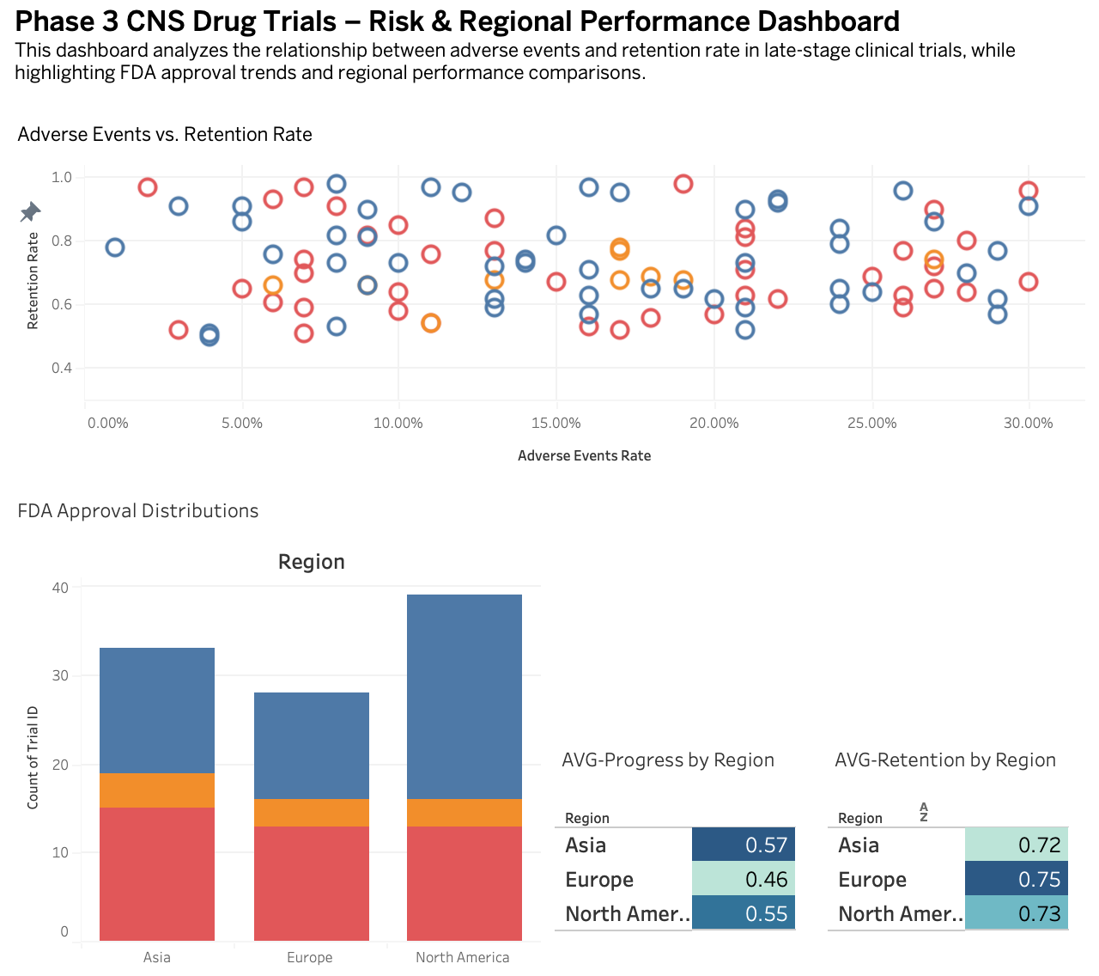
Phase 3 CNS Drug Trials Interactive Risk & Performance Dashboard
Dashboard Features:
- Scatterplot of Retention vs. Adverse Events, colored by FDA status
- Region-wise stacked bar chart of FDA approvals and denials
- Heatmaps showing average progress and retention by region
Notes:
“This dashboard pulls together retention, safety, and regional performance into one interactive view. The scatterplot helps us visually spot at-risk trials, and the stacked bars show where approvals are more likely. Heatmaps let stakeholders quickly compare which regions are outperforming. It’s designed to support go/no-go decisions and help strategy teams align faster.”
Designed and implemented the dashboard using Tableau, based on SQL-cleaned and Python-processed data.
Visualize risk and progress across late-stage CNS drug trials, using real-time insights to support decision-making.

Slide 8
Conclusion & Reflection
Key Takeaways
- Low retention is a stronger predictor of FDA denial than adverse event rate alone
- Region-level data reveals execution strengths and weaknesses
- Clustering adds value in prioritizing trial investment
What I Learned
- How to structure a real-world analytics pipeline: from SQL → Python → Tableau
- How to turn raw data into stakeholder-ready insights
- The importance of testing assumptions before drawing conclusions

Slide 9

Thank you for checking out my project! -Minfei He

