Slide 1
Procure-to-Pay Intelligence
STRATUM · CASE STUDY
What 1.6 million ERP events reveal about how a company really buys and pays.
Process mining · Compliance analytics · Causal inference · Machine learning
Notes:
This is a real event log from the purchasing system of a multinational coatings and paints company: 1.6 million ERP events on about 250,000 purchase order lines. Vendors and users are anonymised. It shows how I'd analyse an ERP process for a client: what happens, where control fails, what causes delay, and what to do about it.

Slide 2




A €997M order book and four hard questions
THE BRIEF
The process owner has compliance questions, and the finance team needs to plan. The answers sit in 1,595,923 ERP events spread across 76,349 purchase orders from 1,975 vendors.
What really happens?
Where do controls fail?
When does cash go out?
What actually causes delay?
The official process and the recorded one are rarely the same.
And how much money sits behind each failure?
Payment dates and near-term outflow, with honest uncertainty.
Separating real causes from things that merely travel with them.
Notes:
The data is BPI Challenge 2019, published by 4TU.ResearchData under CC BY 4.0. The original challenge was framed by the company's process owner around compliance questions.

Slide 3
What the analysis found
THE ANSWERS
€200.2M
CONTROLS
−0.1 days
REWORK
of order value carries at least one control exception (6.7% of lines).
is the adjusted effect of order changes on payment. The naive gap of 5.1 days disappears.
3.6%
CASH
83 days
TIMING
average miss on 30-day cash-out in three backtests, against 5.9% for a naive repeat.
median time to pay when open items count. Looking only at paid items gives 77.
Notes:
Each number is tested on data the model did not see, or formally estimated with an interval. An exception is an indicator to review, not evidence of wrongdoing.

Slide 4

The field that would have broken everything
KNOW YOUR DATA
SUMMED NAIVELY
A name that misleads
€5.7B
“Cumulative net worth” repeats the line's running value on every event, so it isn't the amount of any one document.
A first version summed it, and the totals didn't reconcile to the order book. The check caught it.
Value-based matching isn't possible here, so controls test document counts and exposure uses order value.
apparent goods and invoice value
TRUE ORDER BOOK
€997M
total order value
Notes:
I keep this slide in because it's the real value of a careful analyst. A dashboard built on the naive sum would have looked fine and been wrong by a factor of nearly six. Reconciling totals back to a known figure is what exposed it.

Slide 5



An ERP data model you can trust
ENGINEERING
Bronze
Staging
Marts
Streamed, untouched
dbt on DuckDB
Star schema
730 MB XES log parsed in about 30 seconds
Checksum verified on every run
External XML entities disabled
Typed events and order lines
Implausible dates flagged, not dropped
Every event numbered in process order
Document, line and event grains
Vendor, user, activity and date dimensions
Compliance, variants and process graph
16
dbt models
31 / 31
dbt tests pass, including a rule unit test
1.6M
events reconciled to source
Notes:
The warehouse is a proper dbt project, so it transfers directly to Snowflake or BigQuery. If any test fails, the build stops before a single model runs. A unit test feeds the compliance rules known good and bad lines.

Slide 6
Most waiting happens after the invoice is booked
PROCESS MINING
84%
of paid lines in the main flow ran straight through
0.96
fitness of the discovered model on the main flow
0.68
on the GR-based flow: far less disciplined
Notes:
Models were discovered with the inductive miner and replayed against a sample. The wait after booking the invoice may simply reflect payment terms, which the log doesn't contain, so this is a question for the business rather than a verdict.

Slide 7
€200.2M of orders carry a control exception
COMPLIANCE
7,551
lines with one person on both sides of a control
3 of 10
controls recorded no exceptions at all, and goods receivers never pay
An exception is a prompt to review, not proof of wrongdoing. Exposure is the order value of the line.
Notes:
Ten controls were tested on every line. Saying which controls held is as useful as saying which failed: it shows where the system already enforces the rule and where people can work around it.

Slide 8

Reworked orders look slower. Rework isn't why
CAUSAL INFERENCE
Three traps, handled
Confounding: double machine learning adjusts for vendor, value and spend area.
Immortal time: only orders still unpaid at day 14 count, with changes inside those 14 days.
Censoring: the outcome is unpaid days in a fixed 180-day window.
Result: 95% CI -1.6 to +1.4 days on 108,383 lines. Placebo: +0.5.
Notes:
This changes a decision. A team looking at the raw gap might launch a programme to cut order changes, and on this evidence it wouldn't speed up payment. Packaging is a possible exception, with a small positive effect, but segment results are noisier. A causal reading still assumes no major hidden confounder.

Slide 9
Forecasting cash from the open book
SURVIVAL ANALYSIS
Next 30 days: about €67.7M expected to go out. Average backtest miss 3.6% vs 5.9% naive.
Notes:
Survival models learn from unfinished items as well as finished ones. Summing each open item's chance of being paid gives a cash forecast. The forecast model was picked on a separate earlier date, not on the dates shown. The naive baseline beat it on one of the three dates; on average the survival model is better.

Slide 10
Finding vendors that are truly a problem
HIERARCHICAL BAYES
1
55
1 of 20
median lines per vendor in the raw top 20: league tables crown one-order flukes
median lines in the Bayesian top 20: real volume, worth a conversation
vendors appear on both lists, so the choice of method changes who you call
Predicting each vendor's second half | Log score (higher is better) | Weighted error
Hierarchical Bayes | -0.224 | 0.061
Raw vendor rate | -0.294 | 0.064
Overall rate | -0.240 | 0.077
Notes:
Partial pooling lets each vendor lean on the overall pattern in proportion to how little data it has. Fitted on the first half of the year and scored on the second, it beats both raw vendor rates and a single overall rate. R-hat is about 1.01, so the sampler converged.

Slide 11


Predictions you can rely on
UNCERTAINTY AND LIVE PREDICTION
Conformal prediction
Deep sequence model
Does a “90% range” really hold 90% of the time?
A PyTorch GRU reads events as they happen.
79%
92%
19.8 d
79%
coverage from the raw quantile model
after conformal calibration
error on time remaining, vs 24.2 days for the baseline
next step correct, vs 76% for a Markov chain
Coverage on the smaller flow reaches 88%, and ranges are 105 days wide: honest rather than impressive.
Tested on orders from a later period, with no future information in any prediction (unit-tested).
Notes:
Conformal calibration measures the miss on held-back data and adjusts the range. It assumes the future resembles the calibration window, so a deployed version would recalibrate on a rolling basis. The sequence model's gains are largest mid-process, once the path has shown its hand.

Slide 12
A good model isn't automatically a business case
FROM SCORE TO DECISION
4.2%
of invoices is the best share to review, not all of them
34%
of future corrections sit in that small slice
ROC-AUC 0.75. Assumes €10 a review, €180 a correction and half prevented, which are inputs rather than findings. At €25 a review the saving falls to about €5k.
Notes:
This is the slide I'd most want a finance director to see. The model is decent, but whether to deploy it depends on what a review costs. The dashboard lets the client enter their own numbers.

Slide 13
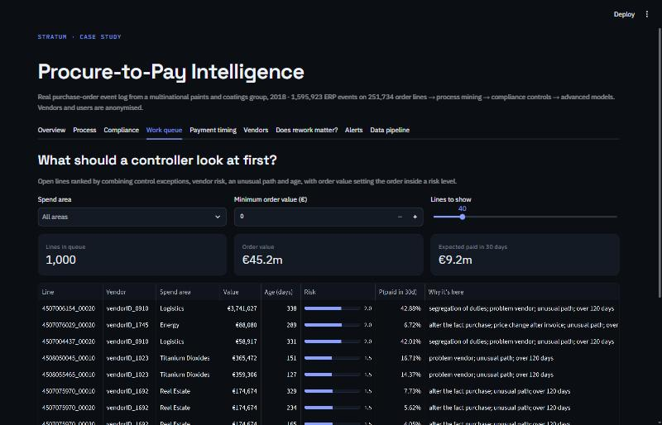
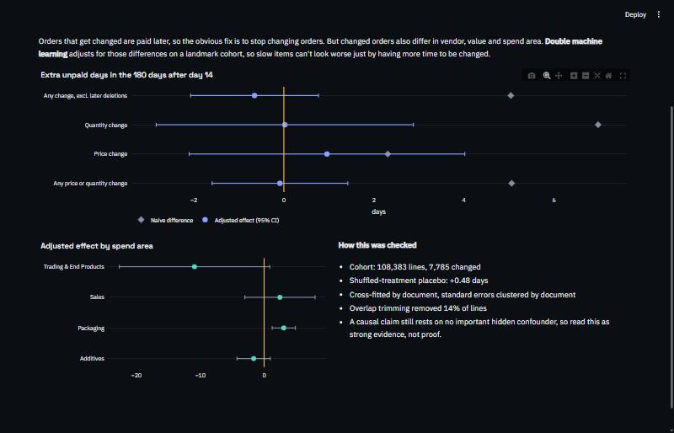
A work queue, not just a report
DELIVERY
Work queue: open lines ranked, with the reason each one is there
Causal view: naive gap against the adjusted effect
Nine tabs: Overview · Process · Compliance · Work queue · Payment timing · Vendors · Rework · Alerts · Data pipeline
Notes:
The work queue is the point of the project. It ranks open lines using control exceptions, vendor risk, an unusual path and age, and says why each line is there. A controller can act on it on Monday morning.

Slide 14




What I'd tell the CFO
CONCLUSIONS
Review the leaking controls
Look at the wait after booking
7,551 lines had one person on both sides of a control. Three other controls held fully: find out why, and copy it.
That step holds the most waiting time. Check it against payment terms before changing anything.
Don't chase order changes
Run cash from the open book
Reducing rework is unlikely to speed payment. Spend that effort elsewhere, with Packaging the one area to look at.
A forecast built on line-level timing gives finance a 30-day view that's better than repeating last month.
Notes:
Each recommendation ties to a finding. The second is deliberately cautious: the log doesn't contain payment terms, so the wait may be contractual.

Slide 15




What makes this work trustworthy
HOW IT'S BUILT
Tested forward in time
TOOLKIT
Every model is scored on later data, against something simple
Python
SQL
dbt
DuckDB
Reported what didn't work
pm4py
lifelines
NumPyro
Limits and weak spots are stated, not hidden
PyTorch
scikit-learn
SciPy
Reproducible
Plotly
Streamlit
pytest
One command from public download to dashboard, with identical results
GitHub Actions
Tested
31 dbt tests plus 12 Python tests, including recovering known effects
Notes:
The same approach applies to any ERP: SAP, Oracle, Microsoft Dynamics or NetSuite. Each records who did what and when, and that's all this method needs.

Slide 16


What's your ERP not telling you?
STRATUM
I turn the transaction history your systems already hold into clear answers on process, control and cash.
stratumdata.org
stratumfreelance@gmail.com
Notes:
Close with the offer: the same analysis on the client's own ERP data, starting with a short scoping call.

