Slide 1
Retail Intelligence
STRATUM · CASE STUDY
From a million messy transactions to decisions a business owner can act on.
Data engineering · Statistics · Machine learning · Analytics
Notes:
Retail Intelligence is an end-to-end data project on real transaction data: a UK online giftware wholesaler, two years, just over a million invoice lines. It shows the full path I take with a client: understand the data, engineer a pipeline you can trust, test what the business believes, build models that are checked against simple baselines, and hand over a dashboard people can use.

Slide 2




A wholesaler with data, but no answers
THE BRIEF
A UK online giftware wholesaler selling mainly to small shops. Two years of sales exports: 1,067,371 invoice lines in a spreadsheet, and four questions the owner couldn't answer.
Q1
Q2
Q3
Q4
Is the business growing?
Who are our valuable customers?
Who should we call this quarter?
What should we plan for?
Revenue looks up on some charts and down on others.
And which of them are quietly slipping away?
The account team can't contact everyone.
Stock and staffing for the next quarter.
Notes:
The data is the public UCI Online Retail II dataset. It's real transaction data, with all the mess that comes with it, which makes it a realistic stand-in for what an SMB client actually has. The four questions are typical of what owners ask.

Slide 3
Four questions, four evidence-backed answers
THE ANSWERS
+2.2%
IS IT GROWING?
69%
WHO MATTERS?
No: revenue is flat. The year-over-year change is not statistically significant.
of revenue comes from 22% of customers, the “Champions”.
2.1×
WHO TO CALL?
±10%
WHAT TO PLAN FOR?
more buyers reached by the model's top 10% than by random calling.
weekly error on a forecast that beats the standard benchmark.
Notes:
The headline: the business is flat, value is concentrated in a small group, and there is a measurable way to focus the sales team. Every number on this slide is validated on data the model never saw, or formally tested.

Slide 4






One pipeline, from raw export to decision
THE APPROACH
01
02
03
04
05
Profile
Engineer
Verify
Analyse
Deliver
Explore the raw data before writing any cleaning rule
Layered ETL into a DuckDB star schema
15 automated data quality checks
Hypothesis tests, segments, lifetime value, propensity, forecasts
Interactive dashboard, notebooks and documentation
One command (uv run retail all) rebuilds everything from the public source in about a minute.
Notes:
This mirrors the process on the Stratum website: scope, build, validate, hand over. The whole thing is reproducible with one command, has 18 automated tests, and runs in CI on every push.

Slide 5
The raw data was messier than it looked
STEP 1 · PROFILE
23%
of lines have no customer ID (guest checkouts)
34,335
exact duplicate lines
19,494
cancellation lines, plus postage and fees mixed in with products
80,995
units in one order (£168k), cancelled 12 minutes later
Notes:
Every issue here became a documented cleaning rule. Rows are tagged with a status rather than deleted, so the path from the source file to the analysed data is fully auditable. 1,003,214 valid sale lines remain.

Slide 6



A pipeline built to be trusted
STEP 2 · ENGINEER & VERIFY
Bronze
Silver
Gold
Untouched copy of the source
Typed, standardised, tagged
DuckDB star schema
Checksum-verified download
Lineage columns: sheet, row, load time
Re-run without the network
Every row gets a status
One canonical name per product
Robust outlier flags
Date, product, customer dimensions
Sales, returns, order facts
KPI, cohort and country marts
15 / 15
data quality checks pass
100%
of rows and revenue reconcile end to end
< 1 min
full rebuild with one command
Notes:
Bronze, silver and gold is the same layering used in modern warehouses. The quality checks are SQL tests in the spirit of dbt: uniqueness, referential integrity, reconciliation and range checks. If any error-level check fails, the pipeline stops, which is what 'pipelines that don't break' means in practice.

Slide 7
Revenue is flat. The monthly chart hides it
FINDING 1 · GROWTH
+2.2%
average daily revenue, Jan–Nov 2011 vs 2010
95% CI includes zero (p = 0.58)
Welch's t-test with a bootstrap interval. The busy monthly chart suggests momentum; the test shows the business is standing still.
Notes:
This is the most important finding for the owner, and it's easy to miss: month-to-month noise looks like growth. Formally testing it (with an effect size and confidence interval, not just a p-value) shows the 2011 lines sit on top of the 2010 lines.

Slide 8
22% of customers drive 69% of revenue
FINDING 2 · CUSTOMERS
69%
of revenue from the Champions segment
55%
of next year's predicted value sits with the top 10% of customers
0.74
Gini coefficient of customer revenue
Notes:
RFM scores every customer on recency, frequency and monetary value. k-means on the same data confirms the structure. Retaining the Champions is the single biggest lever the business has; 'At risk' and 'Can't lose' are the win-back list.

Slide 9


Two common beliefs that turned out to be wrong
FINDING 3 · ASSUMPTIONS, TESTED
BELIEF
BELIEF
“Gift-season customers are one-off buyers”
“Customers who return items are a problem”
66%
59%
£2,072
£479
vs
vs
return within 180 days if first bought in Nov–Dec
if first bought the rest of the year
median lifetime spend of customers who return items
for customers who never return anything
Two-proportion z-test, p < 0.001. Q4 acquisition is worth investing in, not discounting.
Mann-Whitney U with bootstrap CI. Returns come with volume: don't deprioritise these accounts.
Also tested: international orders are larger (median £418 vs £299), and weekday strongly drives revenue. All five tests are Holm-corrected for multiple comparisons.
Notes:
Five hypothesis tests were run. Reporting effect sizes and confidence intervals, and correcting for multiple testing, is what separates evidence from anecdote. These two results directly change how the sales team should treat customers.

Slide 10
Predicting what each customer is worth
MODEL 1 · CUSTOMER LIFETIME VALUE
−1.7%
error in total predicted purchases, on six months the model never saw
+69%
the naive “keep buying at your usual rate” baseline
BG/NBD + Gamma-Gamma, implemented from the original papers.
Notes:
The BG/NBD model treats each customer as buying at their own rate while 'alive', with a chance of silently leaving after each purchase, which suits businesses where customers never tell you they've left. I wrote the likelihoods by hand with scipy rather than using a library, and unit-tested that they recover known parameters from simulated data.

Slide 11
Who to call: twice the buyers for the same effort
MODEL 2 · PURCHASE PROPENSITY
CALL 20% OF CUSTOMERS
889
457
buyers reached with the model
buyers reached calling at random
Model | ROC-AUC | Lift @10%
Recency rule | 0.763 | 1.78×
Logistic regression | 0.804 | 2.13×
Gradient boosting | 0.801 | 2.14×
Out-of-time test. Simple logistic regression matched gradient boosting, so the explainable model ships.
Notes:
Features use only data up to a cutoff date and the label is the following 90 days, so there's no leakage (this is unit-tested). Training stacks four quarterly snapshots and the test is the most recent quarter: an honest out-of-time evaluation. The headline business number is 889 vs 457 buyers when the team calls 20% of customers.

Slide 12
A forecast that beats the standard benchmark
MODEL 3 · FORECASTING
Below 1.0 beats “same week last year”. The most complex model (SARIMAX) did worst.
Notes:
Six models were scored on the last 12 weeks, the 2011 peak season. A simple average of two different models wins, at about 10% weekly error and 3% error on the quarter total. Being upfront that the most complex model lost, and that the ensemble was chosen on the same holdout, is part of building trust.

Slide 13
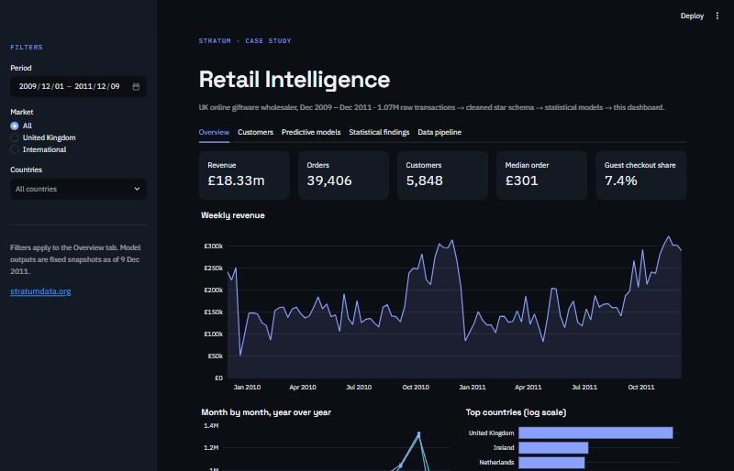
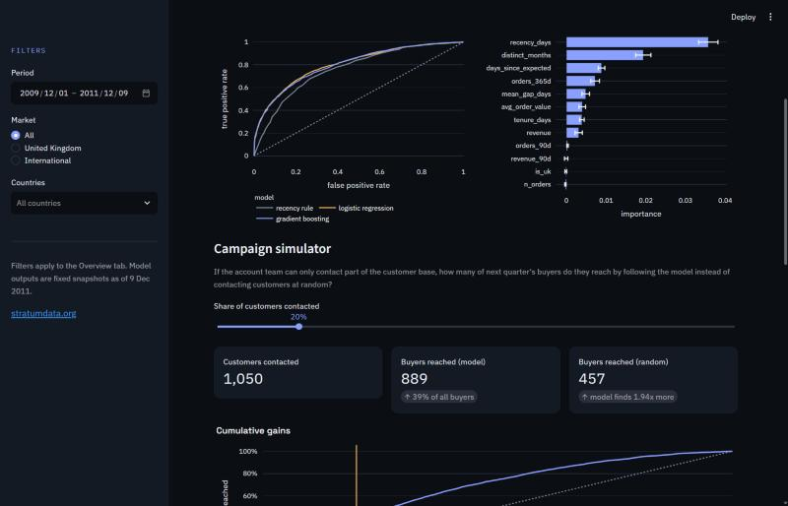
An interactive dashboard the team can use
STEP 5 · DELIVER
Overview: KPIs with like-for-like YoY deltas and filters
Predictive: model comparison and a campaign simulator
Five tabs: Overview · Customers · Predictive models · Statistical findings · Data pipeline (with live quality checks)
Notes:
The dashboard is built in Streamlit and reads only a 1 MB serving layer, so it deploys anywhere without the warehouse. The campaign simulator is the feature that sells: drag a slider and see how many buyers the team reaches. The pipeline tab shows the quality checks live, because trust in the numbers is the point.

Slide 14




What I'd tell the business owner
CONCLUSIONS
Protect the Champions
01
Call by propensity score
02
22% of customers bring 69% of revenue. Give them account management and early access to ranges.
Each quarter, call the top-scored customers first: about twice the buyers per call.
Invest in Q4 acquisition
03
Plan for a flat year
04
Gift-season customers come back more often. Don't treat them as one-off buyers.
Stock and staff to the forecast; growth needs a deliberate plan, it isn't happening on its own.
Notes:
Analysis is only useful if it changes a decision. Each recommendation maps to a finding: concentration, the propensity model, the gift-season test, and the flat-growth test plus forecast.

Slide 15




Production habits, not a notebook demo
HOW IT'S BUILT
Validated against baselines
TOOLKIT
Every model is tested against a simple alternative on data it never saw
Python
SQL
DuckDB
pandas
18 automated tests
SciPy
statsmodels
ETL rules, model correctness on simulated data, no-leakage checks, dashboard smoke test
scikit-learn
Plotly
Streamlit
CI on every push
pytest
GitHub Actions
uv
GitHub Actions lints, tests and rebuilds the full pipeline from source
Reproducible end to end
One command from the public download to the dashboard
Notes:
This is how the work is handed over to a client: clean, tested code with documentation, so it keeps running whether or not I stay involved.

Slide 16


Have data sitting unused?
STRATUM
I'll take the messy data your business already has and turn it into pipelines, models and dashboards your team can actually use.
stratumdata.org
stratumfreelance@gmail.com
Notes:
Close with the offer: the same process, applied to the client's own data. Every engagement starts with a short scoping call.

