Slide 1
Finish
By Charlie Curedale-Rayner

Slide 2
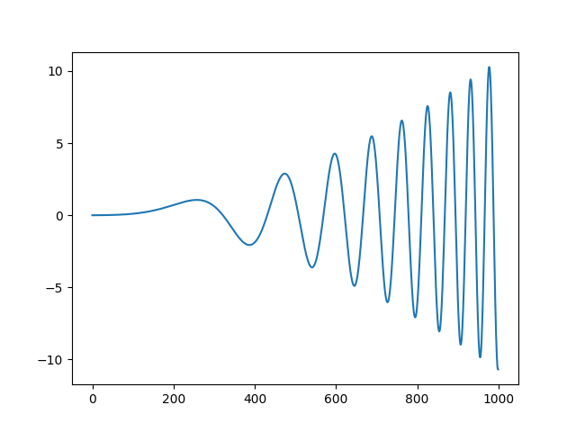
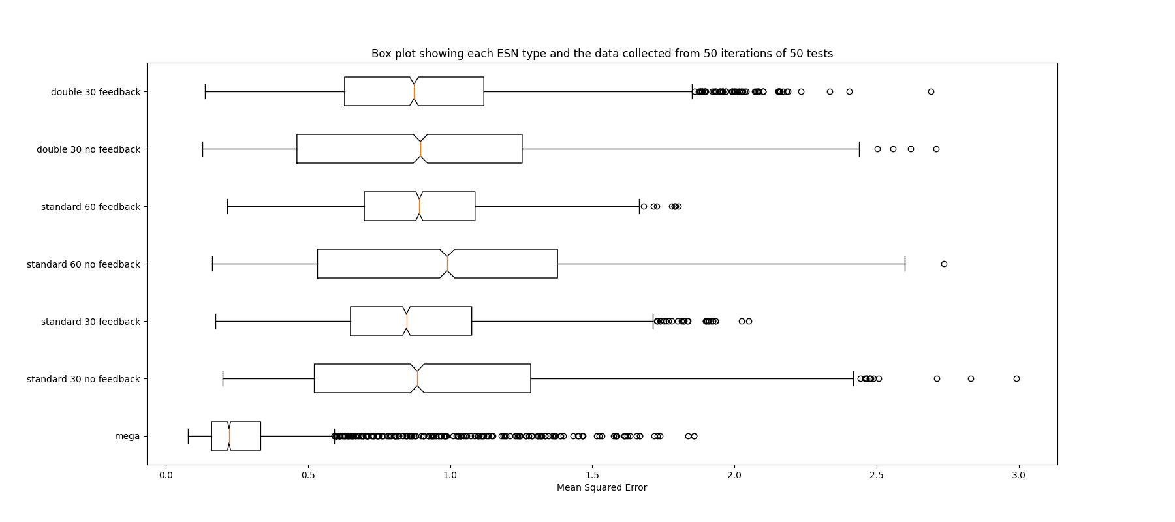
Results
Testing: Each network is trained on one random dataset (as shown in last weeks slides) and then tested on 50 new random datasets. The seven networks are tested as a group. This means that each group is trained on the same dataset and then tested on the same 50 datasets.
Results: This box plot shows all the 2500 test points generated for each network.
We can see that the Mega-ESN does better on this plot, however there are quite a few outliers.
To find the cause of these outliers we produced some more graphs.

Slide 3
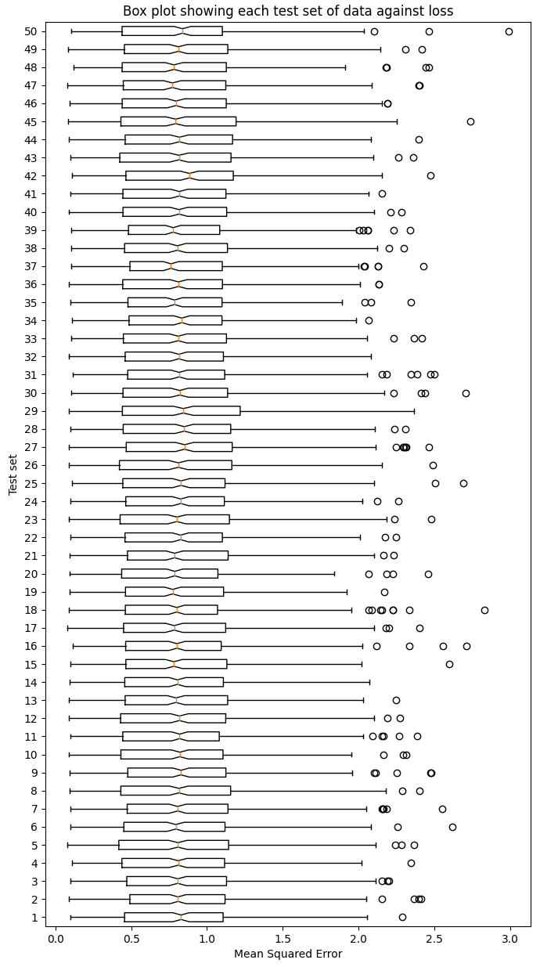
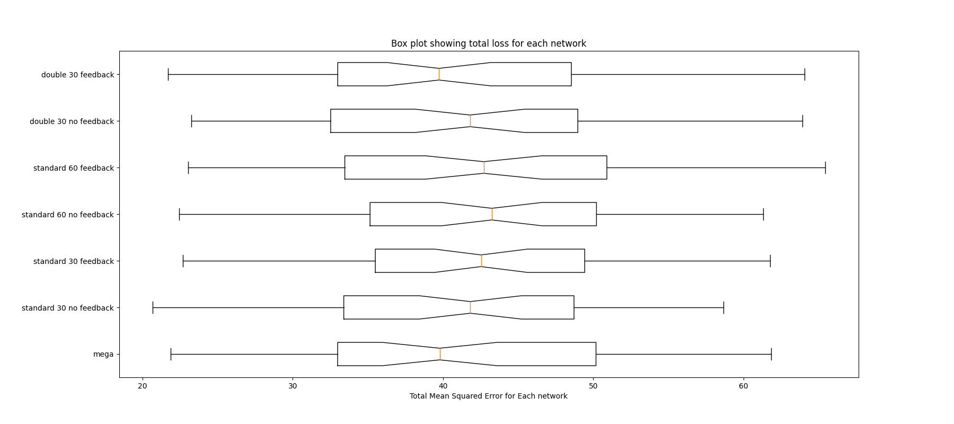
Results Continued
The plot on the right: Shows all 50 of the test sets and the points generated by all networks for that test set. This shows that there was not a particular test set that produces the outliers for the Mega-ESN on the last slide.
The plot below: Shows the total error for all networks. This graph shows that Mega-ESN behaves similarly to all the other networks as all the interquartile ranges are about the same. Using what we see in the graph on the previous slide we can deduce that the Mega-ESN is better on most datasets. However, on a smaller number of datasets it produces a much larger outlier value which means that overall, the expected performance of the Mega-ESN is around the other networks.

Slide 4
What this means
Put simply, the Mega-ESN does better than the other networks on average however, the Mega-ESN produces very large outliers that means that overall, the expected performance for the Mega-ESN is about the same as the other networks.
It would be interesting to find out what exactly the outliers are for the Mega-ESN and how they affect the network itself to produce such incorrect results.
As the Mega-ESN outperform the 60 node standard network, at this point in the project it could be true that the Mega-ESN does more than just adding more nodes. However, a lot more testing is needed.

Slide 5
Where we could go next
What exactly trips up the network for the outliers?
Look into what the autoencoder actually does?
Does it do feature extraction?
How does it improve the network?
How do different types of autoencoder affect the information remembered?
Does there need to be a loop back after every network?
How changing the number of hidden nodes between the networks affects results.
Look into extending the number of ESNs in the loop.
3?
Does that affect the feedback loop to the beginning network?
Is it possible to have two separate networks feeding into one network with a similar technique?
Is it possible to link to separate problems together in this way?

