Slide 1



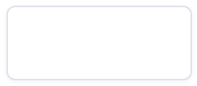
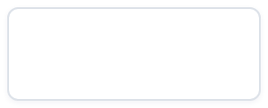
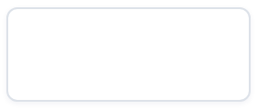
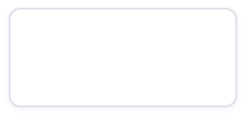





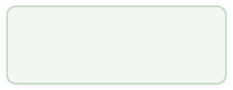
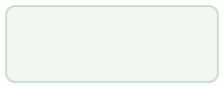
COURSE ASSIGNMENT · BPMN PROCESS AUTOMATION
Cover & Project Overview
Hospital Patient Referral, Treatment and Administration — a Camunda 8 BPMN collaboration
01
Course & Case
Course: Advanced Information Systems Development · Case: Hospital Patient Referral, Treatment and Administration
02
Deliverable Form — One BPMN Collaboration
9
4+1
1 BPMN collaboration with 14 participants — 9 hospital pools + 5 external parties (4 external suppliers + patient)
HOSPITAL POOLS
EXTERNAL PARTIES
03
Deliverables
Runnable
model + deployment config · 36 Camunda Forms · 36 Java external workers · test plan & evidence
36
36
.bpmn
CAMUNDA FORMS
JAVA WORKERS
04
Runtime Platform
Camunda 8 (local
c8run 8.10.0-alpha5
) · Camunda Modeler
5.51.0
· workers on
/
zeebe-client-java 8.9.0
JDK 21
05
Verification Result
✓ Deployed
✓ 0 incidents
9 process definitions + 36 forms deployment accepted · all script paths incidents: none
9 DEFS · 36 FORMS
ALL SCRIPT PATHS
Advanced Information Systems Development · Hospital Patient Pathway
1 / 6
Notes:
EN | Cover & Project Overview
- Course: Advanced Information Systems Development; case: Hospital Patient Referral, Treatment and Administration.
- Deliverable form: one BPMN collaboration with 14 participants — 9 hospital pools plus 5 external parties (4 external suppliers and the patient).
- Deliverables: a runnable .bpmn model with its deployment configuration, 36 Camunda Forms, 36 Java external workers, and the test plan with evidence.
- Runtime platform: Camunda 8 (local c8run 8.10.0-alpha5), Camunda Modeler 5.51.0; workers built on zeebe-client-java 8.9.0 / JDK 21.
- Verified: 9 process definitions and 36 forms were accepted at deployment, and every scripted path completed with incidents: none.
中文 | 封面与项目概览
- 课程：Advanced Information Systems Development；案例：医院患者转诊、治疗与行政管理。
- 交付形态：一份 BPMN collaboration，含 14 个 participant —— 9 个医院 pool 加 5 个院外参与方（4 家外部供应商与患者）。
- 交付物：可运行的 .bpmn 模型及部署配置、36 个 Camunda Form、36 个 Java external worker，以及测试计划与证据。
- 运行平台：Camunda 8（本地 c8run 8.10.0-alpha5）、Camunda Modeler 5.51.0，workers 基于 zeebe-client-java 8.9.0 / JDK 21。
- 已实测：9 个流程定义 + 36 个表单部署被接受，全部脚本路径 incidents: none。

Slide 2
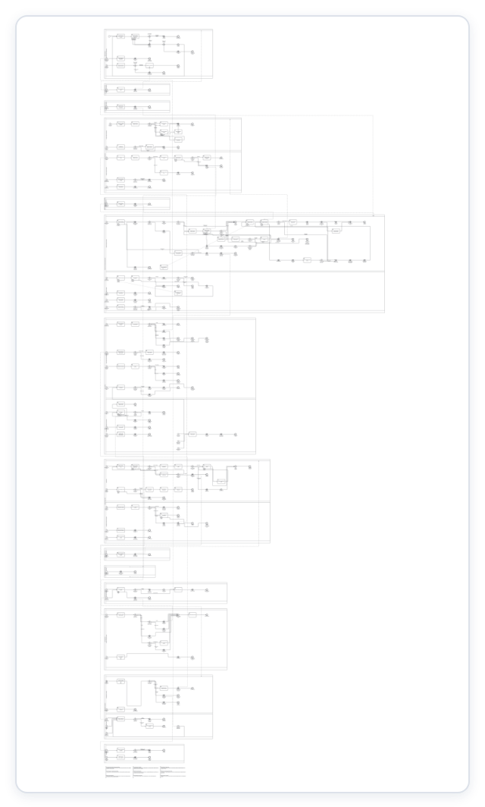
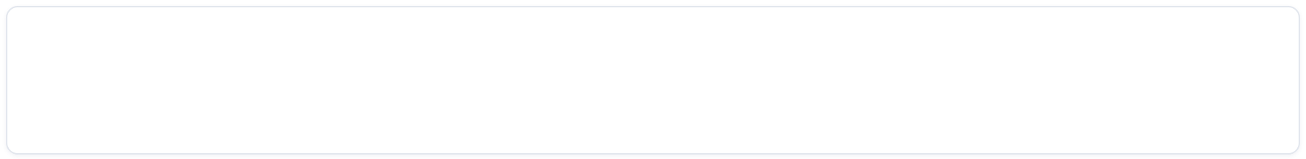
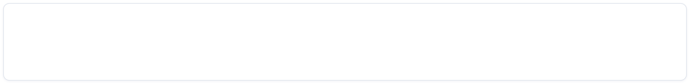
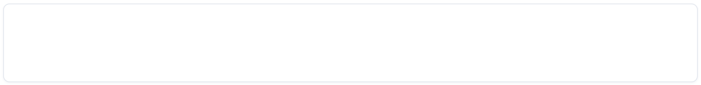
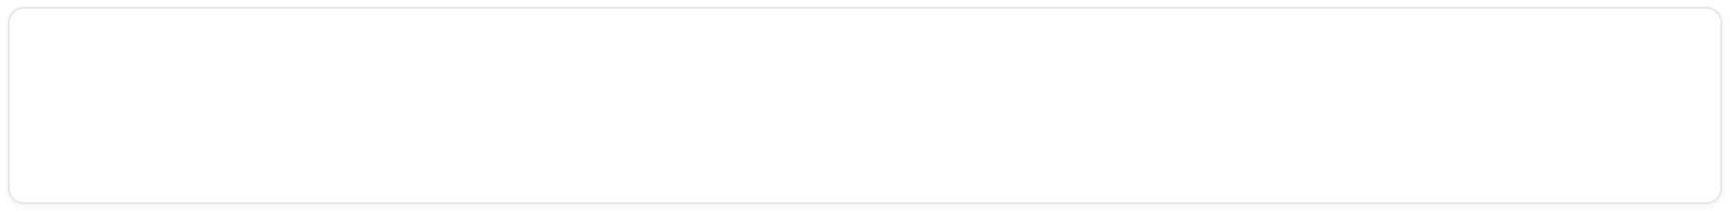
HOSPITAL PATIENT PATHWAY V14 · BPMN COLLABORATION MODEL
Operational Diagram
one diagram · executable · 14 pools
01
A single executable collaboration diagram covering 14 pools and 19 lanes.
02
Scale: 381 shapes, 312 sequence flows, 20 message flows, 39 user tasks, 51 service tasks, 42 gateways, 18 boundary events.
03
Every user task bound to a Camunda Form + candidate group; every service task bound to a job type; every gateway with FEEL conditions.
04
Collaboration via message handoffs (throw event → message start / intermediate catch); 9 pools start instances independently.
05
Diagram-as-evidence: diagram/sections/ provides one-pool-per-page full-size section renders for teaching.
hospital-patient-pathway-v14-overview.png · 910 × 2400
UFCEP-0-3 · Course Assignment Presentation
2 / 6
Notes:
EN | Operational Diagram
- One executable collaboration diagram covers every required element: participants (14 pools), responsibilities (19 lanes), activities, decisions, messages, business rules, exceptions, system boundaries and external services.
- Scale: 381 shapes, 312 sequence flows, 20 message flows, 39 user tasks, 51 service tasks, 42 gateways, 18 boundary events.
- Operability: every user task is bound to a Camunda Form and a candidate group; every service task is bound to a job type; every gateway carries a FEEL condition.
- Pools collaborate through message handoffs (throw event to message start or intermediate catch) rather than one large process — the 9 pools each start their own instance.
- Diagram as evidence: the overview and the one-pool-per-page section renders under diagram/sections/ are produced by headless bpmn-js and are used for teaching.
中文 | 可操作流程图
- 一张可执行的协作图覆盖全部要素：参与者（14 个 pool）、职责（19 条 lane）、活动、决策、消息、业务规则、异常、系统边界与外部服务。
- 规模：381 个绘制形状、312 条顺序流、20 条消息流、39 个 user task、51 个 service task、42 个 gateway、18 个 boundary event。
- 可操作性：每个 user task 绑定 Camunda Form 与候选组；每个 service task 绑定 job type；每个 gateway 带 FEEL 条件。
- 池间协作靠消息接力（throw event 到 message start 或中间捕获事件），而不是一条大流程 —— 9 个池各自独立起实例。
- 图纸即证据：整图与 diagram/sections/ 下“一池一页”的分区图由 bpmn-js 无头渲染，用于课堂讲解。

Slide 3
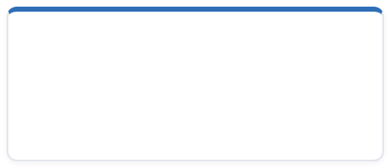
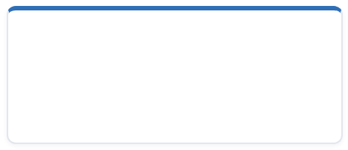
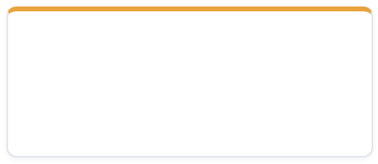
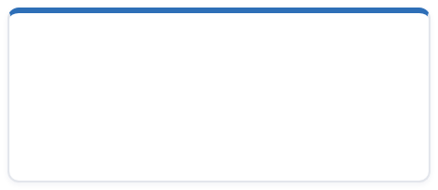



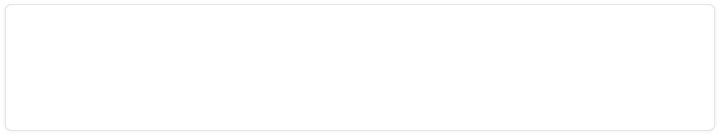

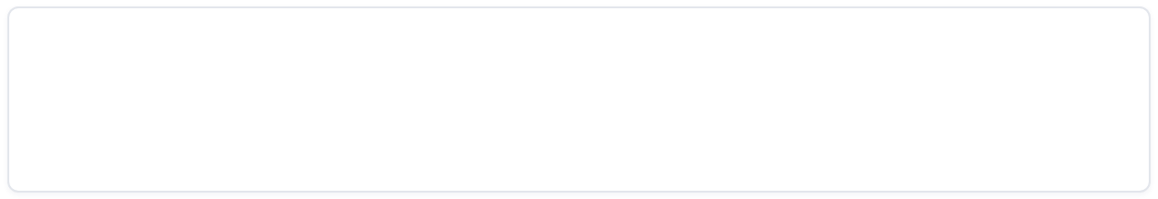
Project Structure — 9 Pools, 36 Forms & Worker Counts
Hospital Patient Pathway v14 · Process landscape, form binding and automation scale at a glance
9
5
36
39 tasks
36
Executable hospital pools
internal departments
External participants
services & the patient
Camunda Forms
bound to user tasks
User tasks
3 forms reused across tasks
Java worker classes
37 subscriptions · 36 job types
EXECUTABLE HOSPITAL POOLS
× 9
FORM DISTRIBUTION BY POOL
36 forms
Medical Secretaries
Consultants
Outpatient Bookings
Consultants
8
Treatment & Chemotherapy Bookings
Finance
Clinical Nurse Specialists
Call Handling
Finance
7
Outpatient Bookings
7
Pathway Coordinators
Administrative Management
Medical Secretaries
4
Treatment Bookings
4
Call Handling
4
EXTERNAL PARTICIPANTS
× 5
Pathway Coordinators
2
external communication service
payment provider
lab & imaging service
Administrative Management
2
CNS
1
scheduling service
patient
WORKERS & JOB SUBSCRIPTIONS
OTHER MODEL SCALE
36
42
18
9
3
Java worker classes with 37 job-type subscriptions covering 36 job types — 35 business jobs plus 1 publish-message
Gateways
Boundary events
Error codes
Collapsed subprocesses
3
Forms reused — the same Camunda Form is bound to multiple user tasks, so 36 forms serve 39 user tasks
UFCEP-0-3 · Hospital Patient Pathway v14 — Course Assignment
4 / 6
Notes:
EN | Project Structure — 9 Pools, 36 Forms & Worker Counts
- 9 executable hospital pools: Medical Secretaries, Consultants, Outpatient Bookings, Treatment & Chemotherapy Bookings, Finance, Clinical Nurse Specialists, Call Handling, Pathway Coordinators and Administrative Management.
- 5 external participants: the external communication service, the payment provider, the lab and imaging service, the scheduling service, and the patient.
- 36 Camunda Forms are bound to 39 user tasks, because 3 forms are reused across several tasks.
- Form distribution by pool: Consultants 8, Finance 7, Outpatient Bookings 7, Medical Secretaries 4, Treatment Bookings 4, Call Handling 4, Pathway Coordinators 2, Administrative Management 2, CNS 1.
- Workers: 36 Java worker classes with 37 job-type subscriptions, covering 36 job types — 35 business jobs plus 1 publish-message.
- Other model scale: 42 gateways, 18 boundary events, 9 error codes and 3 collapsed subprocesses.
中文 | 项目结构：9 个 Pool、36 个 Form 与 Worker 数量
- 9 个可执行的医院 pool：Medical Secretaries、Consultants、Outpatient Bookings、Treatment & Chemotherapy Bookings、Finance、Clinical Nurse Specialists、Call Handling、Pathway Coordinators、Administrative Management。
- 5 个院外 participant：外部通信服务、支付服务商、检验与影像服务、排程服务以及患者。
- 36 个 Camunda Form 绑定在 39 个 user task 上，因为其中 3 个表单被多个任务复用。
- 表单按池分布：Consultants 8、Finance 7、Outpatient Bookings 7、Medical Secretaries 4、Treatment Bookings 4、Call Handling 4、Pathway Coordinators 2、Administrative Management 2、CNS 1。
- Worker 数量：36 个 Java worker 类、37 个 job-type 订阅，覆盖 36 个 job type —— 35 个业务作业加 1 个 publish-message。
- 其他规模：42 个 gateway、18 个 boundary event、9 个错误码、3 个折叠子流程。

Slide 4

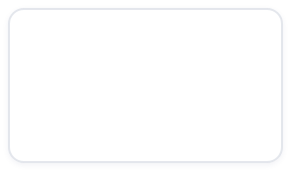
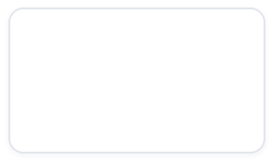
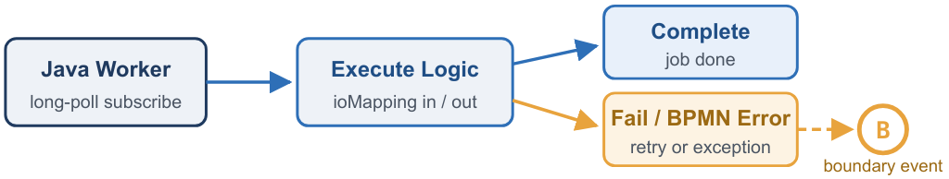
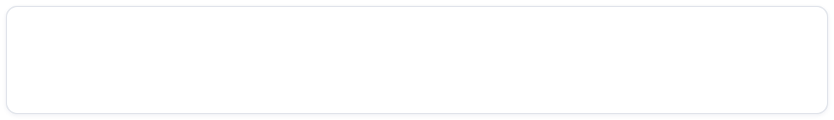
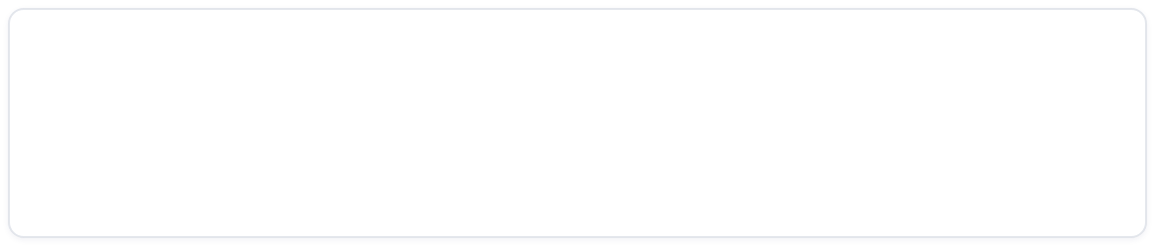
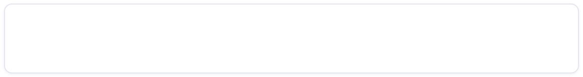
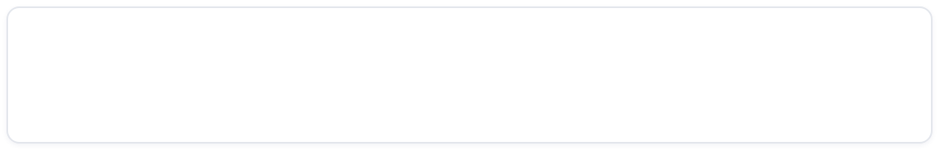
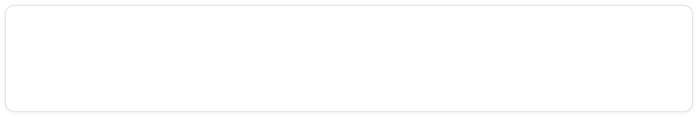
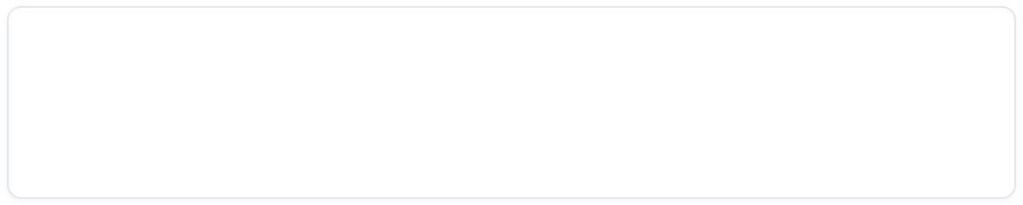
PROCESS AUTOMATION · ZEEBE / CAMUNDA 8
Service Task & Gateway Implementation
How the Hospital Patient Pathway model executes work — external task workers, error handling, compensation, and routing logic
1
Service Tasks — Zeebe External Tasks
2
Gateways — 42 Routing Points
WORKER LIFECYCLE
X
35
3
2
2
EXCLUSIVE
INCLUSIVE
PARALLEL
EVENT-BASED
CONDITIONS WRITTEN IN FEEL
Gateway conditions use FEEL expressions on process variables:
dispatchStatus = "SENT"
contactOutcome = "REACHED"
TASK DEFINITION & VARIABLE MAPPING
EVENT-BASED GATEWAYS
Service tasks uniformly use Zeebe external tasks: taskDefinition type = job type.
The 2 event-based gateways wait for inter-pool messages — the process pauses until a message arrives from another participant pool.
referral.check-supporting-documents
finance.calculate-charge
Workers long-poll subscribe to the job type → execute → Complete / Fail; ioMapping maps process variables in / out.
DESIGN PRINCIPLES
Business Rules
Separation of Concerns
EXCEPTION PATH — BPMN ERRORS
Business rules live in gateway conditions and form validation.
Responsibilities are separated by lanes across the model.
Worker throws a BPMN error, caught by boundary events → exception branch. 9 named error codes, e.g.:
REFERRAL_PACK_UNREADABLE
PAYMENT_CONFIRMATION_LOST
… +7 more
Key takeaway: execution is fully delegated — workers own the logic, gateways own the routing, and boundary events own the failure paths.
RETRY & COMPENSATION
Retry Policy
Compensation
External capacity retries up to 3 times.
Exceeding the limit triggers compensation releasing temp booking sequences.
2 compensation boundary events
2 compensation throw events
UFCEP6-0-3 · Hospital Patient Pathway v14
5 / 6
Notes:
EN | Service Task & Gateway Implementation
- Service tasks uniformly use Zeebe external tasks: the taskDefinition type is the job type, for example referral.check-supporting-documents or finance.calculate-charge.
- Each Java worker long-poll subscribes to its job type, executes the business logic, then completes or fails the job; ioMapping maps process variables in and out.
- Exception path: a worker throws a BPMN error which a boundary event catches and routes to the exception branch. There are 9 named error codes, such as REFERRAL_PACK_UNREADABLE and PAYMENT_CONFIRMATION_LOST.
- Retry and compensation: external capacity is retried by count (limit 3); exceeding the limit triggers compensation that releases the temporary booking sequences. There are 2 compensation boundary events and 2 compensation throw events.
- Gateways: 42 in total — 35 exclusive, 3 inclusive, 2 parallel and 2 event-based. Conditions are written in FEEL, for example dispatchStatus = "SENT" or contactOutcome = "REACHED".
- The 2 event-based gateways wait for inter-pool messages, so the process pauses until a message arrives from another pool. Business rules live in gateway conditions and form validation, and responsibilities are separated by lanes.
中文 | Service Task 与 Gateway 的实现方式
- Service task 统一使用 Zeebe external task：taskDefinition 的 type 就是 job type，例如 referral.check-supporting-documents、finance.calculate-charge。
- 每个 Java worker 以长轮询订阅自己的 job type，执行业务逻辑后 complete 或 fail；输入输出变量通过 ioMapping 映射。
- 异常路径：worker 抛出 BPMN error，由 boundary event 捕获后转到异常分支。共有 9 个命名错误码，如 REFERRAL_PACK_UNREADABLE、PAYMENT_CONFIRMATION_LOST。
- 重试与补偿：外部容量按计数重试（上限 3），超限触发补偿，释放临时预约序列。共有 2 个补偿边界事件与 2 个补偿抛出事件。
- Gateway：共 42 个 —— 35 个 exclusive、3 个 inclusive、2 个 parallel、2 个 event-based。条件用 FEEL 表达式书写，例如 dispatchStatus = "SENT"、contactOutcome = "REACHED"。
- 2 个 event-based gateway 用于等待池间消息，流程会暂停直到其他池发来消息。业务规则落在网关条件与表单校验上，职责由 lane 分离。

Slide 5





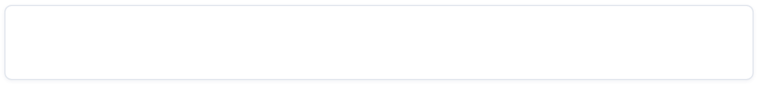
AUTOMATION & VERIFICATION
Collapsed BPMN + Driver Script — Running 36 Forms across 9 Pools Continuously
1 · COLLAPSED BPMN SUBPROCESSES
2 · DRIVER SCRIPT — tools/auto_driver.py
Three collapsed subprocesses absorb the repetitive administrative work inside the pools:
Covers the 3 unattended gaps:
Dispatch the clinic letter
1
Runs workers for 35 external job types
+ad hoc: collapsed marker
2
Fills & announces all forms via Tasklist v2 REST
3
Replays inter-pool message handoffs — correlation keys read from live subscriptions
Contact the patient by telephone
+ad hoc: collapsed marker
python3 auto_driver.py --all ~80s regression
python3 auto_driver.py --all --manual-forms --timeout 600
# demo / evidence — human clicks in Tasklist
Produce the weekly overdue correspondence list
+ad hoc: collapsed marker
demo-timers variant
R/PT168H
P3D
P7D
overdue boundary to
— shortens
weekly report ·
capacity retry ·
15 seconds
for live escalation & compensation demos.
DI preserved inside the boxes — Modeler still shows the fully laid-out flows.
39
2
lint errors
34
scenarios chain all 36 forms — main path plus branches: declined payment · confirmation lost · two-stage escalation · chemo capacity
36/36
forms covered by automated scenarios
9
pools start instances independently
message handoffs present a continuous run
（内容由AI生成，仅供参考）
UFCEP6-0-3 · Hospital Patient Pathway v14
6 / 6
Notes:
EN | Collapsed BPMN + Driver Script — Running 36 Forms across 9 Pools Continuously
- Three collapsed subprocesses absorb the repetitive administrative work inside the pools: Dispatch the clinic letter, Contact the patient by telephone, and Produce the weekly overdue correspondence list.
- The collapsed boxes are folded on the main plane but keep their diagram interchange, so Camunda Modeler still shows the fully laid-out internal flows; lint errors drop from 39 to 2.
- The driver tools/auto_driver.py closes the three unattended gaps: it runs workers for the 35 external job types, fills and announces all forms through the Tasklist v2 REST API, and replays inter-pool message handoffs with correlation keys read from live subscriptions instead of guessing them.
- 34 scenarios chain all 36 forms together: the main path plus branches such as declined payment, confirmation lost, two-stage escalation and chemotherapy capacity.
- Two modes: python3 auto_driver.py --all for a fully automated regression run of about 80 seconds, and --all --manual-forms --timeout 600 for demos and evidence, where a human clicks through every task in Tasklist.
- The demo-timers variant shortens the weekly report R/PT168H, the capacity retry P3D and the overdue boundary P7D to 15 seconds so the escalation ladder and compensation can be demonstrated live.
- Result: forms covered 36/36; the 9 pools start instances independently and present a continuous run through message handoffs.
中文 | 折叠 BPMN + Driver 脚本：让 9 个 Pool 的 36 个 Form 连续运行
- 3 个折叠（collapsed）子流程收纳池内重复性的行政工作：Dispatch the clinic letter、Contact the patient by telephone、Produce the weekly overdue correspondence list。
- 折叠框在主平面收起，但仍保留 diagram interchange，Camunda Modeler 打开即可看到已排版好的内部流程；lint 报错由 39 降至 2。
- driver 脚本 tools/auto_driver.py 补齐无人值守时缺失的三件事：为 35 个外部 job type 代跑 worker；通过 Tasklist v2 REST 代填并播报全部表单；重放池间接力消息，相关性键从实时订阅读取而不是靠猜。
- 34 个场景把 36 个 form 串起来：主路径之外还有拒付、确认丢失、两段升级、化疗容量等分支。
- 两种模式：python3 auto_driver.py --all 为全自动回归，约 80 秒；--all --manual-forms --timeout 600 用于演示与取证，由人在 Tasklist 中逐个点击。
- demo-timers 演示变体把周报 R/PT168H、容量重试 P3D、逾期边界 P7D 缩短为 15 秒，使升级阶梯与补偿可现场演示。
- 结果：forms covered 36/36；9 个 pool 各自独立起实例，靠消息接力呈现连续运行。

