Slide 1
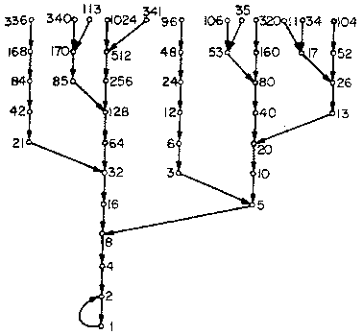
Collatz Conjecture Verification
Presented by Scott Gordon and Steven Kundert

Slide 2
Overview:
What is the Collatz Conjecture?
Hailstone Sequence
Our Methods
Timing Analysis
Q & A

Slide 3
What is the Collatz Conjecture?
A simple to understand, yet so-far unproven number theory problem
Also known as:
The 3n + 1 conjecture
The Ulam conjecture
Kakutani's problem
The Thwaites conjecture
Hasse's algorithm
The Syracuse problem
The Hailstone problem

Slide 4
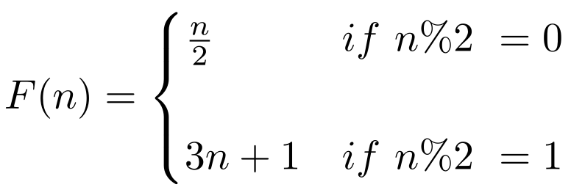
A Curious Number Theory Problem
For any positive integer n,
If n is even, divide by 2
If n is odd, multiply by 3 and add 1
Repeat this process indefinitely
The Collatz Conjecture hypothesizes that all numbers will converge to 1

Slide 5

Example
Let n = 6.

Slide 6
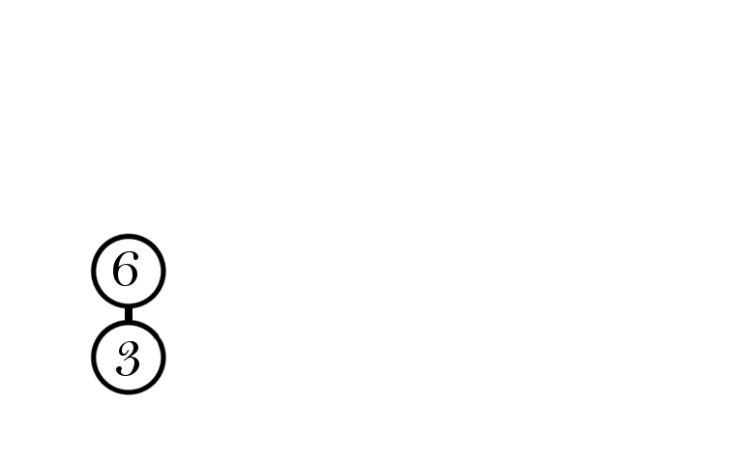
Example
Since 6 is even, we divide by 2 to get 3.

Slide 7
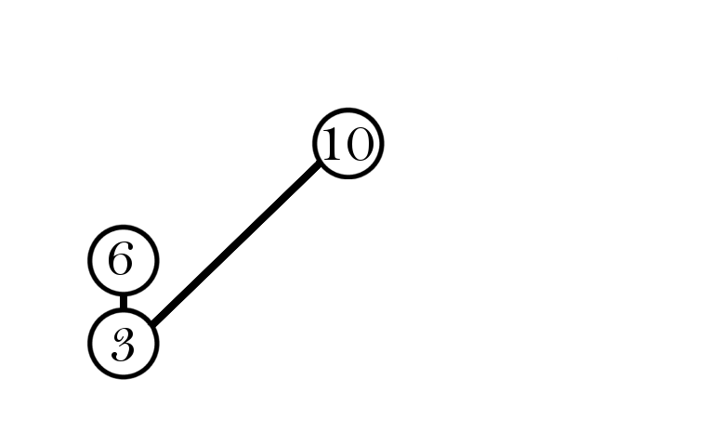
Example
Since 3 is odd, we multiply by 3 and add 1 to get 10.

Slide 8
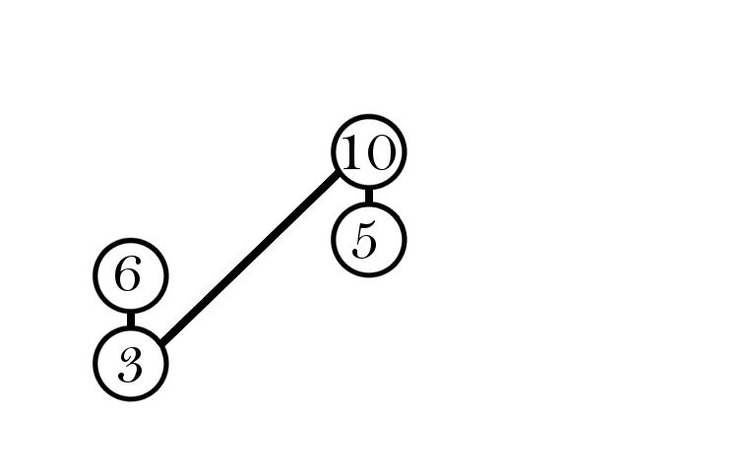
Example
Then since 10 is even, we divide by 2 to get 5.

Slide 9
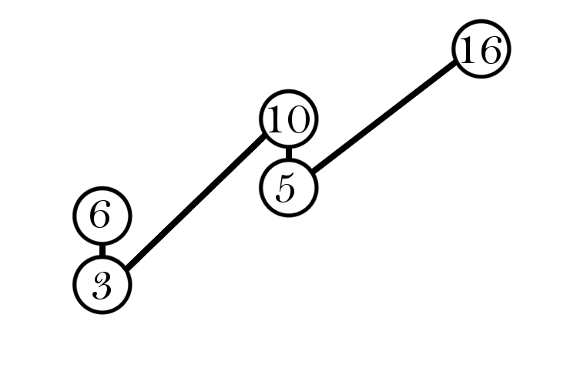
Example
The number 5 is odd, so multiplying by 3 then adding 1 we get 16.

Slide 10
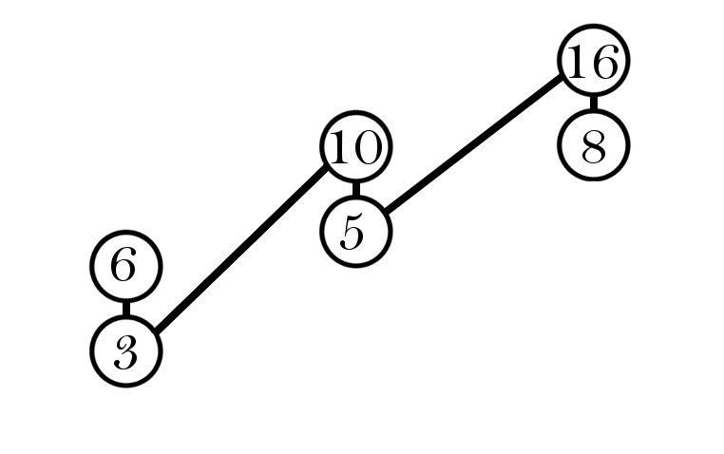
Example
The number 16 is a power of 2, so we divide by 2 again and again.

Slide 11
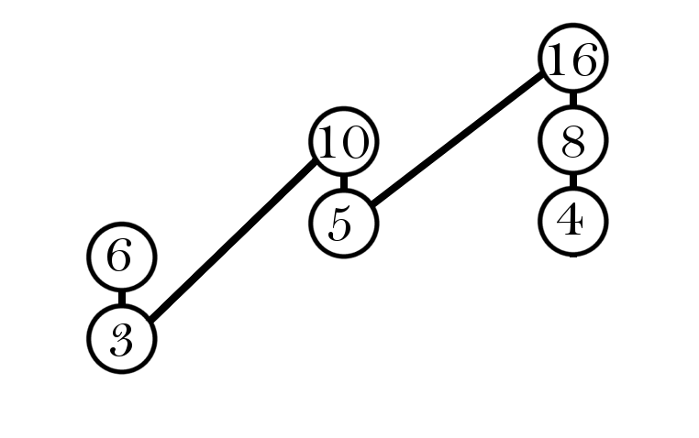
Example
Divide 8 by 2 and get 4.

Slide 12
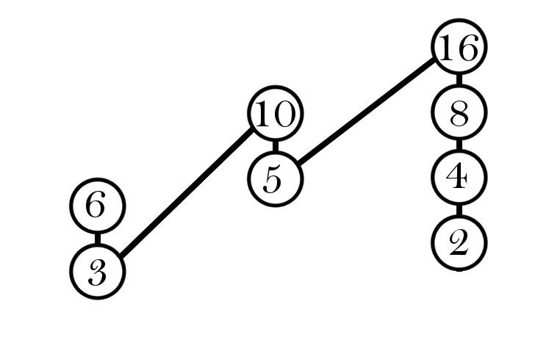
Example
Divide 4 by 2 and we get 2.

Slide 13
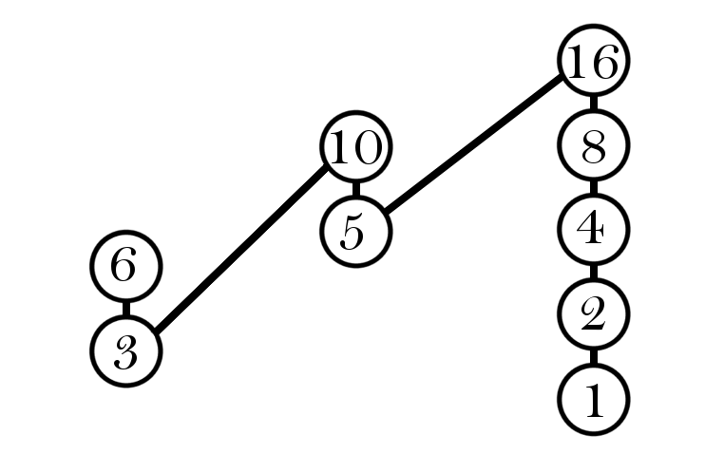
Example
Finally, 2 divided by 2 is 1. Applying the algorithm further creates a 4-2-1 cycle.

Slide 14
Numbers quickly get out of control
In our example, the number went through eight iterations to reach 1, and reached numbers much larger than the original
The series of numbers reached is known as a Hailstone Sequence
The conjecture has been confirmed for all positive integers up to 2^60
To disprove the conjecture, we need only find a sequence that does not converge to 1
The longest Hailstone Sequence found for an initial number less than 100 billion has 1,228 iterations
Powers of two converge quickly, but prime numbers that can be expressed as a power of two minus one (Mersenne primes) need many iterations
No discernible pattern for determining the length of each number’s sequence

Slide 15
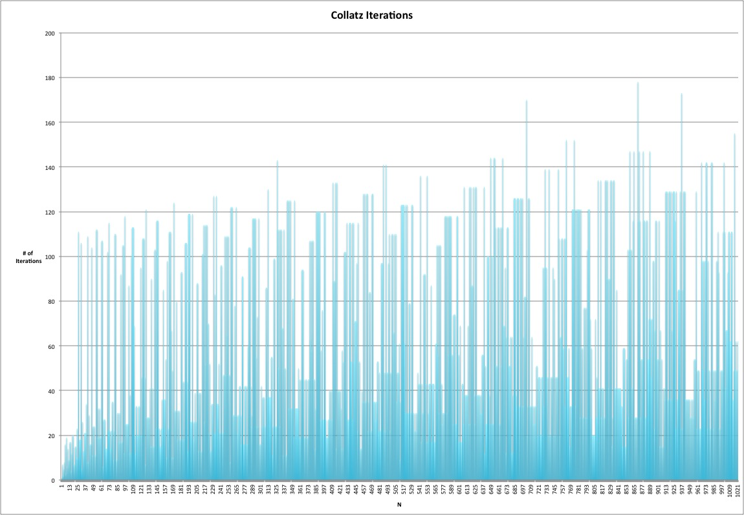

Slide 16
Why Did you Do this?
Exploration, Fun, Example
Exploit / Show off the power of the GPU
Computability vs. Decidability
Cellular Automata

Slide 17
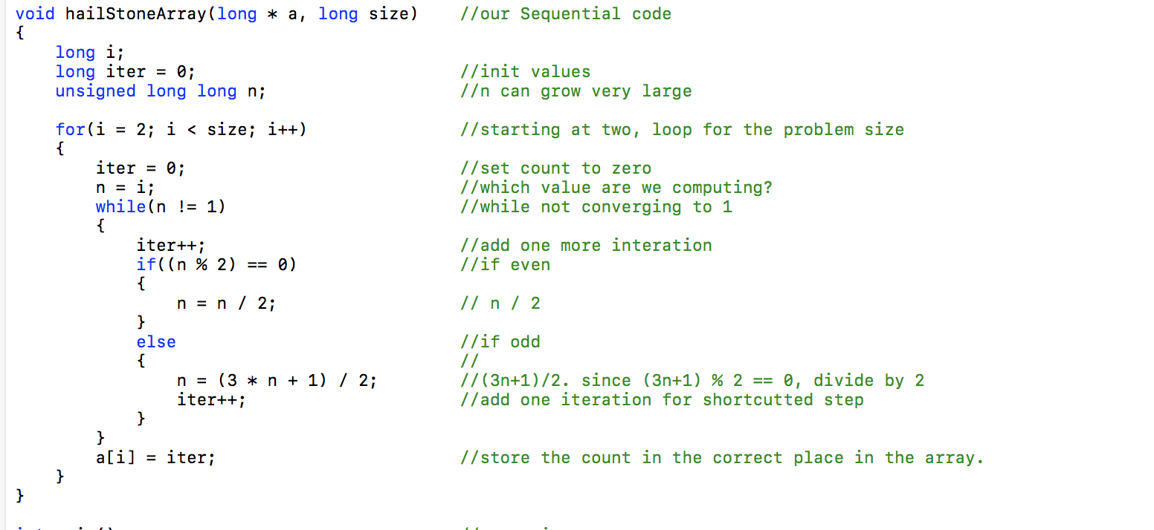
Sequential Method in C

Slide 18
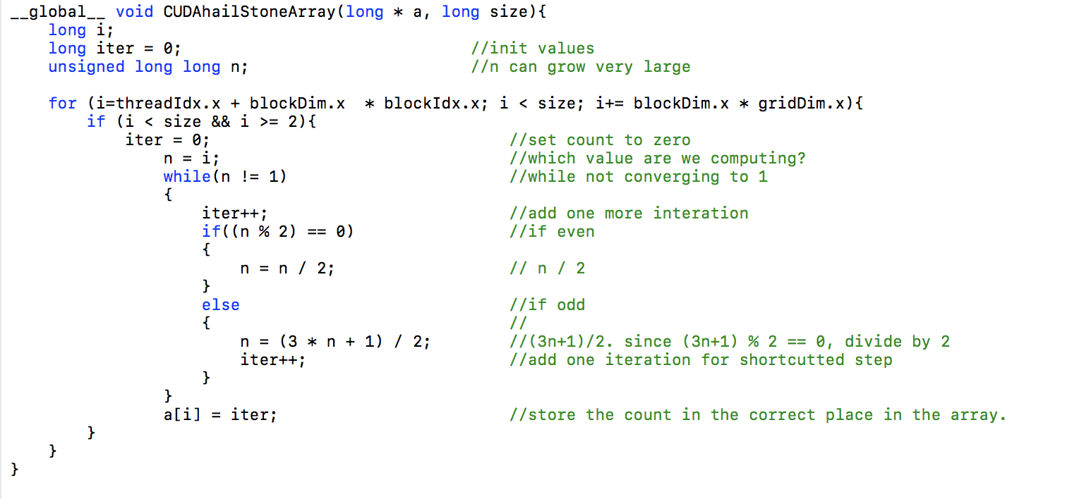
CUDA Method

Slide 19
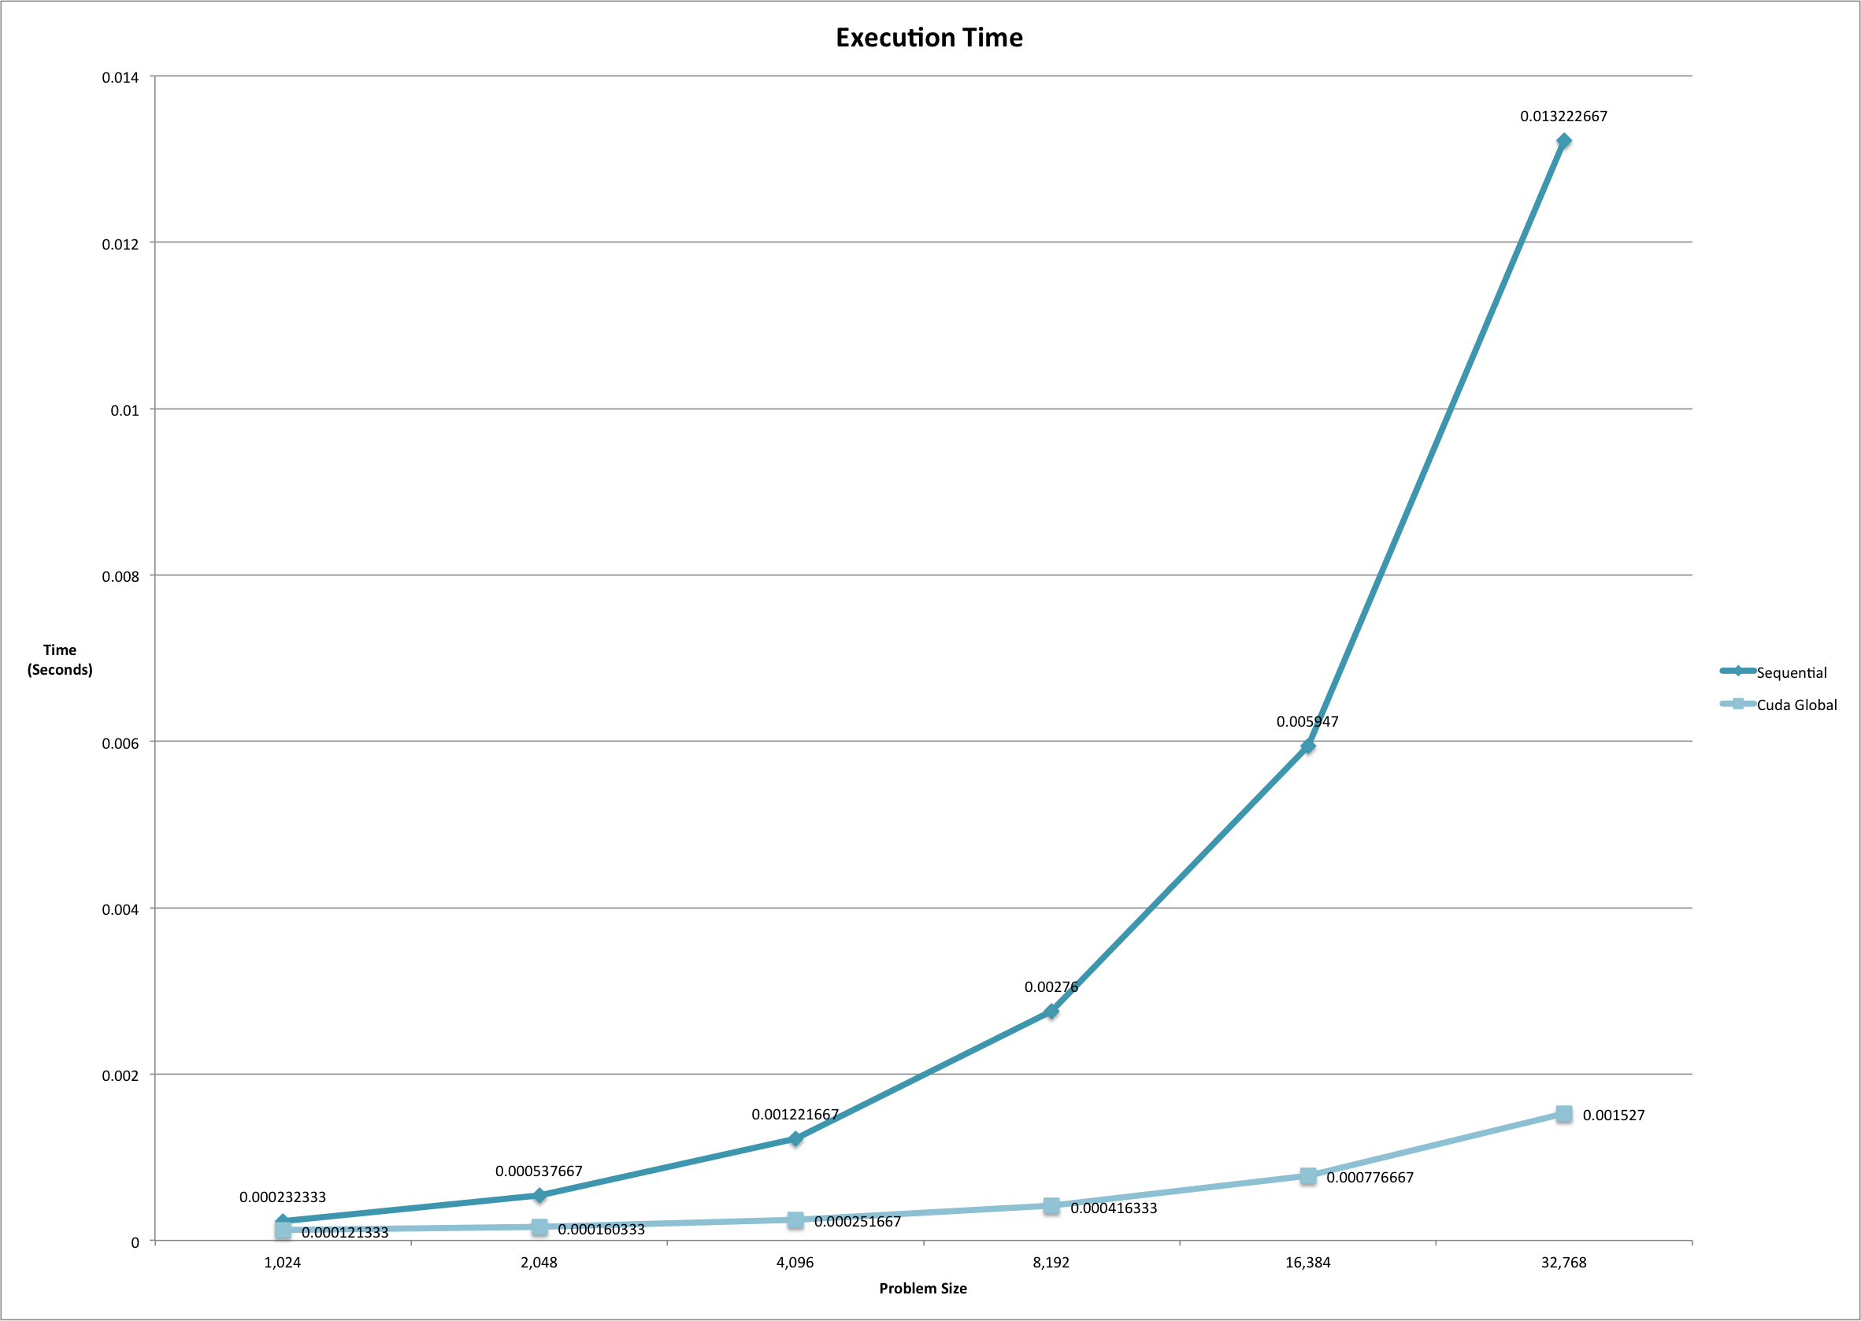

Slide 20
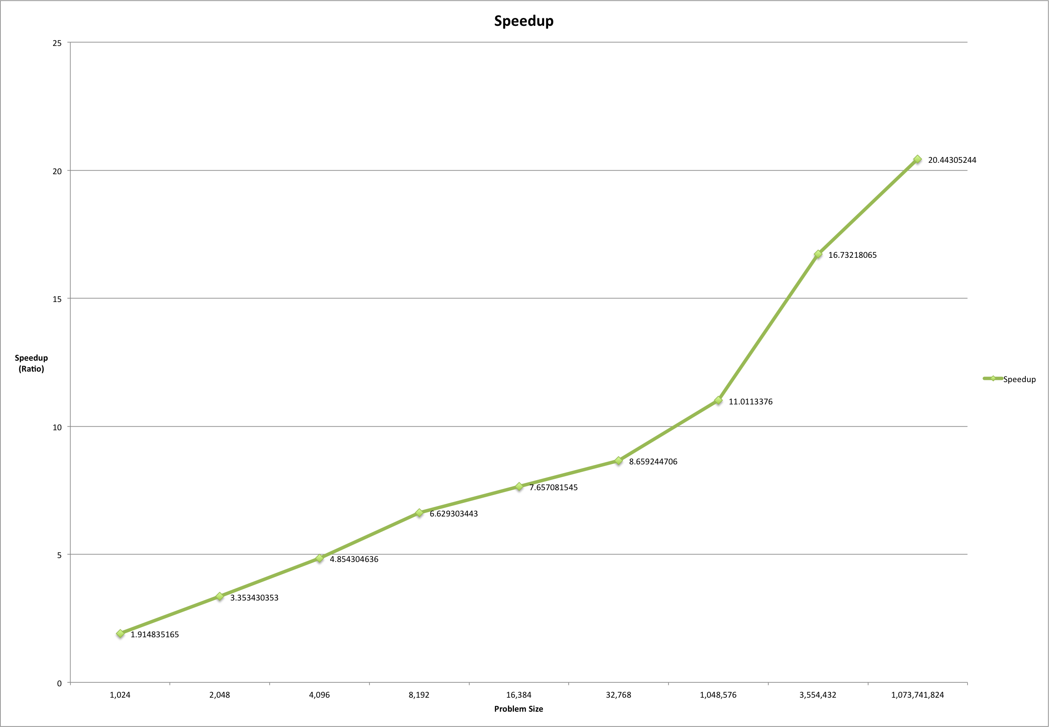

Slide 21
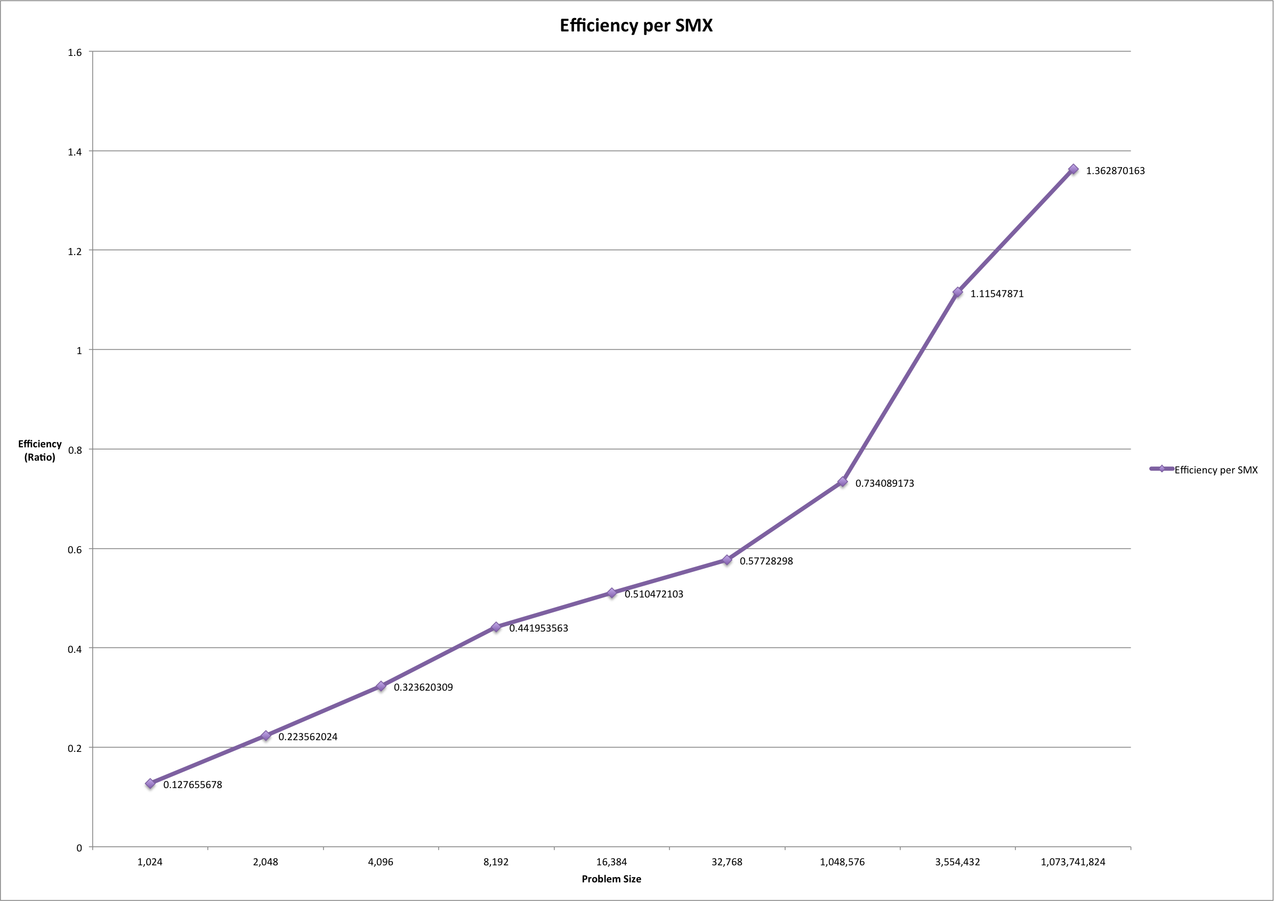

Slide 22
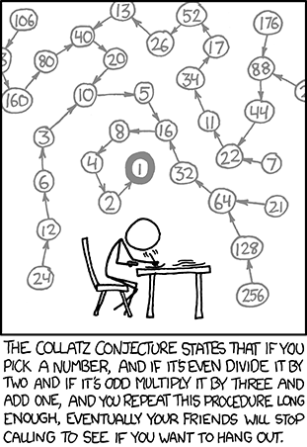
Questions?
xkcd.org

