Slide 1
Collatz Verification
Using CUDA
Midwestern State University Scott Gordon, Steven Kundert
“Two Loops”

Slide 2
Overview:
What is the Collatz Conjecture?
Hailstone Sequence
Why?
Our Method (Sequential)
Our Method (CUDA)
Output
Timing Analysis
Q&A

Slide 3
What Is the Collatz Conjecture?
Consider the following operation on an arbitrary positive integer:
If Even, Divide by 2
If Odd, Triple it and add 1
This process will eventually reach the number 1, regardless of which positive integer is chosen initially.

Slide 4
Hailstone Sequence N=27, 111 Steps
27, 82, 41, 124, 62, 31, 94, 47, 142, 71, 214, 107, 322, 161, 484, 242, 121, 364, 182, 91, 274, 137, 412, 206, 103, 310, 155, 466, 233, 700, 350, 175, 526, 263, 790, 395, 1186, 593, 1780, 890, 445, 1336, 668, 334, 167, 502, 251, 754, 377, 1132, 566, 283, 850, 425, 1276, 638, 319, 958, 479, 1438, 719, 2158, 1079, 3238, 1619, 4858, 2429, 7288, 3644, 1822, 911, 2734, 1367, 4102, 2051, 6154, 3077, 9232, 4616, 2308, 1154, 577, 1732, 866, 433, 1300, 650, 325, 976, 488, 244, 122, 61, 184, 92, 46, 23, 70, 35, 106, 53, 160, 80, 40, 20, 10, 5, 16, 8, 4, 2, 1
(sequence A008884 in the OEIS)

Slide 5
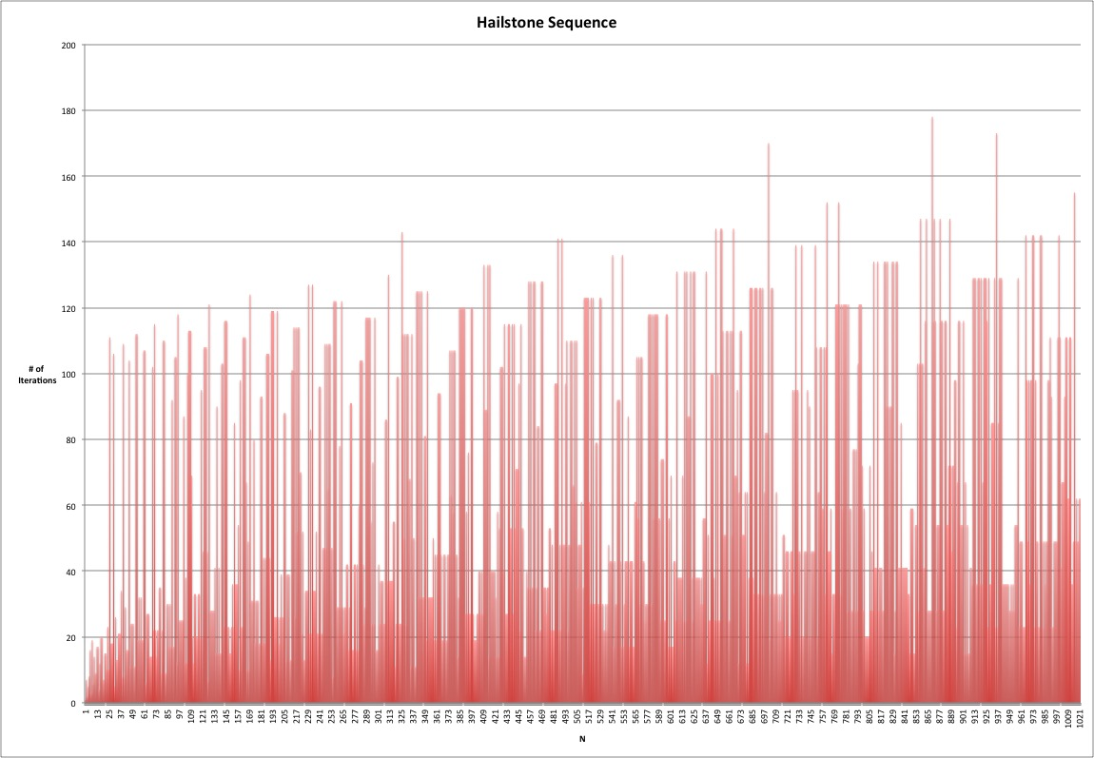

Slide 6
Why did you do this?
Fun, Exploration and Example
Exploit / Show off the power of the GPU
Cellular Automata
Computable vs. Decidable

Slide 7
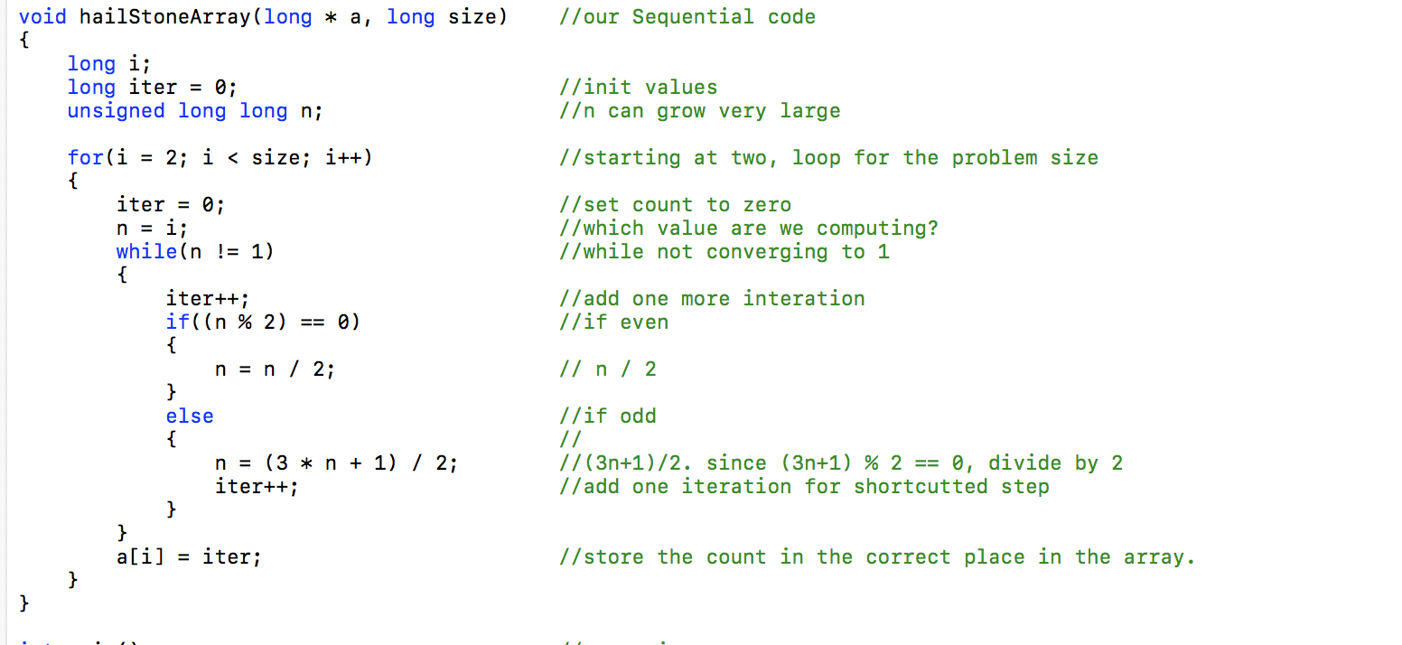
Sequential Method in C

Slide 8
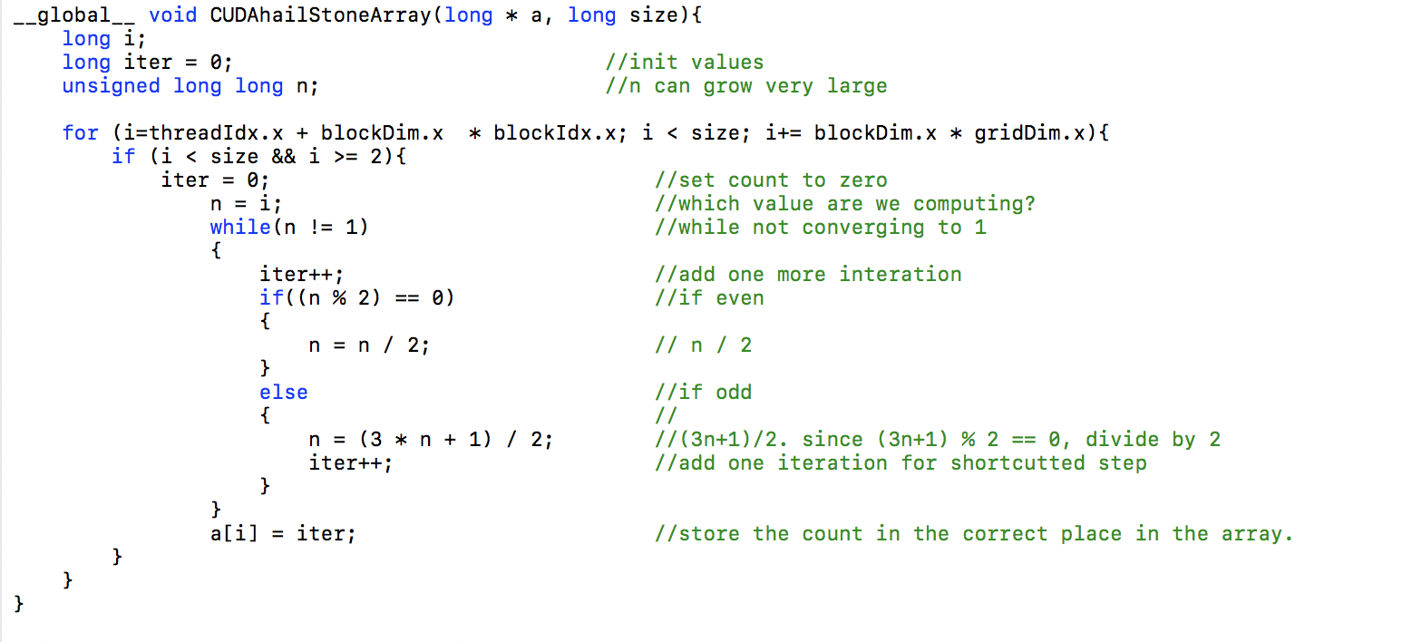
CUDA Method

Slide 9
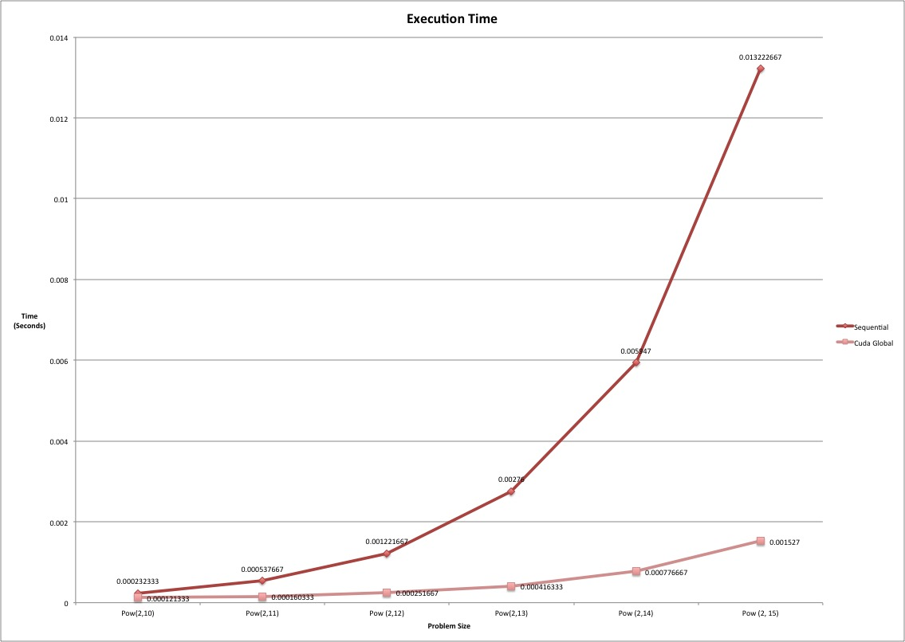

Slide 10
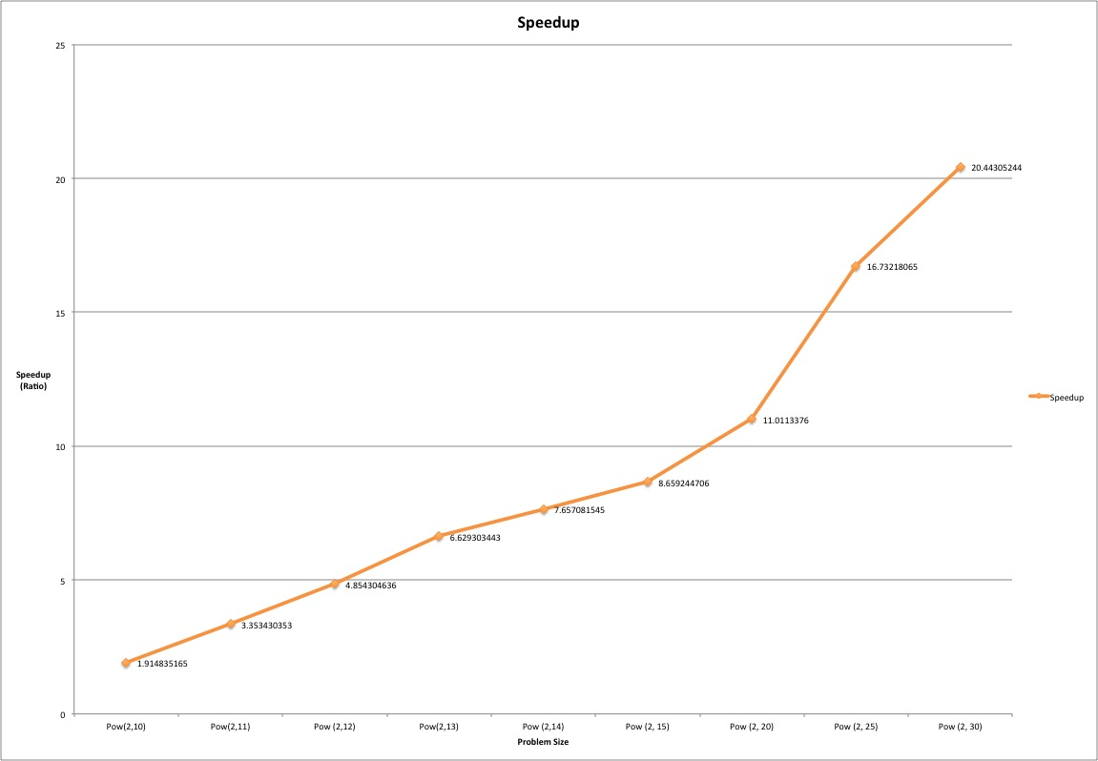
Speedup

Slide 11
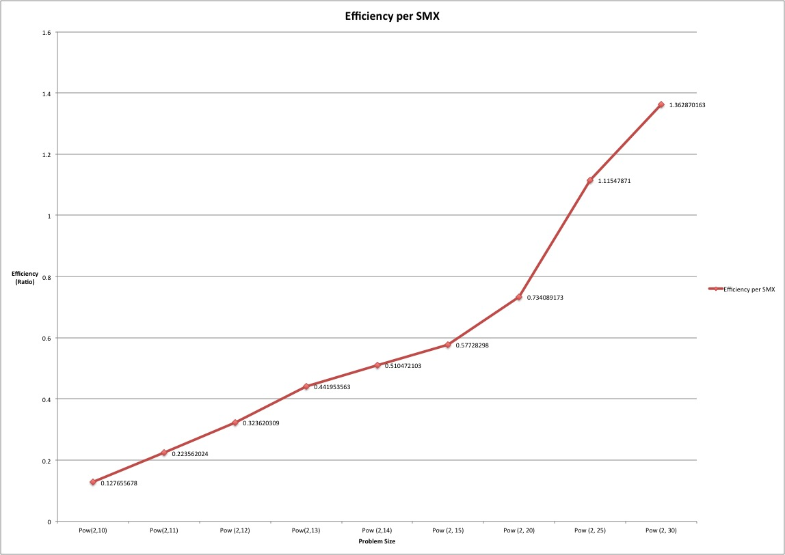
Efficiency

Slide 12

Questions?

Slide 13

Thanks!

