Slide 1
Housing Trends
Across five most populated towns in Connecticut
2006-2022

Slide 2
What are the most important key factors influencing property prices and sales in the market over time?
Location
Economic Conditions
Interest Rates
Supply and Demand
Population Growth
Government Policies
Construction Costs
Notes:
Location-desirability of a neighborhood proximity to amenities, schools and transportation. Economic conditions overall economic health, employment rates, income levels Interest rates- the impact on mortgage affordability Supply and Demand available properties and buyer demand Population Growth increase in pop generally leads to higher demand for housing Gov’t policies zoning, taxes Construction costs building materials and labor impacts the price of homes

Slide 3
Our analysis will reveal the following:
Did COVID-19 have an impact on the housing market
The five most populated towns in Connecticut
The assessed property value vs sales amount
The sales amount vs number of properties sold
Popular sales type
The sales ratio

Slide 4









Notes:
Zillow
Realtor.com
Redfin
OpenHousing
FHFA.gov
Trulia
US Census Bureau
Data.gov
CoreLogic
RentCast
Finding data
We gathered a list of websites that handle real estate sales and inventory data, and reviewed the information they provided to see which site would best serve our interest.

Slide 5
This data set allowed us to view specific pricing and type information needed for our analysis
Assessed Value
The dollar value a public tax assessor places on a property for tax purposes
Sales Amount/Market Value
The highest price a property could sell for on the open market
Property Type
The general category of property
Residential (living, single-family homes, condos, and townhouses)
Commercial (office buildings, hotels, restaurants)
Industrial (storage, factory, warehouses)
Land (underdeveloped, vacant, farm, ranch)
Residential Type
Real Estate zoned for living purposes for individuals or households
Single Family, Condo, Two Family, Three Family, Four Family
Notes:
We settled on Data.gov as this provided us with a large data set to work with

Slide 6
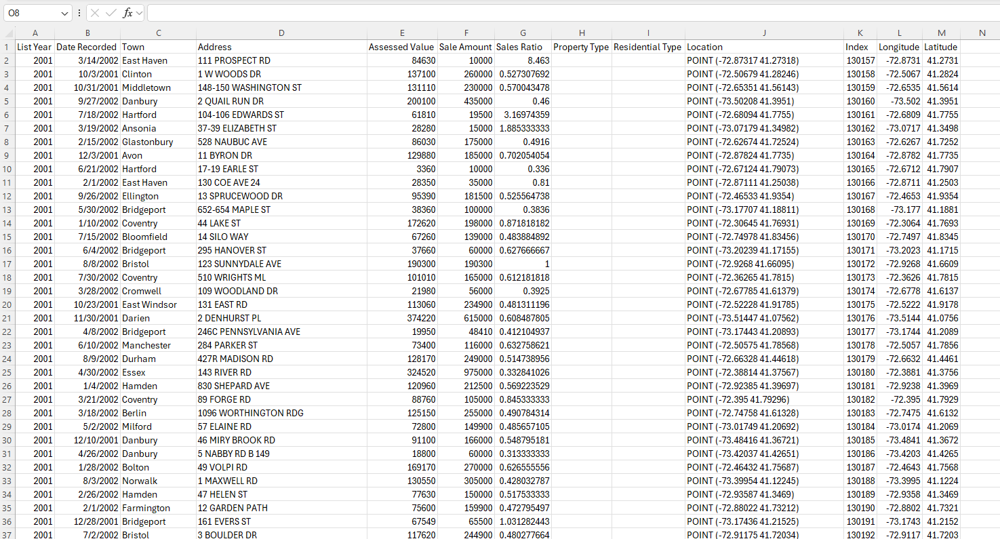
https://catalog.data.gov/dataset/real-estate-sales

Slide 7
Cleaning and Exploring the data
We were able to download our data and save it as a CSV file
We read the file into Pandas DataFrame for our first look at our data
We agreed to remove all null values from the data
Filtered data for the five most populated towns in Connecticut
Investigate relationships between variables like sales amount, assessed value, and sales ratio

Slide 8

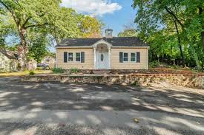

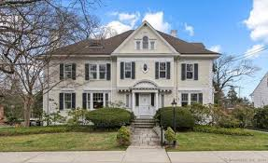
Bridgeport
Hartford
Stamford
New Haven
Waterbury

Slide 9
The analysis process
We used the data we collected to analyze market trends considered the following:
Timeframe
2006-2022
Geographical Focus
Bridgeport
Hartford
New Haven
Waterbury
Stamford
Home Prices
Sales Price vs. Assessed Value
Sales Volume
Economic Correlation

Slide 10
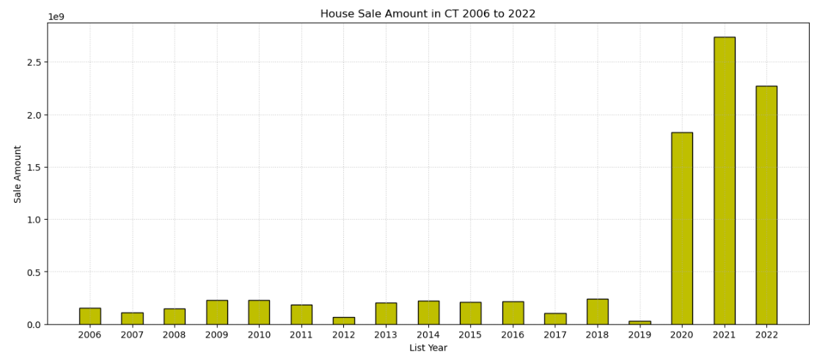
Notes:
#Analysis:
#This dataset shows the total Sale Amount for different years in the housing market. Here's an analysis of the trends:
#2006 to 2019: Fluctuations
#The data from 2006 to 2019 shows significant fluctuations in the sale amounts:
#The highest values in this period were in 2009 ($228.9M), 2010 ($231.7M), and 2014 ($221.9M), indicating a strong housing market during these years.
#In 2012, there is a sharp decline, with the lowest value of $68.8M.
#There's a significant drop again in 2019, with sales down to just $32.2M, marking a potential downturn or slowdown.
#2020 and Onwards: Drastic Increase
#2020 to 2022: Peak of COVID-19
#There is a massive surge in sales, reaching $1.83B, more than an eightfold increase from the previous years.
#This trend continues into 2021, with an even larger increase, reaching $2.74B.
#By 2022, the total sales amount decreased slightly to $2.27B, but it still remains significantly higher than any year prior to 2020.
#Key Observations:
#Prior 2020 (Pre-COVID-19):
#The sales amounts show a relatively stable but fluctuating pattern, likely reflecting normal market cycles, economic conditions, and housing demand.
#2020-2022 (COVID-19):
#The enormous increase starting in 2020 suggests a trend shift, influenced by the COVID-19 pandemic.
#Housing markets in many regions saw massive demand spikes, high demand for space, and shifts in living preferences leading to sharp price increases.
#The continuing high values in 2021 and 2022 suggest that the effects were not just temporary but may have led to a sustained shift in the market.

Slide 11
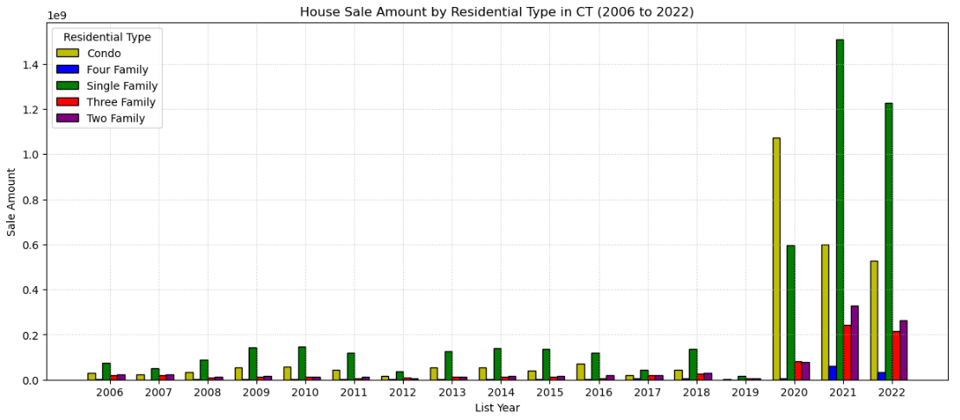
Notes:
#Analysis
# The clustered bar graph illustrates the total sales amounts for different residential types.
#Steady Growth Until 2019 and a Big Surge from 2020 Onwards:
#There’s an explosive increase starting in 2020. This is a dramatic change, with the total sales amount in 2020 reaching over $1.8 billion,
#far exceeding previous years.
#2021 is especially noteworthy with a total sales amount of over $2.7 billion, the highest across all the years.
#2022 remains high at $2.26 billion, though slightly less than 2021.
#Residential Type Breakdown
#a) Single Family Homes:
#Single Family homes show a steady increase from 2006 ($75.8M) to 2016 ($118.1M), followed by an enormous jump in 2020 to $595.76M.
#2021 and 2022 were remarkable years for Single Family homes with sales amounts hitting $1.5 billion and $1.22 billion, respectively.
#This suggests a huge demand for Single Family homes during and after the COVID-19 pandemic,
#likely driven by factors such as people moving to suburban areas or wanting more space during lockdowns.
#b) Condos:
#Condos follow a similar pattern but exhibit more volatility:
#After some fluctuations between 2006 and 2018, the Condo market explodes in 2020, with sales reaching $1.07 billion.
#The sales remain very high in 2021 and 2022, with $599M and $528M, respectively.
#This surge in Condo sales could be due to affordability compared to Single Family homes and a shift towards more urban living as economies began to open up after lockdowns.
#c) Two Family Homes:
#This category shows more stable growth but has smaller absolute numbers compared to Single Family and Condos. From 2006 ($24.3M) to 2019 ($6.76M), the numbers are generally low.
#A significant increase is seen from 2020 onwards, with $79.18M in 2020 and $329.3M in 2021. This reflects a likely investment-driven interest in multi-family homes, as they can provide rental income.
#d) Three Family and Four Family Homes:
#Similar to Two Family homes, these categories have lower sales amounts in the early years but pick up starting in 2020.
#For example, Three Family homes jump from $5.15M in 2019 to $79.96M in 2020.
#Four Family homes also show a rise from $455k in 2019 to $4.89M in 2020.
#These housing types are generally smaller contributors, but the surge in multi-family homes likely reflects investors looking for income-generating properties.
#Key Factors Driving the Trends:
#COVID-19 Impact: The pandemic likely triggered a real estate boom, with people seeking more space or moving away from cities into suburban homes.
#Low-interest rates and remote work arrangements may have fueled these changes.
#Investment in Multi-Family Homes: The jump in Two, Three, and Four Family homes starting in 2020 may indicate that investors sought out these properties
#for their rental income potential, particularly as economic uncertainty rose.
#Urban Housing Trends: Condos also saw massive sales growth, suggesting that urban housing didn't lose its appeal entirely, possibly due to its affordability
#or as buyers capitalized on lower prices.

Slide 12
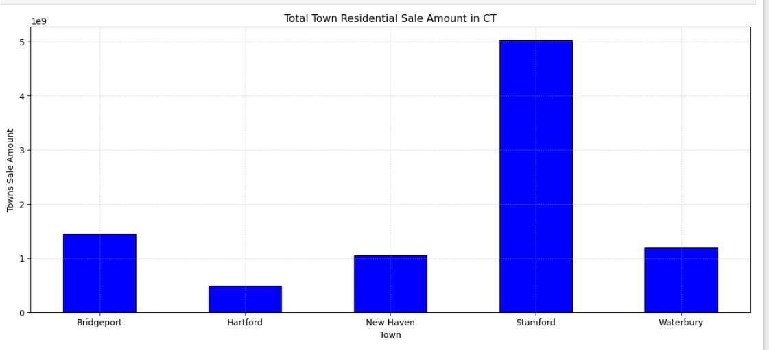
Notes:
We were able to locate the top five cities based on the total sales amount over the last 17 years, Bridgeport $1,445,758,040 Hartford $489,947,393 New Haven $1,052,929,361 Stamford $5,024,249,996 Waterbury $1,190,423,658
# Analysis:
# Stamford is the clear leader, with significantly higher property sales, likely due to high demand and market economics.
# Bridgeport, New Haven, and Waterbury show moderately strong markets, each exceeding $1 billion in sales.
# Hartford lags behind with less than half a billion in sales, possibly reflecting different market dynamics.
# Stamford is the clear leader, with significantly higher property sales, likely due to high demand and market economics.
# Bridgeport, New Haven, and Waterbury show moderately strong markets, each exceeding $1 billion in sales.
# Hartford lags behind with less than half a billion in sales, possibly reflecting different market dynamics.

Slide 13
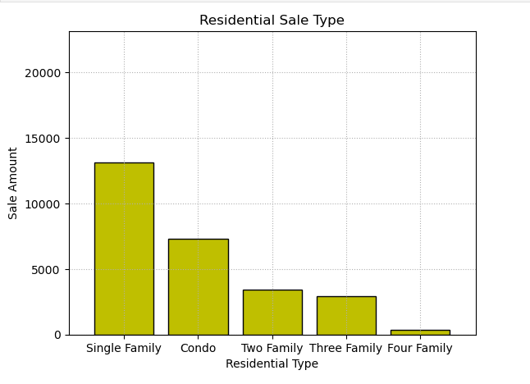
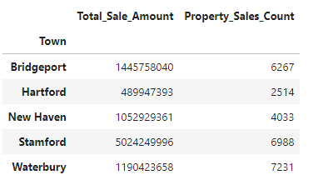
Properties sold by residential type

Slide 14
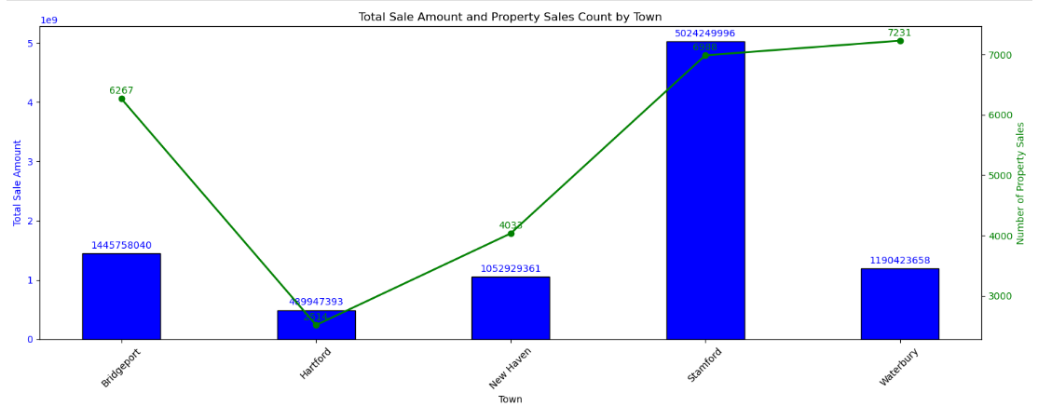
Total Sale Amount and Property Sales Count by Town
Notes:
Stamford
It not only has high volume of transactions but also potentially higher property value.
It likely represents a more affluent area or one with significant high-value residential properties.
Waterbury
Despite having the highest property sales count (7231), it has a lower total sale amount of $1.19 billion compared to Stamford.
It likely represents that it has the lowest mean property prices.
Hartford
Despite being the state capital, has the lowest sales amount ($489.95 million) and fewest property sales (4033).
It likely indicates potentially less demand or lower housing activity compared to the other towns.
New Haven and Bridgeport
They have more transactions but at lower price points.

Slide 15
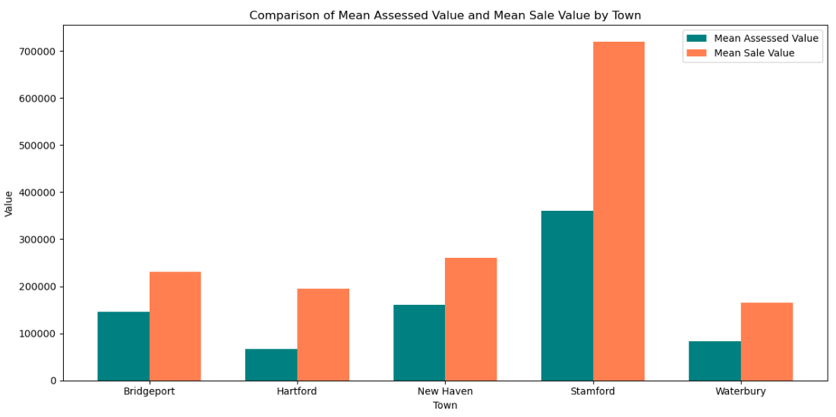
Notes:
Bridgeport:
Difference (Sale - Assessed): $85,548
The mean sale price is significantly higher than the assessed value, indicating that properties are selling for much more than their tax-assessed values.
Hartford:
Difference (Sale - Assessed): $127,594
The mean sale value is almost three times the assessed value, suggesting a substantial underestimation of property values by the local government.
New Haven:
Difference (Sale - Assessed): $100,685
New Haven's mean sale value is about 1.6 times the assessed value, indicating that properties tend to sell for much more than their assessed value.
Stamford:
Difference (Sale - Assessed): $359,105
Stamford stands out with a mean sale value that's double the assessed value. This reflects a significant gap between assessed and market values, with Stamford properties fetching far higher prices.
Waterbury:
Difference (Sale - Assessed): $82,042
Waterbury follows a similar pattern, with the mean sale value being double the assessed value.

Slide 16
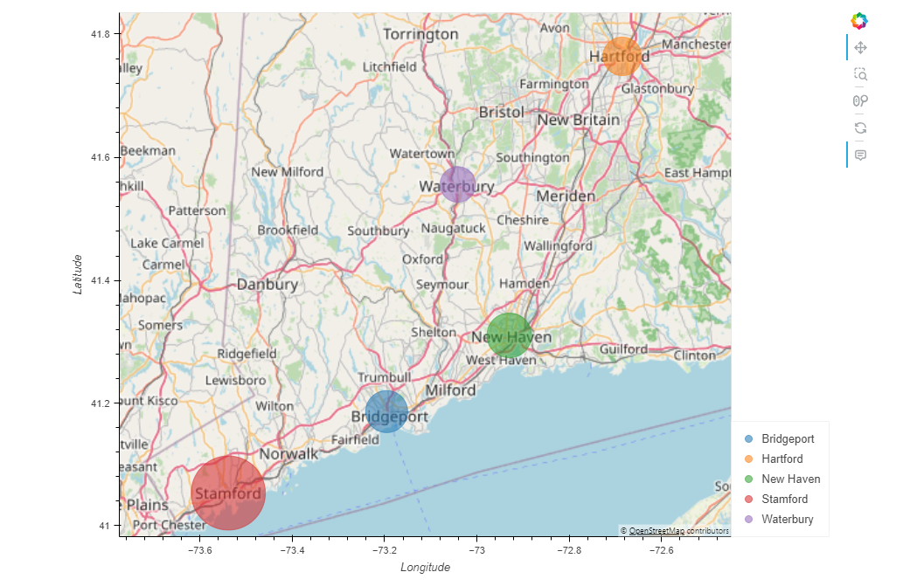
Geographical Scatter Plot
Notes:
Stamford stands out with the highest property values with an average sale amount over $700,000, likely due to its proximity to New York City,
making it attractive for high-income buyers.
Waterbury and Hartford have the lowest property values with average sales prices around $160,000 and $190,000.
These towns could be more affordable to home buyers looking for low-cost housing.
Bridgeport and New Haven fall into the middle category with average sales amounts around $230,000 and $260,000.
These areas may offer a balance between cost and coastal location.

Slide 17
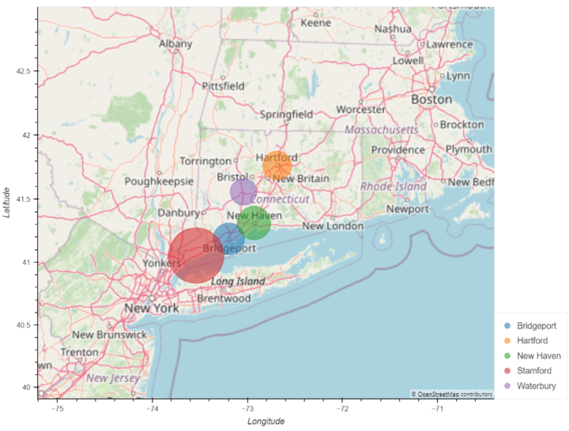

Slide 18
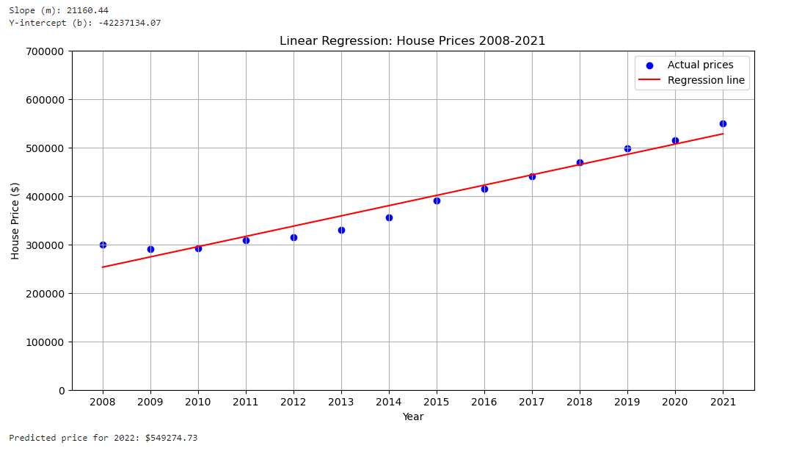
Notes:
Slope (m): 21160.44
For each year, the average house price increases by $21,160A positive slope indicates a general upward trend of property prices over the years.
Y-intercept (b): -42237134.07
This value indicates that, if we extend the graph backwards to point 0, the value of the property is expected to be $42,237,134
This may not be the practical representation of a property value since it is negative.
Predicted price for 2022: $549274.73
Based on the upward trend, the predicted price of a property in 2023 is expected to be around $549,274

Slide 19


