Slide 1
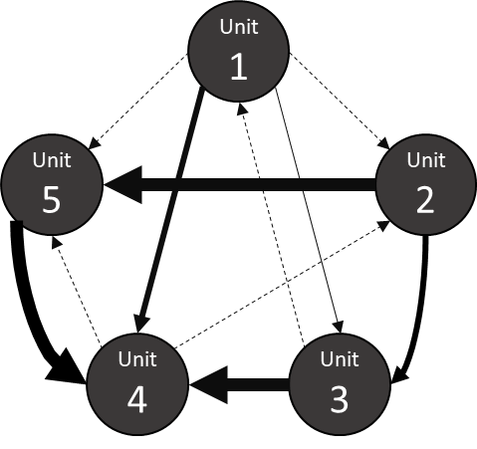

Outcome
Reciprocal
Social
Task
Skill
Workflow
Resource
Vertical
Self-Construal
Goal
Outcome
Syntactic
Logical
Logical
Goal
Reciprocal
Social
Task
Skill
Workflow
Resource
Syntactic
Vertical
ICI
Self-Construal

Slide 2
Outcome
Logical
Goal
Prior Literature
Social
Task
Workflow
Resource
Skill
Vertical
Self-Construal

