Slide 1
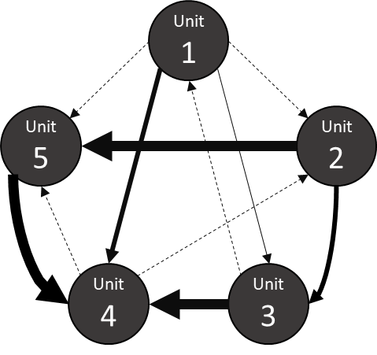
Interdependence Form
Reciprocal
Social
Task
Skill
Workflow
Resource
Vertical
Self-Construal
Goal
Outcome
Syntactic
Logical
ICI

Slide 2

Reciprocal | Social | Task | Skill | Workflow | Resource | Vertical | Self-Construal | Goal | Outcome | Syntactic | Logical
ICI

Slide 3
Outcome
Task
Logical
Workflow
Prior Literature
Goal
Resource
Social
Skill
Vertical
Self-Construal
Reciprocal
Social
Task
Skill
Workflow
Resource
Vertical
Self-Construal
Goal
Outcome
Syntactic
Logical
Dependence Network
Approach
Procedure

Slide 4
Outcome
Logical
Goal
Reciprocal
Social
Current Literature
Task
Skill
Dependence Network Approach
Workflow
Reciprocal
Social
Task
Skill
Workflow
Resource
Vertical
Self-Construal
Goal
Outcome
Syntactic
Logical
Resource
Syntactic
Vertical
Self-Construal

