Slide 1
Simple Example
ζ
γ₁₁ is constrained to 1.00 for simplicity
What is the value of the chi-square?
γ₁₁
X₁
Y₁

Slide 2
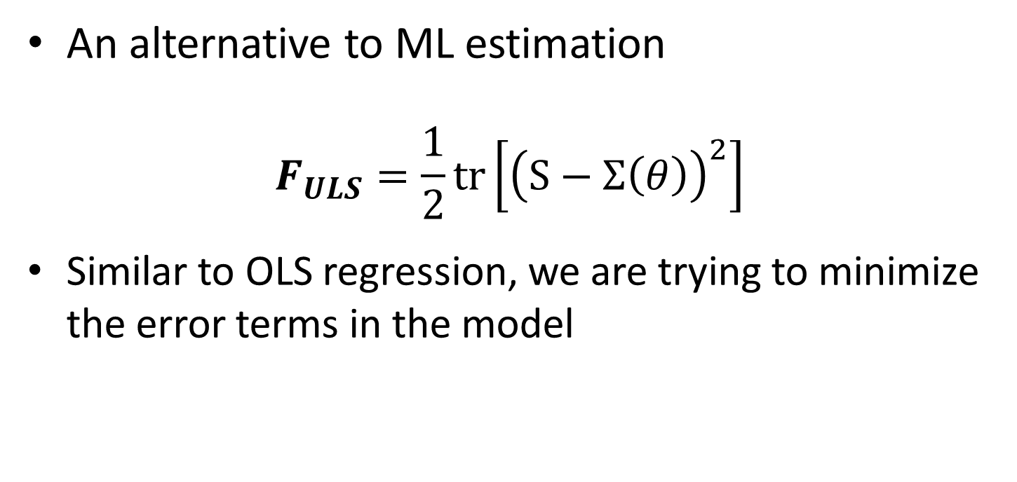
Unweighted Least Squares
An alternative to ML estimation
$$F_{ULS}=\frac{1}{2}tr\left[{\left(S−Σ\left(θ\right)\right)}^{2}\right]$$
Similar to OLS regression, we are trying to minimize the error terms in the model

Slide 3
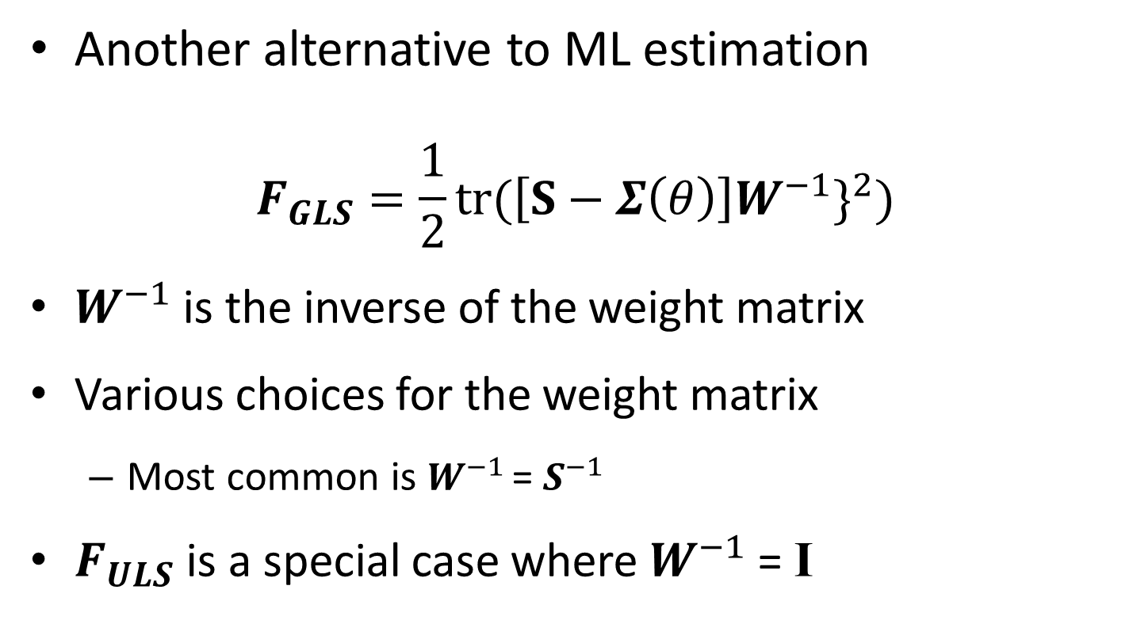
Generalized Least Squares
Another alternative to ML estimation
$$F_{GLS}=\frac{1}{2}tr{(\left[S−Σ\left(θ\right)\right]W^{−1}\}}^{2})$$
$W^{−1}$ is the inverse of the weight matrix
Various choices for the weight matrix
Most common is $W^{−1 }$= $S^{−1}$
$F_{ULS}$ is a special case where $W^{−1}$ = I

Slide 4
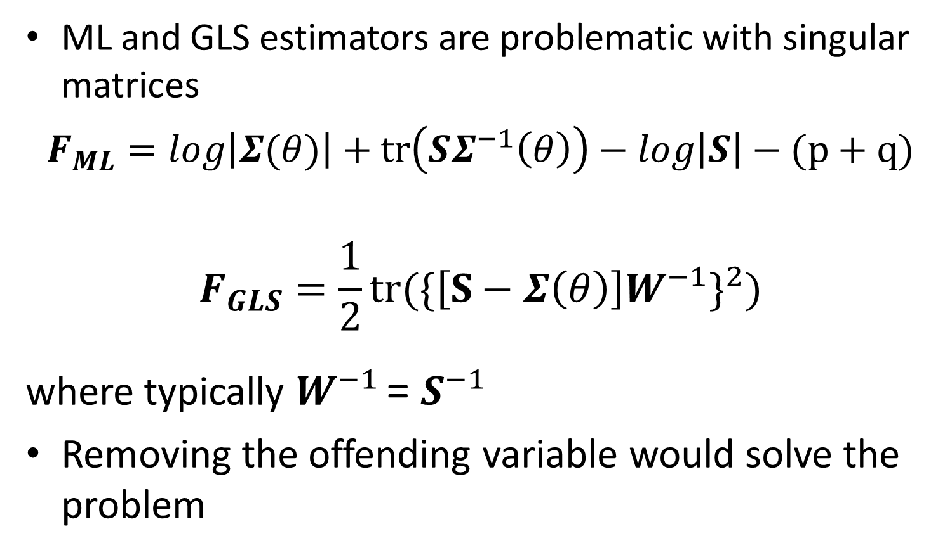
A Note about Singular Matrices
ML and GLS estimators are problematic with singular matrices
$$F_{ML}=log\left|Σ(θ)\right|+tr\left(SΣ^{−1}\left(θ\right)\right)−log\left|S\right|−(p+q)$$
$$F_{GLS}=\frac{1}{2}tr{(\{\left[S−Σ\left(θ\right)\right]W^{−1}\}}^{2})$$
where typically $W^{−1 }$= $S^{−1}$
Removing the offending variable would solve the problem

Slide 5
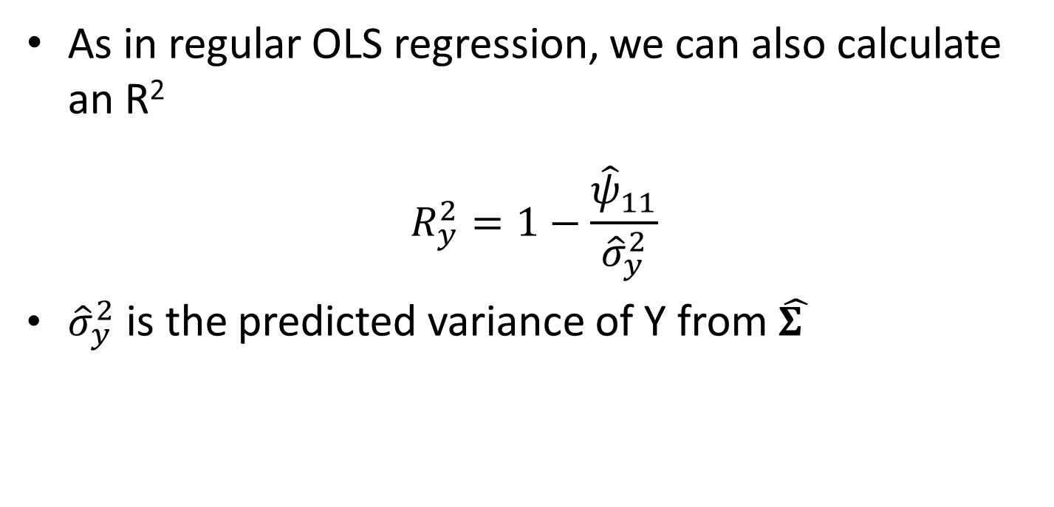
Coefficient of Determination
As in regular OLS regression, we can also calculate an R²
$$R_{y}^{2}=1−\frac{{\hat{ψ}}_{11}}{{\hat{σ}}_{y}^{2}}$$
${\hat{σ}}_{y}^{2}$ is the predicted variance of Y from $\hat{Σ }$

