Slide 2



What we know
(don’t)
^
… about being productive and finding meaning at work
dishopch@msu.edu
Cdishop
Christopher R. Dishop

Slide 3
Agenda
Selection
Teams
Methods
Meaningful
Work
Performance
Diversity

Slide 4
Agenda
What we know
Selection
Teams
Methods
Meaningful
Work
Performance
Diversity

Slide 5
Agenda
What we know
Selection
Teams
Methods
Meaningful
Work
Performance
Diversity
What we don’t know

Slide 6
Agenda
MSU | Grad School | Career Path

Slide 7
Maybe Caveat
Correlational. External validity.
Low on data, high on buzzwords. I was going to present my dissertation
But I was asked to keep it basic. So I’m keeping it basic.

Slide 8
What we know about finding meaning and being productive at work

Slide 9
MEANINGFUL WORK

Slide 10
MEANINGFUL WORK
- Engaged
- Satisfied

Slide 11
Meaningful Work
What we know

Slide 12
Meaningful Work
What we know
Job Characteristics Model

Slide 13
Meaningful Work
Autonomy
Identity
Significance
Feedback
Skill Variety
What we know

Slide 14
Meaningful Work
Autonomy
Identity
Significance
Feedback
Skill Variety
What we know

Slide 15
Meaningful Work
Autonomy
Identity
Significance
Feedback
Skill Variety
What we know

Slide 16
Meaningful Work
Autonomy
Identity
Significance
Feedback
Skill Variety
What we know

Slide 17
Meaningful Work
Autonomy
Identity
Significance
Feedback
Skill Variety
What we know

Slide 18
Meaningful Work
Autonomy
Identity
Significance
Feedback
Skill Variety
What we know

Slide 19
Meaningful Work
Autonomy
Identity
Significance
Feedback
Skill Variety
Uniquely Valuable
What we know

Slide 20
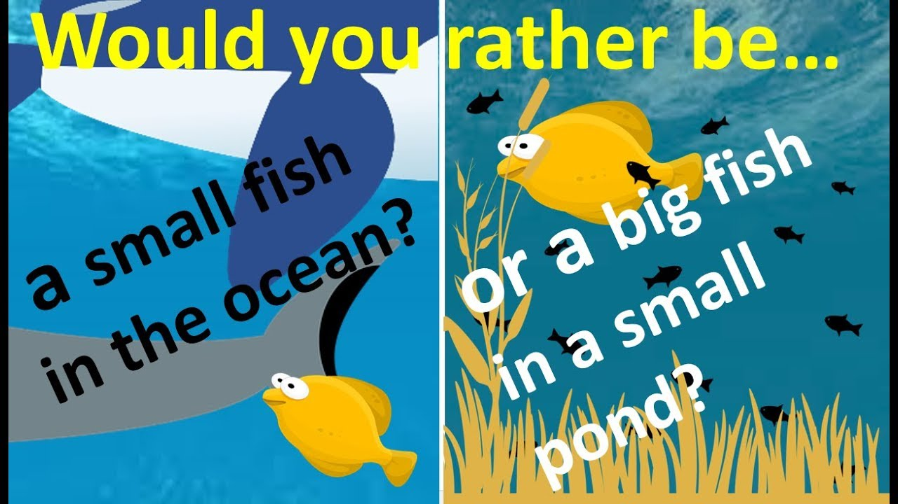
Meaningful Work
Autonomy
Identity
Significance
Feedback
Skill Variety
Uniquely Valuable
What we know

Slide 21
Meaningful Work
What we know
☹️

Slide 22
Meaningful Work
Follow your passion
What we know
☹️

Slide 23
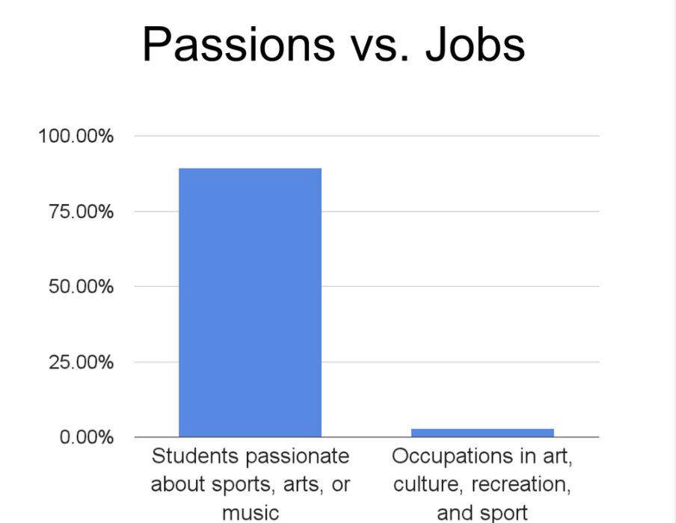
Meaningful Work
Follow your passion
What we know
☹️

Slide 24
Meaningful Work
Follow your passion
What we know
☹️
“We are all passionate about music, art, sex, and sports. There are no jobs in those industries.” - Freakonomics

Slide 25
Meaningful Work
Follow your passion
Commute time
What we know
☹️
☹️

Slide 26
Meaningful Work
What we don’t know

Slide 27
Meaningful Work
Limits
Technology & Social Media
What we don’t know

Slide 28
Individual Performance & Career Success

Slide 29
Individual Performance & Career Success
- Effective
- Ladder

Slide 30
Individual Success
What we know
Notes:
Agent. Environment.
Self Regulation.
Sklls – learning, writing, communicating

Slide 31

Individual Success
What we know
Notes:
Self regulation. Connects person and environment. Something I study. What is the link between someone performing, the feedback he gets from the envioronment, and so on.

Slide 32
Individual Success
What we know
Cognitive Ability
Notes:
Self regulation. Connects person and environment. Something I study. What is the link between someone performing, the feedback he gets from the envioronment, and so on.

Slide 33
Individual Success
What we know
Cognitive Ability
Assertive
Optimism
Conscientiousness
Notes:
Self regulation. Connects person and environment. Something I study. What is the link between someone performing, the feedback he gets from the envioronment, and so on.

Slide 34
Individual Success
What we know
Cognitive Ability
Assertive
Optimism
Conscientiousness
Learning, Writing, Communicating
Notes:
Self regulation. Connects person and environment. Something I study. What is the link between someone performing, the feedback he gets from the envioronment, and so on.

Slide 35
Individual Success
What we know
Cognitive Ability
Assertive
Optimism
Conscientiousness
Learning, Writing, Communicating
Parents
Social Support
Notes:
Self regulation. Connects person and environment. Something I study. What is the link between someone performing, the feedback he gets from the envioronment, and so on.

Slide 36
Individual Success
What we know
Human Capital Investments
Cognitive Ability
Assertive
Optimism
Conscientiousness
Learning, Writing, Communicating
Parents
Social Support
Notes:
Self regulation. Connects person and environment. Something I study. What is the link between someone performing, the feedback he gets from the envioronment, and so on.

Slide 37
Individual Success
What we know
Environment
State
Notes:
Self regulation. Connects person and environment. Something I study. What is the link between someone performing, the feedback he gets from the envioronment, and so on.
Goals. Rewards

Slide 38
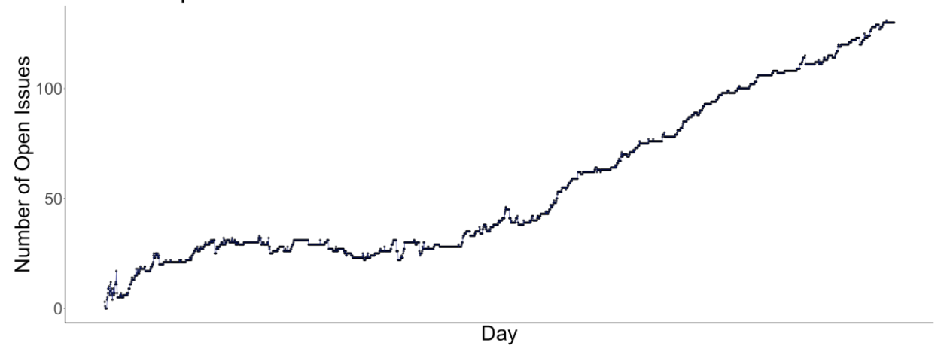
Individual Success
What we know
Notes:
Self regulation. Connects person and environment. Something I study. What is the link between someone performing, the feedback he gets from the envioronment, and so on.

Slide 39
Individual Success
What we don’t know
Notes:
Self regulation. Connects person and environment. Something I study. What is the link between someone performing, the feedback he gets from the envioronment, and so on.

Slide 40
Individual Success
Translating
What we don’t know

Slide 41
Individual Success
Translating (Scientist Practitioner Gap)
Protean & Boundaryless
What we don’t know

Slide 42
Team Performance

Slide 43
Team Performance
- Effective

Slide 44
TRANSITION HEADLINE
1
Let’s start with the first set of slides

Slide 45
Quotations are commonly printed as a means of inspiration and to invoke philosophical thoughts from the reader.

Slide 46
THIS IS A SLIDE TITLE
Here you have:
A list of items
And some text
But remember not to overload your slides with content
Your audience will listen to you or read the content, but won’t do both.

Slide 47
What we know
(don’t)
^
… about being productive and finding meaning at work
dishopch@msu.edu
Cdishop
Christopher R. Dishop

Slide 48
YOU CAN ALSO SPLIT YOUR CONTENT
White
Is the color of milk and fresh snow, the color produced by the combination of all the colors of the visible spectrum.
Black
Is the color of ebony and of outer space. It has been the symbolic color of elegance, solemnity and authority.

Slide 49
IN TWO OR THREE COLUMNS
Yellow
Is the color of gold, butter and ripe lemons. In the spectrum of visible light, yellow is found between green and orange.
Blue
Is the colour of the clear sky and the deep sea. It is located between violet and green on the optical spectrum.
Red
Is the color of blood, and because of this it has historically been associated with sacrifice, danger and courage.

Slide 50
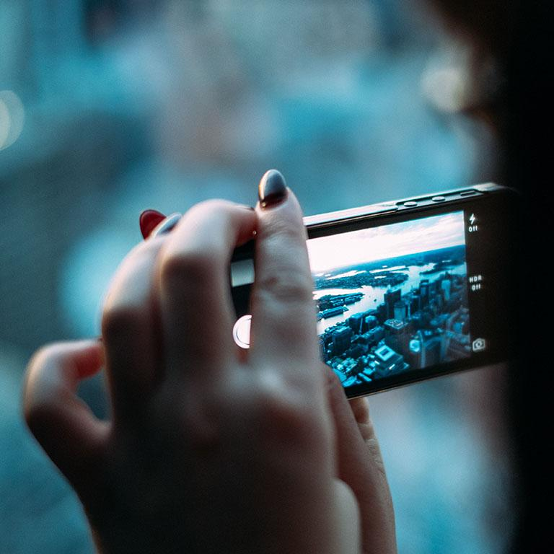
A PICTURE IS WORTH A THOUSAND WORDS
A complex idea can be conveyed with just a single still image, namely making it possible to absorb large amounts of data quickly.

Slide 51

WANT BIG IMPACT?
Use big image.

Slide 52
USE CHARTS TO EXPLAIN YOUR IDEAS
White
Gray
Black

Slide 53
AND TABLES TO COMPARE DATA
 | A | B | C
Yellow | 10 | 20 | 7
Blue | 30 | 15 | 10
Orange | 5 | 24 | 16

Slide 54
MAPS
our office

Slide 55
89,526,124
Whoa! That’s a big number, aren’t you proud?

Slide 56
89,526,124$
185,244 users
100%
That’s a lot of money
And a lot of users
Total success!

Slide 57
OUR PROCESS IS EASY
First
Second
Last

Slide 58
LET’S REVIEW SOME CONCEPTS
Yellow
Is the color of gold, butter and ripe lemons. In the spectrum of visible light, yellow is found between green and orange.
Blue
Is the colour of the clear sky and the deep sea. It is located between violet and green on the optical spectrum.
Red
Is the color of blood, and because of this it has historically been associated with sacrifice, danger and courage.
Yellow
Is the color of gold, butter and ripe lemons. In the spectrum of visible light, yellow is found between green and orange.
Blue
Is the colour of the clear sky and the deep sea. It is located between violet and green on the optical spectrum.
Red
Is the color of blood, and because of this it has historically been associated with sacrifice, danger and courage.

Slide 59
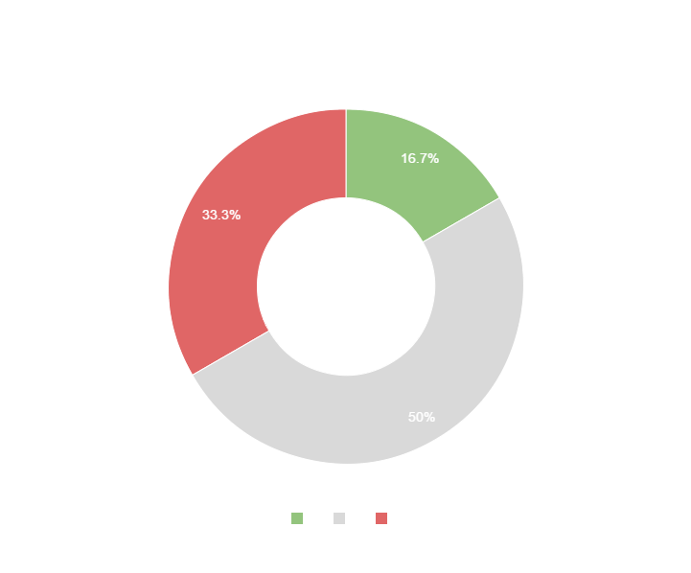
You can copy&paste graphs from Google Sheets

Slide 60
Place your screenshot here
MOBILE PROJECT
Show and explain your web, app or software projects using these gadget templates.

Slide 61
Place your screenshot here
TABLET PROJECT
Show and explain your web, app or software projects using these gadget templates.

Slide 62
Place your screenshot here
DESKTOP PROJECT
Show and explain your web, app or software projects using these gadget templates.

Slide 63
Thanks!
ANY QUESTIONS?
You can find me at
@username
user@mail.me

Slide 64
CREDITS
Special thanks to all the people who made and released these awesome resources for free:
Presentation template by SlidesCarnival
Photographs by Unsplash

Slide 65
PRESENTATION DESIGN
This presentations uses the following typographies and colors:
Titles & body copy: Quicksand
You can download the fonts on this page:
https://www.fontsquirrel.com/fonts/quicksand
Dark gray #2e3037
Aqua #39c0ba
Salmon #f35b69
Blue #6d9eeb
You don’t need to keep this slide in your presentation. It’s only here to serve you as a design guide if you need to create new slides or download the fonts to edit the presentation in PowerPoint®

Slide 66
SlidesCarnival icons are editable shapes.
This means that you can:
Resize them without losing quality.
Change line color, width and style.
Isn’t that nice? :)
Examples:

Slide 67
Diagrams and infographics

Slide 68
Now you can use any emoji as an icon!
And of course it resizes without losing quality and you can change the color.
How? Follow Google instructions https://twitter.com/googledocs/status/730087240156643328
😉
✋👆👉👍👤👦👧👨👩👪💃🏃💑❤😂😉😋😒😭👶😸🐟🍒🍔💣📌📖🔨🎃🎈🎨🏈🏰🌏🔌🔑 and many more...

Slide 69

Free templates for all your presentation needs
For PowerPoint and Google Slides
100% free for personal or commercial use
Ready to use, professional and customizable
Blow your audience away with attractive visuals

