Slide 2
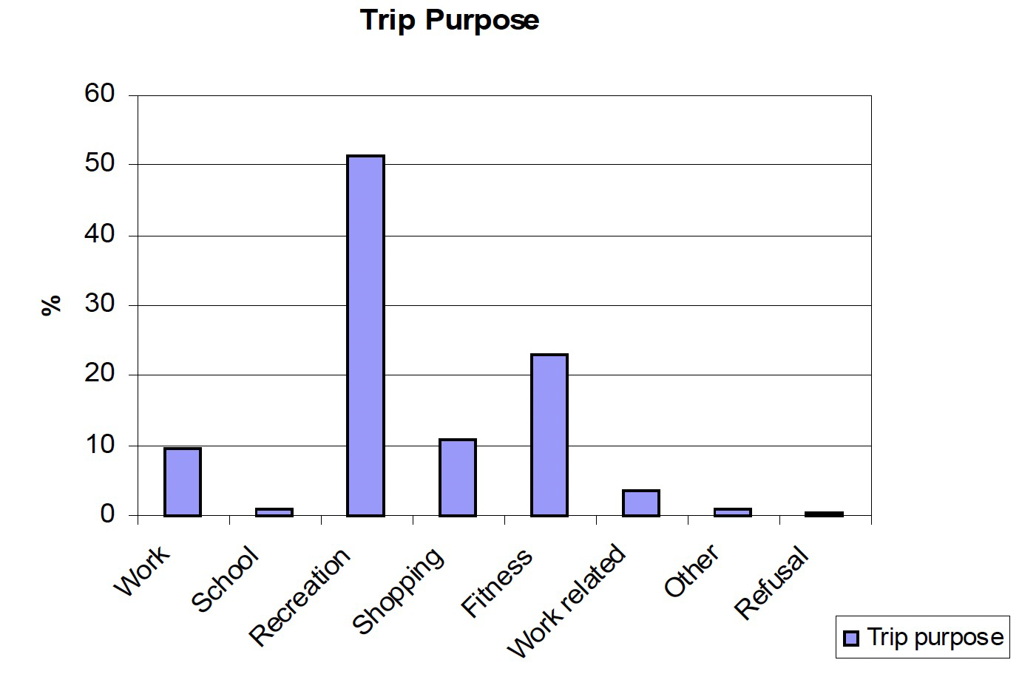
Hong Kong cycling purpose
It can be seen that over 70% of the trips were for recreation or fitness purposes. Work, work related and school trips accounted for about 14% of trips overall. It is also worth noting that, overall, of those people aged 15 and over, who knew how to cycle (but had not necessarily cycled in the past 3 months), only 3.5% had cycled to work or school in the past 3 months.
Source: Transport department cycling study

Slide 3
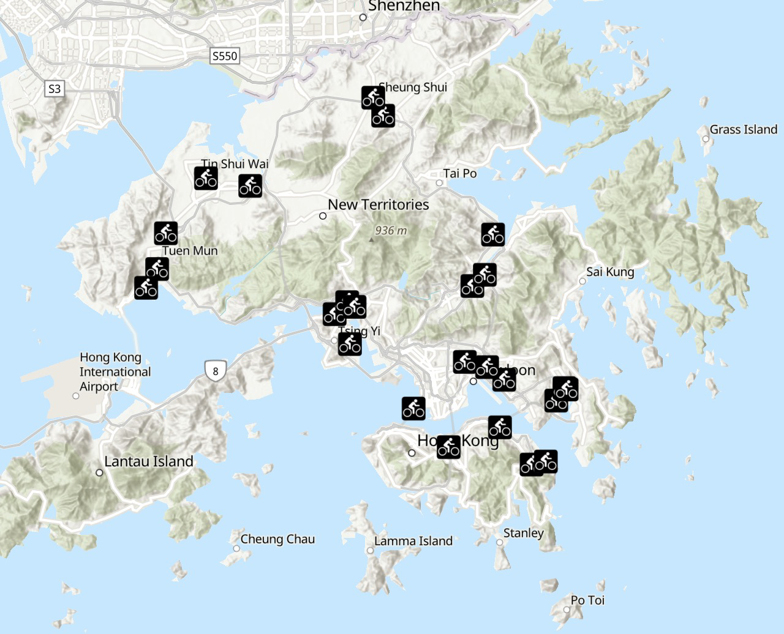
Cycling Sites in Hong Kong

Slide 4
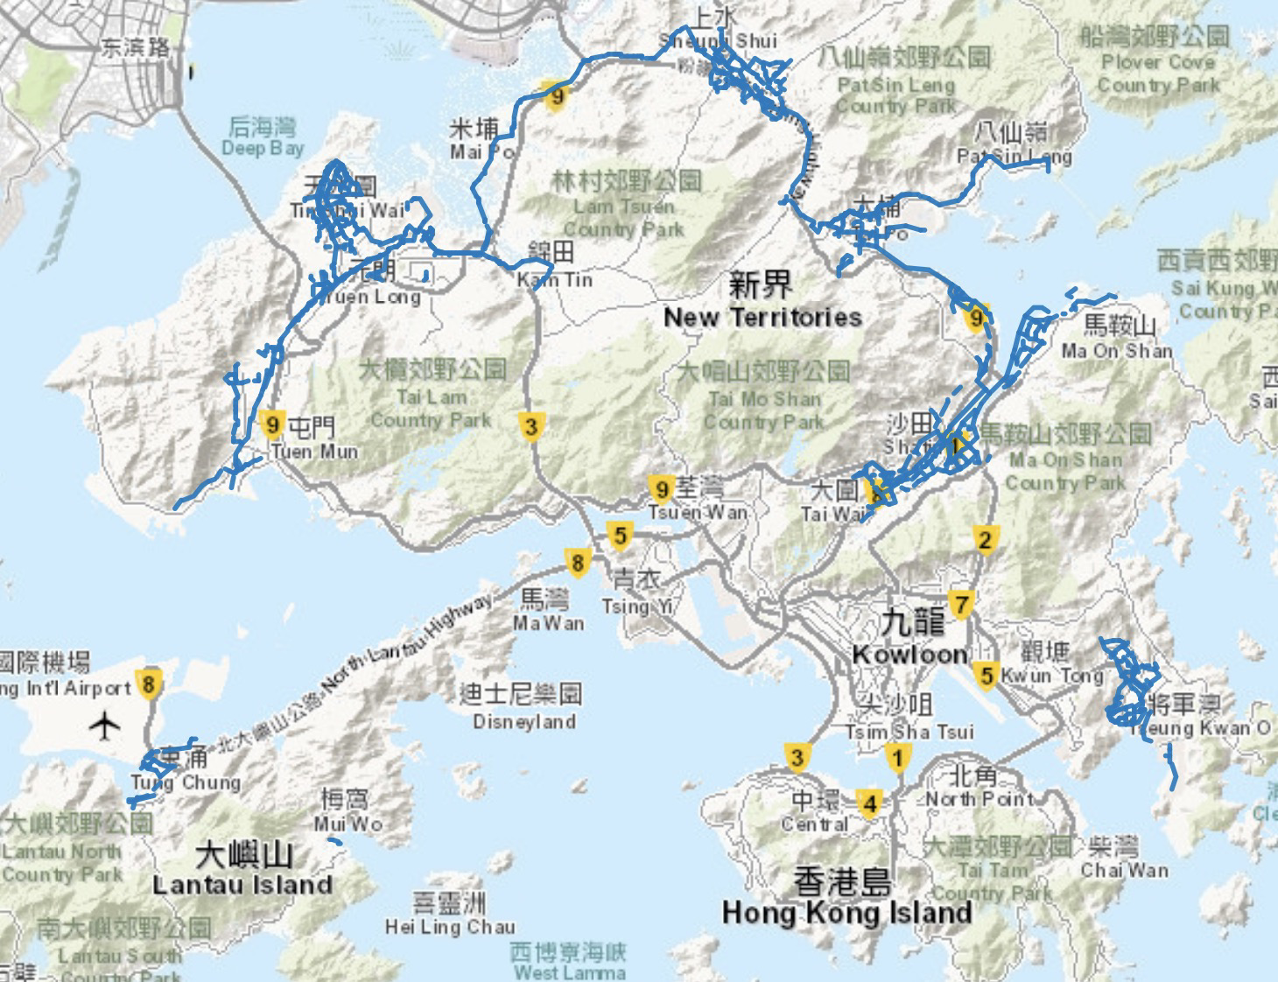
Cycle tracks in Hong Kong

Slide 5
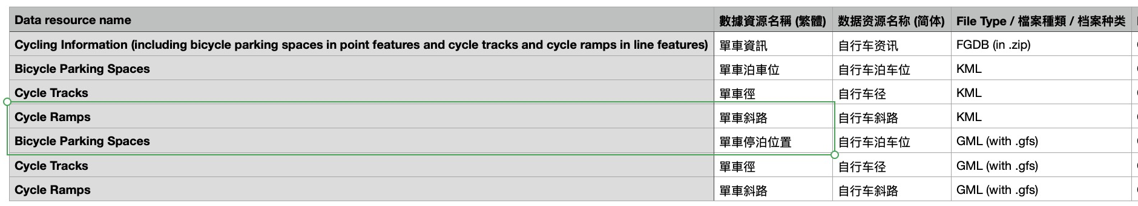

Slide 6
从香港的街景-提取街景feature->娱乐为目的的街景特征
提取出来的特征与伦敦的街景比对，选出与香港街景特征相近的街景
提取出来的街景的和娱乐/非娱乐目的的cycling pattern做比对，看他们的pattern是不是distinguishable

Slide 7
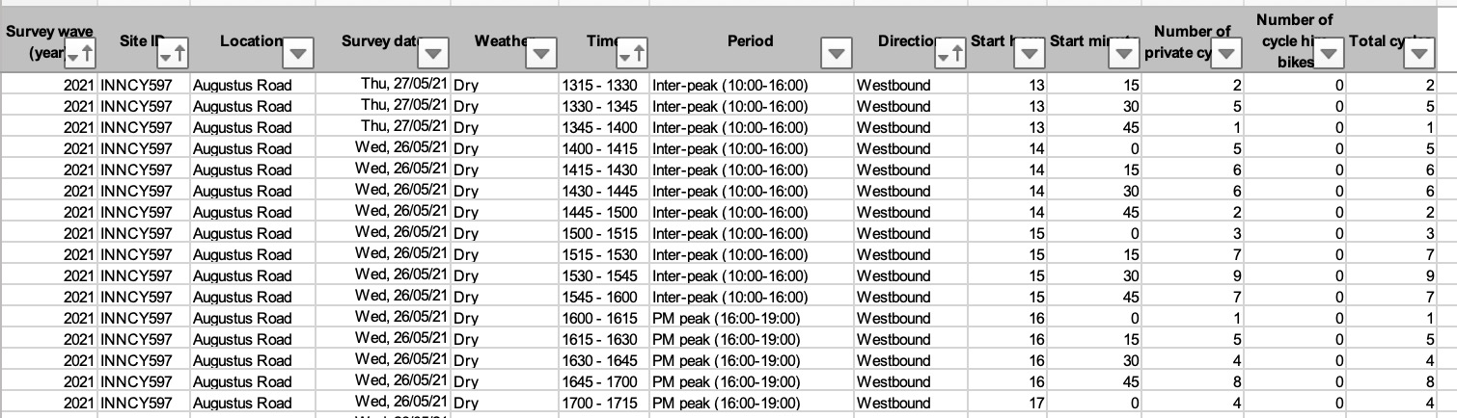
London cycling count data

