Slide 2
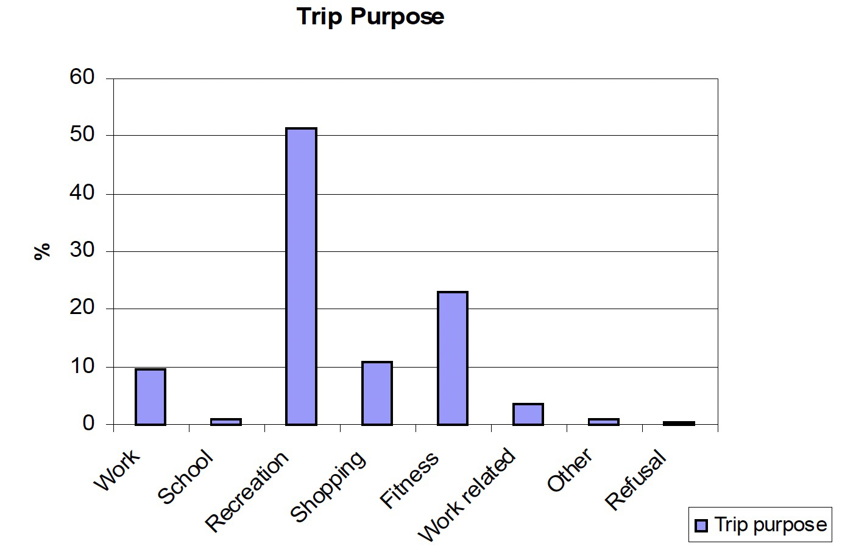
Hong Kong cycling purpose
It can be seen that over 70% of the trips were for recreation or fitness purposes. Work, work related and school trips accounted for about 14% of trips overall. It is also worth noting that, overall, of those people aged 15 and over, who knew how to cycle (but had not necessarily cycled in the past 3 months), only 3.5% had cycled to work or school in the past 3 months.
Source: Transport department cycling study

