Slide 2
Routing
The Routing is to describe how URL paths are matched to actions.
ASP.NET Core controllers use the Routing middleware to match the URLs of incoming requests and map them to actions.
.

Slide 3
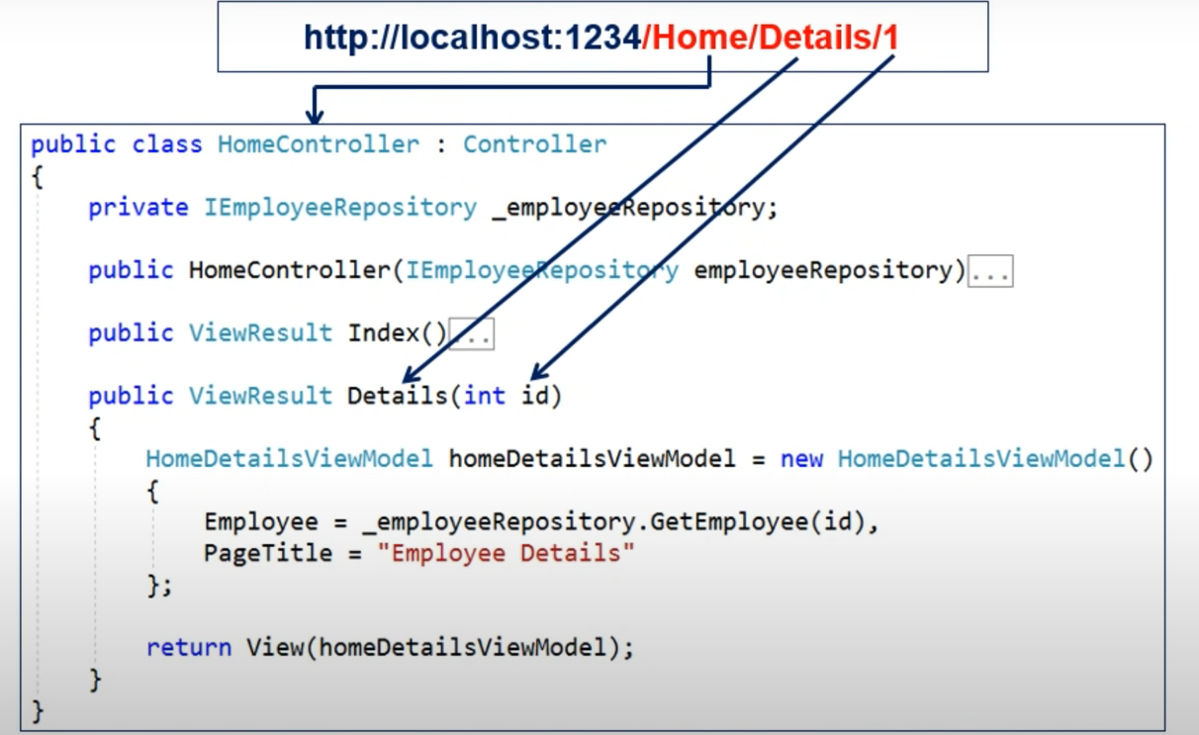
Http Request mapped to a Controller/Action

Slide 4
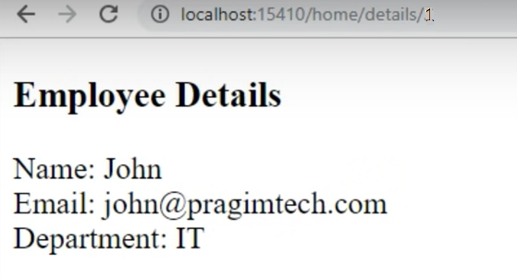

Slide 5
Routing Techniques
Conventional Routing:
app.MapControllerRoute Most apps with controllers and views use a route template as defined in Program.cs . REST APIs should use attribute routing.
Attributes Routing:
Placing a route on the controller or action makes it attribute-routed.
Actions are either conventionally-routed or attribute-routed.
Mix Routing: ASP.NET Core apps can mix the use of conventional routing and attribute routing. It's typical to use conventional routes for controllers serving HTML pages for browsers, and attribute routing for controllers serving REST APIs.

Slide 6
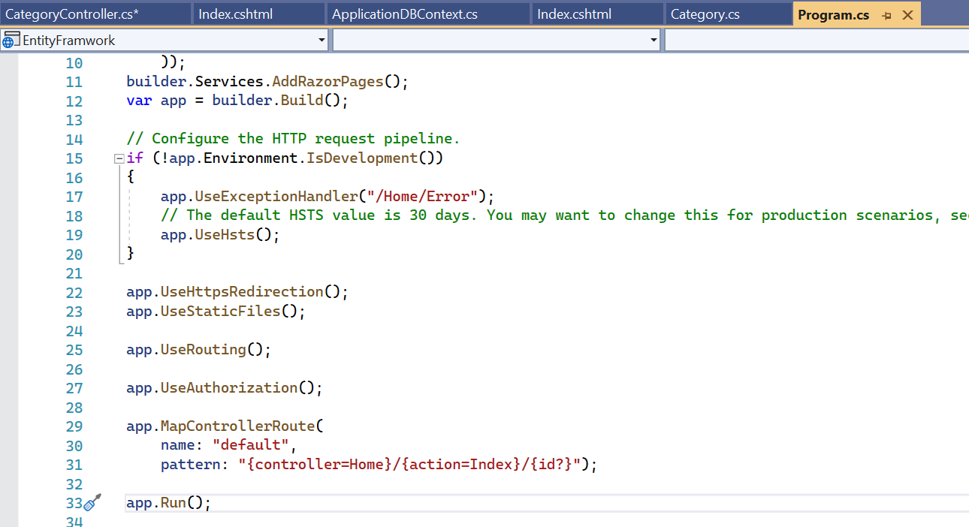
How the Default Routing Work?

Slide 7

/*app.MapControllerRoute( name: "default", pattern: "{controller=Home}/{action=Index}/{id?}"); */

Slide 8
Multiple conventional routes
We can add multiple routes by calling MapRoute() multiple times.
This allows us to define multiple conventions or to add routes
that are dedicated to a specific action.

Slide 9
Multiple conventional routes
app.MapControllerRoute
(name: "blog",
pattern: "blog/{*article}",
defaults: new { controller = "Blog", action = "Article" });
app.MapControllerRoute
(name: "default",
pattern: "{controller=Home}/{action=Index}/{id?}");
Routes in the route collection are ordered and will be processed in the order we add them. So in this example, MVC will try the blog route before the default route.
It is always good to specify a route name while creating the routes. It gives the route a logical name so that we can use the named route for URL generation.

Slide 10
Attribute Routing
By placing a route on the controller or the action method, we can make use
of the Attribute Routing feature.
Let’s modify the Program.cs class and remove the default routes:
/*app.MapControllerRoute(
name: "default",
pattern: "{controller=Home}/{action=Index}/{id?}");*/
app.MapControllers();

Slide 11
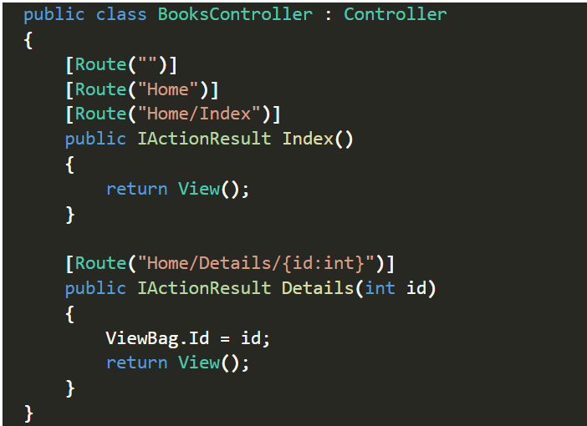
Custom attributes as routes
We can call the BooksController.Index() action by using the URL paths
/,
/Home,
or /Home/Index for
And
/Home/Details/{id} for the Details() method. When using Attribute Routing, the controller name and action method name plays no role in selecting which action method to execute.

Slide 12
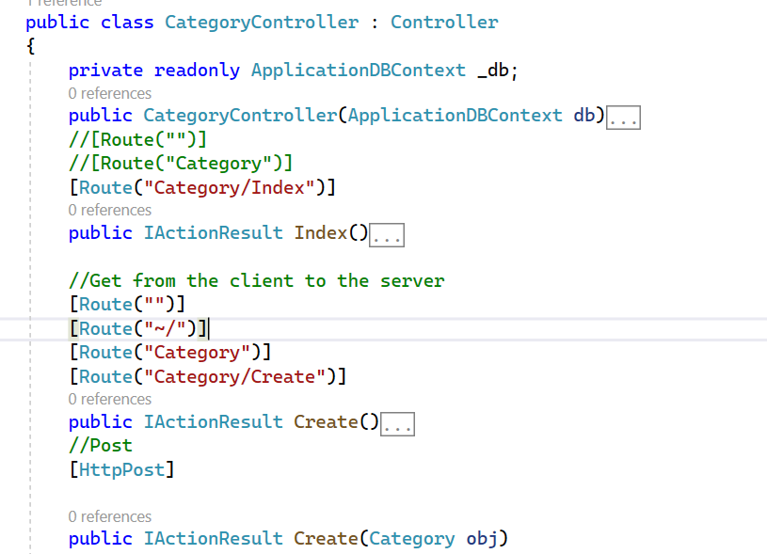
Attribute Routing

Slide 13
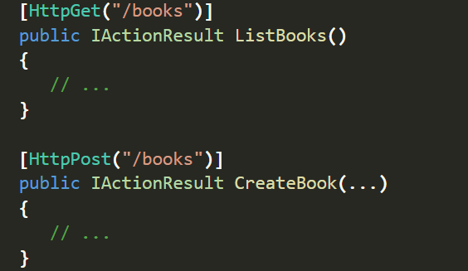
Attribute Routing
We can also use Http[Verb] attributes for Attribute Routing:
For the URL path /books, MVC will execute the ListBooks() action when the HTTP verb is GET
and CreateBook() when the HTTP verb is POST

Slide 14
Attribute routes support token replacement
Attribute routes support token replacement by enclosing a token in square-braces ([, ]).
The tokens [action], [area], and [controller]
are replaced with the values of the action name, area name, and controller name
from the action where the route is defined.

Slide 15
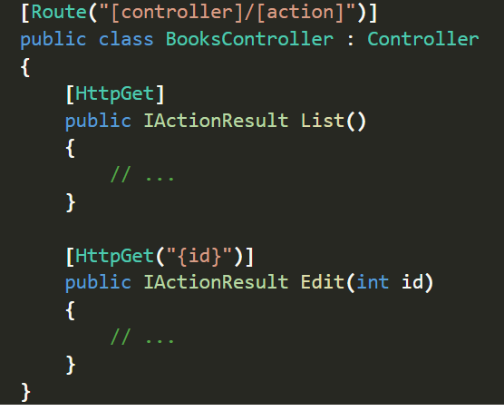
The List() action method matches the URL /Books/List and
Edit() method matches the URL /Books/Edit/{id}.
Attribute routes support token replacement

Slide 16
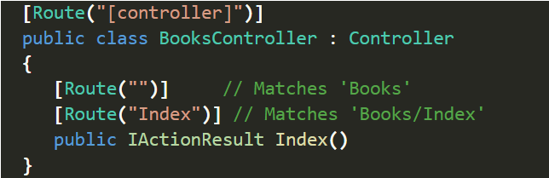
By defining two routes, the Index() method matches the URL paths:
/Books and
Books/Index.
Multiple Routes
Attribute routing supports defining multiple routes that reach the same action. The most common usage of this is to achieve the functionality of the default conventional route:

Slide 17
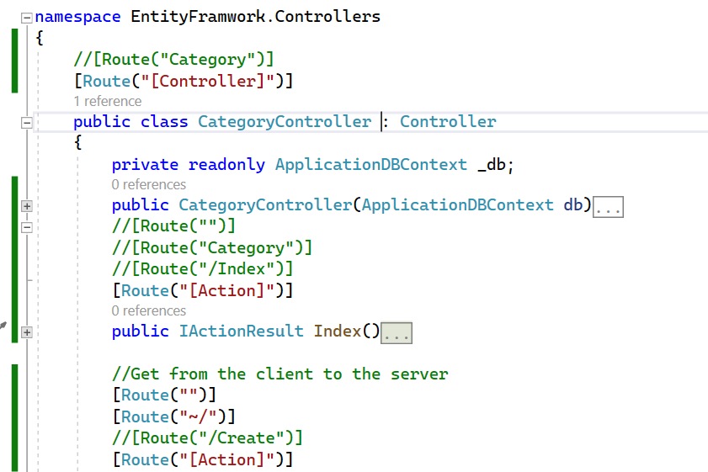
Attribut Controller

Slide 18
Attribute Routing
With Attribute Routing we use [Route] to define routes.
Route attribute can be applied on the controller or controller action Method.
Attribute Routing offer a bit more flexibilty THAN conventional routing

Slide 19
Inconvenient du callback
Lorsqu'on imbrique les fonctions de rappel ainsi «faireOperation() avec de nombreux niveaux d'imbrication »,
il devient très difficile de gérer les erreurs : il faut souvent les gérer à chaque niveau de la « pyramide » plutôt que d'avoir à gérer uniquem
C'est pour ces raisons que la plupart des API asynchrones modernes n'utilisent plus les callbacks. À la place, la programmation asynchrone en JavaScript utilise les promessesent les erreurs au niveau le plus haut.

Slide 20
TP
Creat Model/DBContext
Create Two Controllers
Apply Conventionnel Routing with two or multiples routes
Apply Attribute Routing

