Slide 1
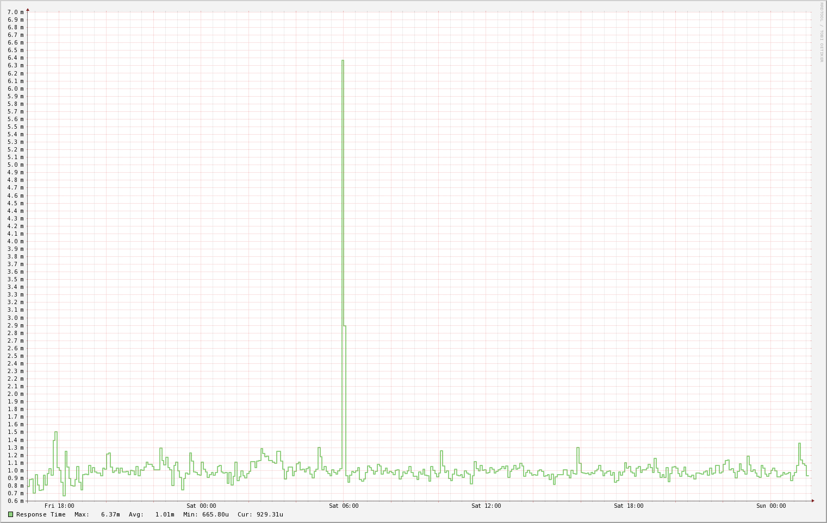
2017 10 30
Koruna

Slide 2
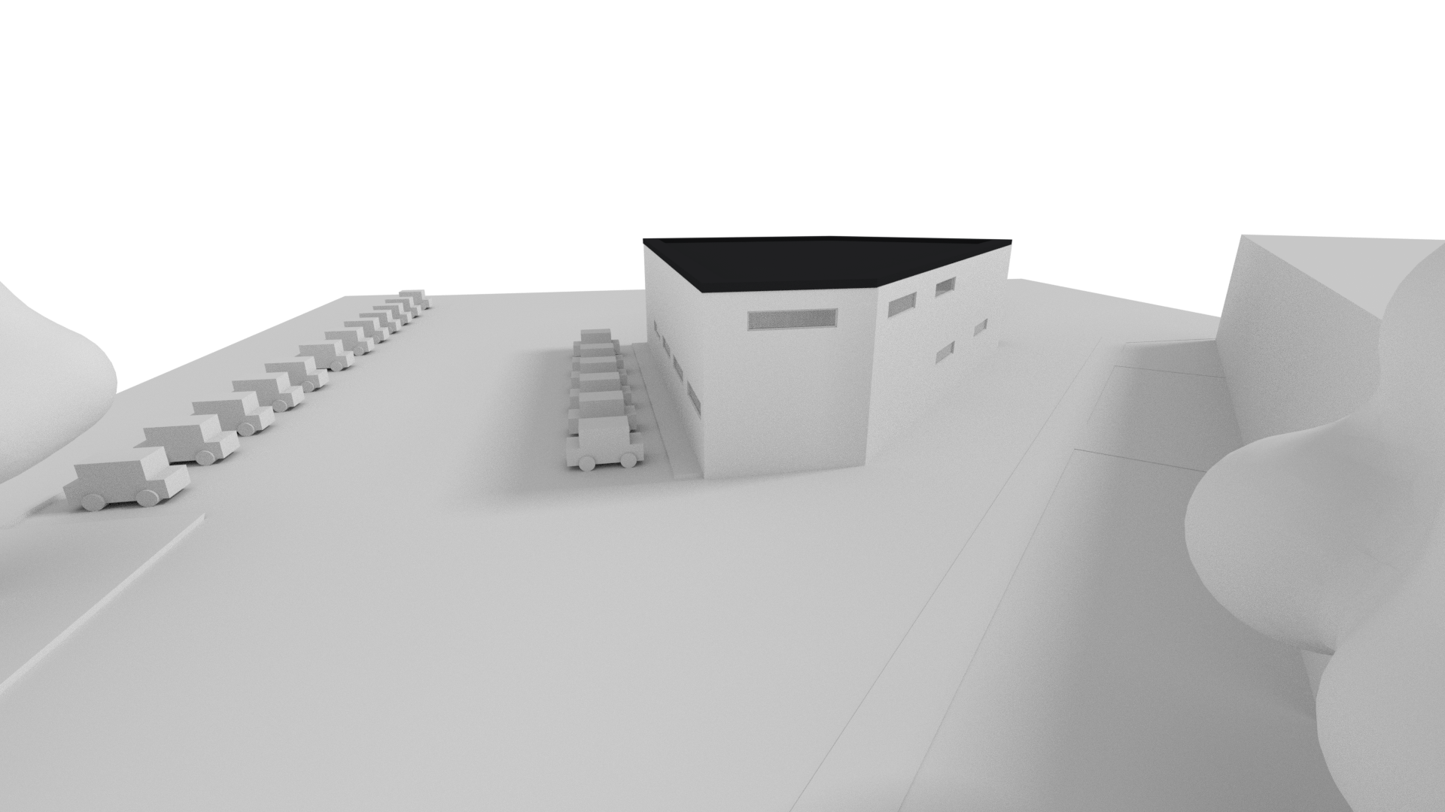
2017 10 30
2017 10 30

Slide 3
Master Title
Title 1
Title 2
Title 3
Title 4

