Slide 1
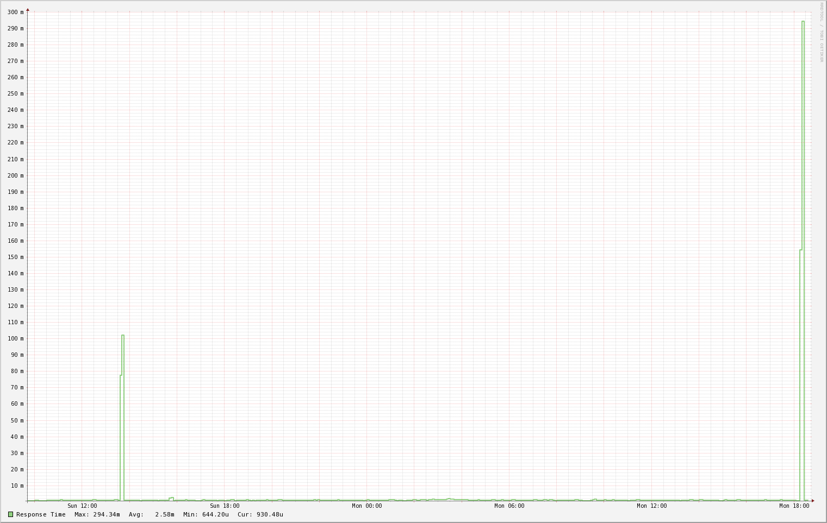
2017 11 28
Koruna

Slide 2
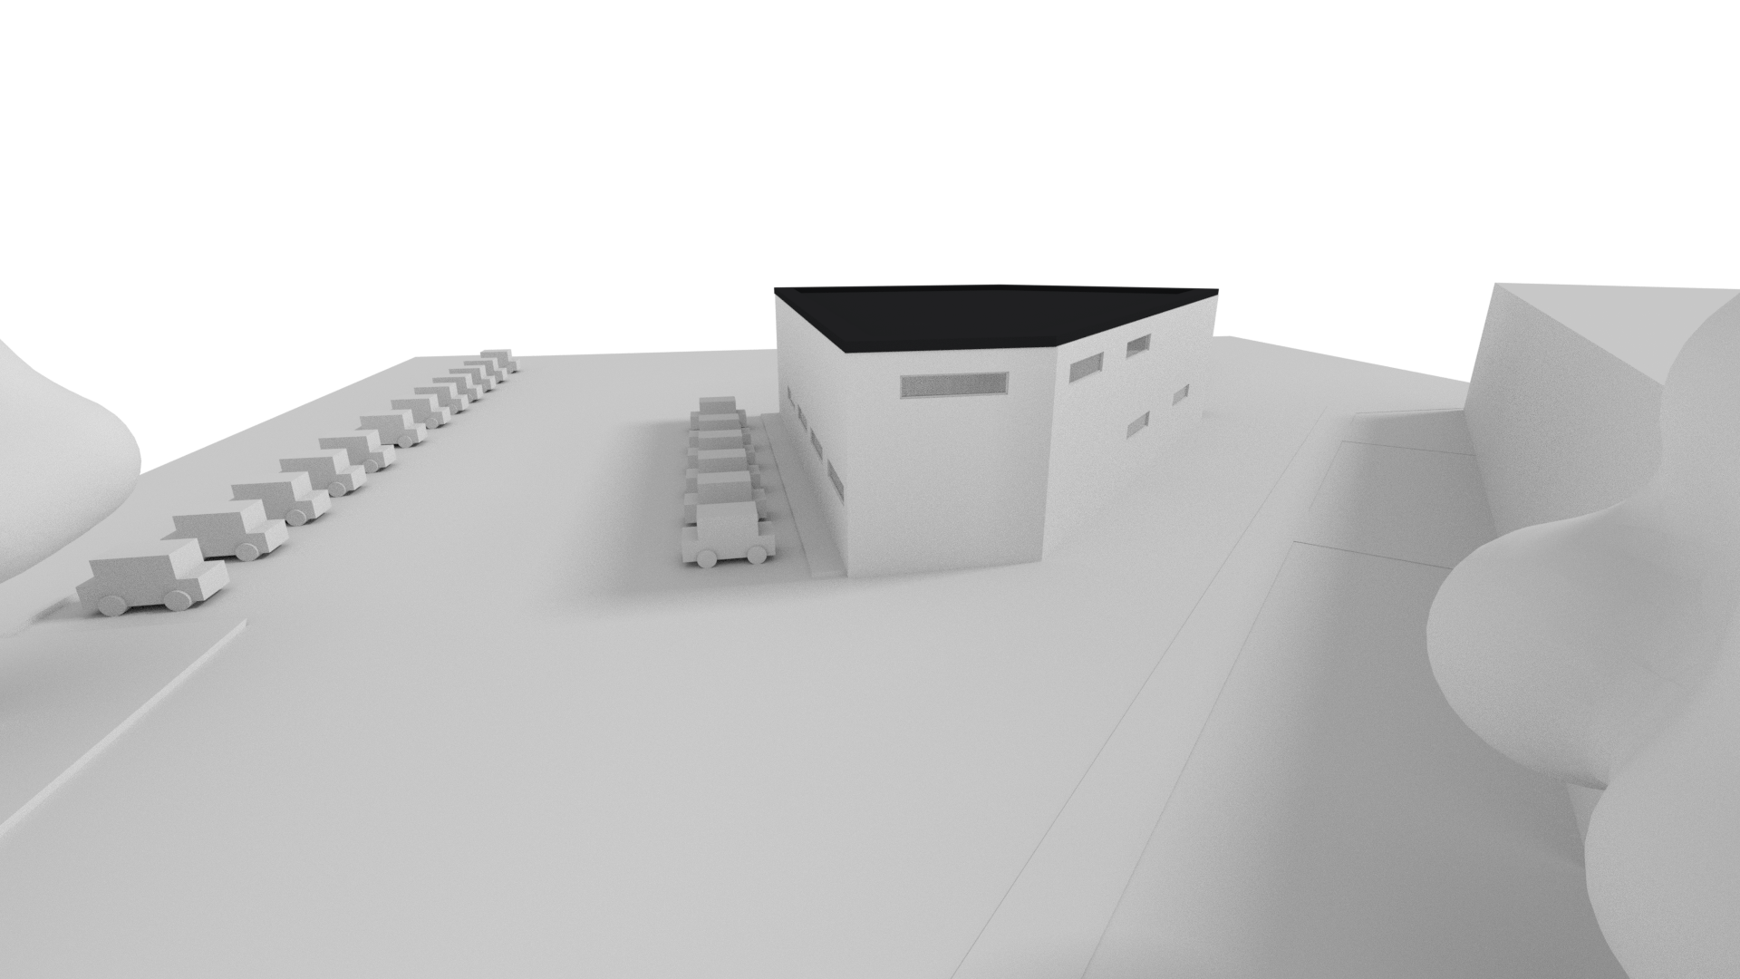
Master Title
Title 1
Title 2
Title 3
Title 4

