Slide 1
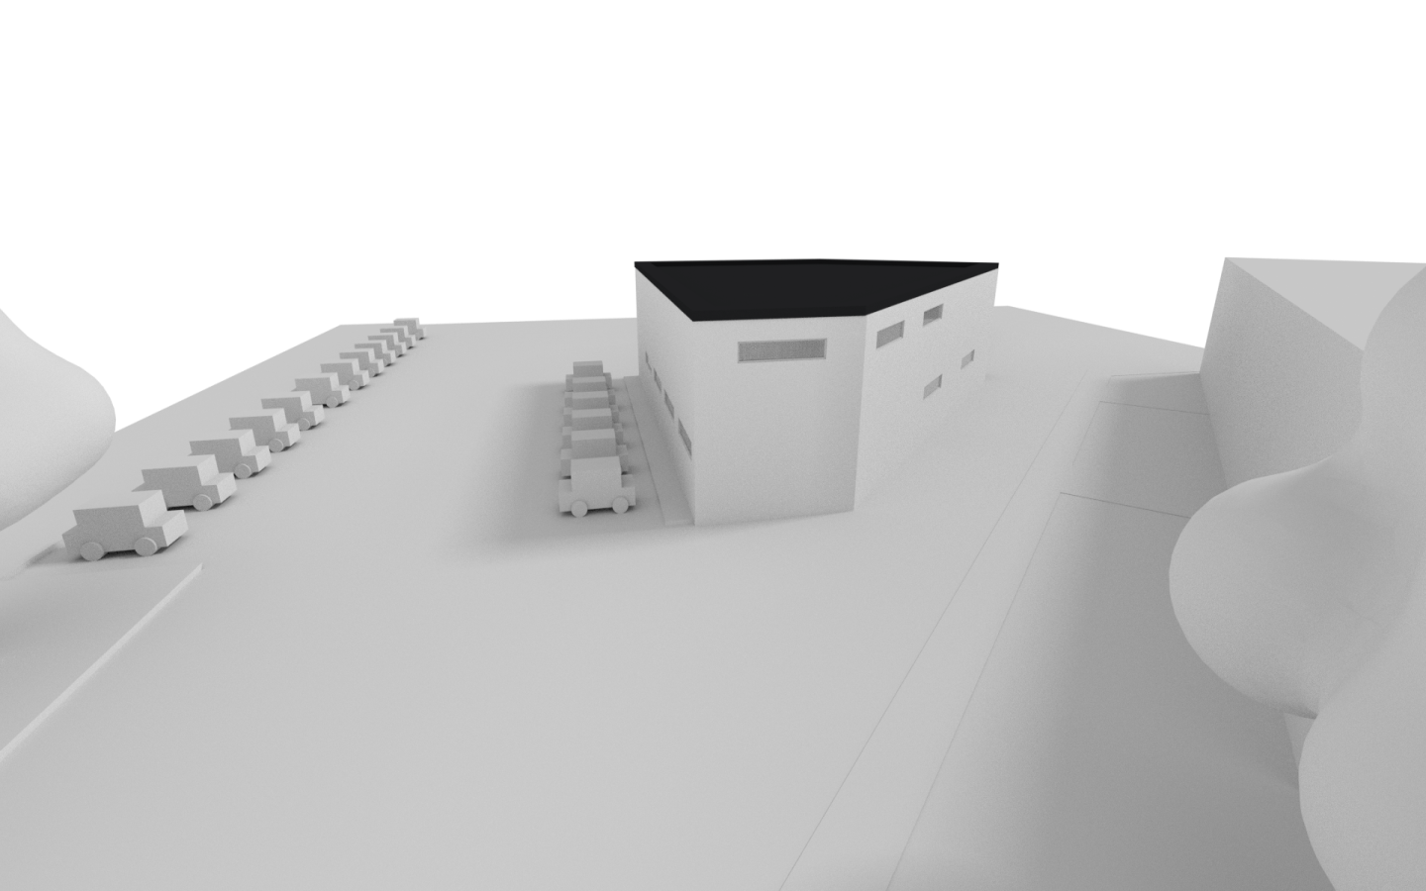
2017 09 17
Europe/Prague
yyyy MM dd

Slide 2
2017 09 17
2017 09 17

Slide 3
Master Title
Title 1
Title 2
Title 3
Title 4

