Slide 1
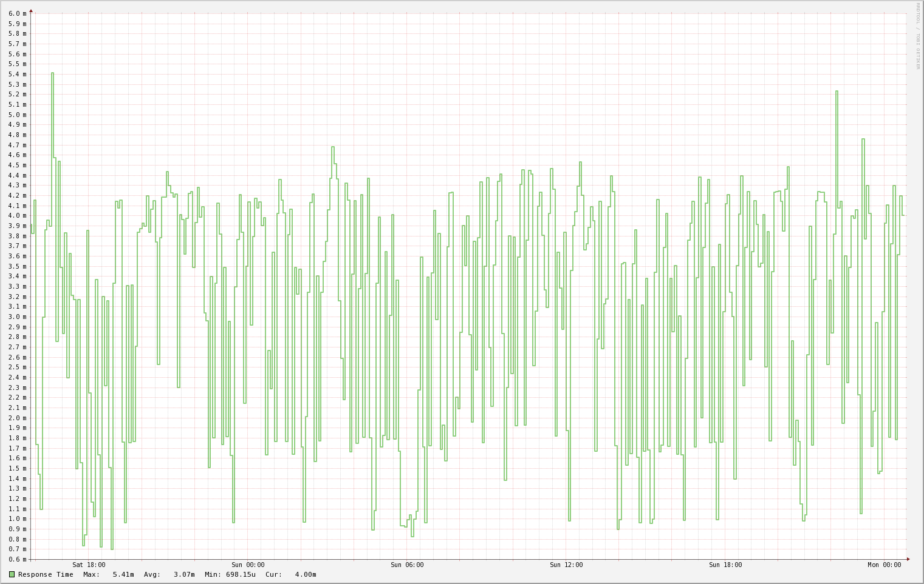
2017 11 21
Koruna

Slide 2
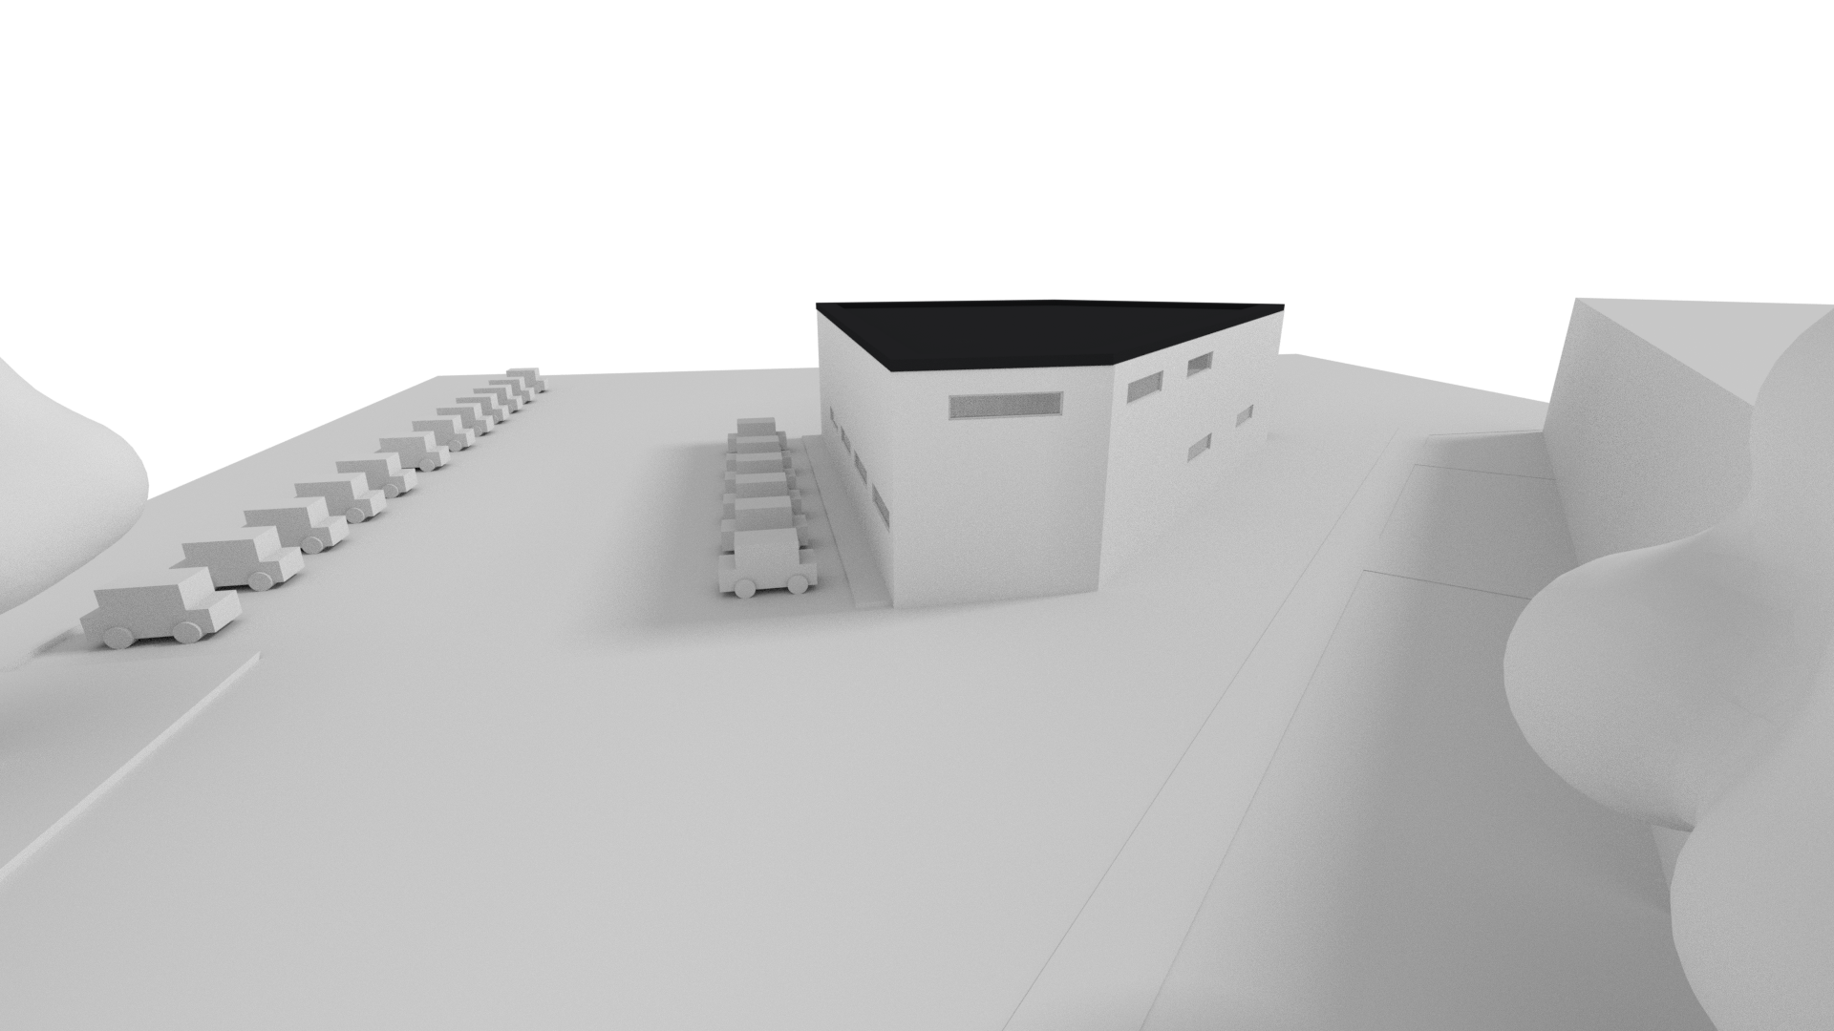
2017 11 21
2017 11 21

Slide 3
Master Title
Title 1
Title 2
Title 3
Title 4

