Slide 1


H ISTORIC E NVIRONMENTAL A NALYSIS OF D ANGER
It gives you a HEADs up,
to get aHEAD of the problem!!
BY DRONNIES. -Ceagan Paladino
-Jayesh Anil
-Wentao Sun
-Alan
-Yujia Wang

Slide 2
Objective
Demonstrate how spaceborne, airborne, and ground-based remote sensing data can be combined with data collected by UAVs to improve the timeliness and quality of urban-related indicators, support sustainable urban development, and enable tangible improvements to the quality of people’s lives in cities and local communities.

Slide 3
Solution
Navigate everyday life by analyzing past weather/environment information
Identify major risks and health concerns
Provide visual representation of danger levels

Slide 4
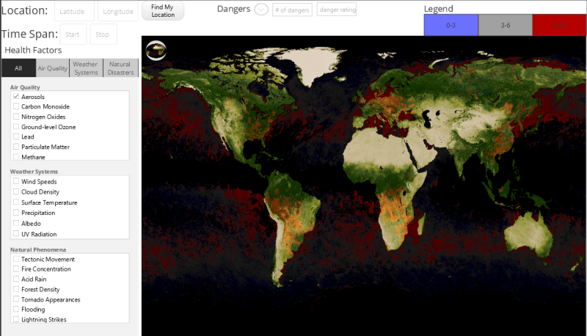
World View

Slide 5
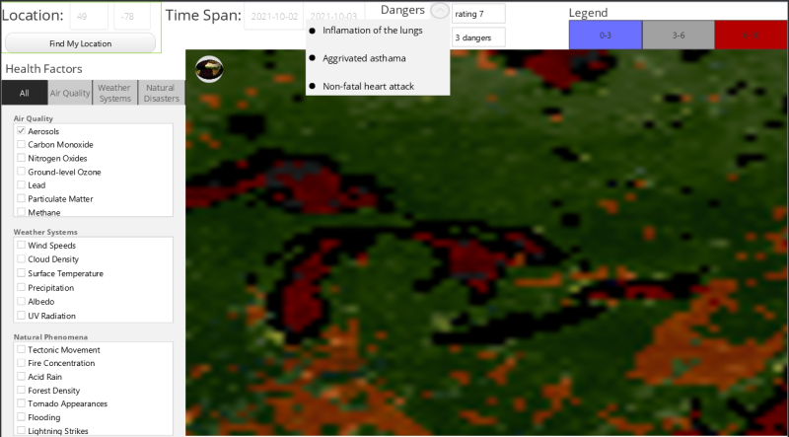
Particular location (Hamilton)

Slide 6
The Audience
How could people benefit ?
Idustrial sectors that could benefit
Urban developers
Federal Aviation Administration
Outdoor sports
Power and Energy production
Agriculture sector (farmers)
Tourism sector
How the area they are living or want to live in is less prone to natural disasters
Tell them about how much pollution is there in that area through the overall danger rating
What precaution they should take

Slide 7
Future Goal
Danger Management
Resources and solutions
Predictive Analysis
Indicate when and where a problem is likely to strike
Impact Reduction
Provide methods to improve the quality of life and danger levels within certain areas
Where to place parks and trees within a city to increase air quality

