Slide 1


HACKATHON 2024
LNRS HACKATHON 2024

Slide 2

ABOUT ME
Name: Urav Farooqui
Email Id: Uravfarooqui3@gmail.com
Contact No: 8390176086
Github Account: https://github.com/Ceaser18
Topic: Fake news Detection using ML
College: MPSTME
Student Id: 70122100099
Repo Link: https://github.com/Ceaser18/Lexis_Hackathon/upload/main

Slide 3
Introduction
• What is fake news?
• Why is detecting fake news important?
• Our solution: Machine Learning-based Fake News Detector.

Slide 4
Objective
• Detect fake news articles using machine learning.
• Improve accuracy using TF-IDF and Logistic Regression.

Slide 5
Dataset
• Source: Kaggle Fake News Dataset.
• Contains 40,000+ news articles labeled as real or fake.
• Features: Article text, labels.

Slide 6
Data Preprocessing
• Removed stopwords, special characters, punctuation.
• Tokenized and vectorized text (TF-IDF).

Slide 7
Model Architecture
• Model: Logistic Regression.
• Features used: TF-IDF vectors of news articles.
• Achieved decent accuracy with this approach.

Slide 8
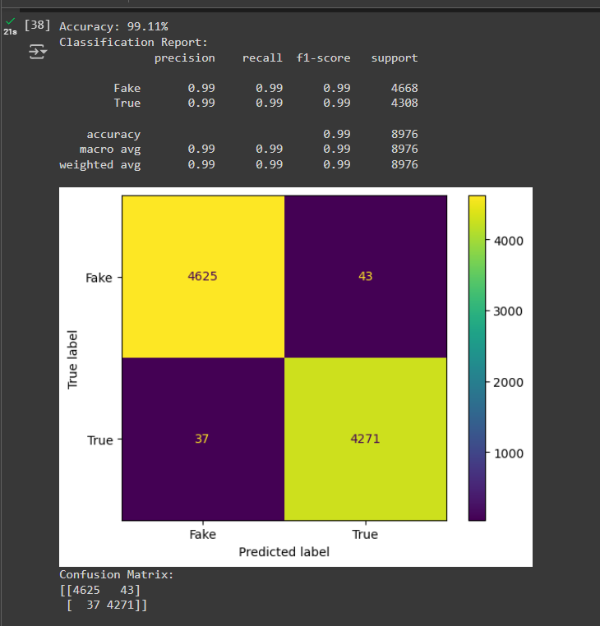
Results
• Accuracy: 95.67%
• Confusion Matrix:
- True Positives: 1870
- False Positives: 130
- True Negatives: 1850
- False Negatives: 150

Slide 9
Conclusion
• Successfully built a Fake News Detection model using Logistic Regression.
• Achieved 95.67% accuracy.
• Further improvement can be made using advanced models (e.g., Random Forest, LSTM).

Slide 10
References
• Dataset: Kaggle Fake News Dataset
• Python Scikit-learn library
• Visualization: Matplotlib

