Slide 1

Onboarding to work with register data DARTER Kickstarter
Register Space Meeting, September 26 2024

Slide 2
Agenda
Challenge: How to work efficiently on DST
Potential solutions
DARTER Kickstarter
Current and future challenges
Experiences: Ida & Vithiya
Others?

Slide 3
Challenge
Closed environment
No introduction provided by DST
Workflow is not self-explanatory
Messy folder/file structure and naming
R.I.P. non-native Danish speakers

Slide 4
Solution
Don’t reinvent the wheel
Share & reuse knowledge/code
Shared challenge & workspace:
Potential for shared guides, utilities & workflows

Slide 5
DARTER Kickstarter
Ad-hoc onboarding resource
Most new users will be using R
Luke’s R package: dstDataPrep
Handles ”folder hell” in raw data
Processes data extremely fast: Parquet/DuckDB
Standard R/dplyr syntax
A few twists (database connection vs. in-memory)

Slide 6
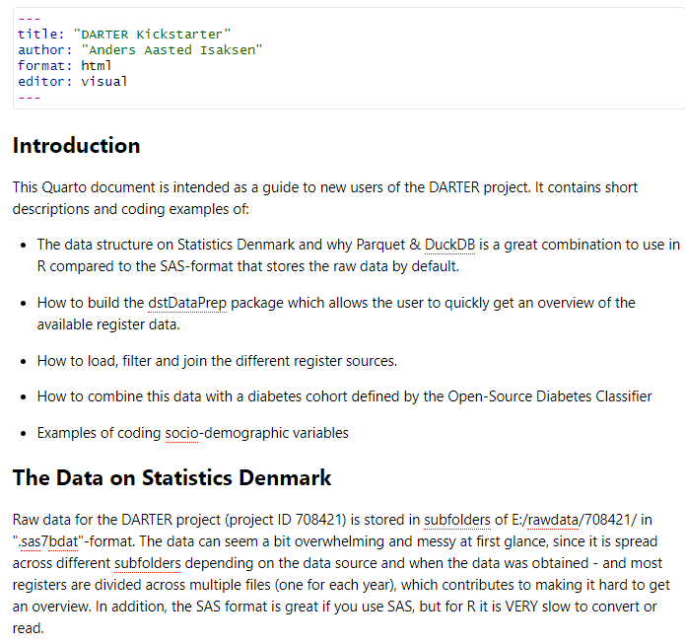
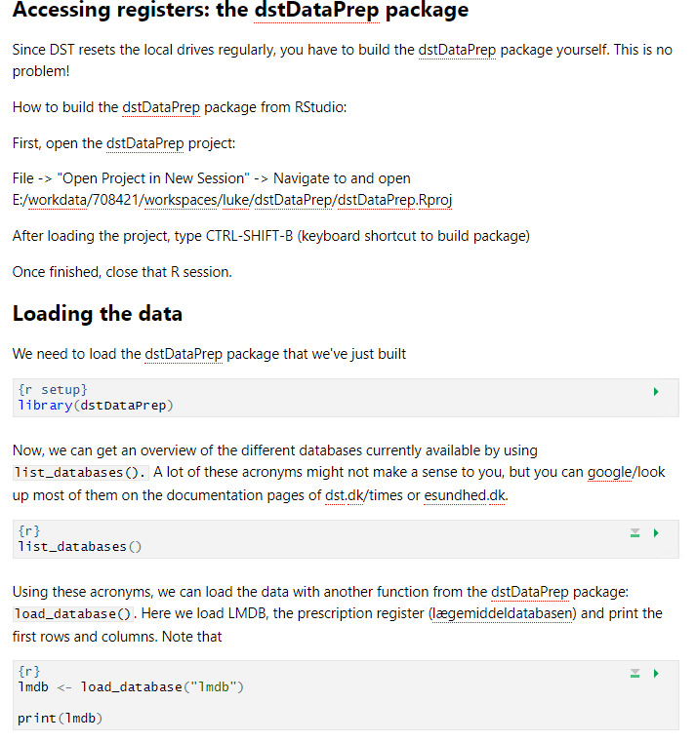
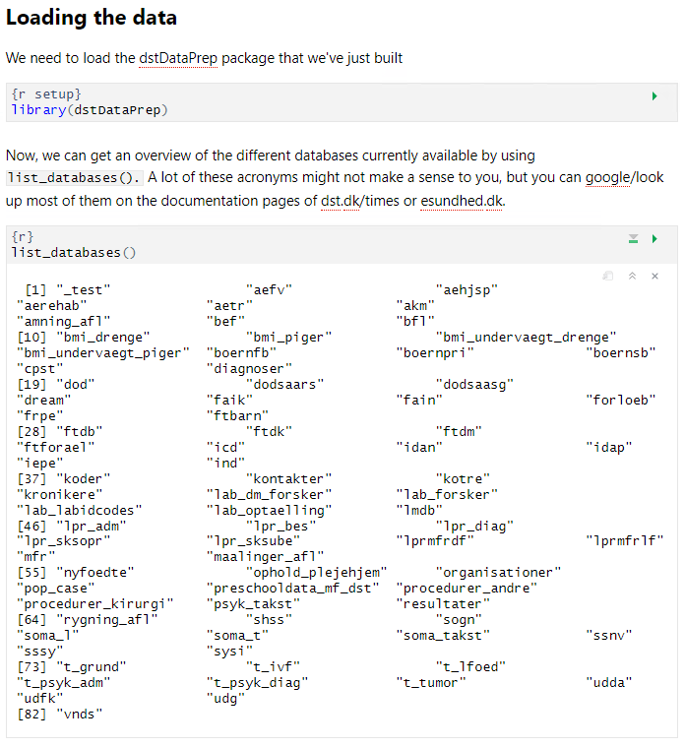
Current format
Quarto document
Text and executable code
E:/workdata/708421/
workspaces/_onboarding/
darter_kickstarter.qmd

Slide 7
Current contents
Working with dstDataPrep:
Listing and loading register data
Selecting variables, filtering rows, joining tables
Using the OSDC cohort:
Loading, joining to background population, filtering to prevalent cases

Slide 8
WIP contents
Adding sociodemographic data
Personal income/household income
Formatting sociodemographic data
what in the world is
”n_audd_pria_l1lx_k.sas7bdat”?
”n_socio_13_kt.sas7bdat”?

Slide 9
Possible future content
Common functions for common use-cases
source(helper_functions.R)
add_variables(
population = my_pop,
index_date = ”01-01-2018”,
variables = c(”3y_income”, ”education”, ”employment”, ”diabetes”, ”prevalent_cvd”, ”incident_cvd”)
)
Project setup, Git use?
Needs? Suggestions? (discussion for later)

Slide 10
Challenges
Current:
Individual:
Learn programming/statistical concepts
Learn R syntax/workflows & DST/dstDataPrep niches
Future:
Organization:
Package & document maintenance/updates
Project database: Workspace fragmentation

Slide 11
Experiences
Ida & Vithiya
Intended users:
Junior researchers, non-technical backgrounds
Non-technical supervisor group
No previous experience working on DST
Others’ experiences?
Needs? Suggestions? Non-R tools?

