Slide 1
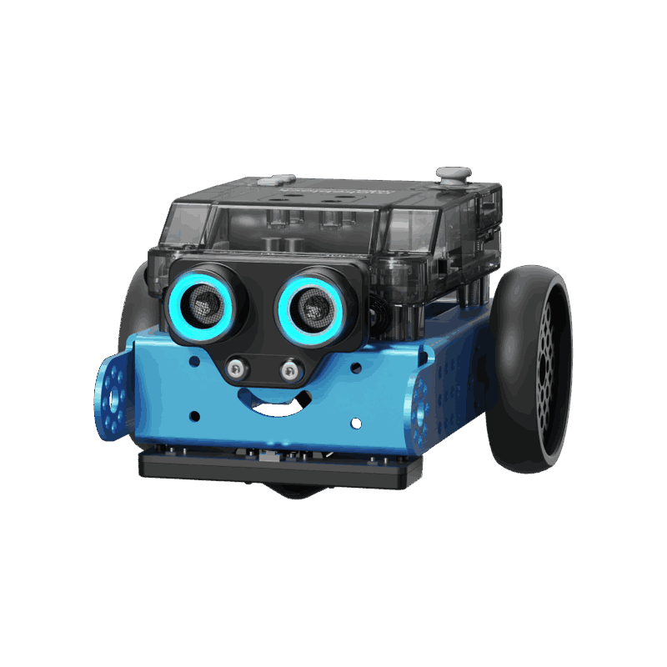
COSC-3070 Programming Autonomous Robot
Autonomous Path Following and Obstacle Avoidance With mBot Neo
Lecturer: Ginel Dorleon
xxxxxx
Huynh Ngoc Tai (s3978680)
Tran Quang Minh (s3988776)
Chau Tung Nguyen ()
"I declare that in submitting all work for this assessment, I have read, understood and agree to the content and expectations of the assessment declaration".

Slide 2
Problem Overview

Slide 3
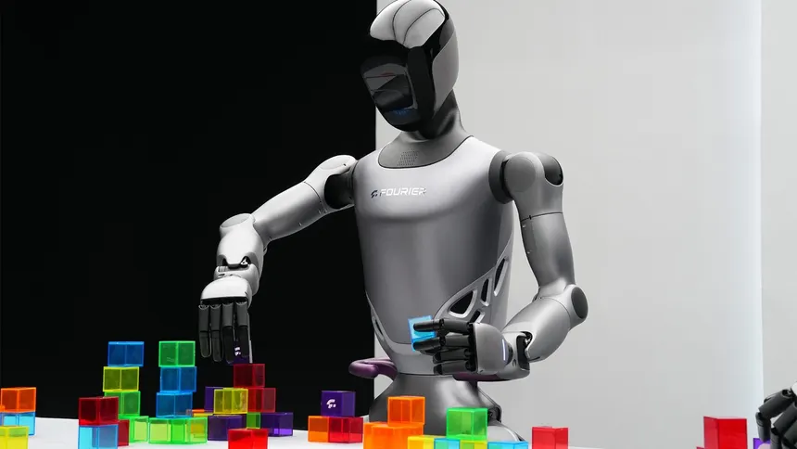
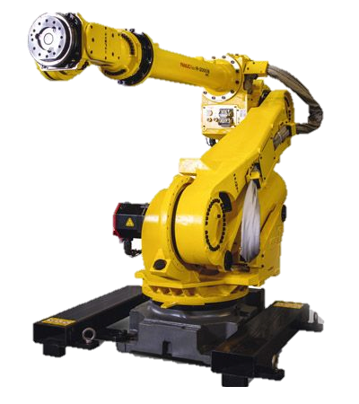
Problem Overview
Autonomous robots are revolutionizing industries like logistics and transportation.
They rely on AI, computer vision, and sensors to interpret paths, detect signs, and avoid obstacles.

Slide 4
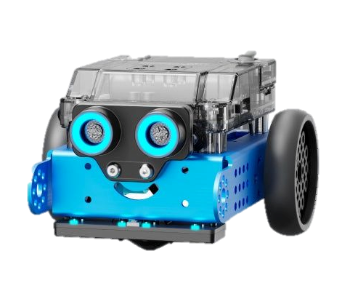
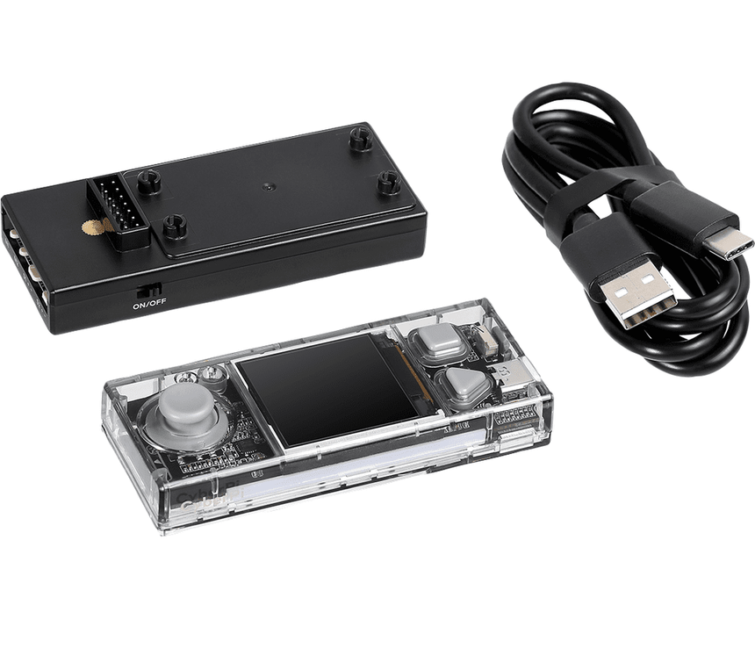
Problem Overview
For the final project of the course, we are given 2 things, which is :
- Cyber Pi is the microcontroller – the brain of the robot.
- mBot2 Neo is the complete robot – includes wheels, motors, sensors.
CODE

Slide 5
Project Setup

Slide 6
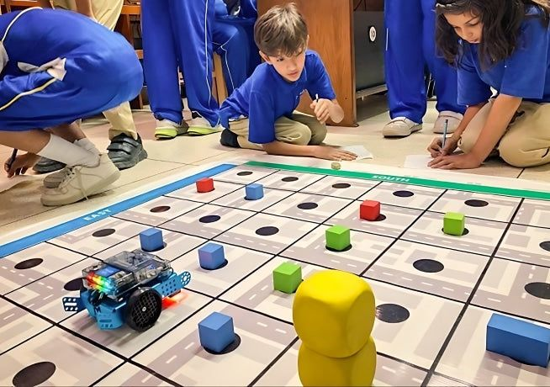
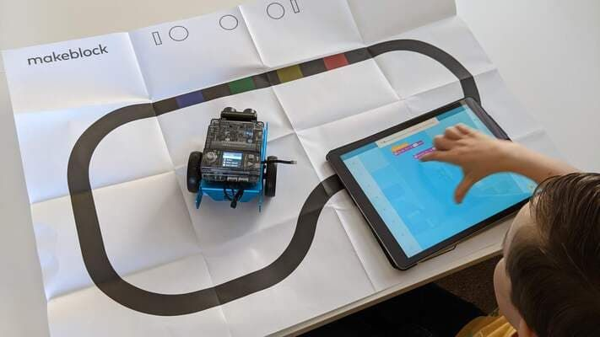
Problem Overview
The aim of the project is to simulate read-world autonomous robot using simple sensors and vision systems, which then the robot will need to successfully navigate a maze-like environment following and act accordingly to the signs it will sensor, or the obstacles along the way like an AI powered robot in the real world.

Slide 7
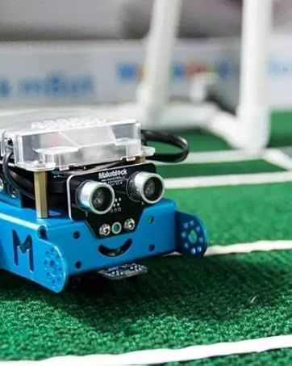
Problem Goal
For the demo, the robot must navigate a complex maze using only onboard logic, no remote control or intervention.
It follows traffic rules: stop on red, go on green, slow on yellow, and even handle combinations like yellow-to-green transitions. It must also avoid static obstacles automatically and reroute in T-junctions when needed.

Slide 8
Methodology

Slide 9
Methodology

Slide 10
Implementation

Slide 11
Problem Overview

Slide 12
Testing

Slide 13
Problem Overview

Slide 14
Result, Evaluation and Conclusion

Slide 15
Problem Overview

Slide 16
COSC-3070 Programming Autonomous Robot
Autonomous Path Following and Obstacle Avoidance With mBot Neo
THANK YOU FOR LISTENING TO OUR PRESENTATION AND WISH YOU A NICE DAY
"I declare that in submitting all work for this assessment, I have read, understood and agree to the content and expectations of the assessment declaration".

