Slide 2
Building Office Add-ins using Node.js
699
Jeremy Thake
Microsoft
@jthake
Andrew Connell
MVP
@andrewconnell

Slide 3
Topics
What is Node.js? … and io.js?
Developer Tooling for Node.js
Creating Websites & Web APIs with Node.js
Developing with Node.js
Node for Office & SharePoint Add-ins

Slide 4
What is Node.js?

Slide 5
What is Node.js
Cross platform environment for hosting JavaScript
Facilitates end-to-end JavaScript environment
Ideal for network & I/O based applications
Non-blocking, event driven
Open source
Managed by
Node.js Foundation
Joyent
https://nodejs.org

Slide 6
Who uses Node.js?
Microsoft Azure - http://aconn.me/1HZWEl2
Yammer - http://aconn.me/1Gxy9hL
Walmart - http://aconn.me/1HZWz0w
PayPal - http://aconn.me/1DsFZqx
LinkedIn - http://aconn.me/1NZNs1S
Trello - http://aconn.me/1OjCPsI

Slide 7
Node.js Components
Node
NPM
V8

Slide 8
Node.js vs io.js
Node.js – https://nodejs.org
Managed by Node.js Foundation (+Joyent)
Current (v0.12.2) uses V8 v3.28.73
io.js - https://iojs.org
Forked copy of Node.js in late 2014
Created out of community frustrations with decline in the pace of contributions & releases - http://aconn.me/1NZQvHl
Current version (v1.6.4) uses V8 v4.1.0.27
Contains many fixes & features not yet implemented in Node.js
Compatible with NPM
What will the future hold? Yet to be determined!

Slide 9
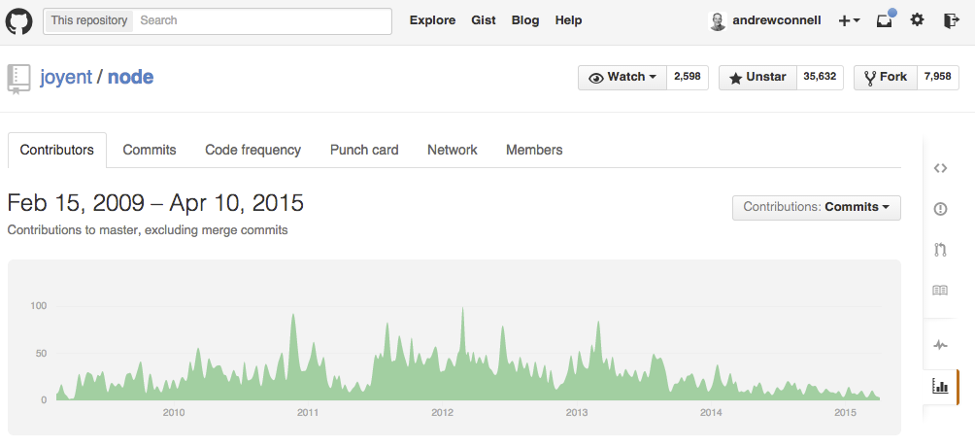
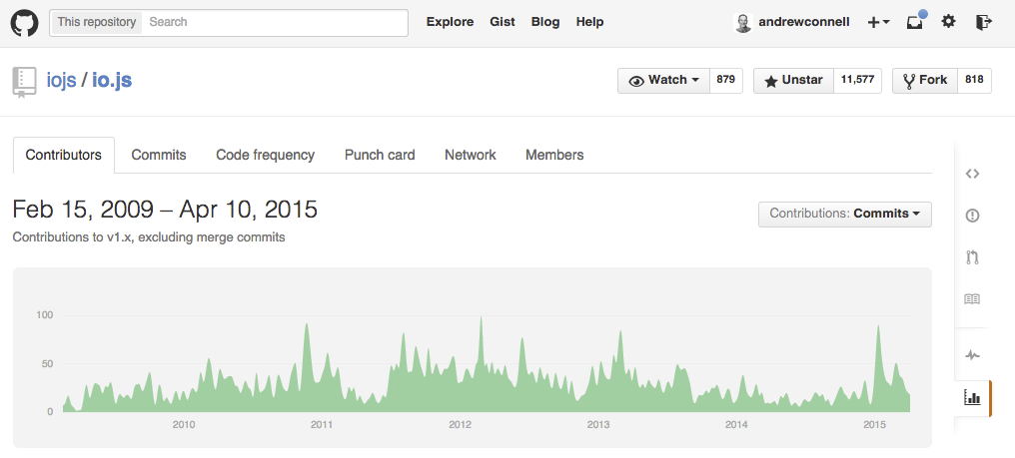

Slide 10
Appeal of Node.js & io.js
One language used from server to client
Same language used in projects & ecosystem around the projects
Build process
Developer tooling
System configuration
Cross platform
Built for network & I/O bound operations

Slide 11
Developer Tooling for Node.js

Slide 12
Node.js Developer Tooling Options
Visual Studio
Node.js Tools for Visual Studio
https://www.visualstudio.com/en-us/explore/node-js-vs
WebMatrix
http://www.microsoft.com/web/webmatrix
WebStorm
https://www.jetbrains.com/webstorm
Brackets
Open source – written in JavaScript & Node.js!
http://brackets.io
Any text editor

Slide 13
Developing Node

Slide 14
Node.js for Websites & Web APIs
Connect
Express
MVC
APIs

Slide 15
Connect
HTTP Middleware for Node.js
var app = connect();
Facilitates simple request & response
Extensible HTTP server framework using plugins
Plugins = Middleware
Code that is added as a stack
Incoming requests execute each middleware one-by-one
Continues until middleware doesn’t call next()
Use middleware by executing:
app.use(‘/foo’, function mw(req, res, next){next();});

Slide 16
Express
Minimalist web framework
Built on Connect
Unopionated
Developers write all the plumbing code
Extensible – multiple MVC framework options

Slide 17
MVC Frameworks in Node.js
Jade
Unique HTML shorthand syntax
EJS
Embedded JavaScript
Vash
Similar to ASP.NET’s Razor syntax
Handlebars
Same as client-side syntax

Slide 18
Debugging Node.js Applications
Node --debug
node-inspector
Nodemon
spy.js

Slide 19
Node.js for Office 365, Office Add-ins & SharePoint Add-ins

Slide 20
Office 365, Office Add-ins & SharePoint Add-ins
All extensibility in Office related products & platforms is web based
Websites, web applications & Web APIs
Underlying tech & platform irrelevant
Node.js, just like ASP.NET, is just another option

Slide 21
Node.js + Office - Things to Consider
No wizards
No “Connected Service Wizard”
Create Azure AD application via Azure Portal
No Office 365 / SharePoint SDKs
Some packages available in NPM & bower
Use REST APIs
Authentication Flow
If all client side – use Azure AD’s Implicit Flow & ADAL JS
If server side – use ADAL for Node.js

Slide 22
Call to Action
https://nodejs.org
https://iojs.org
Demos used in this session:
https://github.com/andrewconnell/pres-o365-node

Slide 23
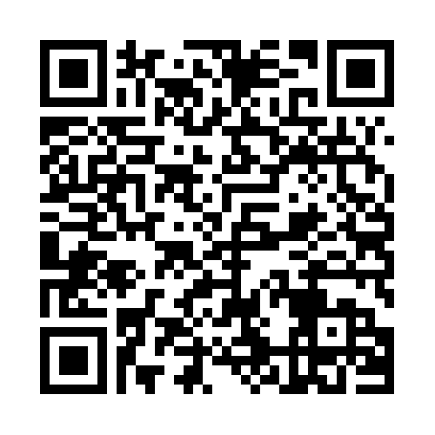
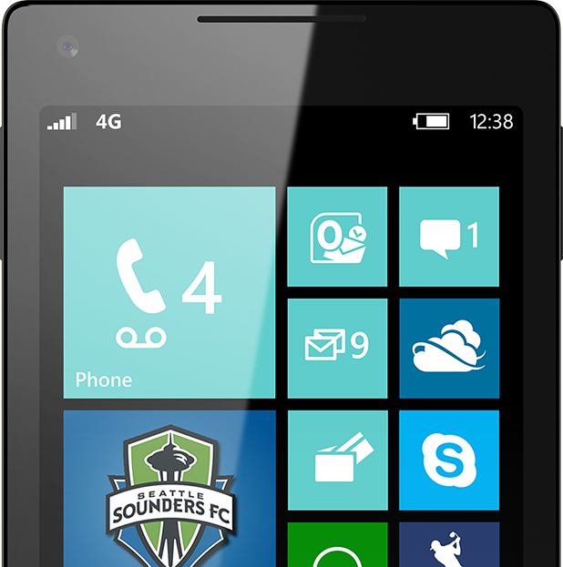

Please Complete An Evaluation Form Your input is important!
Required Slide
*delete this box when your slide is finalized
or
SAMPLE

Slide 24
Evaluate this session
Required Slide
*delete this box when your slide is finalized
Speakers: This slide will be updated during the scrub process with a unique QR code. Attendees scan the QR code to access the eval for your session.
SAMPLE
Notes:
Speakers: Please note this slide will be updated with your session’s QR code during the scrub process which is outlined on side 3. Attendees can scan the QR code for access to your session’s eval.

