Slide 1
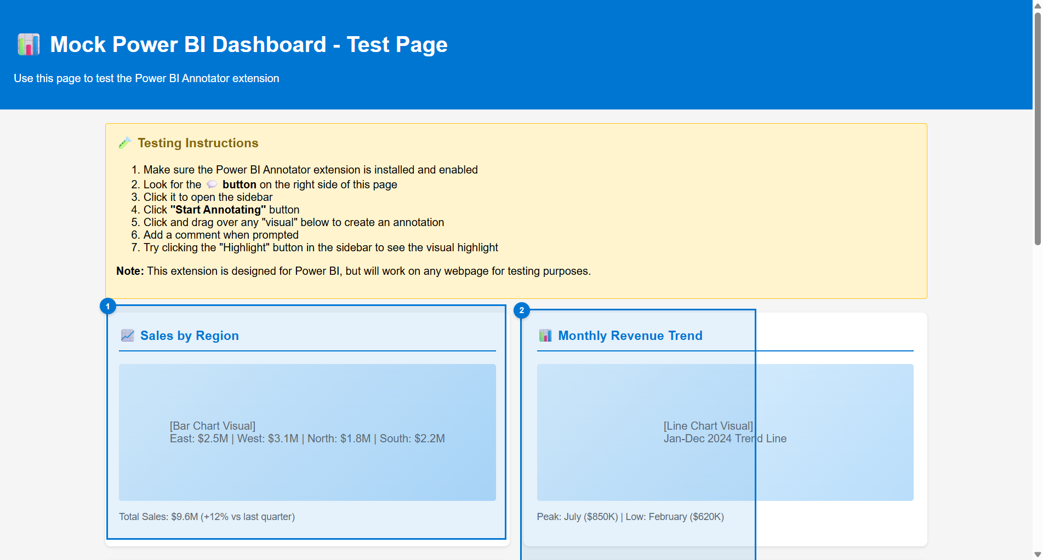
Power BI Annotator - Test Page
#1 Test
2/10/2026
#2 Test
2/10/2026

