Slide 1
Should Candidates Campaign
Like Influencers?
Evidence from 16,572 Instagram Reels and Two Generative AI Video Experiments
Cecilia Y. Sui
Department of Political Science, Washington University in St. Louis
November 13, 2026
Notes:
Hi everyone! Thank you so much for being here. I’m Cecilia Sui from Washington University in St. Louis.
Today I want to talk about whether political candidates should campaign like social media influencers.

Slide 2
The Advice
Notes:
I want to start with a piece of advice that has become remarkably common in contemporary campaigns.

Slide 3
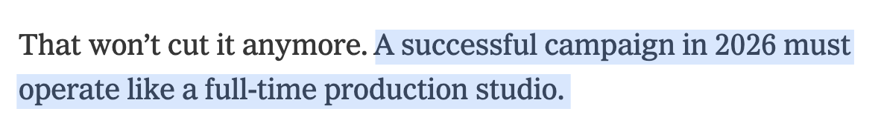
The Advice
— David Plouffe, The New York Times
Notes:
David Plouffe (ploof), who managed Barack Obama’s presidential campaign, recently argued that a successful campaign in 2026 has to operate like a full-time production studio.

Slide 4
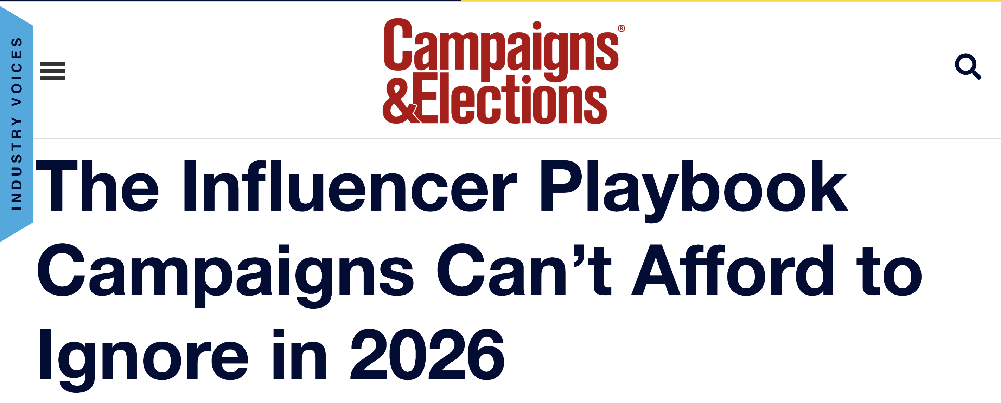
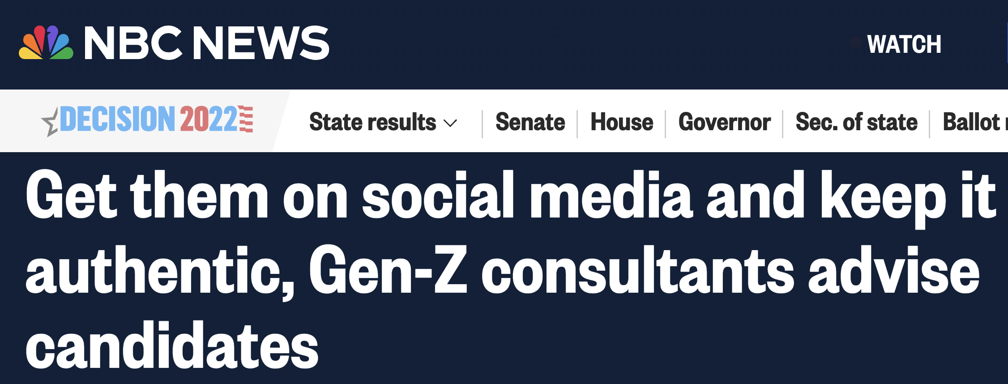
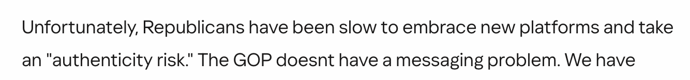
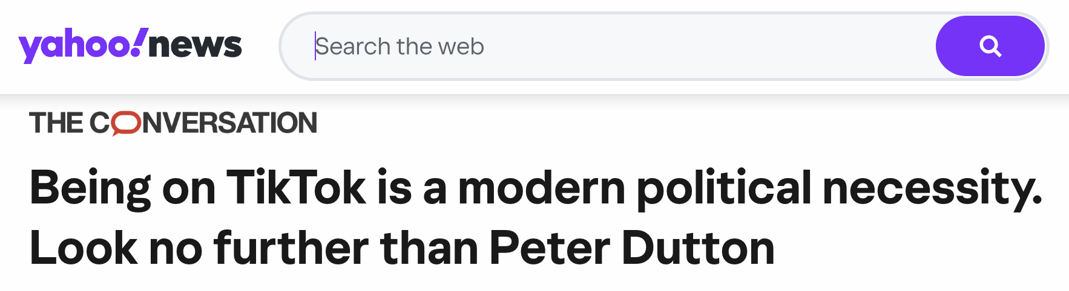
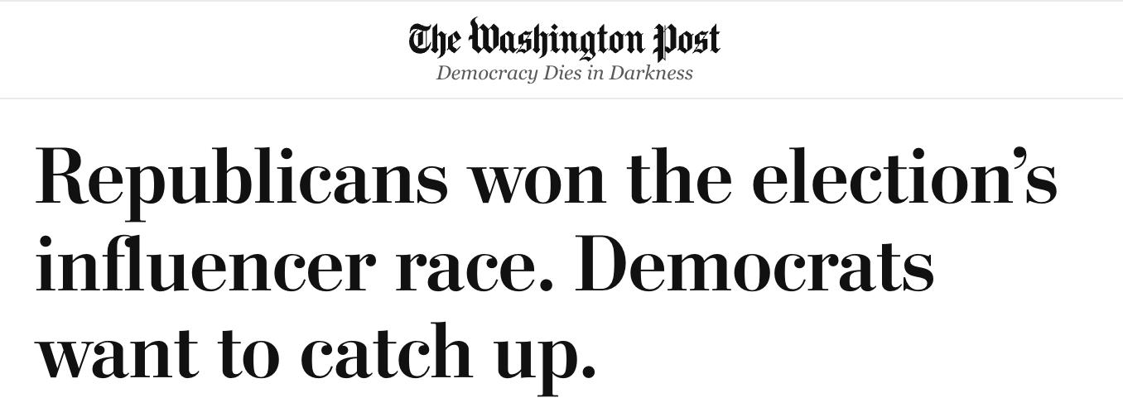
The Advice: Campaign Like An Influencer
— David Plouffe, The New York Times
— Corey Vale, Yahoo News
Notes:
The advice, is not particularly partisan. In short, strategists across the political spectrum are telling candidates to campaign like influencers.

Slide 5
Sometimes, It Looks Spectacularly Successful
Notes:
And it’s not hard to understand why campaigns find that advice appealing.
Because a handful of politicians have used this style to spectacular effect.

Slide 6
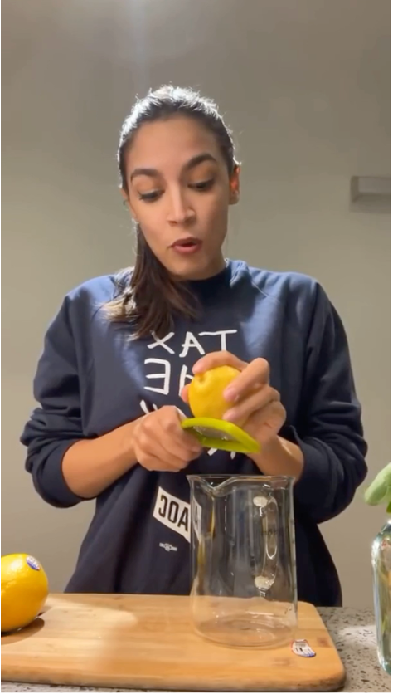
Sometimes, It Looks Spectacularly Successful
Alexandria
Ocasio-Cortez
(D-NY)
U.S. Representative
Instagram Live
Notes:
AOC became famous early on for using Instagram Live in ways that looked almost nothing like conventional political communication. She would answer questions about politics while cooking dinner or zesting lemons in her kitchen.

Slide 7
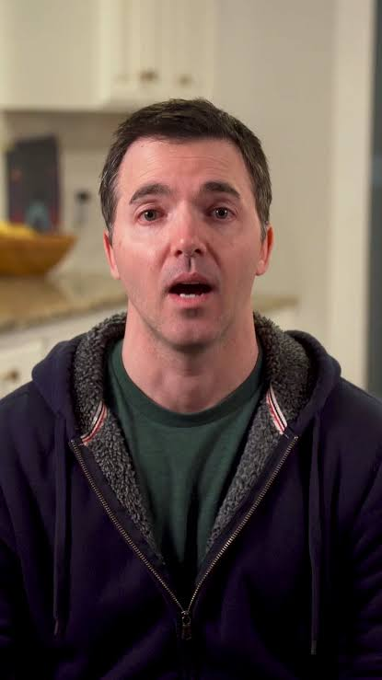
Sometimes, It Looks Spectacularly Successful
Alexandria
Ocasio-Cortez
(D-NY)
U.S. Representative
Instagram Live
Jeff
Jackson
(D-NC)
Former U.S.
Representative
Now N.C. Attorney
General
TikTok
Notes:
Jeff Jackson, built a similarly distinctive presence on TikTok.
These politicians attracted enormous attention. And importantly, their success seems to become evidence for the strategy itself.

Slide 8
The Exception or the Rule?
Notes:
But this creates a problem.
The politicians we point to as evidence for this strategy are exemplars precisely because they are exceptional.

Slide 9
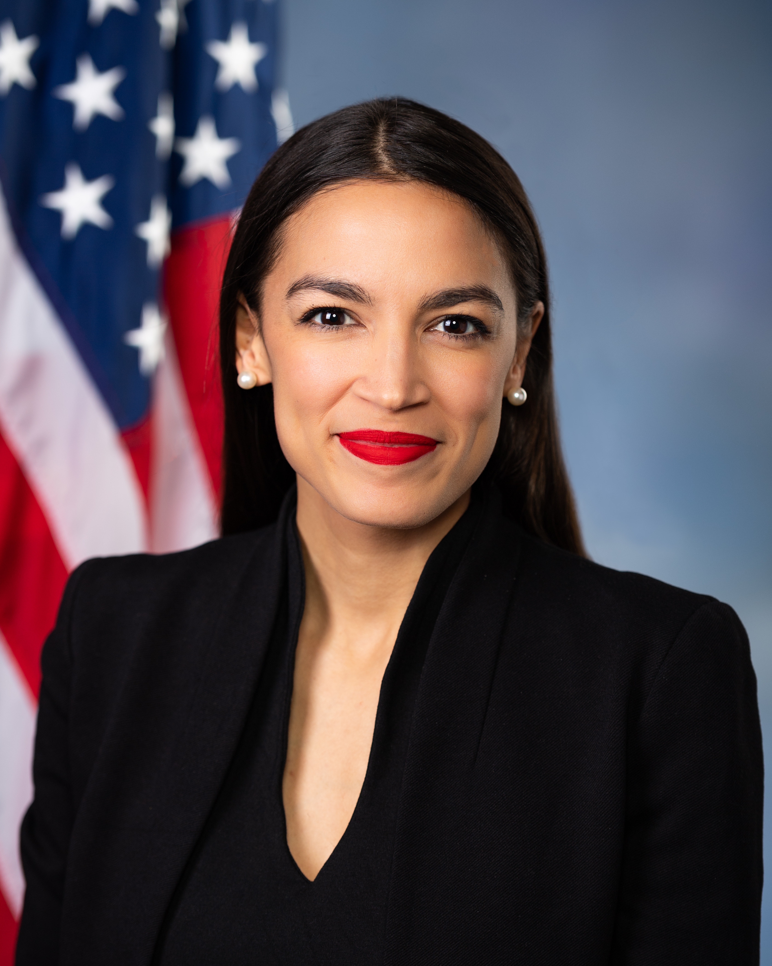
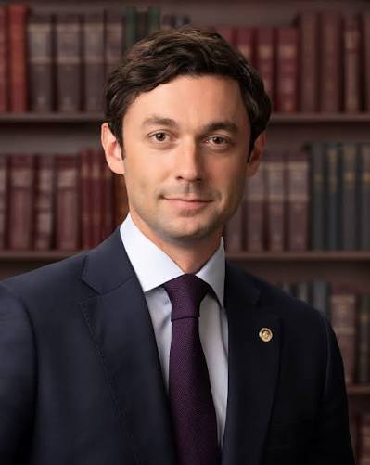
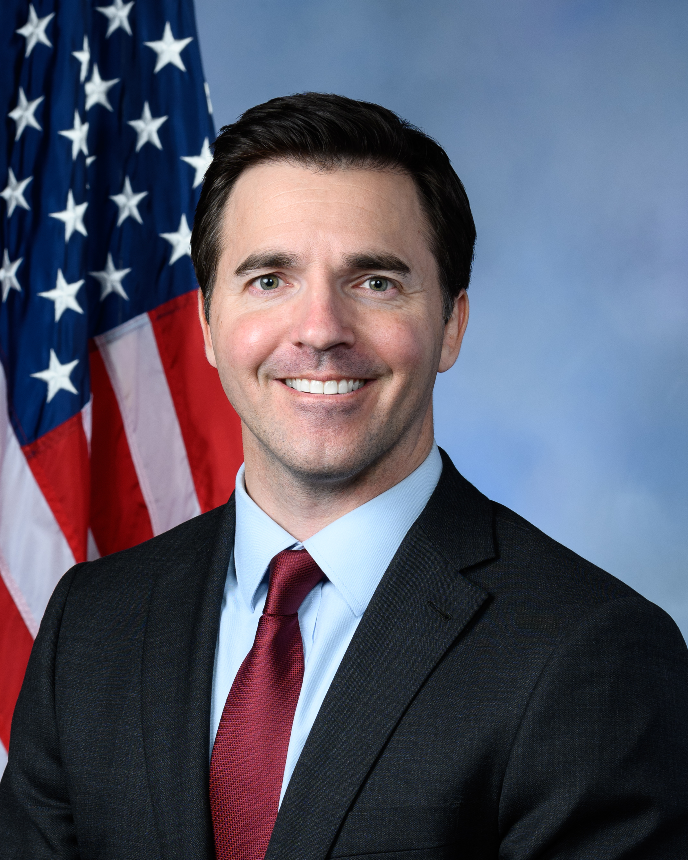
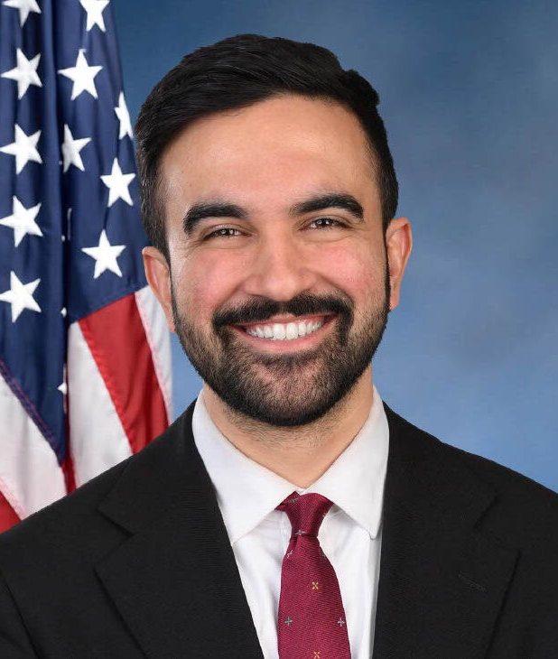
The Exception or the Rule?
Often Young, Digitally Fluent, Charismatic, Mostly Progressive
Notes:
They tend to be young, digitally fluent, charismatic, and mostly progressive.

Slide 10
The Exception or the Rule?
Often Young, Digitally Fluent, Charismatic, Mostly Progressive
Ideology, constituency, campaign resources, … Or Style?
Notes:
Their success also travels together with ideology, constituency, campaign resources, and many other things that are difficult to separate from communication style.

Slide 11

The Exception or the Rule?
Can influencer-style coexist with political prominence?
Notes:
These few examples show us that the casual, informal, influencer style can clearly coexist with political prominence,

Slide 12

The Exception or the Rule?
Can influencer-style coexist with political prominence?
Does influencer-style cause political success?
Notes:
but how much influencer style really contributed to their success remains unknown.

Slide 13

What Happens When Candidates Campaign This Way?
Notes:
We don’t know what happens, when an ordinary candidate, not AOC, Ossoff, Jackson or Mamdani tries to communicate the same way.
And that is where the puzzle in this paper begins.
~(02:45)

Slide 14
Parasocial Closeness Predicts Political Support
Notes:
Existing research tells us that

Slide 15
Parasocial Closeness Predicts Political Support
Parasocial Closeness
Strongly Predicts (Cohen and Holbert, 2021; Tsfati et al., 2022)
Notes:
In politics, parasocial closeness is shown to be strongly associated

Slide 16
Parasocial Closeness Predicts Political Support
Parasocial Closeness
Strongly Predicts (Cohen and Holbert, 2021; Tsfati et al., 2022)
Political Support
Notes:
with more favorable evaluations and greater political support for famous politicians.

Slide 17
Parasocial Closeness Predicts Political Support
Influencer-Style Cues
Effective Among Influencers (Abidin 2016; Hartmann & Goldhoorn 2011; Marwick & boyd 2011; Nah 2022)
Parasocial Closeness
Strongly Predicts (Cohen and Holbert, 2021; Tsfati et al., 2022)
Political Support
Notes:
And Influencer-style cues may build parasocial closeness shown to be effective among influencers.
But there is an important missing link.

Slide 18
Parasocial Closeness Predicts Political Support
Influencer-Style Cues
Effective Among Influencers (Abidin 2016; Hartmann & Goldhoorn 2011; Marwick & boyd 2011; Nah 2022)
Parasocial Closeness
Strongly Predicts (Cohen and Holbert, 2021; Tsfati et al., 2022)
Only among politicians with existing parasocial closeness
Political Support
Notes:
Existing research mostly tells us that voters who already feel close to politicians support them more.

Slide 19

Parasocial Closeness Predicts Political Support
Influencer-Style Cues
Can candidates create this closeness?
Parasocial Closeness
Strongly Predicts (Cohen and Holbert, 2021; Tsfati et al., 2022)
Only among politicians with existing parasocial closeness
Political Support
Notes:
It does not tell us whether candidates can actually create that closeness simply by adopting influencer-style communication cues.
And there is another reason to be skeptical about the advice.

Slide 20
Candidates Are Not Only Judged as Influencers
Notes:
Because voters are not evaluating politicians only as influencers.

Slide 21
Candidates Are Also Judged as Prospective Officeholders
Notes:
They are also evaluating them as prospective officeholders.

Slide 22
Candidates Are Also Judged as Prospective Officeholders
Perceived Competence
Notes:
And a large literature on candidate evaluation shows that voters form judgments about political competence

Slide 23




Candidates Are Also Judged as Prospective Officeholders
Thin Presentational Cues
Perceived Competence
(Bilson et al., 2024; Dumitrescu, Gidengil and Stolle, 2015; Mattes et al., 2010;
Kaczmarek and Stencel, 2021; Klofstad, 2017; Todorov et al., 2005)
Notes:
from surprisingly thin presentational cues.

Slide 24
Candidates Are Also Judged as Prospective Officeholders
Thin Presentational Cues
Perceived Competence
Unavoidable in Short-Form Videos
(Bilson et al., 2024; Dumitrescu, Gidengil and Stolle, 2015; Mattes et al., 2010;
Kaczmarek and Stencel, 2021; Klofstad, 2017; Todorov et al., 2005)
Notes:
And notice that these are precisely the kinds of cues that short-form video makes unusually visible and unavoidable.
(03:45)

Slide 25
The Core Tension: Closeness vs. Competence
Notes:
So the same informality that succeeds on an influencer

Slide 26
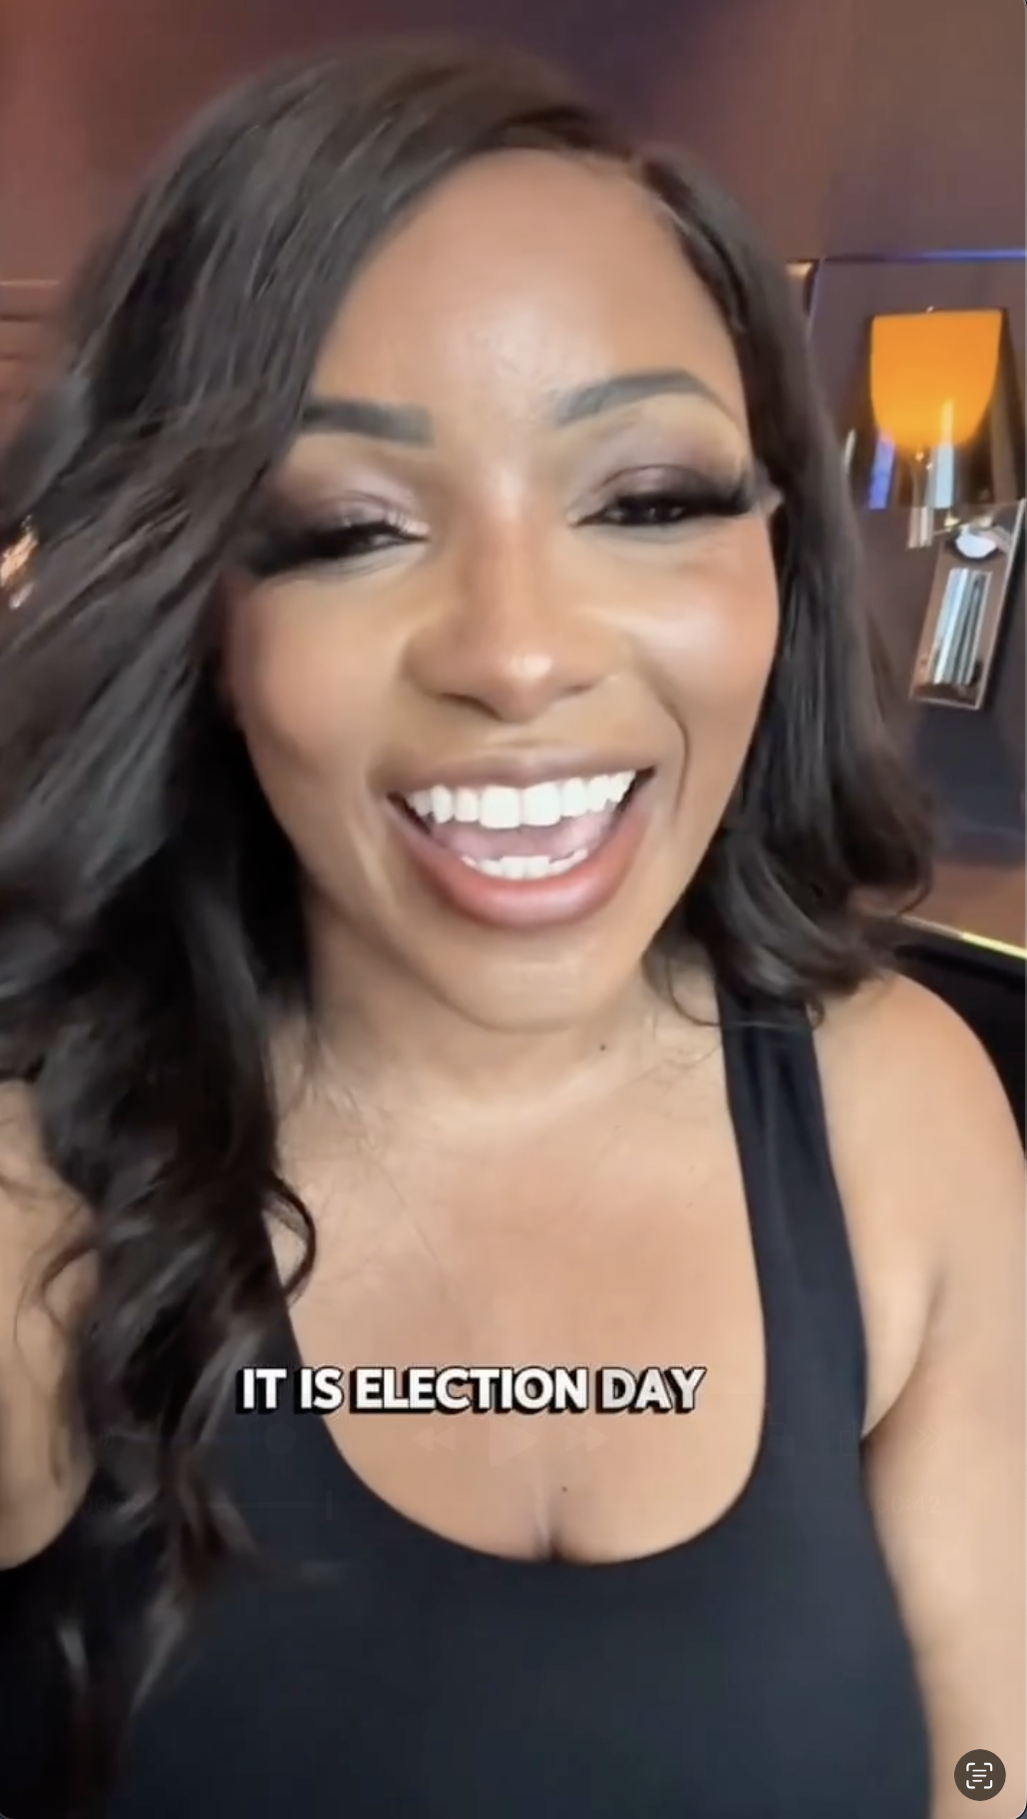
The Core Tension: Closeness vs. Competence
Jasmine Crockett
(D-TX)
U.S. Representative
Instagram
“She’s talking to me!”
Notes:
may build parasocial closeness for politicians

Slide 27
The Core Tension: Closeness vs. Competence
Jasmine Crockett
(D-TX)
U.S. Representative
Instagram
“She’s talking to me!”
“She doesn’t look electable.”
Notes:
or make a candidate look less competent.

Slide 28
The Core Tension: Closeness vs. Competence
Which one is correct?
Jasmine Crockett
(D-TX)
U.S. Representative
Instagram
“She’s talking to me!”
“She doesn’t look electable.”
Notes:
That is the tension I try to resolve in this paper.
(04:05)

Slide 29
Three Questions Separate the Hype From the Strategy
Notes:
So I break that larger puzzle into three questions.

Slide 30
Three Questions Separate the Hype From the Strategy
Adoption:
  RQ1: Do candidates use influencer-style communication?
Notes:
First, do candidates actually use this informal, casual, influencer-style communication? Beyond the famous exemplars, how common is this style in political campaigns?

Slide 31
Three Questions Separate the Hype From the Strategy
Adoption:
  RQ1: Do candidates use influencer-style communication?
Platform Rewards:
  RQ2: Is influencer-style associated with higher engagement?
Notes:
Second, when candidates use it, does the platform reward them?

Slide 32
Three Questions Separate the Hype From the Strategy
Adoption:
  RQ1: Do candidates use influencer-style communication?
Platform Rewards:
  RQ2: Is influencer-style associated with higher engagement?
Voter Evaluations:
Notes:
So the third—and most important—question is:

Slide 33
Three Questions Separate the Hype From the Strategy
Adoption:
  RQ1: Do candidates use influencer-style communication?
Platform Rewards:
  RQ2: Is influencer-style associated with higher engagement?
Voter Evaluations:
  RQ3: How does influencer style affect candidate evaluations?
Notes:
do voters reward it? These three questions organize the rest of the talk.

Slide 34
Three Studies: From Campaign Behavior to Voter Response
Notes:
To resolve the tension, I use three studies that build on each other.

Slide 35
Three Studies: From Campaign Behavior to Voter Response
Study 1: What candidates do
16,572 Instagram Reels
Adoption Patterns
&
Platform Engagement
Notes:
Study 1 asks what candidates are doing in the wild.

Slide 36
Three Studies: From Campaign Behavior to Voter Response
Study 1: What candidates do
16,572 Instagram Reels
Adoption Patterns
&
Platform Engagement
Studies 2&3: How voters respond
Notes:
Studies 2 and 3 ask what those same communicative cues do to voters.

Slide 37
Three Studies: From Campaign Behavior to Voter Response
Study 1: What candidates do
16,572 Instagram Reels
Adoption Patterns
&
Platform Engagement
Studies 2&3: How voters respond
2 GenAI Video Experiments
Notes:
In two preregistered experiments, I hold the candidate and message fixed while varying influencer style cues.

Slide 38
Three Studies: From Campaign Behavior to Voter Response
Study 1: What candidates do
16,572 Instagram Reels
Adoption Patterns
&
Platform Engagement
Studies 2&3: How voters respond
2 GenAI Video Experiments
Parasocial Closeness
Perceived Competence
Voter Support
Notes:
I then measure parasocial closeness, perceived competence, And voter support.

Slide 39
Three Studies: From Campaign Behavior to Voter Response
Study 1: What candidates do
16,572 Instagram Reels
Adoption Patterns
&
Platform Engagement
Studies 2&3: How voters respond
2 GenAI Video Experiments
Parasocial Closeness
Perceived Competence
Voter Support
Notes:
So let me start with Study 1: (04:55)

Slide 40
Study 1: Candidate Instagram Use in the Wild
Notes:
what candidates are actually doing in the wild.

Slide 41
Study 1: Candidate Instagram Use in the Wild
Data
16,572 Reels
200 Accounts
NJ & VA
2025 State
Legislative
Elections
Notes:
I collected over 16,000 Instagram Reels

Slide 42
Study 1: Candidate Instagram Use in the Wild
Data
16,572 Reels
200 Accounts
NJ & VA
2025 State
Legislative
Elections
Notes:
from 200 candidate accounts

Slide 43
Study 1: Candidate Instagram Use in the Wild
Data
16,572 Reels
200 Accounts
NJ & VA
2025 State
Legislative
Elections
Notes:
in the 2025 New Jersey and Virginia state legislative elections.
These were the most recent elections at the time of data collection.

Slide 44
Study 1: Candidate Instagram Use in the Wild
Data
16,572 Reels
200 Accounts
NJ & VA
2025 State
Legislative
Elections
Ongoing Data Collection for Congressional Candidates
Notes:
I am currently in the midst of collecting these again for congressional candidates for the very recent elections.
But this data turns out to be quite fit for the project.

Slide 45
Study 1: Candidate Instagram Use in the Wild
Data
16,572 Reels
200 Accounts
NJ & VA
2025 State
Legislative
Elections
Off-Year Elections
Ongoing Data Collection for Congressional Candidates
Notes:
First, it’s an off-year cycle.

Slide 46
Study 1: Candidate Instagram Use in the Wild
Data
16,572 Reels
200 Accounts
NJ & VA
2025 State
Legislative
Elections
Off-Year Elections
  Not competing with a presidential race
Ongoing Data Collection for Congressional Candidates
Notes:
so these candidates were not competing with a presidential race for attention.

Slide 47
Study 1: Candidate Instagram Use in the Wild
Data
16,572 Reels
200 Accounts
NJ & VA
2025 State
Legislative
Elections
Off-Year Elections
  Not competing with a presidential race
Broad Candidate Coverage
  Near-complete data collection
Ongoing Data Collection for Congressional Candidates
Notes:
Second, they are small enough that I can get much closer to a near-complete population of candidates and their posts, instead of a small random sample.

Slide 48
Study 1: Candidate Instagram Use in the Wild
Data
16,572 Reels
200 Accounts
NJ & VA
2025 State
Legislative
Elections
Off-Year Elections
  Not competing with a presidential race
Broad Candidate Coverage
  Near-complete data collection
Closer to Average Candidates
  Diffused beyond famous examples?
Ongoing Data Collection for Congressional Candidates
Notes:
And third, these candidates generally operate with fewer resources and lower name recognition than national politicians. That makes them especially useful for asking whether influencer-style communication has diffused beyond the famous exemplars we started with.

Slide 49
Study 1: Candidate Instagram Use in the Wild
Data
16,572 Reels
200 Accounts
NJ & VA
2025 State
Legislative
Elections
Off-Year Elections
  Not competing with a presidential race
Broad Candidate Coverage
  Near-complete data collection
Closer to Average Candidates
  Diffused beyond famous examples?
Why Instagram?
Ongoing Data Collection for Congressional Candidates
Notes:
I focus on Instagram because, in this candidate population

Slide 50
Study 1: Candidate Instagram Use in the Wild
Data
16,572 Reels
200 Accounts
NJ & VA
2025 State
Legislative
Elections
Off-Year Elections
  Not competing with a presidential race
Broad Candidate Coverage
  Near-complete data collection
Closer to Average Candidates
  Diffused beyond famous examples?
Why Instagram?
  4 x coverage than TikTok
Ongoing Data Collection for Congressional Candidates
Notes:
it gives me substantially broader coverage than TikTok. About 70% of all candidates are on Instagram.
(06:00)

Slide 51
What is Influencer-Style?
Notes:
So that brings me to the measurement problem: what exactly counts as “influencer style” in a political video?

Slide 52
Decomposition of Influencer-Style
Notes:
I decompose influencer-style communication into two dimensions based on observable features of the video.

Slide 53
Decomposition of Influencer-Style
Aesthetic Proximity
(2 indicators)
Informal production
Informal candidate presentation
Notes:
The first is what I call aesthetic proximity.

Slide 54

Decomposition of Influencer-Style
Aesthetic Proximity
(2 indicators)
Informal production
Informal candidate presentation
Notes:
This captures the visual and presentational side of the style.

Slide 55

Decomposition of Influencer-Style
Aesthetic Proximity
(2 indicators)
Informal production
Informal candidate presentation
Notes:
So I look for things like informal production, such as selfie framing, handheld cameras,

Slide 56
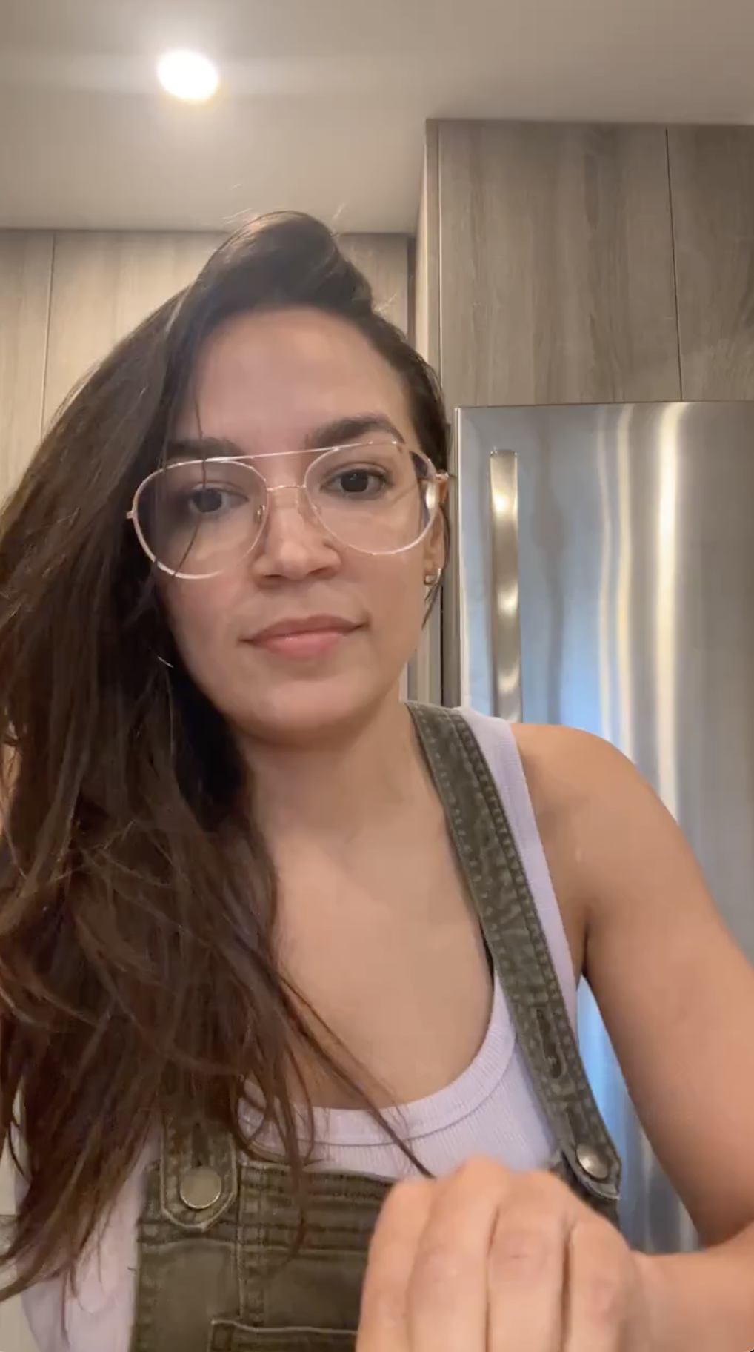
Decomposition of Influencer-Style
Aesthetic Proximity
(2 indicators)
Informal production
Informal candidate presentation
Notes:
as well as informal candidate presentation, such as casual clothing or everyday settings.

Slide 57
Decomposition of Influencer-Style
Aesthetic Proximity
(2 indicators)
Informal production
Informal candidate presentation
Relational Signaling
(5 indicators)
Direct address
Personal self-disclosure
Mutual awareness
Identity bridging
Interaction invitations
Notes:
The second dimension is relational signaling.

Slide 58

Decomposition of Influencer-Style
Aesthetic Proximity
(2 indicators)
Informal production
Informal candidate presentation
Relational Signaling
(5 indicators)
Direct address
Personal self-disclosure
Mutual awareness
Identity bridging
Interaction invitations
Notes:
This is about how the candidate communicates verbally with the viewers.
Here I look for cues that simulate interpersonal exchange.

Slide 59
Decomposition of Influencer-Style
Aesthetic Proximity
(2 indicators)
Informal production
Informal candidate presentation
Relational Signaling
(5 indicators)
Direct address
Personal self-disclosure
Mutual awareness
Identity bridging
Interaction invitations
Full codebook available online (in appendix)
Notes:
I’m happy to talk more about this in the Q&A.

Slide 60
Scaling the Annotation to 16,572 Videos
Aesthetic Proximity
Relational Signaling
Notes:
So with these two dimensions defined, the next step is to measure them consistently across all videos.
(07:10)

Slide 61
Scaling the Annotation to 16,572 Videos
Aesthetic Proximity
Relational Signaling
Hand-Code
100 Reels
Random Sample
Apply 7 Indicators
Notes:
I start by hand-coding a random sample of 100 videos using the same codebook we just discussed.

Slide 62
Scaling the Annotation to 16,572 Videos
Aesthetic Proximity
Relational Signaling
Hand-Code
Validate
Same Codebook
Gemini-3.1-Pro
95.1% Agreement
100 Reels
Random Sample
Apply 7 Indicators
Notes:
I then asked Gemini to classify each indicator independently as present or absent.
Across the seven indicators

Slide 63
Scaling the Annotation to 16,572 Videos
Aesthetic Proximity
Relational Signaling
Hand-Code
Validate
Same Codebook
Gemini-3.1-Pro
95.1% Agreement
100 Reels
Random Sample
Apply 7 Indicators
Notes:
the model and human coding agree 95.1% on average.

Slide 64
Scaling the Annotation to 16,572 Videos
Aesthetic Proximity
Relational Signaling
Hand-Code
Validate
Scale
Same Codebook
Gemini-3.1-Pro
95.1% Agreement
100 Reels
Random Sample
Apply 7 Indicators
16,572 Reels
Each Indicator
(0/1)
Notes:
I then scale this procedure to apply across all Instagram Reels.

Slide 65
Scaling the Annotation to 16,572 Videos
Aesthetic Proximity
Relational Signaling
Hand-Code
Validate
Scale
Aggregate
Same Codebook
Gemini-3.1-Pro
95.1% Agreement
2 Indices [0,1]
Aesthetic
Proximity
Relational
Signaling
100 Reels
Random Sample
Apply 7 Indicators
16,572 Reels
Each Indicator
(0/1)
Notes:
Finally, I combine the individual indicators into two normalized indices

Slide 66
Scaling the Annotation to 16,572 Videos
Aesthetic Proximity
Relational Signaling
Hand-Code
Validate
Scale
Aggregate
Same Codebook
Gemini-3.1-Pro
95.1% Agreement
2 Indices [0,1]
Aesthetic
Proximity
Relational
Signaling
100 Reels
Random Sample
Apply 7 Indicators
16,572 Reels
Each Indicator
(0/1)
Notes:
one for aesthetic proximity

Slide 67
Scaling the Annotation to 16,572 Videos
Aesthetic Proximity
Relational Signaling
Hand-Code
Validate
Scale
Aggregate
Same Codebook
Gemini-3.1-Pro
95.1% Agreement
2 Indices [0,1]
Aesthetic
Proximity
Relational
Signaling
100 Reels
Random Sample
Apply 7 Indicators
16,572 Reels
Each Indicator
(0/1)
Notes:
one for relational signaling—each ranging from zero to one.
Once I code these features, a clear pattern emerges:
(08:00)

Slide 68
Candidates Mostly Borrow the Influencer Look
Notes:
Candidates are adopting influencer-style communication selectively.

Slide 69
Candidates Mostly Borrow the Influencer Look
72.5% has at least 1 of 7 cues
Notes:
72.5% of Reels have at least one of the 7 cues, so this isn't niche behavior.

Slide 70
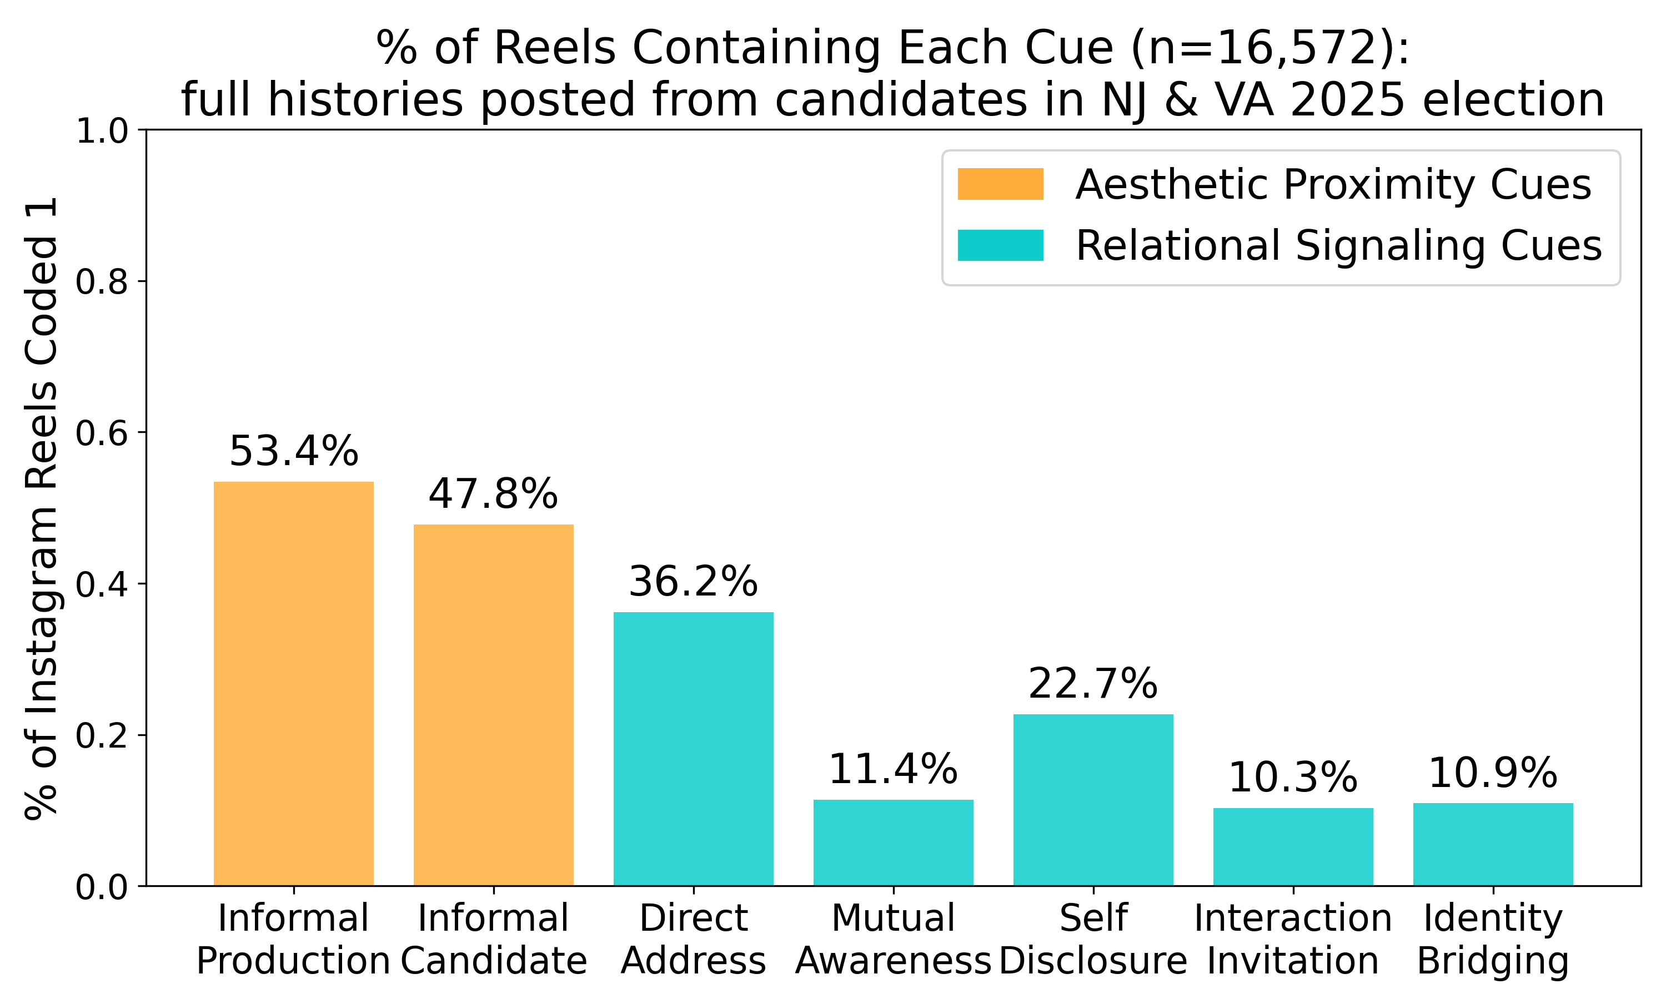
Candidates Mostly Borrow the Influencer Look
72.5% has at least 1 of 7 cues
Notes:
On the aesthetic side, about 53% of Reels use informal production,

Slide 71
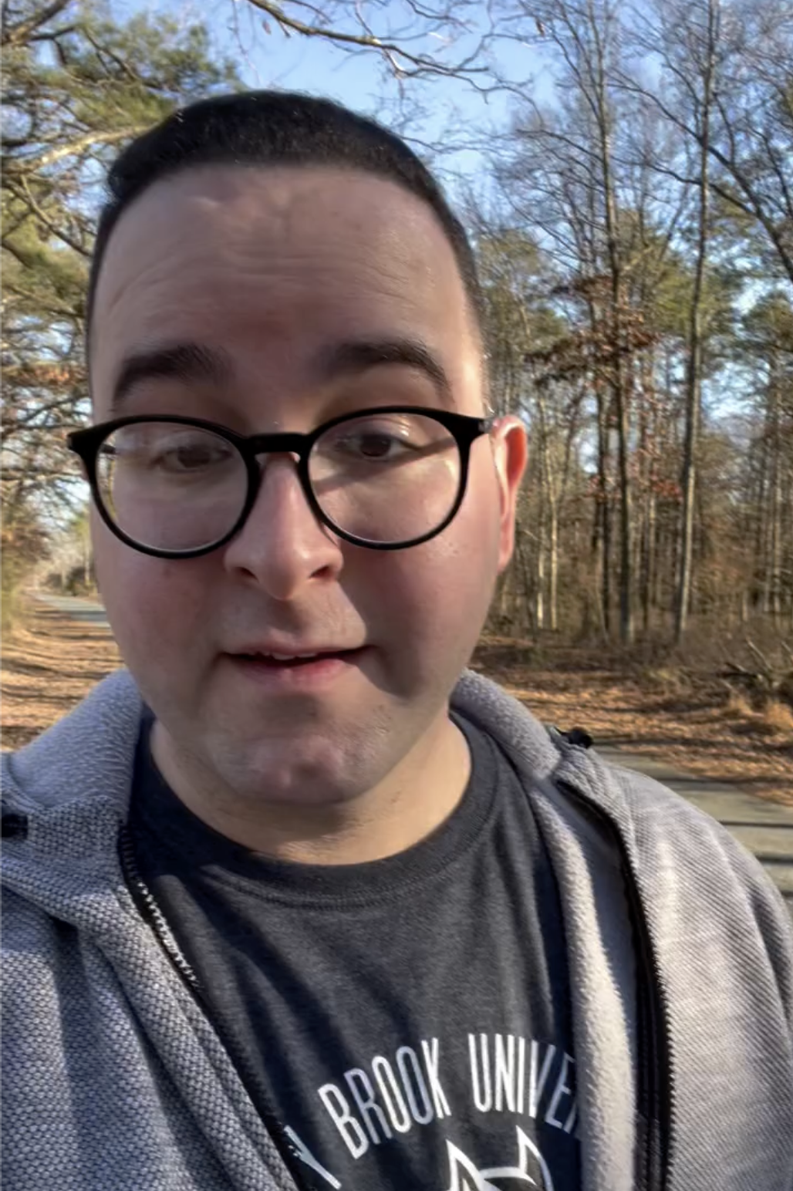
Candidates Mostly Borrow the Influencer Look
72.5% has at least 1 of 7 cues
Notes:
and 48% feature informal candidate presentation.
So roughly half already use the visual grammar of influencer style.

Slide 72
Candidates Mostly Borrow the Influencer Look
72.5% has at least 1 of 7 cues
Notes:
Relational cues are much rarer.

Slide 73
Candidates Mostly Borrow the Influencer Look
72.5% has at least 1 of 7 cues
Notes:
Direct a’ddress appears in about 36% of Reels,

Slide 74
Candidates Mostly Borrow the Influencer Look
72.5% has at least 1 of 7 cues
Notes:
while the deeper relational practices appear in only about 10–20%.

Slide 75
Candidates Mostly Borrow the Influencer Look
72.5% has at least 1 of 7 cues
Common
Notes:
So candidates are quite willing to look like influencers

Slide 76
Candidates Mostly Borrow the Influencer Look
72.5% has at least 1 of 7 cues
Common
Rare
Notes:
but much less likely to communicate using their relational language.

Slide 77
The Platform Rewards Aesthetic Proximity
Notes:
So why might candidates be adopting the aesthetic side more readily?
One possibility is that it also appears to perform better on the platform.

Slide 78
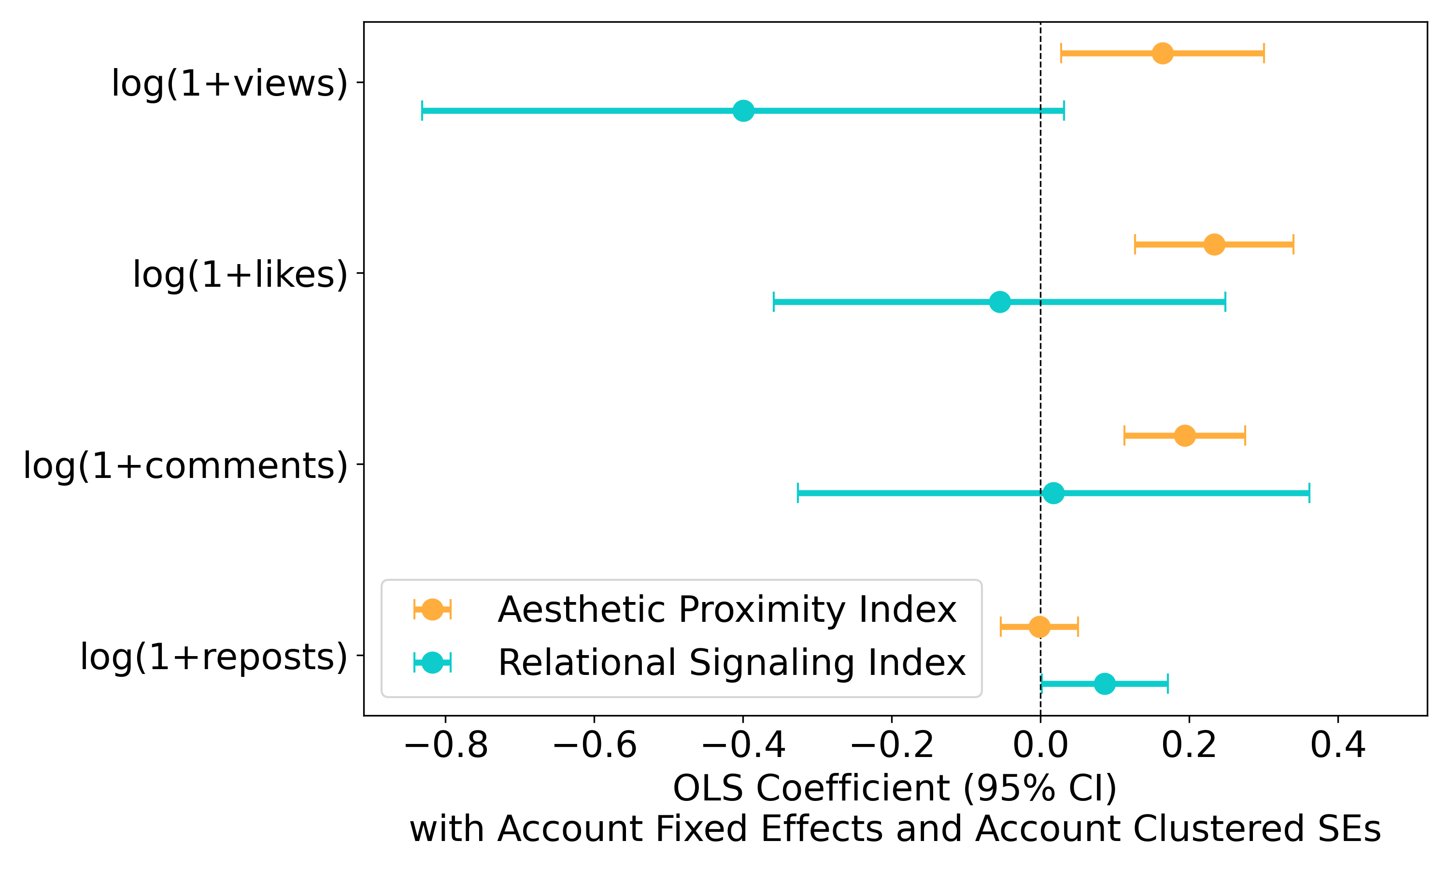
The Platform Rewards Aesthetic Proximity
Notes:
So I ran an OLS relating each video's aesthetic and relational indices to the platform engagement metrics.

Slide 79
The Platform Rewards Aesthetic Proximity
Notes:
including views,

Slide 80
The Platform Rewards Aesthetic Proximity
Notes:
likes

Slide 81
The Platform Rewards Aesthetic Proximity
Notes:
comments

Slide 82
The Platform Rewards Aesthetic Proximity
Notes:
and reposts.

Slide 83
The Platform Rewards Aesthetic Proximity
Notes:
Moving from the bottom to the top of the aesthetic-proximity index is associated with

Slide 84
The Platform Rewards Aesthetic Proximity
+ 18% views
+ 26% likes
+ 21% comments
Notes:
about 18% more views,

Slide 85
The Platform Rewards Aesthetic Proximity
+ 18% views
+ 26% likes
+ 21% comments
Notes:
26% more likes,

Slide 86
The Platform Rewards Aesthetic Proximity
+ 18% views
+ 26% likes
+ 21% comments
Notes:
and 21% more comments.

Slide 87
The Platform Rewards Aesthetic Proximity
+ 18% views
+ 26% likes
+ 21% comments
Weak
Inconsistent
Returns
Notes:
For relational signaling, the pattern is much weaker and less consistent across outcomes.

Slide 88
The Causal Comparison I Need Doesn’t Exist (in real campaigns)
Notes:
Now, if I want to isolate the effect of influencer style communication, I need to look at comparable videos that are different only in communication style but the same on all other dimensions.
As you can imagine, it is extremely difficult to find these videos in real campaign content.

Slide 89
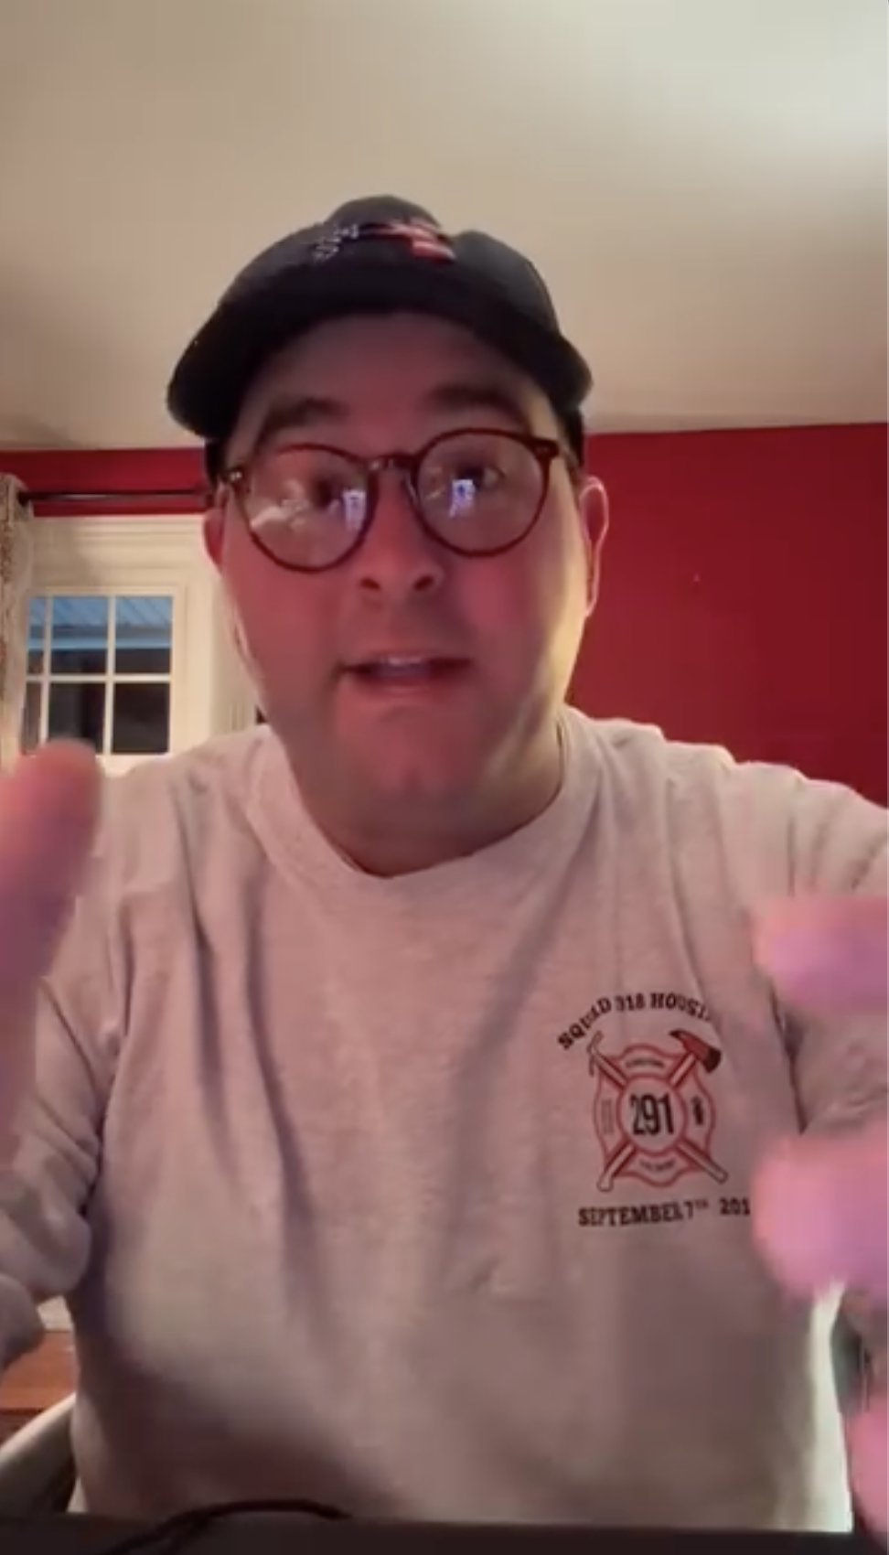
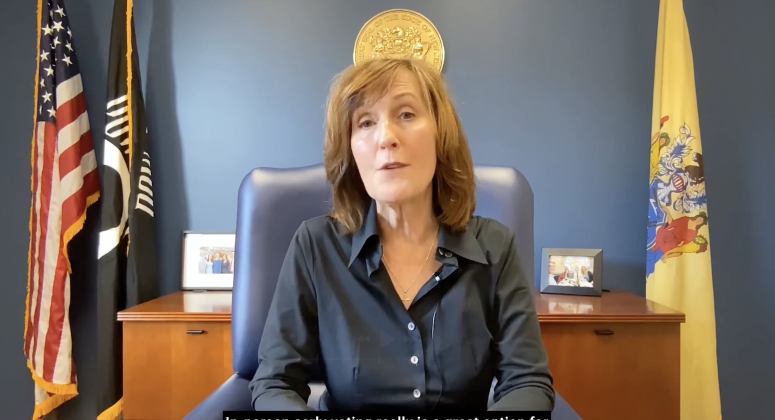
The Causal Comparison I Need Doesn’t Exist (in real campaigns)
Notes:
Take these two videos. There're both real videos from data I collected for Study 1.

Slide 90
The Causal Comparison I Need Doesn’t Exist (in real campaigns)
Traditional
Notes:
One looks more like traditional political communication

Slide 91
The Causal Comparison I Need Doesn’t Exist (in real campaigns)
Influencer
Traditional
Notes:
The other looks more like influencer-style content.
But they also differ in almost everything else.

Slide 92
The Causal Comparison I Need Doesn’t Exist (in real campaigns)
No isolation of treatment
Notes:
So if voters respond differently to these two videos, I have no way to know whether they are responding to the communication style—or to any of the other things that changed with it.

Slide 93
The Causal Comparison I Need Doesn’t Exist (in real campaigns)
Counterfactuals?
Notes:
What I really need is a counterfactual that campaigns almost never produce:

Slide 94
The Causal Comparison I Need Doesn’t Exist (in real campaigns)
Same candidate.
Notes:
the same candidate

Slide 95
The Causal Comparison I Need Doesn’t Exist (in real campaigns)
Same candidate. Same message.
Notes:
saying the same thing twice,

Slide 96
The Causal Comparison I Need Doesn’t Exist (in real campaigns)
Same candidate. Same message. Different style.
Notes:
with only the communication style changing.
So if that comparison does not exist naturally—

Slide 97
The Causal Comparison I Need Doesn’t Exist (in real campaigns)
Let’s create it!
Notes:
I have to create it.
And that is where generative AI enters the research design.
(10:30)

Slide 98
A Modular Generative AI Pipeline
Notes:
When video generation models came out, I thought this step was going to be easy. But one-shot models like Sora really struggled with consistency.
So I spent several months testing different models, prompts, and generation procedures to try to solve this problem.

Slide 99
A Modular Generative AI Pipeline
Held constant across conditions: identity, voice, policy position, length
Script
Design
Voice
Creation
Avatar
Generation
Animation
Lip-sync
Realism
Validation
Script
(ChatGPT)
Voice/
Audio
(ElevenLabs)
Avatar Image
(KlingAI)
Visual/
Frame
(KlingAI)
Audiovisual
(SyncLabs)
Ratings
(Human)
Manipulating
Relational
Signaling
Manipulating
Aesthetic
Proximity
Notes:
And the solution I arrived at is to break the video into separate components and control each one independently.
That gives me a modular six-stage generation pipeline. Happy to talk more in the Q&A.

Slide 100
Treatments Change Two Components (While Holding Candidates Fixed)
High
Relational Signaling
Low
Low
High
Aesthetic Proximity
Notes:
Here I’ll use my Study 3 for illustration.
Across all four conditions,

Slide 101
Treatments Change Two Components (While Holding Candidates Fixed)
Same candidate.
High
Relational Signaling
Low
Low
High
Aesthetic Proximity
Notes:
participants see the same fictional candidate

Slide 102
Treatments Change Two Components (While Holding Candidates Fixed)
Same candidate. Same voice.
High
Relational Signaling
Low
Low
High
Aesthetic Proximity
Notes:
using the same voice

Slide 103
Treatments Change Two Components (While Holding Candidates Fixed)
Same candidate. Same voice. Same policy.
High
Relational Signaling
Low
Low
High
Aesthetic Proximity
Notes:
talking about the same policy issue,

Slide 104
Treatments Change Two Components (While Holding Candidates Fixed)
Same candidate. Same voice. Same policy. Same position.
High
Relational Signaling
Low
Low
High
Aesthetic Proximity
Notes:
and taking the same political position.

Slide 105
Treatments Change Two Components (While Holding Candidates Fixed)
Same candidate. Same voice. Same policy. Same position.
High
Relational Signaling
Low
Low
High
Aesthetic Proximity
Notes:
What changes are only the two dimensions I introduced earlier.
Across the columns, I vary aesthetic proximity.

Slide 106
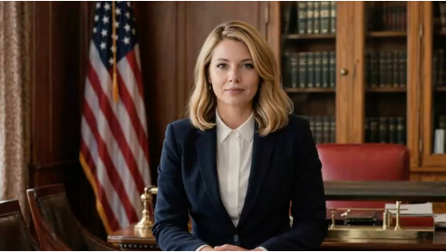
Treatments Change Two Components (While Holding Candidates Fixed)
Same candidate. Same voice. Same policy. Same position.
High
Relational Signaling
Low
Low
High
Aesthetic Proximity

Slide 107
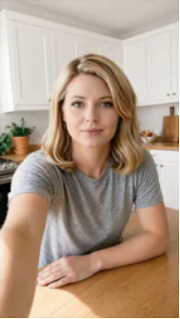
Treatments Change Two Components (While Holding Candidates Fixed)
Same candidate. Same voice. Same policy. Same position.
High
Relational Signaling
Low
Low
High
Aesthetic Proximity

Slide 108
Treatments Change Two Components (While Holding Candidates Fixed)
Same candidate. Same voice. Same policy. Same position.
High
Relational Signaling
Low
Low
High
Aesthetic Proximity
Notes:
Across the rows, I vary relational signaling.

Slide 109
Treatments Change Two Components (While Holding Candidates Fixed)
Same candidate. Same voice. Same policy. Same position.
High
Relational Signaling
The rising cost of living has increased significantly in recent years, placing sustained pressure on household …
Low
Low
High
Aesthetic Proximity

Slide 110
Treatments Change Two Components (While Holding Candidates Fixed)
Same candidate. Same voice. Same policy. Same position.
So a lot of you have been telling me how expensive everyday life has gotten lately…
High
Relational Signaling
The rising cost of living has increased significantly in recent years, placing sustained pressure on household …
Low
Low
High
Aesthetic Proximity

Slide 111
Treatments Change Two Components (While Holding Candidates Fixed)
Same candidate. Same voice. Same policy. Same position.
So a lot of you have been telling me how expensive everyday life has gotten lately…
High
Relational-Only
Full-Influencer
Relational Signaling
The rising cost of living has increased significantly in recent years, placing sustained pressure on household …
Low
Traditional Baseline
Aesthetic-Only
Low
High
Aesthetic Proximity
Notes:
So this gives me four versions of the same candidate.
The key point is that I am not comparing different politicians who happen to communicate differently.

Slide 112
Treatments Change Two Components (While Holding Candidates Fixed)
Same candidate. Same voice. Same policy. Same position.
High
Relational-Only
Full-Influencer
Relational Signaling
Low
Traditional Baseline
Aesthetic-Only
Low
High
Aesthetic Proximity
Notes:
I am comparing different versions of the same politician, where the treatment is the communication style itself.

Slide 113
Two Experiments On Voter Evaluations
Notes:
So I now turn to the two preregistered experiments and ask what happens when voters encounter these different versions of the same candidate.

Slide 114
Two Experiments On Voter Evaluations
Study 2:
Isolating
Aesthetic Proximity
N = 1,952
Mixed Design
4 Videos Per Respondent
(Female/Male,
Liberal/Conservative)
Notes:
Study 2 starts with the simpler question.

Slide 115
Two Experiments On Voter Evaluations
Study 2:
Isolating
Aesthetic Proximity
N = 1,952
Mixed Design
4 Videos Per Respondent
(Female/Male,
Liberal/Conservative)
2
Notes:
I manipulate only aesthetic proximity.

Slide 116
Two Experiments On Voter Evaluations
Study 2:
Isolating
Aesthetic Proximity
N = 1,952
Mixed Design
4 Videos Per Respondent
(Female/Male,
Liberal/Conservative)
Notes:
and fielded that study with over 1,900 respondents.

Slide 117
Two Experiments On Voter Evaluations
Study 2:
Isolating
Aesthetic Proximity
N = 1,952
Mixed Design
4 Videos Per Respondent
(Female/Male,
Liberal/Conservative)
Notes:
Each respondent evaluated multiple candidate videos.

Slide 118
Two Experiments On Voter Evaluations
Study 2:
Isolating
Aesthetic Proximity
N = 1,952
Mixed Design
4 Videos Per Respondent
(Female/Male,
Liberal/Conservative)
Notes:
This gives me repeated observations of how changing the aesthetic proximity cues affects candidate evaluations.

Slide 119
Two Experiments On Voter Evaluations
Study 2:
Isolating
Aesthetic Proximity
N = 1,952
Mixed Design
4 Videos Per Respondent
(Female/Male,
Liberal/Conservative)
Study 3:
Manipulating Relational
& Aesthetic Cues Independently
N = 1,575
Between-Subject Design
2 x 2 Factorial
Single Video Exposure
Notes:
Then Study 3 extends the design to the full theoretical argument.

Slide 120
Two Experiments On Voter Evaluations
Study 2:
Isolating
Aesthetic Proximity
N = 1,952
Mixed Design
4 Videos Per Respondent
(Female/Male,
Liberal/Conservative)
Study 3:
Manipulating Relational
& Aesthetic Cues Independently
N = 1,575
Between-Subject Design
2 x 2 Factorial
Single Video Exposure
Notes:
With over 1,500 respondents, I independently manipulate both aesthetic proximity and relational signaling

Slide 121
Two Experiments On Voter Evaluations
Study 2:
Isolating
Aesthetic Proximity
N = 1,952
Mixed Design
4 Videos Per Respondent
(Female/Male,
Liberal/Conservative)
Study 3:
Manipulating Relational
& Aesthetic Cues Independently
N = 1,575
Between-Subject Design
2 x 2 Factorial
Single Video Exposure
Notes:
in a two-by-two, between-subject design.

Slide 122
Study 2: Isolating Aesthetic Proximity
Notes:
So let me start with Study 2 and the simplest treatment: changing only aesthetic proximity.

Slide 123
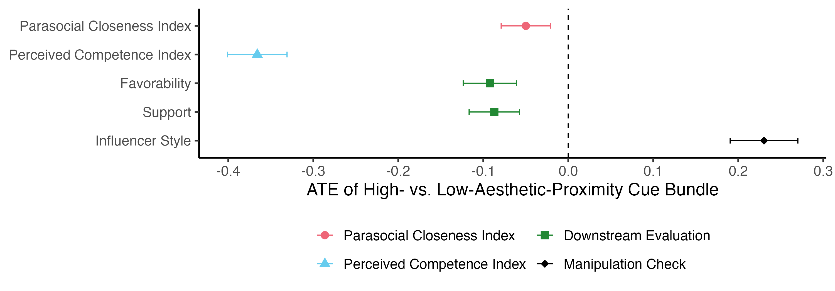
Study 2: Isolating Aesthetic Proximity
Parasocial Closeness?
Notes:
If the visual language of influencer communication helps candidates connect with voters, we should see greater parasocial closeness when the same candidate appears in the high-aesthetic condition.

Slide 124
Study 2: Isolating Aesthetic Proximity
Parasocial Closeness: No Benefit
Notes:
But that is not what I find.
Changing the candidate from a more traditional presentation to the more casual, influencer-style presentation produces no increase in parasocial closeness.

Slide 125
Study 2: Isolating Aesthetic Proximity
Parasocial Closeness: Small Decline
Notes:
If anything, the estimate moves slightly in the opposite direction,

Slide 126
Study 2: Isolating Aesthetic Proximity
Parasocial Closeness: Small Decline
Perceived Competence:
Notes:
When we look at perceived competence, changing only aesthetic cues produces a much larger effect.

Slide 127
Study 2: Isolating Aesthetic Proximity
Parasocial Closeness: Small Decline
Perceived Competence: Large Penalty
-0.37 SD
Notes:
The high-aesthetic condition reduces perceived competence by about 0.37 standard deviations.

Slide 128
Study 2: Isolating Aesthetic Proximity
Parasocial Closeness: Small Decline
Perceived Competence: Large Penalty
Voter Support: Small Decline
Notes:
I also see a small decline in voter support in Study 2.

Slide 129
A Cost Without the Promised Benefit
Notes:
So in Study 2, Aesthetic proximity creates a competence cost without producing the promised gain in parasocial closeness.

Slide 130
Study 3: Is Relational Signaling the Missing Ingredient
Same candidate. Same voice. Same policy. Same position.
So a lot of you have been telling me how expensive everyday life has gotten lately…
High
Relational Signaling
The rising cost of living has increased significantly in recent years, placing sustained pressure on household …
Low
Low
High
Aesthetic Proximity
Notes:
Then in Study 3, I independently vary both dimensions.
Does relational signaling generate the closeness that aesthetic proximity does not?

Slide 131
Neither Dimension Reliably Increases Parasocial Closeness
Notes:
The answer is: not reliably.

Slide 132
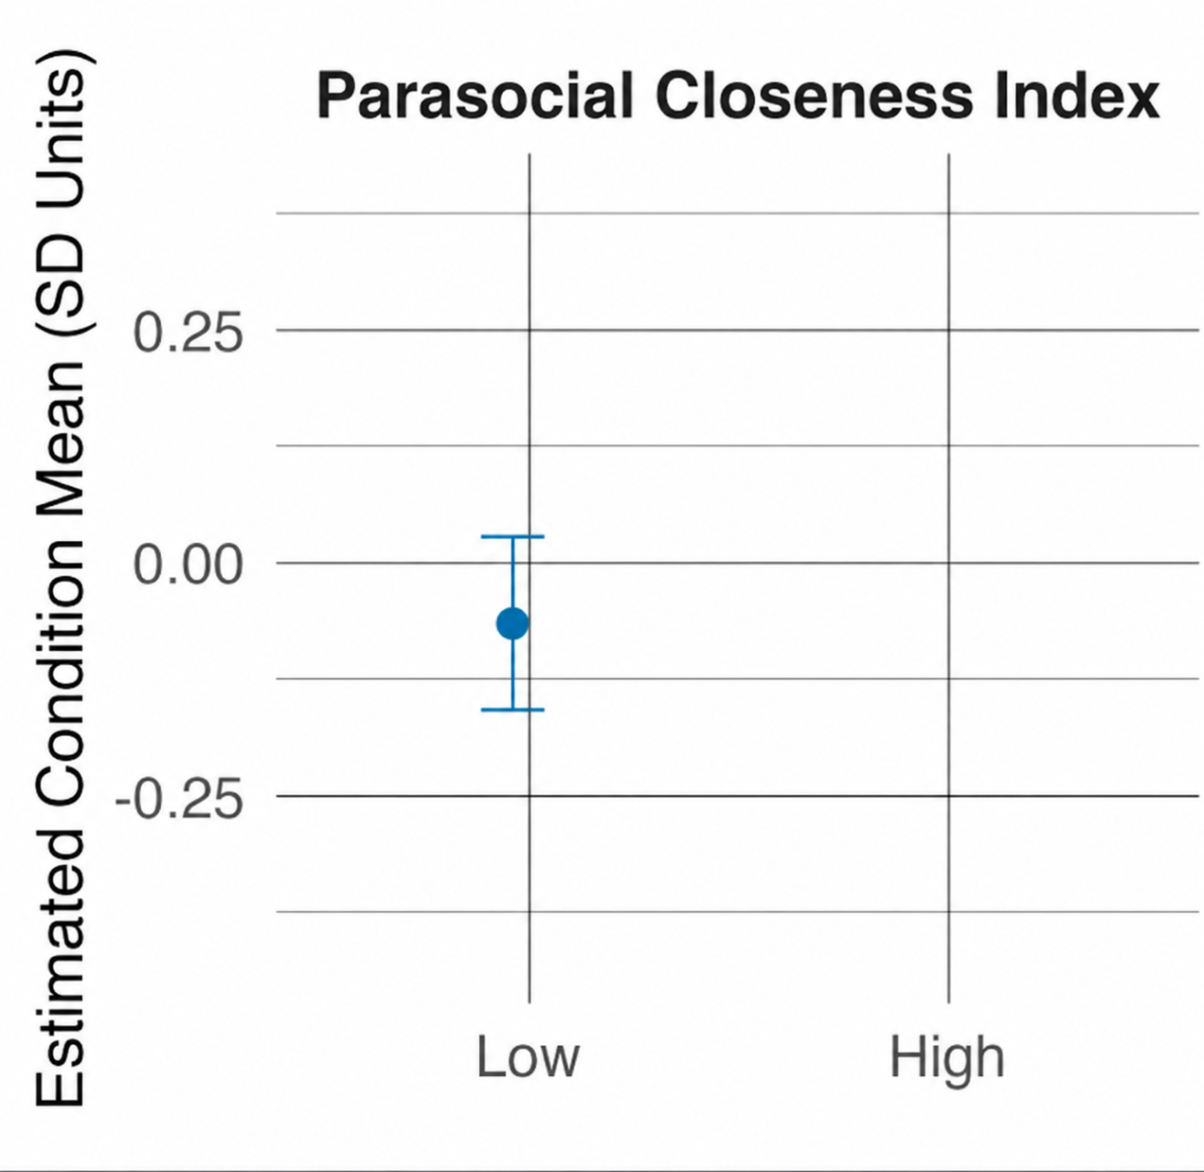
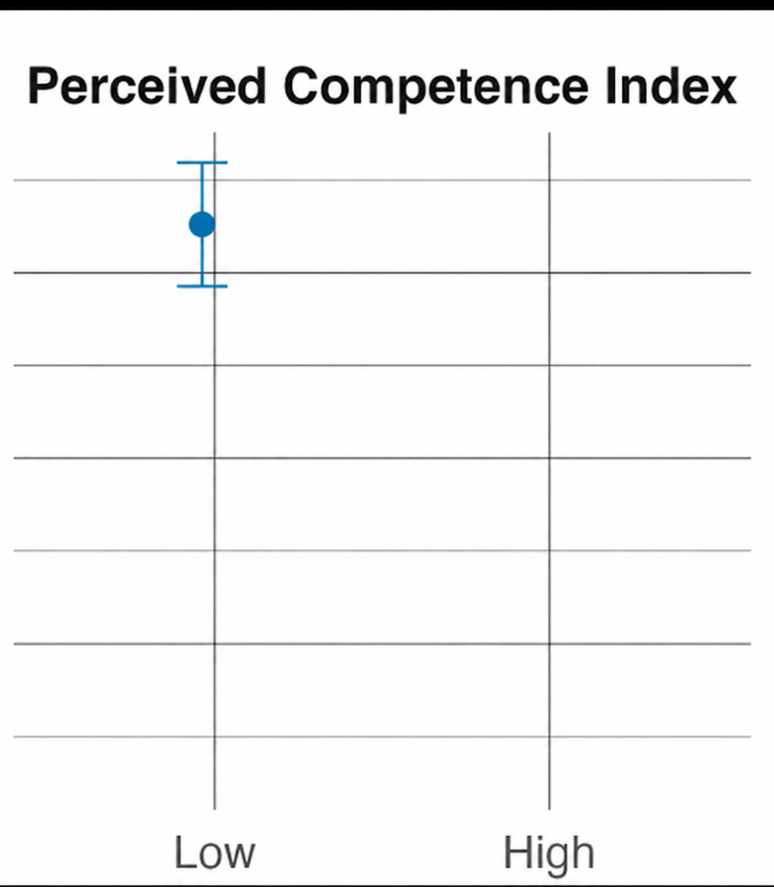
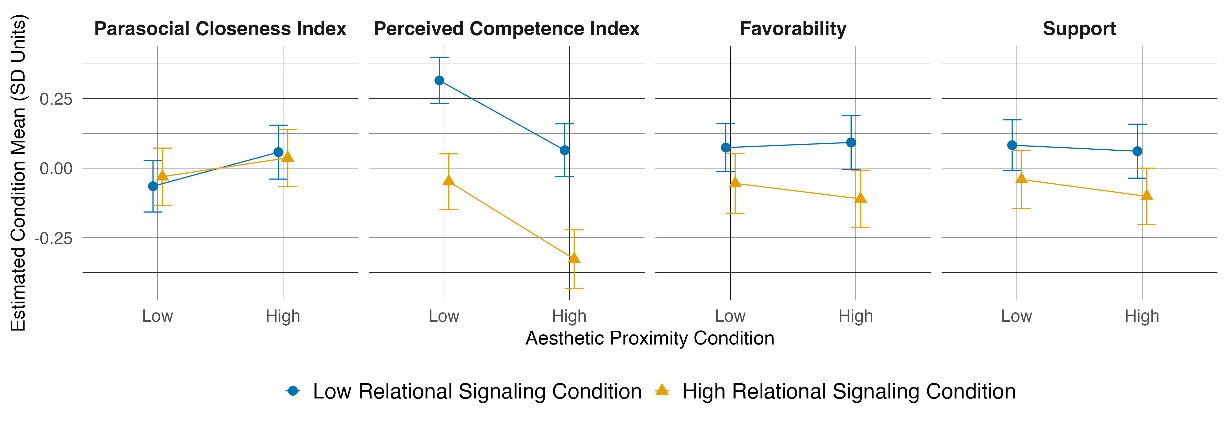
Neither Dimension Reliably Increases Parasocial Closeness
Notes:
Across all four conditions,

Slide 133
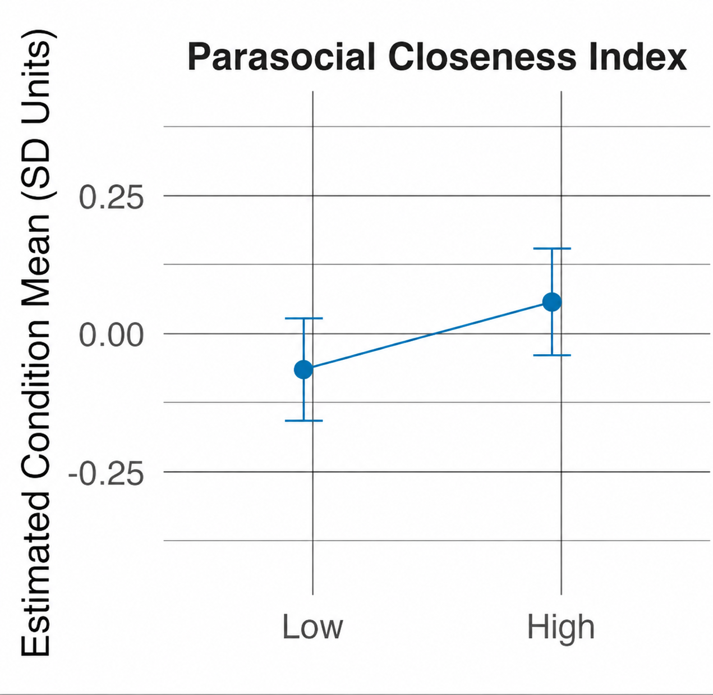
Neither Dimension Reliably Increases Parasocial Closeness
Notes:
neither aesthetic proximity

Slide 134
Neither Dimension Reliably Increases Parasocial Closeness
Notes:
relational signaling, nor the full influencer-style treatment produces a reliable gain in closeness.

Slide 135
Does Perceived Competence Replicate?
Notes:
But when we turn to perceived competence, the pattern is much clearer—and much more consequential.

Slide 136
Does Perceived Competence Replicate?
Notes:
I’ll start with the traditional baseline.
First, I change only aesthetic proximity.

Slide 137
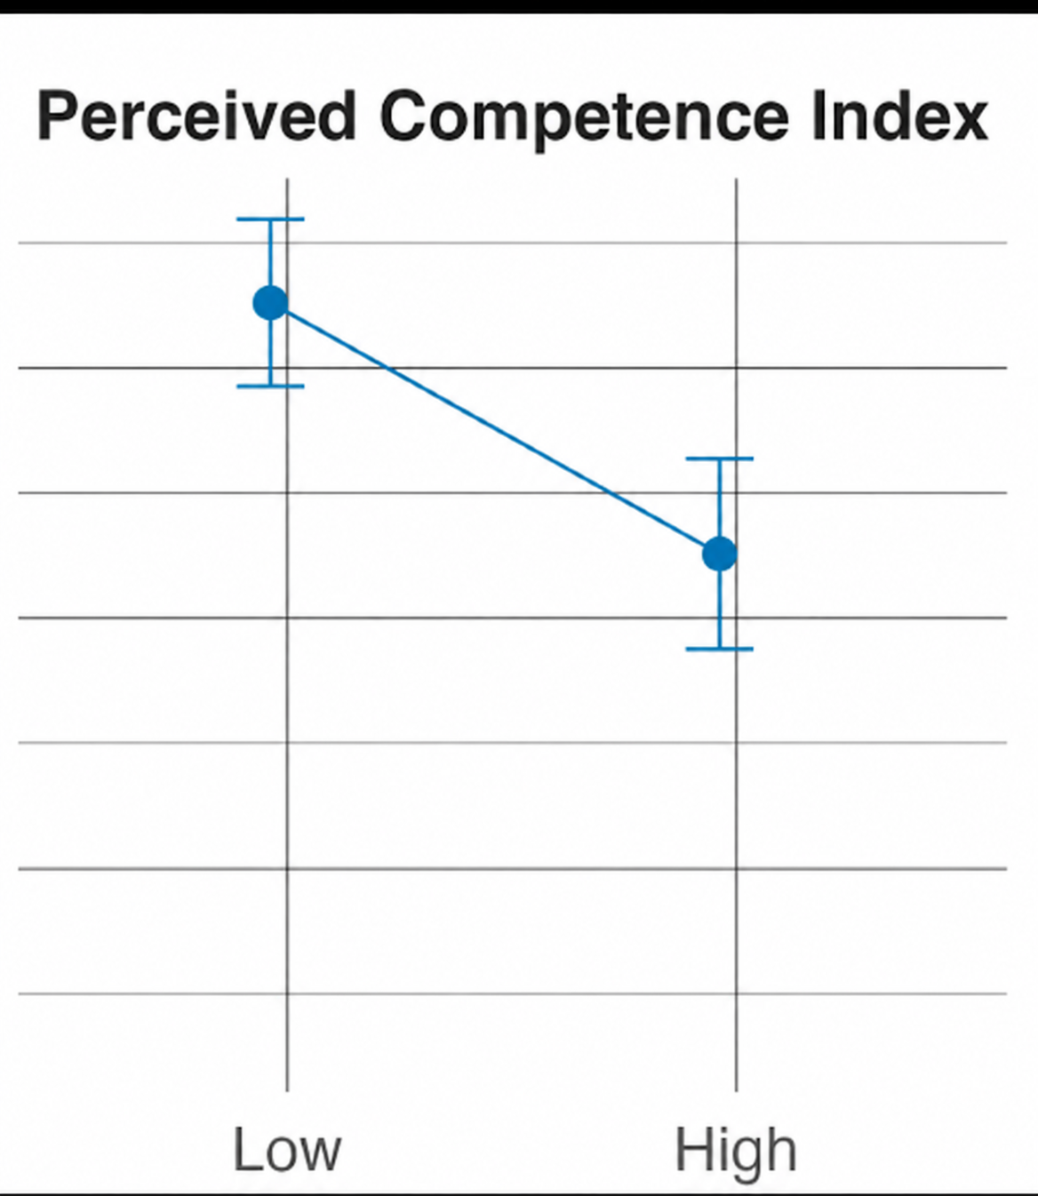
Does Perceived Competence Replicate? Yes!
Δ = −0.25 SD, p <.001
Notes:
Perceived competence falls by about a quarter of a standard deviation.
So the aesthetic penalty from Study 2 appears again in a different experimental design.
If I keep the low aesthetic proximity condition and change only the relational signaling,

Slide 138
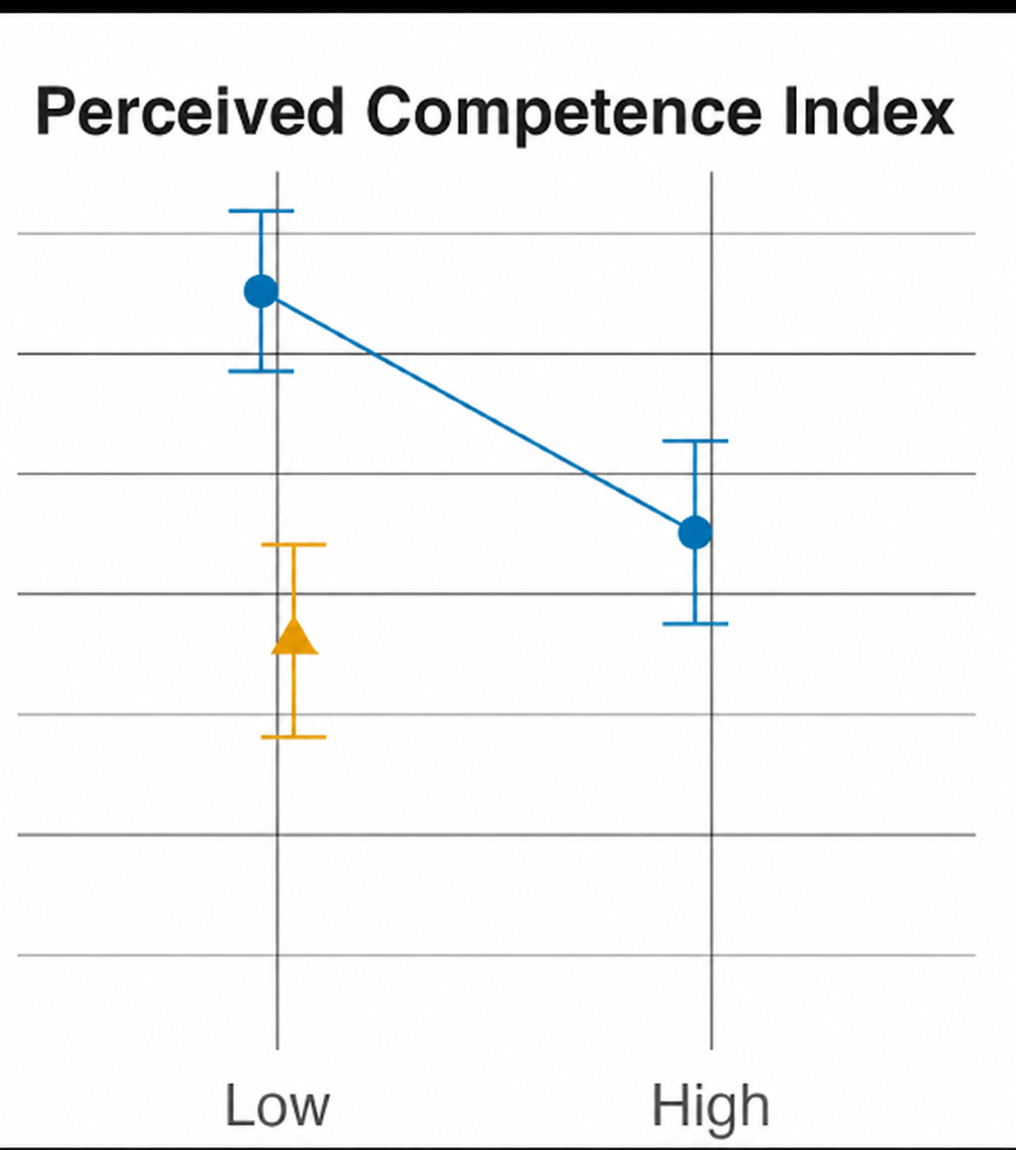
Does Perceived Competence Replicate? Yes!
Δ = −0.36 SD, p <.001
Notes:
perceived competence falls as well.
And when I combine both dimensions in the full influencer-style condition,

Slide 139
Does Perceived Competence Replicate? Yes!
Δ = −0.64 SD, p <.001
Notes:
the candidate receives the lowest competence rating of all four conditions.

Slide 140
Voter Support?
Notes:
Finally, voter support.

Slide 141
Support Does Not Reliably Improve
Notes:
Study 2 found a negative effect of aesthetic proximity. That specific result is less precise in Study 3, in part because Study 3 is also less powered with the between-subject single-exposure design.

Slide 142
Support Does Not Reliably Improve
Δ = −0.18 SD, p =.008
Notes:
But there is still no evidence of a benefit, and the full influencer condition actually reduces support. So at minimum, it is not helping—and it may even hurt.

Slide 143
So, Should Candidates Campaign Like Influencers?
Notes:
And that brings us back to the question we started with:
Should candidates campaign like influencers?

Slide 144
So, Should Candidates Campaign Like Influencers?
Not obviously.
Notes:
My answer is: not obviously.

Slide 145
So, Should Candidates Campaign Like Influencers?
Not obviously.
Adapting to the medium adopt the influencer playbook
Notes:
Candidates have to adapt to the new medium like they’ve always been, but that is different from adopting the full influencer playbook altogether.

Slide 146
So, Should Candidates Campaign Like Influencers?
Not obviously.
Adapting to the medium adopt the influencer playbook
Platform engagement voter persuasion
Notes:
The styles that perform well on the platform do not reliably produce greater closeness or support, and I find much clearer evidence of a cost to competence.

Slide 147
So, Should Candidates Campaign Like Influencers?
Not obviously.
Adapting to the medium adopt the influencer playbook
Platform engagement voter persuasion
New media do not erase old standards of political evaluation
Notes:
More broadly, new media do not erase old standards of political evaluation. Voters are still evaluating the person on screen as a prospective officeholder.

Slide 148
So, Should Candidates Campaign Like Influencers?
Not obviously.
Adapting to the medium adopt the influencer playbook
Platform engagement voter persuasion
New media do not erase old standards of political evaluation
Same Cues, Different Roles
Influencers
Authentic? Relatable? Personal?
Politicians
Serious? Capable? Fit to govern?
Notes:
So the same cue that makes an influencer seem authentic or relatable can carry a very different meaning when attached to someone asking to govern.

Slide 149
Likes Aren’t Votes.
— Candidate for the South Carolina House of Representatives
Notes:
I want to end with something a candidate running for the South Carolina House told me when I interviewed her.

Slide 150
Likes Aren’t Votes.
“I know it's important. I use it. I need to use it. I have to be on it. But being popular on social media does not convert to votes as much as some people like to think it does… Likes aren't votes.”
— Candidate for the South Carolina House of Representatives
Notes:
“I know it’s important. I use it. I need to use it. I have to be on it. But being popular on social media does not convert to votes as much as some people like to think it does....”

Slide 151
Likes Aren’t Votes.
“I know it's important. I use it. I need to use it. I have to be on it. But being popular on social media does not convert to votes as much as some people like to think it does… Likes aren't votes.”
— Candidate for the South Carolina House of Representatives
Notes:
“Likes aren’t votes.”

Slide 152

Paper + Appendix
Available for download
Thank you!
Cecilia Y. Sui
Washington University in St. Louis
c.sui@wustl.edu
ceciliaysui.com
Notes:
Thank you so much! I look forward to your questions and comments.

