Slide 1
Lab 2
Probability review

Slide 2
Pairwise independence does not imply mutual independence.
X = Flip coin, Pr(X = heads) = ½
Y = Flip Coin, Pr(Y = heads) = ½
Z = Pr(exactly X or Y are heads (not both)) = ½
X | Y | Z = XOR(X,Y)
0 | 0 | 0
1 | 0 | 1
0 | 1 | 1
1 | 1 | 0
X | Y | Pr[X,Y]
0 | 0 | 1/4
1 | 0 | 1/4
0 | 1 | 1/4
1 | 1 | 1/4
X | Z | Pr[X,Y]
0 | 0 | 1/4
1 | 1 | 1/4
0 | 1 | 1/4
1 | 0 | 1/4

Slide 3
Pairwise independence does not imply mutual independence.
X | Y | Z = XOR(X,Y) | Pr[X]*Pr[Y]*Pr[Z] | Pr[X,Y,Z]
0 | 0 | 0 | ⅛ | ¼
1 | 0 | 1 | ⅛ | ¼
0 | 1 | 1 | ⅛ | ¼
1 | 1 | 0 | ⅛ | ¼
0 | 0 | 1 | ⅛ | 0
1 | 0 | 0 | ⅛ | 0
0 | 1 | 0 | ⅛ | 0
1 | 1 | 1 | ⅛ | 0
Pr(X,Z) pairwise independence:
Pr(X=0,Z=0) = Pr(X=0 )* Pr(Z=0 ) = ½ * ½ = ¼
NOT mutual independence
Pr(X=1,Y=1,Z=0) = ¼ where as Pr(X=1)*Pr(Y=1)*Pr(Z=0) = 1/8

Slide 4
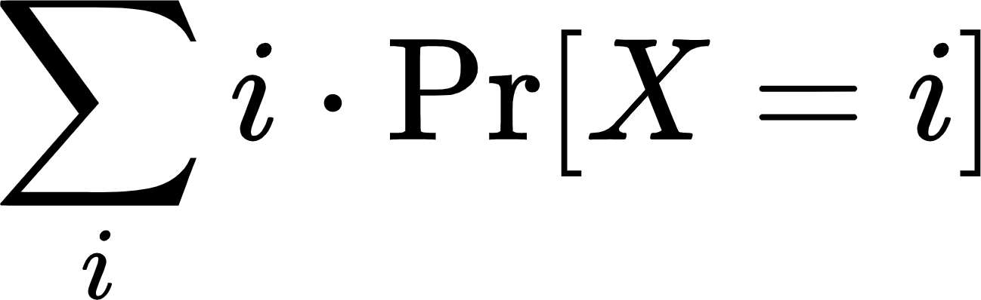
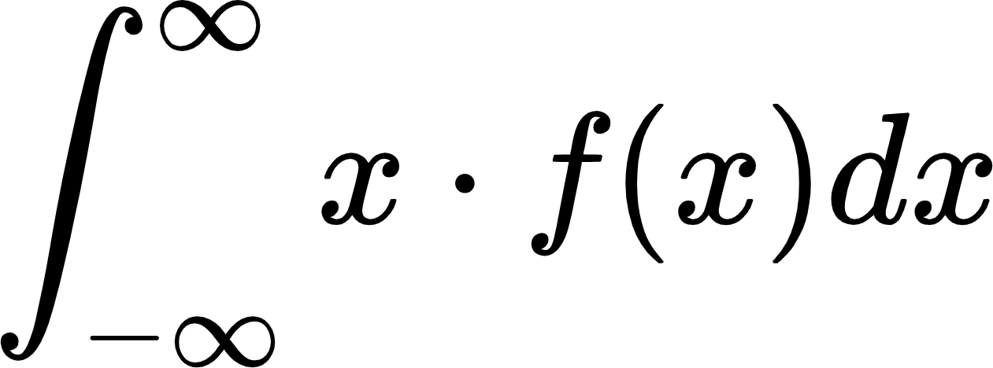
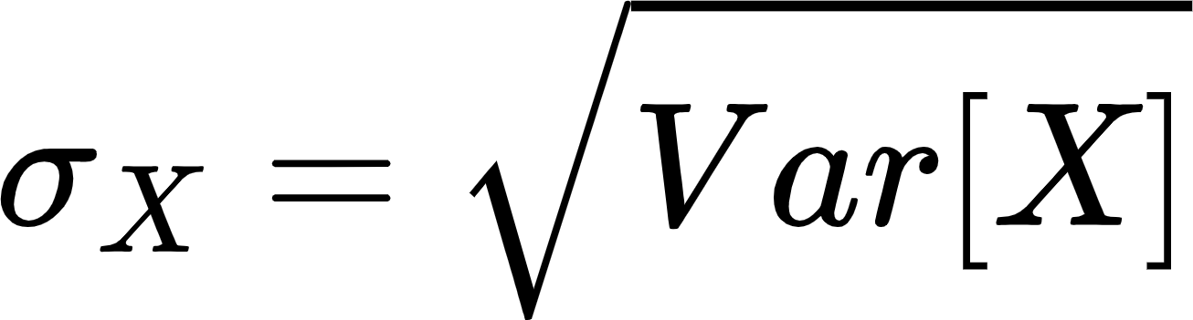
Definitions
Expectation
When X is a discrete random variable
When X is a continuous random variable, and f(x) is its probability density function
Variance
It measures how far your data spread out from their average value.
Standard deviation
Notes:
Var[X] = E[(X-E(X))^2] = E[X^2]-(E[X])^2

Slide 5
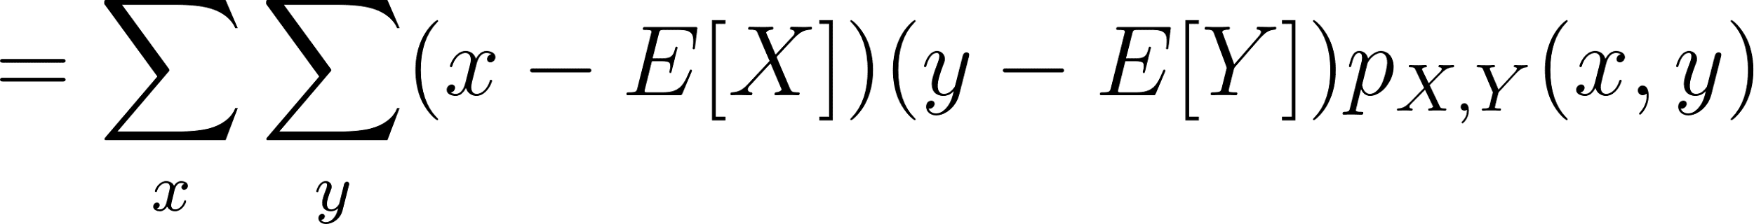
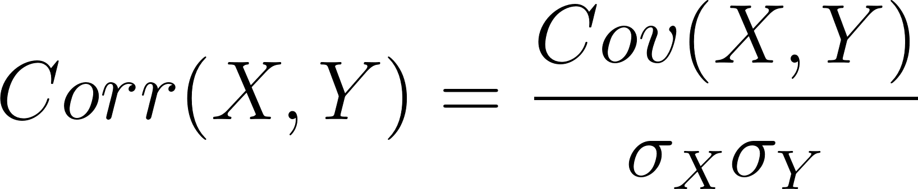
Covariance and Correlation
Definitions:
From a linear algebra perspective: If X, Y are two random variables of zero mean, then the covariance Cov[XY ] = E[ X · Y ] is the dot product of X and Y . The standard deviation of X is the length of X. The correlation is the cosine of the angle between the two vectors.

Slide 6
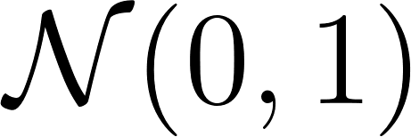
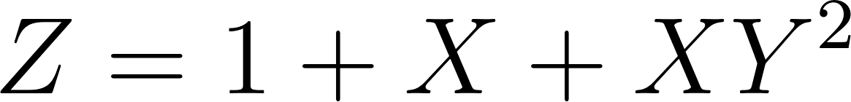

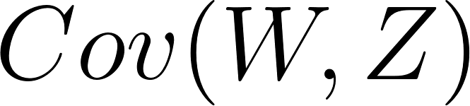
Covariance
Some properties:
Exercise:
X and Y are two independent random variables and:
Find

Slide 7
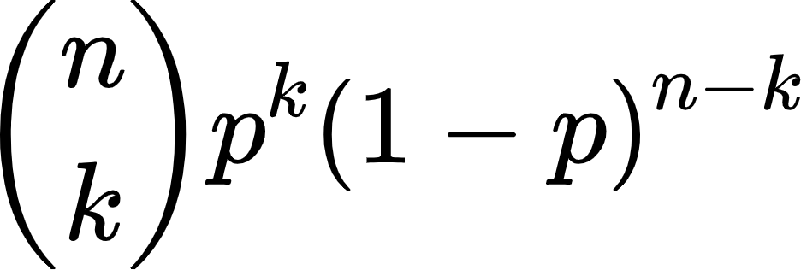
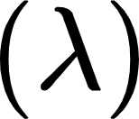
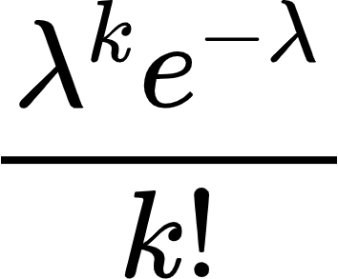

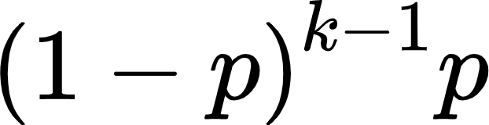

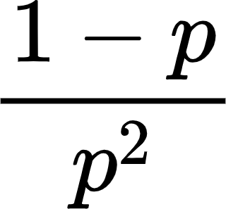
Discrete probability distributions
 | PMF | Mean | Variance
Bernoulli (p) | 1-p if k=0 p if k=1 | p | p(1-p)
Binomial (n,p) |  | np | np(1-p)
Poisson
Geometric (p)

Slide 8
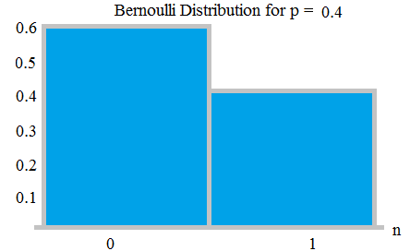
Bernoulli(p)
Discrete
Two outcomes: 0,1 || fail, success
Pr(X = 1) = p = 1-q
Pr(X = 0) = q = 1-p
Expectation:
E[x] = 1*p + (0)*(1-p) = p

Slide 9
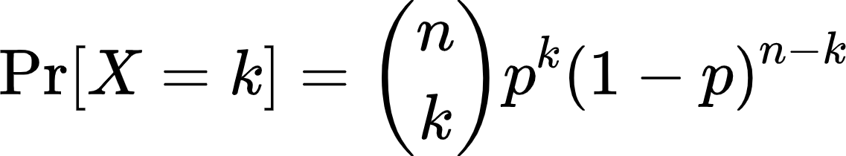
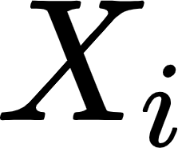
Binomial(n,p)
Example: Flip a coin 5 times, what is the probability of having exactly 2 heads?
Sample repetitively from a Bernoulli distribution n times
Bernoulli = Binomial with n=1
Expectation
Use linearity of expectations
Let be the ith sample outcome from the Bernoulli distribution

Slide 10
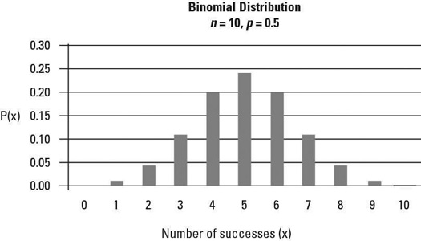
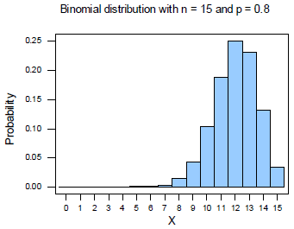
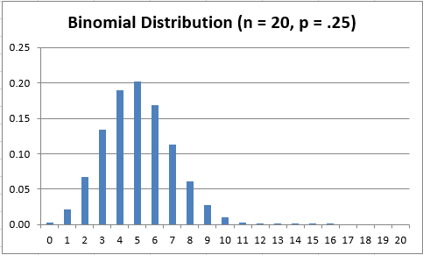
Binomial Distributions
PDF

Slide 11
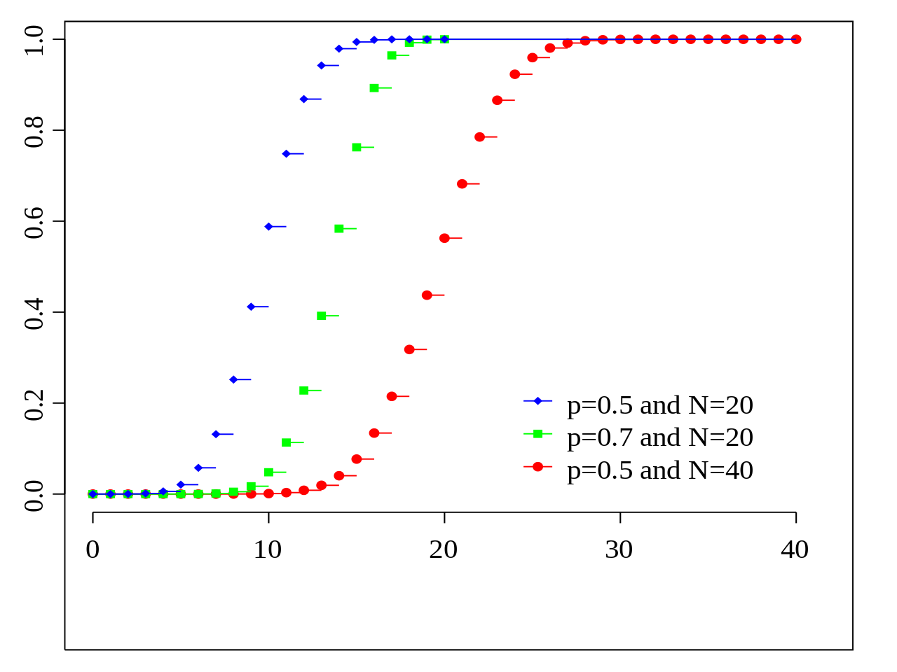
Binomial Distribution CDF

Slide 12

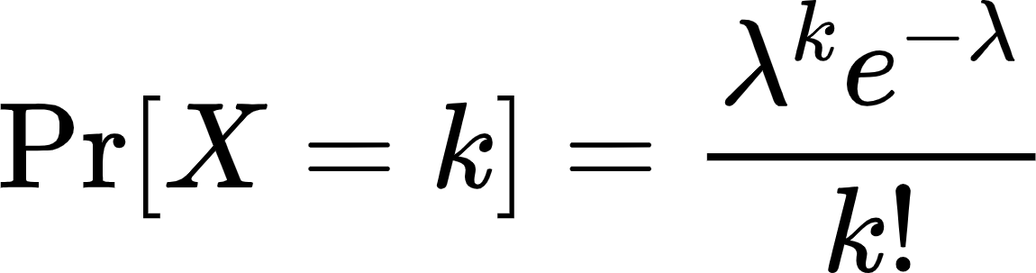
Poisson distribution is a probability distribution that is used to show how many times an event is likely to occur over a specified period
Events are independent of each other.
The occurrence of one event does not affect the probability another event will occur.
The average rate (events per time period) is constant.
Two events cannot occur at the same time.

Slide 13
Poisson Example
Example: You are “on call” at work. And every night between 12 and 8 AM you receive about 6 calls from customers
Question: What is the probability you receive a call from 2-4 AM?
Definitions: X~P(lambda) where X is a random variable with a Poisson distribution, and “lambda” is the mean for the interval
6 calls over an 8 hour window is about ¾ of a call every hour, our window is 2 hours, so our “lambda” value is 2*3/4 = 1.5
https://homepage.divms.uiowa.edu/~mbognar/applets/pois.html

Slide 14
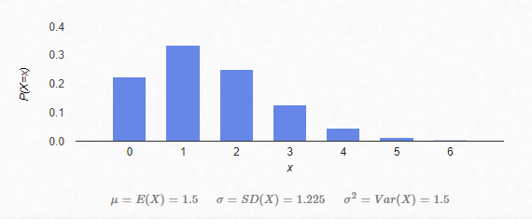
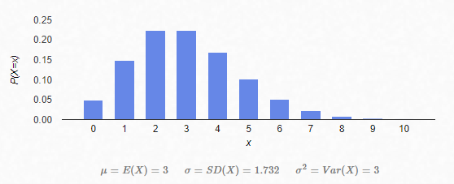

Slide 15
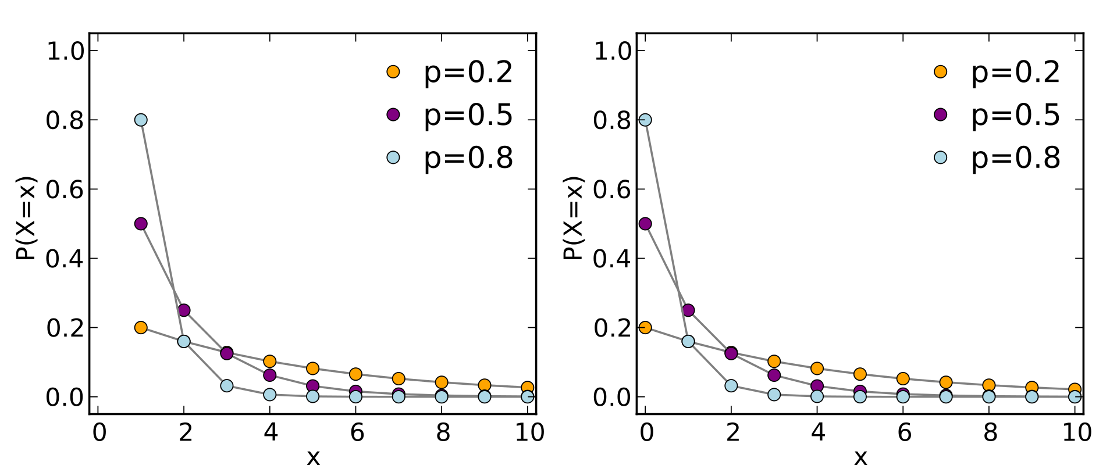
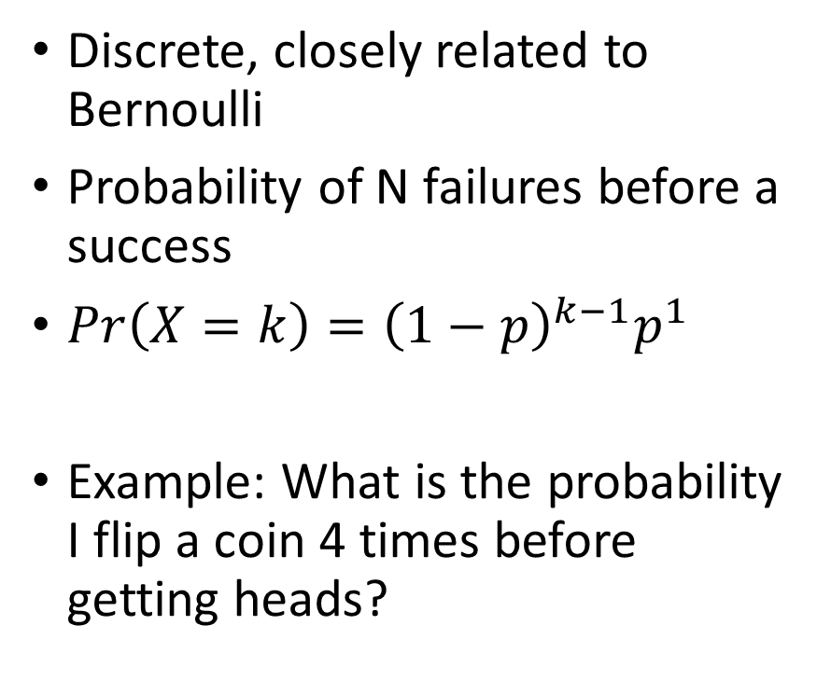

Geometric(p)
Notes:
https://math.stackexchange.com/questions/605083/calculate-expectation-of-a-geometric-random-variable
Do this computation slowly so they understand

Slide 16
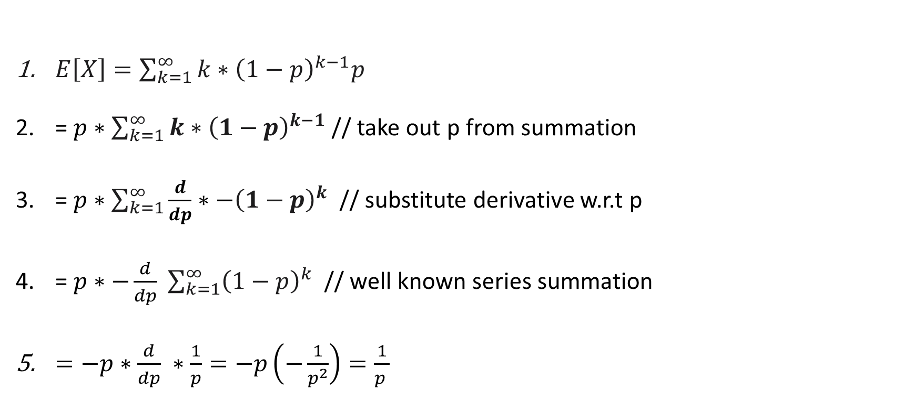
Geometric Expectation Derivation

Slide 17
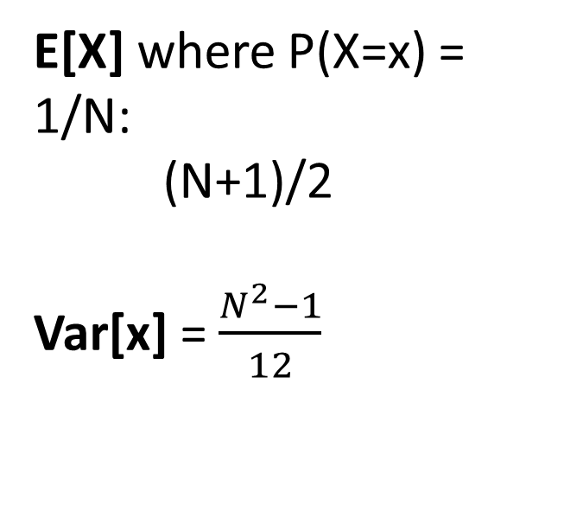
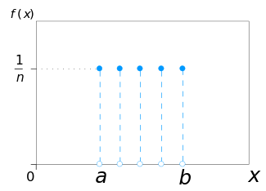
Uniform - Discrete

Slide 18
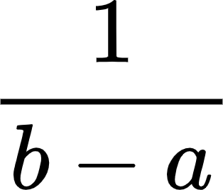
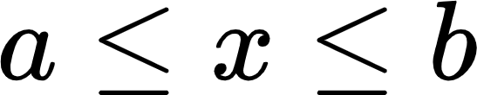
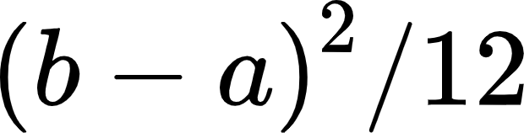

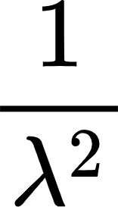
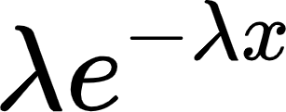
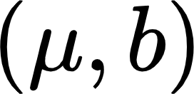
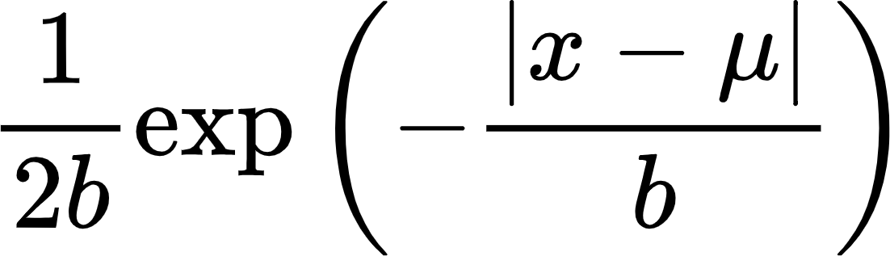

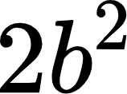
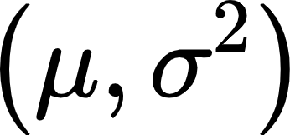
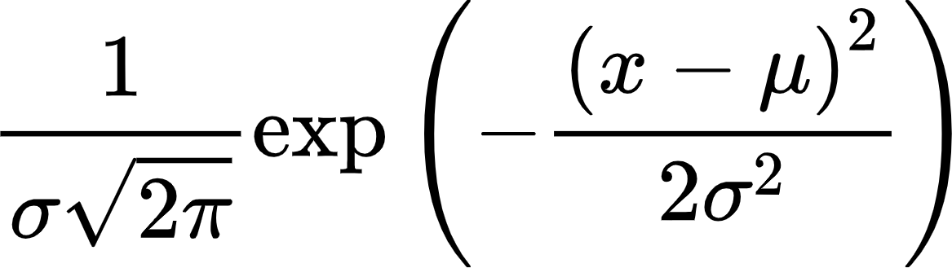
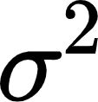
Continuous probability distributions
 | PDF | Mean | Variance
Uniform (a,b) | for 0 otherwise | (a+b)/2
Exponential
Laplace
Gaussian

Slide 19
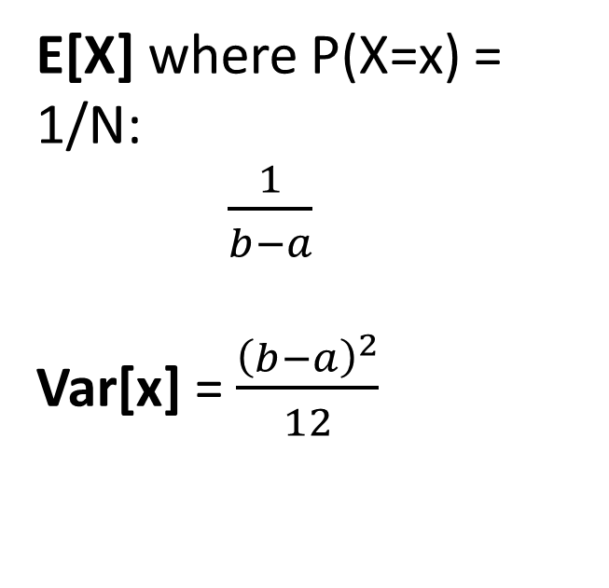
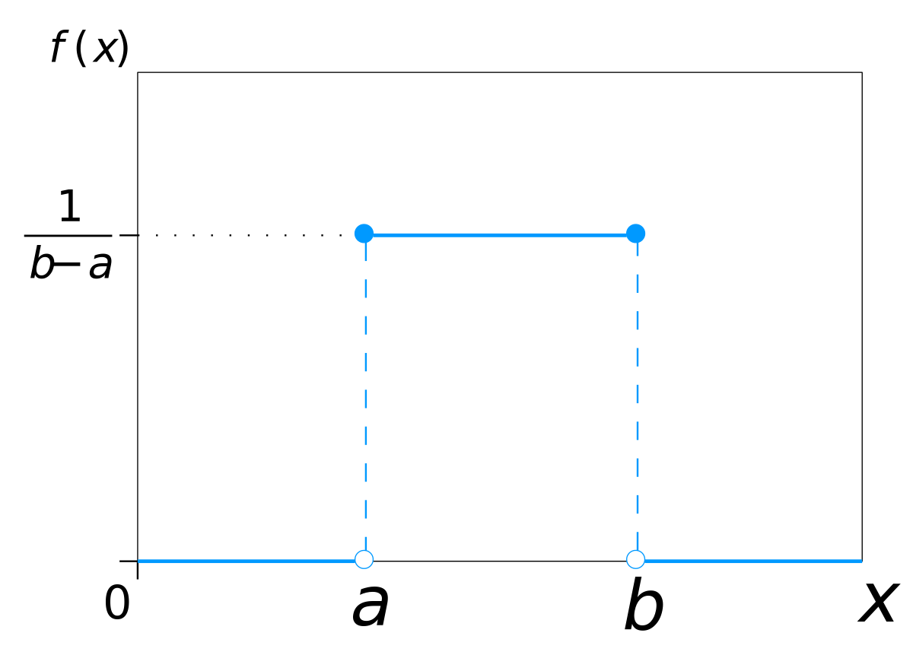
Uniform - Continuous

Slide 20
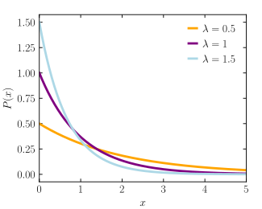

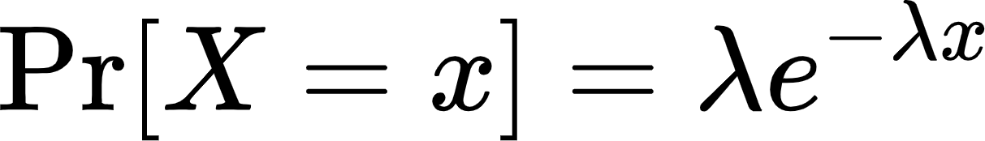
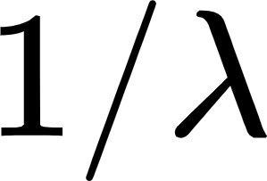
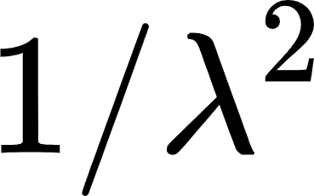
Exponential
The exponential distribution is the probability distribution of the time between events in a Poisson point process.
Parameterized by
PDF
Expected value
Variance
Remark: Exponential distribution is not the same as the class of exponential families of distributions

Slide 21
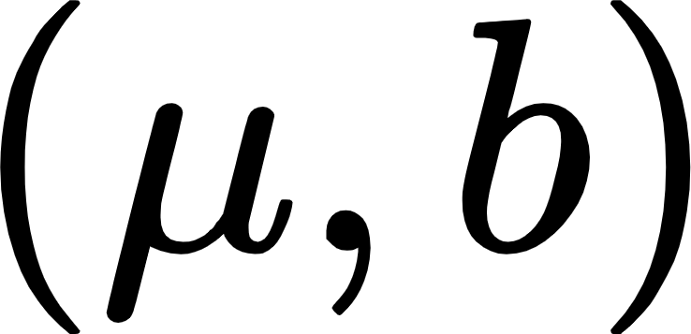
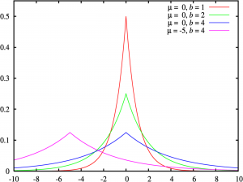
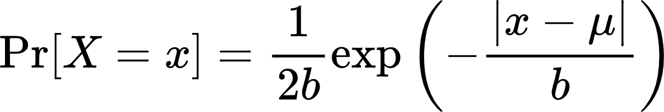
Laplace
It can be thought of as two exponential distributions (with an additional location parameter) spliced together along the abscissa
Parametrized by mu and beta:
Mu = Location (shift along the x axis)
B = scaling, maximum peak value
Notes:
https://www.statisticshowto.com/laplace-distribution-double-exponential/

Slide 22
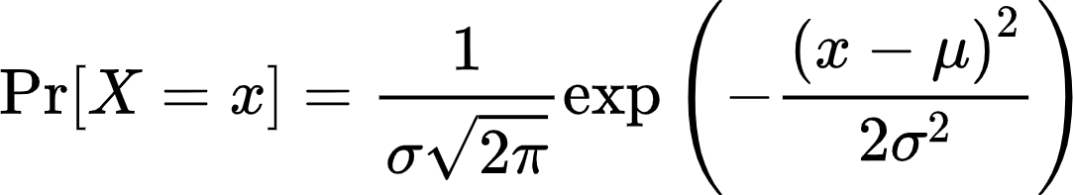
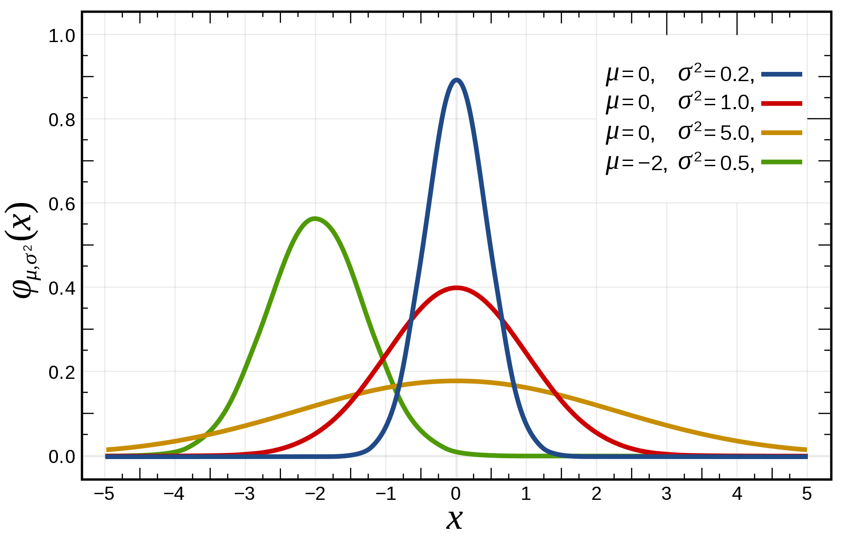


Gaussian – One dimension
Parameterized by
= mean
= standard deviation
It is important partly due to CLT.
Notes:
https://en.wikipedia.org/wiki/Normal_distribution

Slide 23


Chebyshev Inequality

Slide 24
Poisson Chebyshev problem
Let us say that X is modeled by a Poisson variable with mu/lambda/mean = 100
What is the lower bound of P(75 < X < 125)?

Slide 25

Poisson Chebyshev solution
Notes:
Explain the strict inequalities in

Slide 26
End

Slide 27
Practice Problem
Broken device, calling customer support
1% chance a human representative being available and picking up my call, or else robot will disconnect me
Question:
What is the expected number of times I will have to call in before I talk to a human being?

Slide 28

Practice Solution
Identify an analytical distribution:
Geometric in our case (fails until a success)

Slide 29

Practice Solution

