Slide 1

Eviction Predictions
Areej humaydan, katie buckner, MERcy griffin, annmarie morrison

Slide 2
“the act of forcing someone to leave somewhere, especially their home”
EVICTION: Noun – Cambridge English dictionary

Slide 3
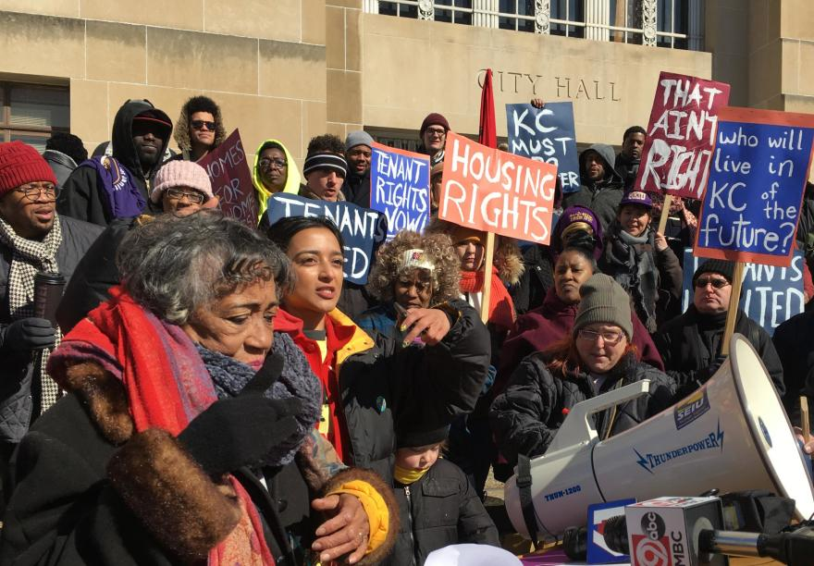
Current Events
Federal eviction moratorium to prevent the spread of COVID-19
Rise of KC Tenants

Slide 4
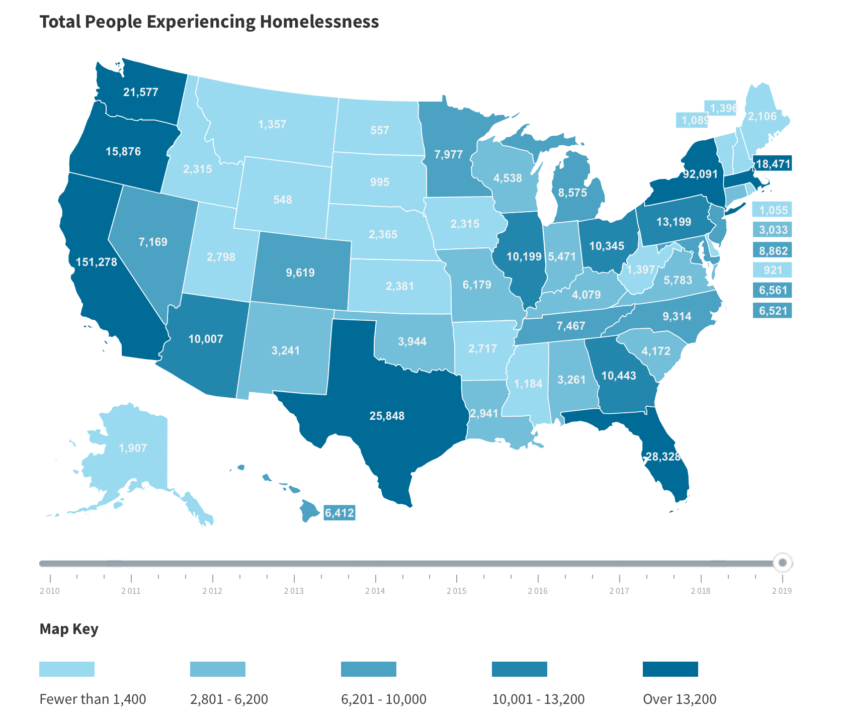
Impact of evictions
Direct cause of homelessness
567,715 people without homes per day in United States
6,179 people without homes per day in MO
Source: https://www.usich.gov/homelessness-statistics/mo/

Slide 5
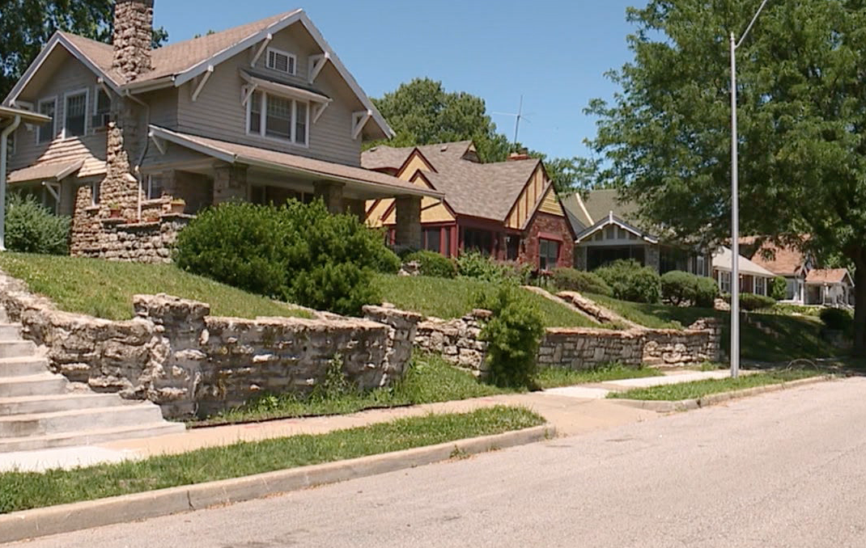
KCMO Locally
65th in evictions nationwide
Over 10 households are evicted on an average day
19 in 100 renter homes are evicted every year

Slide 6
Project Objective
Establish and visualize a relationship between certain demographic factors and eviction rates

Slide 7
Expectations VS Findings
We expected to find strong relationships between higher median home values and evictions
However, what we found is a much more complicated set of factors that drive eviction rates

Slide 8
Procedure
Found data
Cleaned data using Python Pandas
Used Tableau to visualize both high-level perspectives and an overview of bigger impact points
Utilized Machine Learning to project something
Deployed to GitHub pages to be simulated as a web page

Slide 9
Conclusion and Limitations

