Slide 1

eDNA: Which sequences are real?

Slide 2










What is eDNA?
z

Slide 3
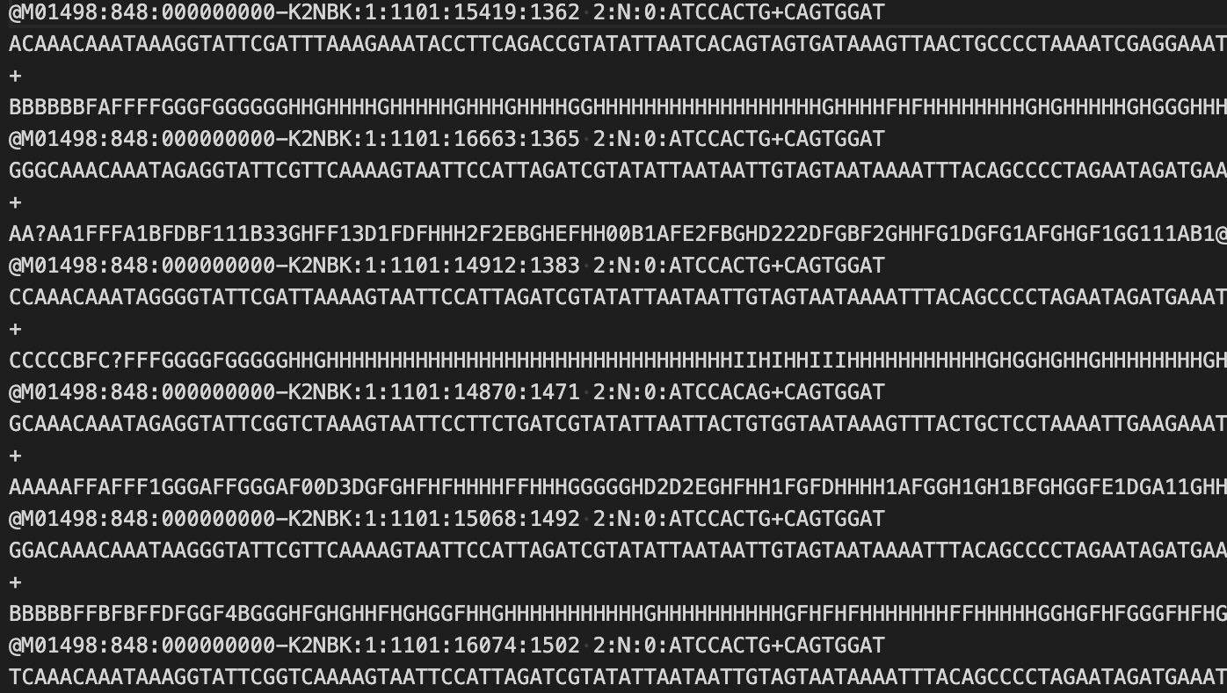
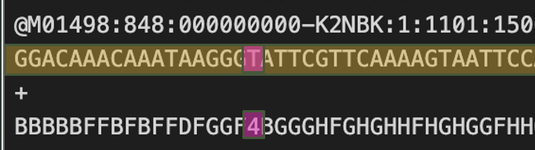
What is metabarcoding?

Slide 4
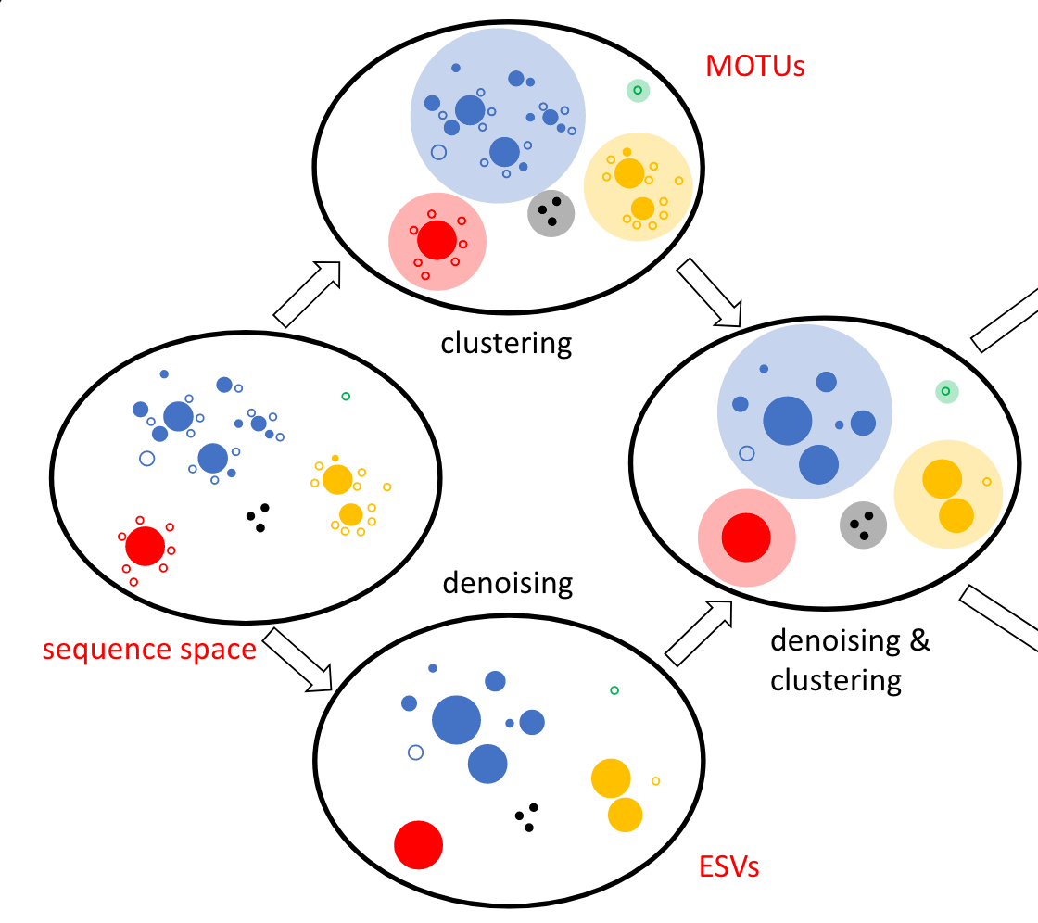
Size of circle = # of reads Closeness in space = similarity of sequences
= True sequence variant (haplotype)
= Artifact (error in sequencing)
Antich et al. 2021

Slide 5
Cluster into ”species” but lose haplotype info
(“Species”)
Antich et al. 2021

Slide 6
Keep haplotype info but risk more erroneous sequences.
(“Species”)
(“Haplotypes”)
Antich et al. 2021

Slide 7
The missing info
16S and 18S Ribosomal RNA
COI and Mitochondrial Markers
16S and 18S code for rRNA (not a protein coding gene)
rRNA = NO CODONS
COI codes for a protein (oxidase something something)
Base position in a codon means something!
A T G T A G C C A T G C G A C
1 2 3 1 2 3 1 2 3 1 2 3 1 2 3

Slide 8
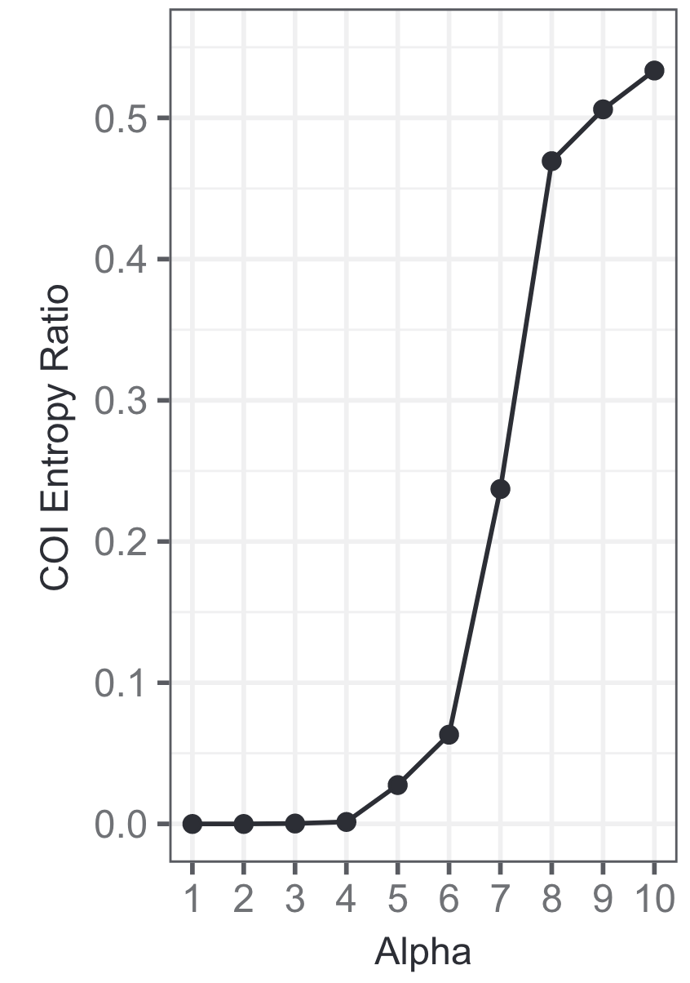
Weitemier et al. 2021

