Slide 1

Direct Conversion Receiver Design
with TI LMX8410L IQ Demodulator
Zixuan Song
2023.11.24
Notes:
Hello, everyone. Today I’m going to give my presentation about ……… Here , TI means Texas Instruments, a famous semiconductor company and manufacturer of analog circuit components.

Slide 2
Abstract
For C- and X-band applications, a direct conversion receiver has many advantages over other types of receivers. This receiver is flexible, highly integrated, cost-effective, and free of image signals.
The core component of a direct conversion receiver is an IQ demodulator that can directly convert a RF signal to DC-centered complex baseband.
My presentation will discuss when to choose a direct conversion type and why, what to consider when choosing an IQ demodulator, and the performance of LMX8410L.
Notes:
制作者：98id 菠萝雨凤梨

Slide 3
CONTENTS
1
4
Overall Performance Evaluation
for Mixers
Receiver Architecture Overview
2
5
Performance of LMX8410L
In-System Evaluation of LMX8410L
3
Implementation Challenges
for IQ Demodulator
6
Conclusion

Slide 4
01
Receiver Architecture Overview

Slide 5
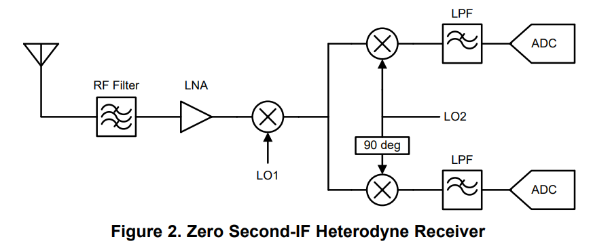
Receiver Architecture Overview
1.1 Modern Heterodyne Receivers
1.1.1 Zero Second-IF and Sliding-IF Receiver
Zero-second IF architecture (Figure 2) uses a quadrature down-conversion to remove the image from the second IF without the need for an image reject filter.
The basic idea of quadrature down-conversion is that the cos and sin of the LO effectively form a complex exponential. According to Modulation Property of Fourier Transform, this complex exponential moves the signal band from RF to DC. Now the signal band is the same from DC – BW/2 to DC + BW/2, and only low pass filtering is required. The two ADC channels for I and Q paths sample data from DC to DC + BW/2 separately, and digital processing can fully recover the signal.
Quadrature down-conversion theoretically removes the image, but in reality, how well the image is rejected depends on whether or not the I and Q channel outputs match. Since IF is centered at DC, RF = LO, and the image of the signal is a flipped version of signal itself. If the image rejection is not adequate, the signal can corrupt itself.
A modern zero second-IF heterodyne receiver divides down the first LO to form the second LO so that only one synthesizer is required.
This type of structure is also called a 'sliding-IF receiver'
Notes:
附：内容页部分可发挥空间非常大，由于信电模板自身有左上角的边框，所以把标题放在右侧会比较好

Slide 6
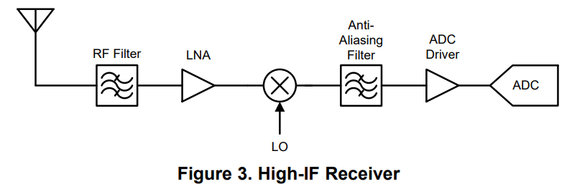
Receiver Architecture Overview
1.1 Modern Heterodyne Receivers
1.1.2 High-IF Heterodyne
Figure 3 shows a receiver that can directly sample the signal at a relatively high IF frequency. In this example, the tradeoff between image rejection and channel selection for traditional heterodyne is eliminated and the second mixing stage is no longer required.
With this architecture, however, the signal quality is very sensitive to spurs that are aliased into a signal band by ADC. The combination of LNA and mixer generates mixing spurs, harmonics, and intermodulation products that range from very low to very high frequency. On the other hand, an anti-aliasing filter can be used before ADC, but this off-chip bandpass filter will take up more board space and make the system inflexible.
This type of receiver still suffers from the first mixing stage image, and sampling at high frequencies can lead to high ADC cost and low ADC performance.
Notes:
附：内容页部分可发挥空间非常大，由于信电模板自身有左上角的边框，所以把标题放在右侧会比较好

Slide 7
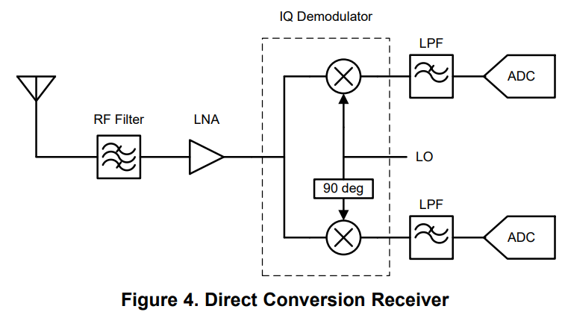
Receiver Architecture Overview
1.2 Direct Conversion Receivers
Figure 4 shows a direct conversion receiver that can directly convert the signal from RF to DC using a quadrature down-conversion.
For C- and X-band applications, a direct conversion receiver is usually preferred over heterodyne receivers.
The advantages of a direct conversion receiver over a zero-second IF heterodyne receiver are that a direct conversion receiver can remove the first mixing stage and is free of mixing spurs and image signals, which can greatly simplify the design process and improve signal quality.
Notes:
附：内容页部分可发挥空间非常大，由于信电模板自身有左上角的边框，所以把标题放在右侧会比较好

Slide 8
Receiver Architecture Overview
A direct conversion also has the following advantages:
Spur management and interference aliasing: As mentioned earlier, the designer must check all of the spurs in the entire frequency range of high-IF heterodyne receivers, because the spurs could be aliased as part of the signal band. An anti-aliasing filter can be bad for integration and system flexibility, but a direct conversion only requires a low pass filter to filter out any aliasing interference.
System flexibility: Without image signals and mixing spurs, a direct conversion receiver can be very flexible. A designer can easily change the LO/RF frequency without affecting other parts of the system.
ADC performance: A direct conversion receiver samples signals at DC, so the input frequency to ADC is very low. For a typical ADC, the SNR (Signal to Noise Ratio) and SFDR (Spurious Free Dynamic Range) drop with the increase of input frequency. Therefore, the best ADC performance is used in direct conversion receivers.
Notes:
Compared to a high-IF heterodyne, a direct conversion is not only free from images but also has some advantages

Slide 9
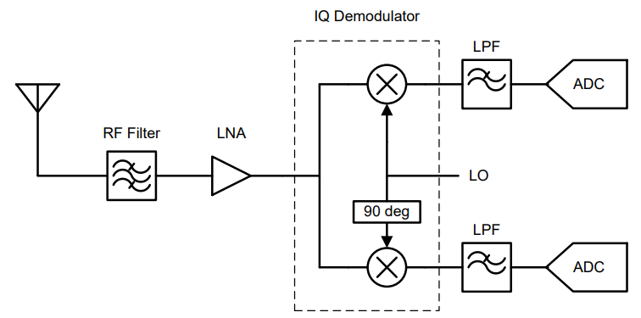
Receiver Architecture Overview
1.3 Low IF Receiver
A low IF receiver has the same structure with direct conversion receiver.
The only change is that the IF is moved from DC to a lower frequency to avoid the drawbacks of working at DC, mainly the DC offset and 1/f noise from IQ demodulator.
However, a low IF receiver typically has a much higher requirement for IRR (Image Rejection Ratio). This is because the image is no longer the flipped version of signal itself, or there could be some out-of-band interferers that may have much higher power than the signal, and therefore must be sufficiently suppressed.
Notes:
附：内容页部分可发挥空间非常大，由于信电模板自身有左上角的边框，所以把标题放在右侧会比较好

Slide 10
CONTENTS
1
4
Overall Performance Evaluation
for Mixers
Receiver Architecture Overview
2
5
Performance of LMX8410L
In-System Evaluation of LMX8410L
3
Implementation Challenges
for IQ Demodulator
6
Conclusion

Slide 11
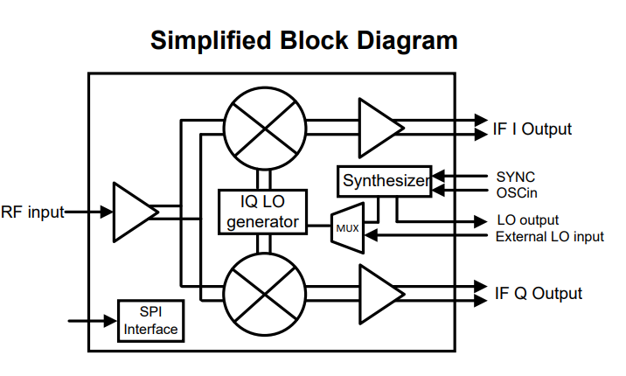
Performance of LMX8410L
2.1 Brief Introduction to LMX8410L
The LMX8410L is a high-frequency IQ demodulator primarily aimed at direct conversion applications.
The RF frequency range of LMX8410L is between 4 GHz to 10 GHz, and the upper limit can potentially go up to 12 GHz. The IF bandwidth is from DC to 1350 MHz, which means that the available complex gain bandwidth is 2.7 GHz from –1350 MHz to +1350 MHz.
The LMX8410L integrates a low-noise RF synthesizer that serves as the internal LO. The internal synthesizer can be powered down and bypassed if an external LO is preferred. In other words, the LMX8410L supports both internal and external LO mode. The integrated LO can be phase synchronized among multiple devices, which makes the LO a valuable feature in many applications.
The LMX8410L offers an automatic DC offset correction algorithm that reduces the offset to less than ±2 mV. Fine control of gain and phase of I and Q channels is enabled using SPI interface to achieve high image rejection.
Notes:
附：内容页部分可发挥空间非常大，由于信电模板自身有左上角的边框，所以把标题放在右侧会比较好

Slide 12
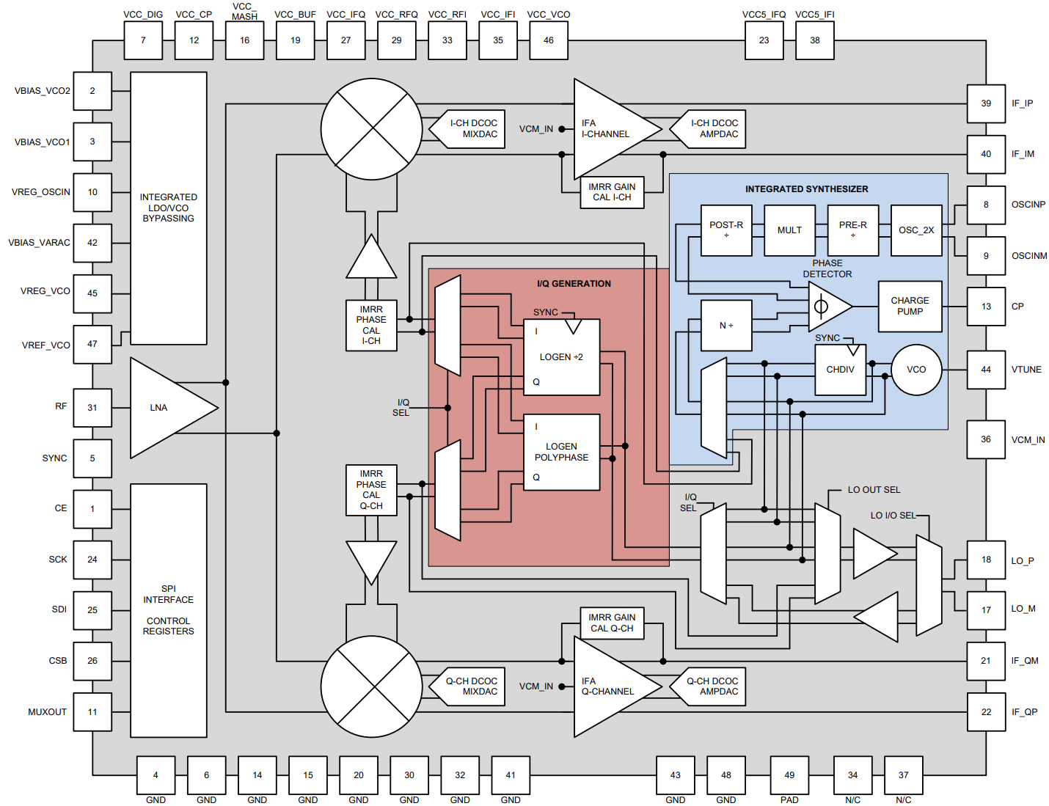
Performance of LMX8410L
2.2 Functional Block Diagram
Notes:
Here I put the full functional block diagram from the datasheet, we can clearly see the Integrated Synthesizer on the right part and the I/Q Generation in the middle part of the chip. RF signal enters from the left pin of the chip and the IF exits from the right.

Slide 13
CONTENTS
1
4
Overall Performance Evaluation
for Mixers
Receiver Architecture Overview
2
5
Performance of LMX8410L
In-System Evaluation of LMX8410L
3
Implementation Challenges for IQ Demodulator
6
Conclusion

Slide 14
Implementation Challenges for IQ Demodulator
3.1 DC Offset
Several mechanisms can cause severe DC offset at the output of an IQ demodulator. Although DC component by itself does not affect signal quality, a large DC offset could saturate the baseband circuits and degrade system dynamic range.
An AC-coupling capacitor or High Pass Filter (HPF) is usually not the best choice for DC offset cancellation. If the stopband of the HPF is too wide, it filters out useful signals. If the bandwidth is too narrow, it requires a large capacitor. As a result, the HPF responds slowly to an abrupt change at the input, and could fail to block the DC component. A sudden transition in DC offset may occur when LO frequency varies or LNA gain changes.
For LMX8410L, however, the DC offset is not an issue. TI provides automated DCOC (DC Offset Correction), which automatically corrects DC offset. The corrected DC offset achieved is less than ±2 mV.
Notes:
附：内容页部分可发挥空间非常大，由于信电模板自身有左上角的边框，所以把标题放在右侧会比较好

Slide 15

Implementation Challenges for IQ Demodulator
3.2 1/f Noise (Flicker Noise)
The 1/f noise of IQ demodulator adds extra noise to the signal. To quantify the penalty of 1/f noise, Flicker Noise Penalty is defined as the ratio of total noise power (Pn1) and noise power with the absence of 1/f noise (Pn2), integrated from f_BW/1000 to f_BW . Use Equation below to calculate the Flicker Noise Penalty.
where
• Pn1 is total noise power
• Pn2 is noise power with the absence of 1/f noise
• f_BW is signal bandwidth
• fc is the corner frequency where 1/f noise power equals thermal noise power
The fc of the LMX8410L is less than 200 kHz. Consider the case where signal bandwidth (real bandwidth) is 10 MHz. The Flicker Noise Penalty is 1.04 when fc = 200 kHz, which means that the 1/f noise only adds a little extra noise to the signal. On the other hand, the flicker noise penalty is 16.4 if the signal bandwidth is 100 kHz, which means the 1/f noise is dominating.
Therefore, for wide-band applications where signal bandwidth is greater than 10 MHz, the 1/f noise of LMX8410L adds negligible penalty. For narrow-band applications, low-IF receiver should be considered.
Notes:
附：内容页部分可发挥空间非常大，由于信电模板自身有左上角的边框，所以把标题放在右侧会比较好

Slide 16
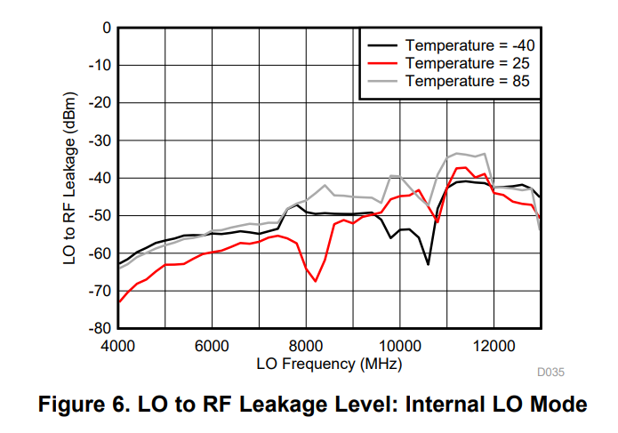
Implementation Challenges for IQ Demodulator
3.3 LO Leakage to Antenna
In a transceiver where the receiver and transmitter share the antenna, the LO component can be leaked to the RF port then back to the antenna, where the LO may be transmitted in transmitter mode. For this reasoning, isolation from LO to antenna is required. Typical acceptable values range from –50 to –70 dBm measured at the antenna.
The LMX8410L LO to RF leakage is below –52 dBm at 6 GHz with the internal LO enabled. Figure 6 is a typical performance plot that shows the extremely low LO leakage of LMX8410L. A typical LNA provides reverse isolation of at least 30 dB. In this case, the LO leakage at the antenna will be well below –70 dBm.
Notes:
附：内容页部分可发挥空间非常大，由于信电模板自身有左上角的边框，所以把标题放在右侧会比较好

Slide 17
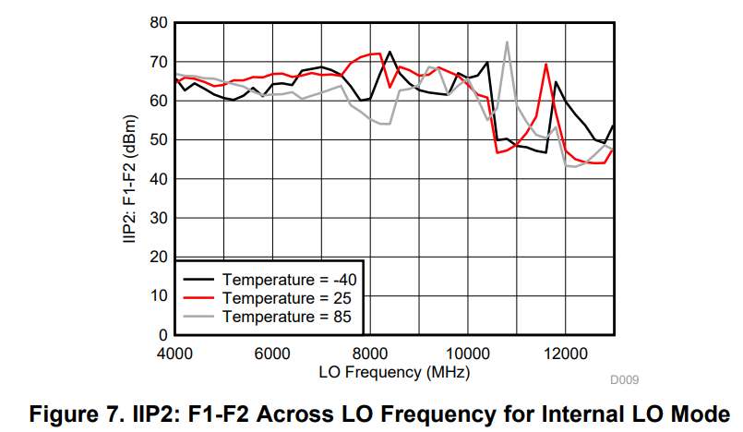
Implementation Challenges for IQ Demodulator
3.4 Even-Order Distortion
IIP2 (Input-referred second order Intercept Point) is a measure of distortion due to second order intermodulation. High IIP2 means that higher input power is allowed without raising any beat frequency spurs above noise floor. The requirement of IIP2 depends on the type of application.
IIP2 of LMX8410L is above 46 dBm at 6 GHz. Figure 7 shows the IIP2 across LO frequency when IF = 65 MHz.
Notes:
We can see the IIP varies due to the influence of temperature

Slide 18
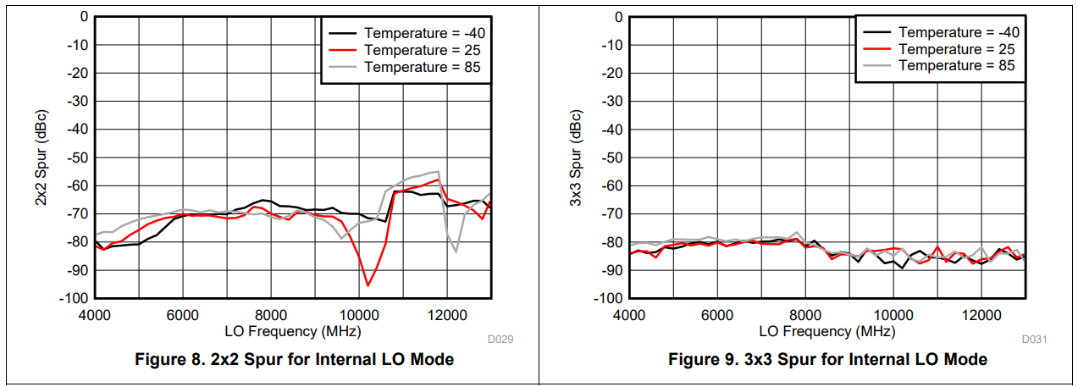
Implementation Challenges for IQ Demodulator
3.5 Mixing Spurs
Mixing spurs refers to the mixing products of RF and LO harmonics. For example, a 2x2 spur is the mixed product of the second RF harmonic and the second LO harmonic. Therefore the 2x2 mixing spur frequency is twice the IF frequency. For wide band applications, a 2x2 spur or 3x3 spur may fall into the IF band.
For the LMX8410L, however, mixing spurs are not a concern. In fact, the mixing spurs from the LMX8410L are almost negligible. Figure 8 and show the 2x2 and 3x3 mixing spur level (in dBc) versus frequency, respectively.
Notes:
附：内容页部分可发挥空间非常大，由于信电模板自身有左上角的边框，所以把标题放在右侧会比较好

Slide 19
CONTENTS
1
4
Overall Performance Evaluation for Mixers
Receiver Architecture Overview
2
5
Performance of LMX8410L
In-System Evaluation of LMX8410L
3
Implementation Challenges for IQ Demodulator
6
Conclusion

Slide 20
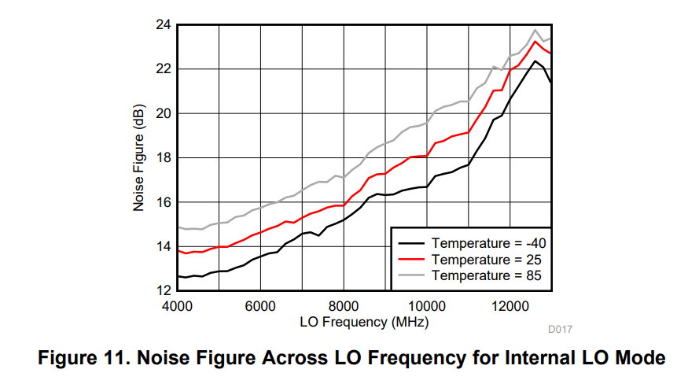
Overall Performance Evaluation for Mixers
4.1 Noise Figure
Noise figure is defined as SNR (Signal to Noise Ratio) at the input divided by SNR at the output, when environment temperature is 290K. Y-method is used for LMX8410L noise figure measurement.
The LMX8410L typical performance plot of NF is shown in Figure 11. At 6 GHz, the noise figure is below 16 dB.
Notes:
附：内容页部分可发挥空间非常大，由于信电模板自身有左上角的边框，所以把标题放在右侧会比较好

Slide 21
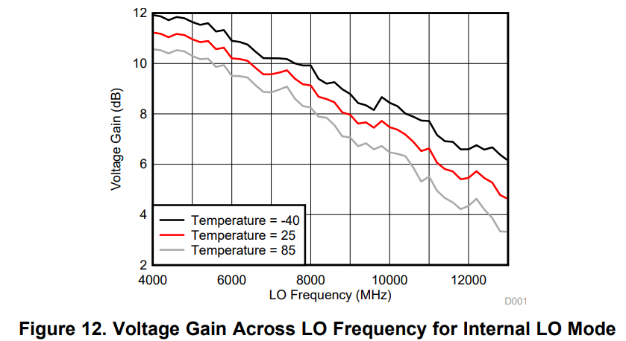
Overall Performance Evaluation for Mixers
4.2 Conversion Gain
Voltage gain is used for characterization of LMX8410L to avoid confusion, because the input and output impedances are not the same, and because in practice, the following IQ demodulator stage may have capacitive input impedance if the LMX8410L directly drives the ADCs.
Notes:
The voltage gain of LMX8410 versus LO frequency is shown in Figure 12.

Slide 22
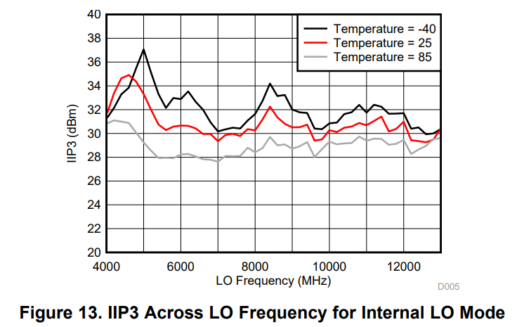

Overall Performance Evaluation for Mixers
4.3 IIP3 and OIP3
IIP3 is a measure of linearity with respect to input power. It is defined as the input power level when the power of IM3 (third order intermodulation product) equals the power of the fundamental tones. Use Equation below to calculate the IIP3.
where
• Pin is the input tone power
• Pout is the power of fundamental tone at the output
• PIM3,out is the power of IM3 at the output
Notes:
The IIP3 of LMX8410L across LO frequency is shown in Figure 13

Slide 23
CONTENTS
1
4
Overall Performance Evaluation for Mixers
Receiver Architecture Overview
2
5
Performance of LMX8410L
In-System Evaluation of LMX8410L
3
Implementation Challenges for IQ Demodulator
6
Conclusion

Slide 24
In-System Evaluation of LMX8410L
This section describes the in-system performance evaluation of the LMX8410L in a RF front end example. We will describes the two parameters that are used to characterize receiver RF front end, namely sensitivity and dynamic range, and explains how to calculate these parameters in the presence of the LMX8410L.
5.1 Receiver Sensitivity
The sensitivity of a receiver is the minimum signal power level that a receiver can detect:
where
• –174dBm is the absolute noise floor kTB when T = 290K and B = 1Hz
• NF is the cascaded system noise figure
• B is signal bandwidth in Hz
• SNRmin is the minimum acceptable SNR at the output of ADC
When signal bandwidth and minimum SNR are fixed, the system noise figure is the determining factor of receiver sensitivity
Notes:
附：内容页部分可发挥空间非常大，由于信电模板自身有左上角的边框，所以把标题放在右侧会比较好

Slide 25

In-System Evaluation of LMX8410L
5.2 Spurious Free Dynamic Range
The maximum input power allowed for a spurious free system is the level when IM3 equals noise floor. The minimum input power is the receiver sensitivity. Equation below shows that the difference between cascaded IIP3 and cascaded NF reflects the system SFDR.
Notes:
附：内容页部分可发挥空间非常大，由于信电模板自身有左上角的边框，所以把标题放在右侧会比较好

Slide 26
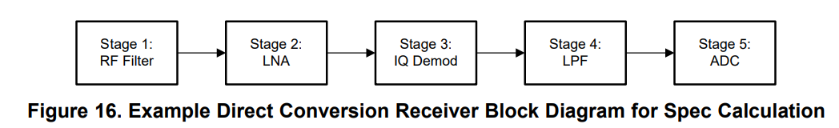
In-System Evaluation of LMX8410L
5.3 LMX8410 In-System Performance
Consider the block diagram shown in Figure 16, where only one of the I/Q paths is shown and the other one is the same. For this example, the user can assume that RF frequency = 6 GHz, the complex signal bandwidth = 200 MHz (that is, IF band is from DC to 100 MHz), and SNRmin = 20 dB.
Notes:
附：内容页部分可发挥空间非常大，由于信电模板自身有左上角的边框，所以把标题放在右侧会比较好

Slide 27
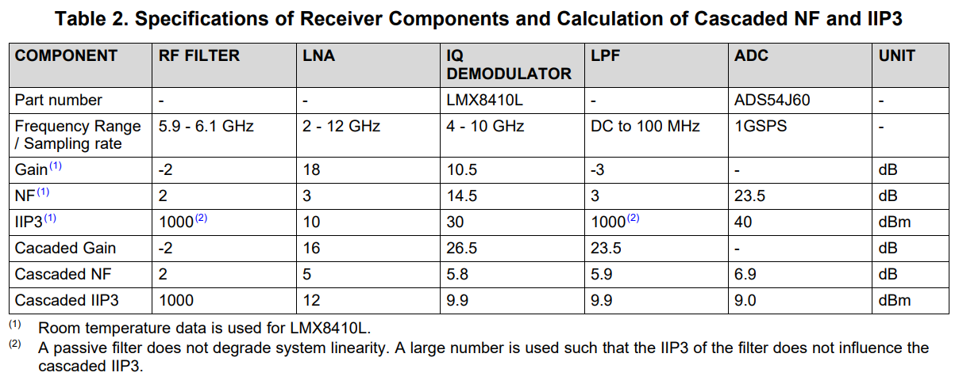
In-System Evaluation of LMX8410L
5.3 LMX8410 In-System Performance
The specs required for each stage are shown in Table 2. Note that ADS54J60 is a dual-channel ADC that can sample both I and Q channels at the same time. The NF and IIP3 for ADC are calculated based on the Direct RF Conversion: From Vision to Reality and Calculating noise figure and third-order intercept in ADCs. Room temperature data is used for LMX8410L.
Notes:
In this table, we can see all the parameter we mentioned above, and , with this application , our device works under very good conditions.

Slide 28
CONTENTS
1
4
Overall Performance Evaluation for Mixers
Receiver Architecture Overview
2
5
Performance of LMX8410L
In-System Evaluation of LMX8410L
3
Implementation Challenges for IQ Demodulator
6
Conclusion

Slide 29
Conclusion
The designer must consider two things when choosing IQ demodulators for the direct conversion receivers: the implementation challenges and the performance of the mixer.
The designer should always look for devices that have low DC offset, low 1/f noise corner frequency, high IRR (absolute value), high IIP2, low LO to RF leakage, and low mixing spurs. For the mixer, a low NF, high IIP3, and high gain are required for better system sensitivity and spurious free dynamic range.
The LMX8410L has excellent performance in both. The device also has an integrated internal LO, a single-ended 50-Ω RF input, and the device can support a VCM input for setting ADC common mode to help system design.
Notes:
My slide is based on TI’s application report, which leads us review the direct conversion receiver structure and the application of a specific chip.

Slide 30
Thanks for listening
Zixuan Song
2023-11-24
Notes:
here comes the end of my presentation,

