Slide 1
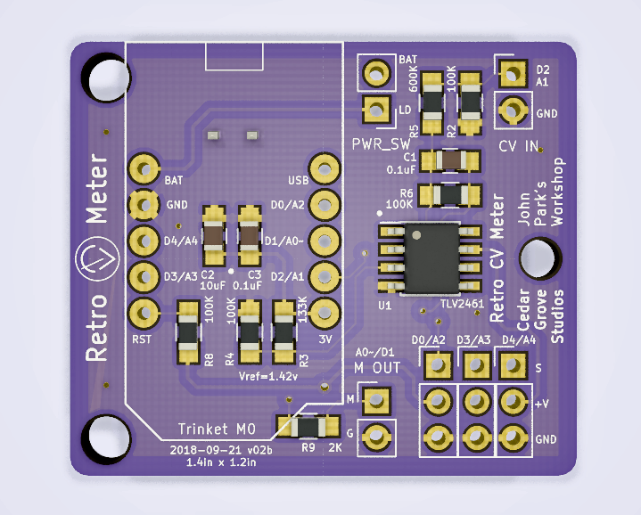
PWR_SW:
Power switch pins in series with the positive battery input terminal
M OUT:
Analog output to meter (M = +, G = -)
R9:
Series resistance matched to meter full-scale current at +3.3volts

Slide 2
SenseBit Inputs/Outputs:
Unbuffered GPIO directly connected to the Trinket M0
(connect input/output signal to upper pin;
+3.3 volts power and ground available on the remaining two pins)

Slide 3
CV INPUT:
-10 volt to +10 volt control voltage input to signal processing stage

