Slide 1


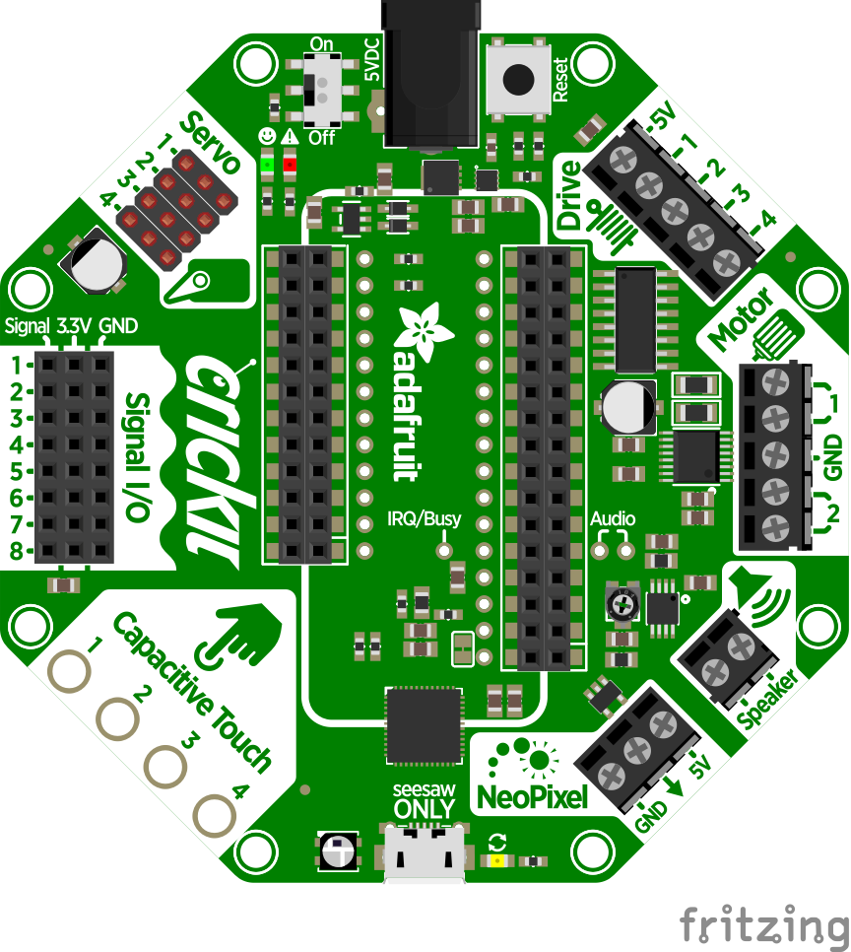


FeatherWing
PINOUT
5V IN
4.4VDC to 5VDC only
5V
17
16
13
Drive pins are open-collector
15
12
14
43
Power
DAC
TOUCH
2
2
42
GND
TOUCH
3
3
17
5-volt dual H-bridge
Physical PIN
TOUCH
40
40
16
Port PIN
TOUCH
41
41
GND
11
11
15
5-volt dual H-bridge
Analog PIN
14
10
10
Feather A0 pin
Audio jumper required
Serial PIN
9
9
A0_{f}
A0_{f}
DAC_{f}
PIN Function
8
8
GND
Interrupt PIN
TOUCH
4
4
5V
Control PIN
TOUCH
5
5
20
TOUCH
6
6
27
GND
PWM PIN
TOUCH
7
7
NEO
DO NOT use
Seesaw USB
for power
EN_{f}
RESET_{f}
Feather PINs
3V3_{f}
150mA max
3_{f}
A0_{f}
DAC_{f}
32_{f}
I2C_{f}
SCL_{f}
31_{f}
I2C_{f}
SDA_{f}
https://www.adafruit.com/product/3343
DRAFT 2019-12-01

Slide 2

FeatherWing
PINOUT
5V IN
4.4VDC to 5VDC only
5V
17
16
13
Drive pins are open-collector
15
12
14
43
Power
DAC
TOUCH
2
2
42
GND
TOUCH
3
3
17
5-volt dual H-bridge
Physical PIN
TOUCH
40
40
16
Port PIN
TOUCH
41
41
GND
11
11
15
5-volt dual H-bridge
Analog PIN
14
10
10
Feather A0 pin
Audio jumper required
Serial PIN
9
9
A0_{f}
A0_{f}
DAC_{f}
PIN Function
8
8
GND
Interrupt PIN
TOUCH
4
4
5V
Control PIN
TOUCH
5
5
20
TOUCH
6
6
27
GND
PWM PIN
TOUCH
7
7
NEO
DO NOT use
Seesaw USB
for power
EN_{f}
RESET_{f}
Feather PINs
3V3_{f}
150mA max
3_{f}
A0_{f}
DAC_{f}
32_{f}
I2C_{f}
SCL_{f}
31_{f}
I2C_{f}
SDA_{f}
https://www.adafruit.com/product/3343
DRAFT 2019-12-01

