Slide 1
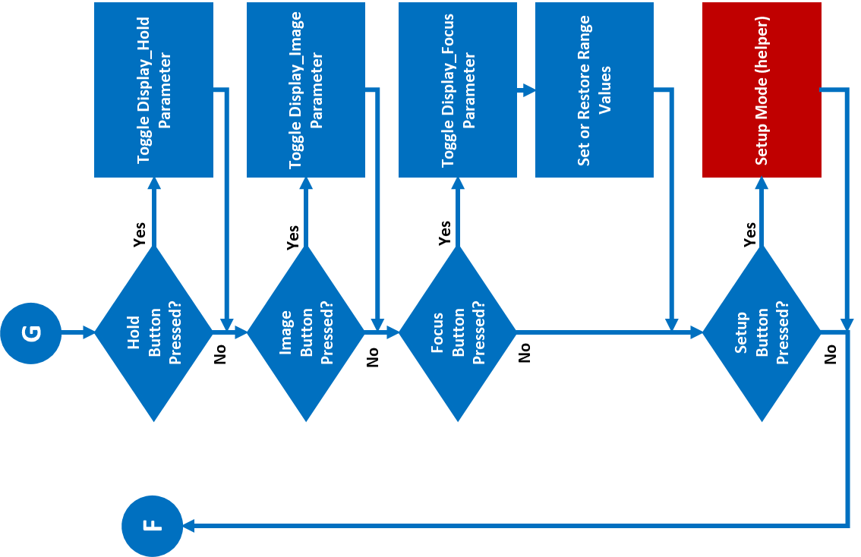
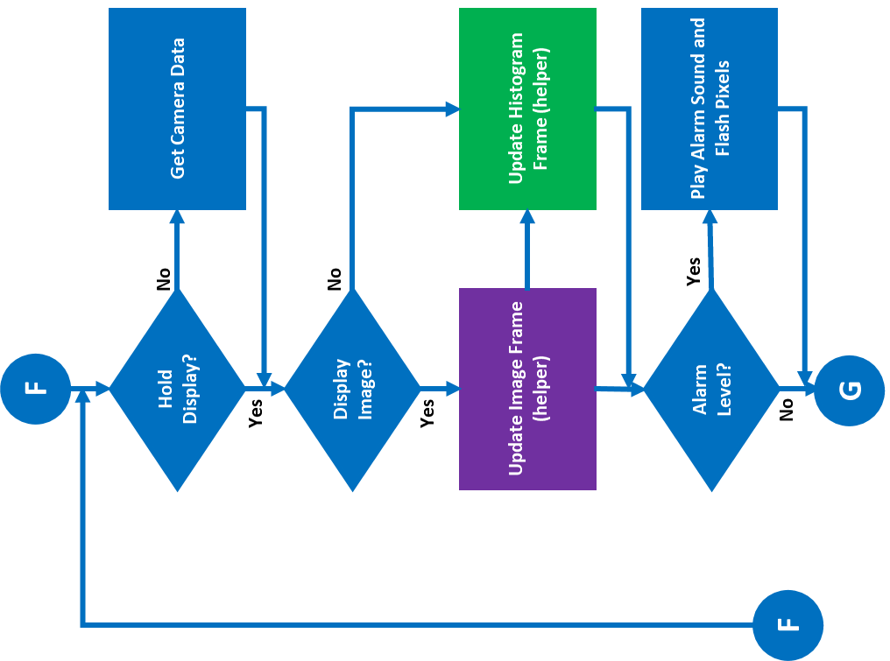
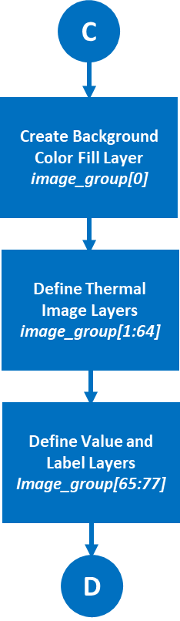
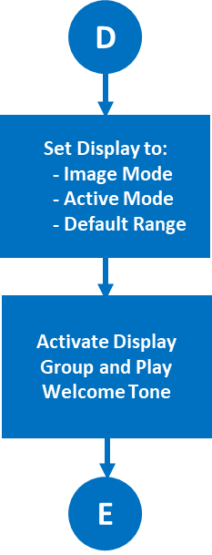
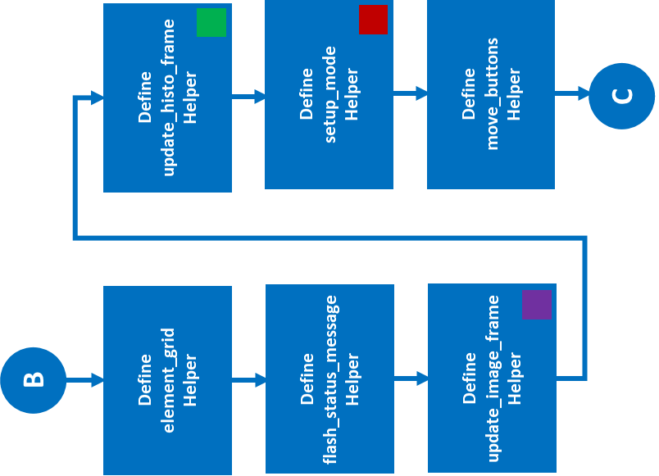
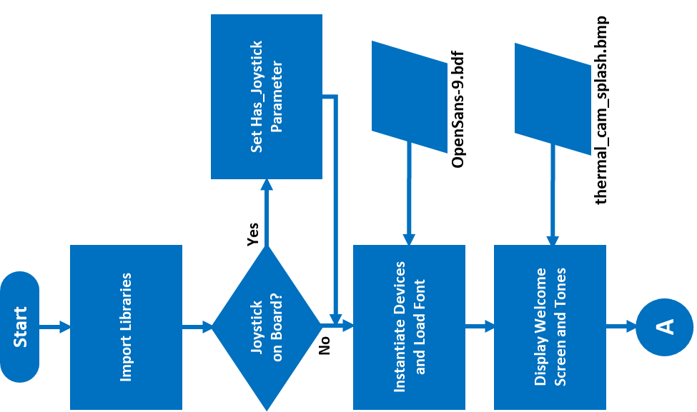
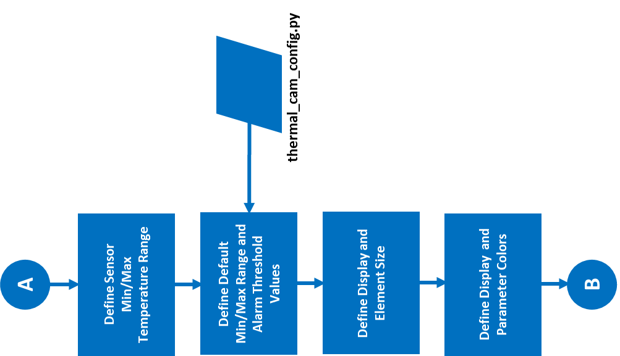

Slide 2
Start
Import Libraries
Joystick on Board?
Set Has_Joystick
Parameter
Yes
No
Instantiate Devices and Load Font
OpenSans-9.bdf
Display Welcome Screen and Tones
thermal_cam_splash.bmp
A
Power-Up
  Import Libraries
  Instantiate Devices and Font
  Display Splash Screen

Slide 3
A
Define Sensor Min/Max Temperature Range
Define Default Min/Max Range and Alarm Threshold Values
thermal_cam_config.py
Define Display and Element Size
Define Display and Parameter Colors
B
Define Globally-Used Parameters

Slide 4
B
Define
element_grid
Helper
Define update_histo_frame Helper
Define
flash_status_message Helper
Define
setup_mode
Helper
Define update_image_frame Helper
Define
move_buttons
Helper
C
Define Helpers

Slide 5
C
Create Background Color Fill Layer
image_group[0]
Define Thermal Image Layers
image_group[1:64]
Define Value and Label Layers
Image_group[65:77]
D
Define Display Group

Slide 6
D
Set Display to:
  - Image Mode
  - Active Mode
  - Default Range
Activate Display Group and Play Welcome Tone
E
Primary Process Setup

Slide 7
F
Hold Display?
Get Camera Data
No
Yes
Display Image?
No
Yes
Update Image Frame (helper)
Update Histogram Frame (helper)
Alarm Level?
Play Alarm Sound and Flash Pixels
Yes
F
No
From End of
Primary Process Loop
G
Primary Process
Get Camera Data
Display Image or Histogram
Check for Alarm

Slide 8
G
To Start of
Primary Process Loop
Hold Button Pressed?
Toggle Display_Hold Parameter
F
Yes
No
Image Button Pressed?
Toggle Display_Image Parameter
Yes
No
Focus Button Pressed?
Toggle Display_Focus Parameter
Yes
No
Set or Restore Range Values
Setup Button Pressed?
Setup Mode (helper)
Yes
No
Primary Process Loop
Watch Push Buttons
Setup Mode

Slide 9
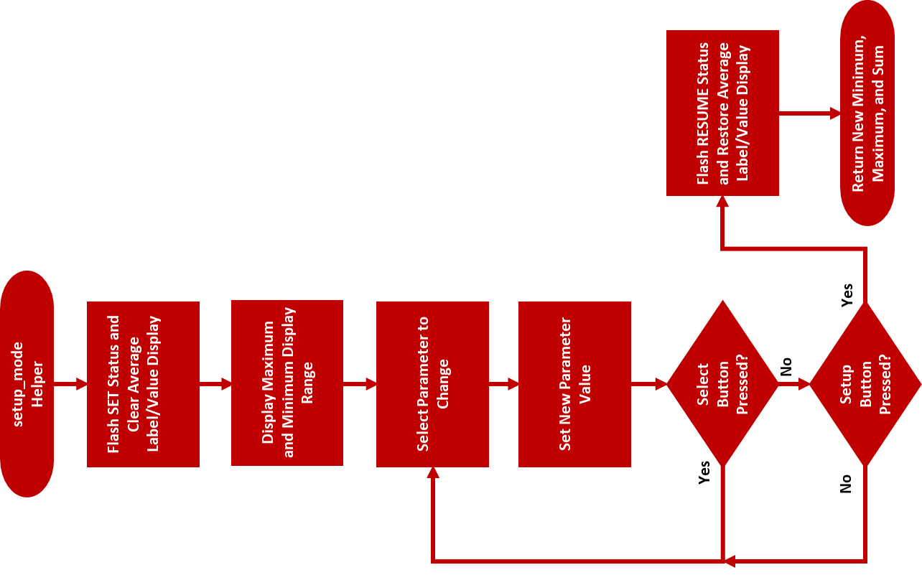
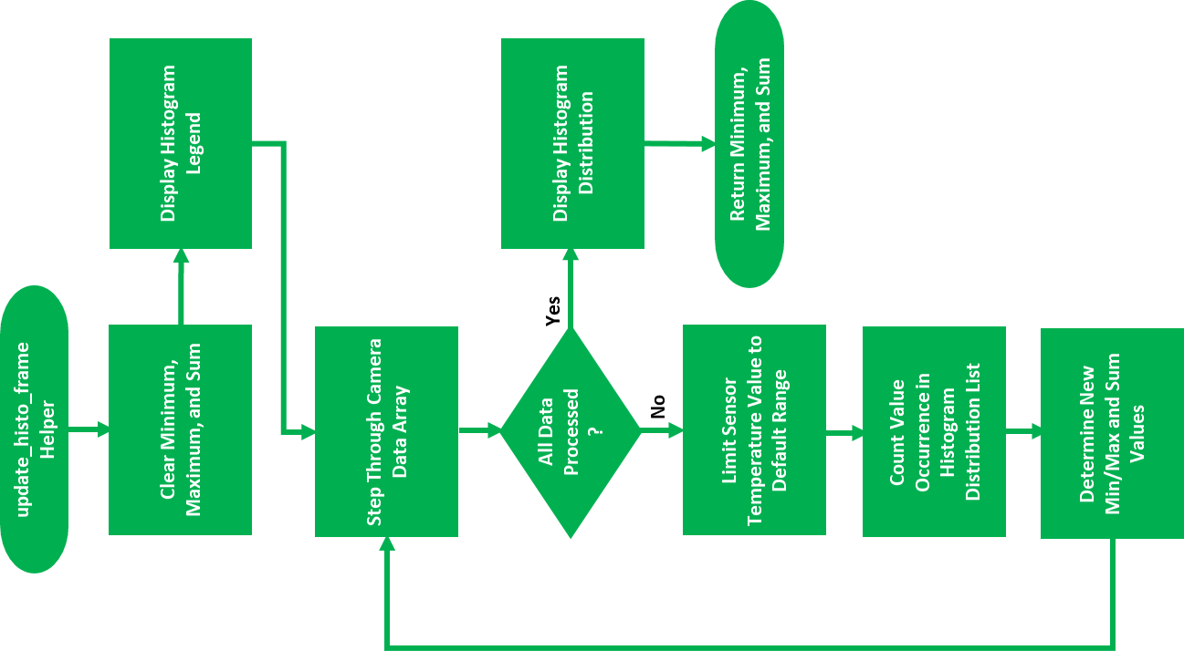
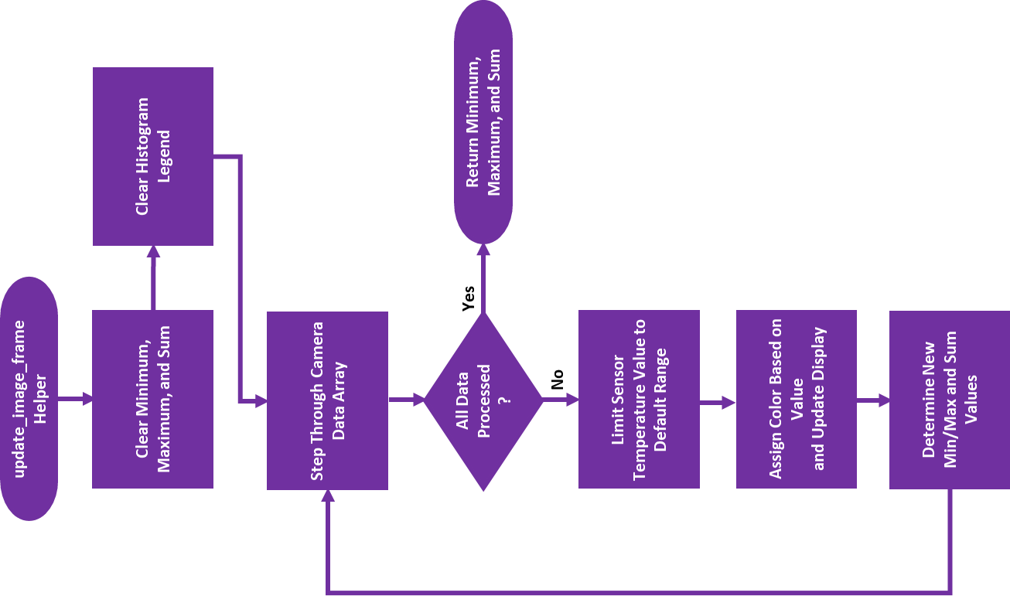

Slide 10
update_image_frame
Helper
Clear Minimum, Maximum, and Sum
Clear Histogram Legend
Step Through Camera Data Array
All Data Processed?
Yes
Return Minimum, Maximum, and Sum
No
Limit Sensor Temperature Value to Default Range
Assign Color Based on Value
and Update Display
Determine New Min/Max and Sum Values
Update Image Frame Helper

Slide 11
update_histo_frame
Helper
Clear Minimum, Maximum, and Sum
Display Histogram Legend
Step Through Camera Data Array
All Data Processed?
Display Histogram Distribution
Yes
No
Limit Sensor Temperature Value to Default Range
Return Minimum, Maximum, and Sum
Count Value Occurrence in Histogram Distribution List
Determine New Min/Max and Sum Values
Update Histogram Frame Helper

Slide 12
setup_mode
Helper
Flash SET Status and
Clear Average Label/Value Display
Display Maximum and Minimum Display Range
Select Parameter to Change
Set New Parameter Value
Yes
Select Button Pressed?
Flash RESUME Status and Restore Average Label/Value Display
No
No
Setup Button Pressed?
Yes
Return New Minimum, Maximum, and Sum
Setup Mode Helper

