Slide 1
WeOD:
A DASH-based VOD research tool for codec and frame rate performance analysis with automatic data collection
Presenter: Cedar Huang
5/6/2026

Slide 2
Motivation
Video streaming and VOD systems are widely used across diverse network and hardware environments, while modern codecs provide different trade-offs between compression efficiency and system performance.
Our goal: Develop a lightweight DASH-based VOD experimental platform for comparing codec and FPS configurations with automatic performance data collection.

Slide 3

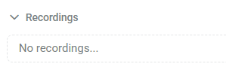

Motivation - why this structure?
Most modern VOD systems adopt a client-server architecture for scalable video delivery.
This project uses HTTP-based MPEG-DASH streaming with dash.js, a widely used open-source DASH player for browser-based playback.

Slide 4
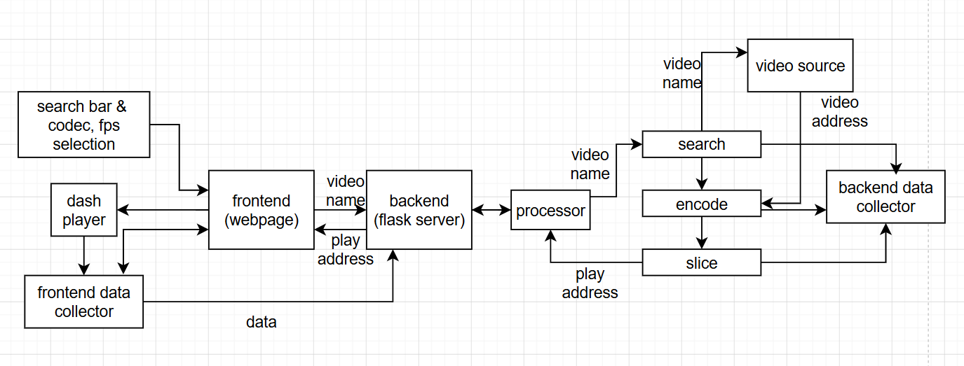
Implementation - Structure

Slide 5

As a software, how to use it?

Slide 6
Result - dataset & environment
The dataset includes selected videos from Pexels and several self-recorded gameplay screen captures, including natural scenes, street recordings, and dynamic gameplay footage with varying levels of visual changes.
Experiments are conducted in a local area network (LAN) environment using a laptop server and a mobile client for browser-based playback.

Slide 7
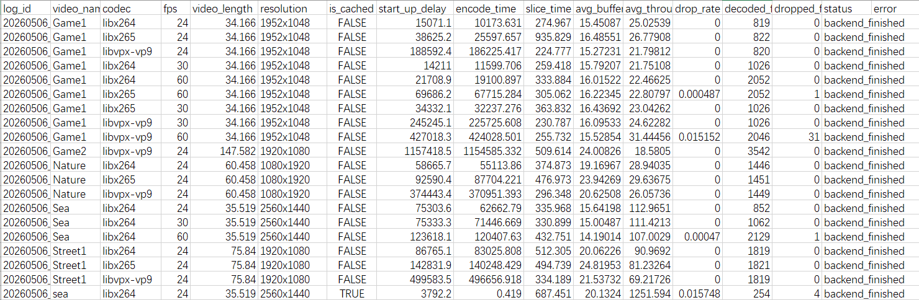
Result data
Our system automatically collects several performance metrics. Although the current evaluation is still preliminary, the collected data already shows some observable trends.

Slide 8
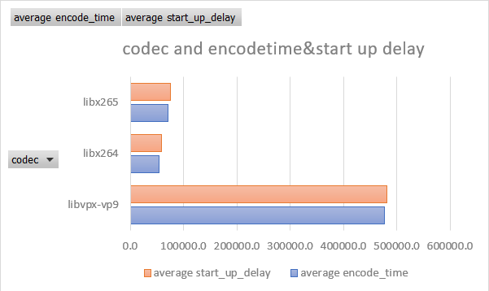

Result
Vp9 has clear higher encode time.

Slide 9
Cache
Although this project focuses on evaluating codec and FPS configurations, In practical VOD systems, pre-transcoding and caching are often essential for smooth playback experience.
While this project intentionally avoids complex caching strategies to reduce interference with codec evaluation, a simple reuse-based cache mechanism is implemented, which already reduces startup delay by more than 95% for previously processed videos (with a big tradeoff of using more storage space)

Slide 10
Future Work
Expand the dataset with more videos and motion categories, like derf's collection
Analyze additional collected metrics such as buffer level and throughput
Investigate the impact of different network conditions and deployment environments
Explore more advanced caching and streaming optimization strategies

Slide 11
Thank you!

