Slide 1
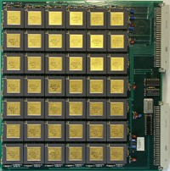
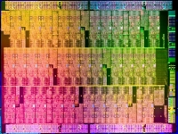
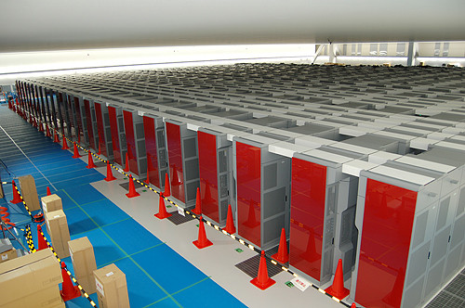




Numerical Reproducibility for Parallel Stochastic Simulation “Exascale Ready”
D.R.C. Hill, F.Y.P. Congo, T. Dao Van
Blaise Pascal University ISIMA/LIMOS UMR CNRS 6158

Slide 2
Exascale Computing…
The goal of Exascale computing is to multiply by 20x the performance of the fastest machine on operation.
We can anticipate that Exascale systems will have around around 10⁹ computing cores.
This also means that at the same time each standard nodes will be able to deliver tenths of teraflops.
This will help to generate much faster, more precise and more complex simulations, higher quality medical imaging will yield faster and personalized medicine with smarter medical diagnostic and treatment.
Parallel Stochastic simulations are useful at this scale, particularly because they are “fault” tolerant.

Slide 3
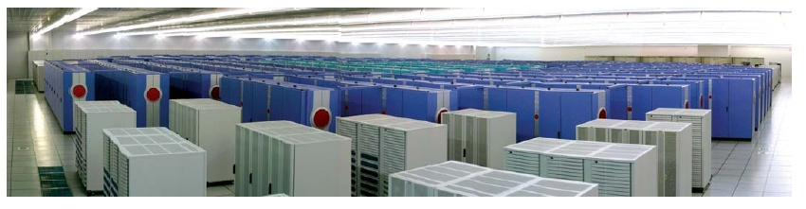
Some scalability problems
Really ‘Big’ data & output Results interpretability
Software costs for:
Optimization with Numerical reproducibility and ability to debug !
Reliability (hardware errors will be the rule…)
Software & Hardware (including « soft » errors)
Performances: the need for « disruptive technologies »
Processors, InterConnect, IO (at affordable energy cost)
Energy questions

Slide 4

Programmability
Exascale application will involve approximately around O(10⁹) logical cores (hardware threads).
No human being can program, debug or optimize directly this many threads.
Hope: High-level languages and DSL will allow us to express that parallelism more effectively
Positive: data-parallel applications, can use the same kind of automation that has proved successful in areas like geometry and meshing and then map them onto complex graphical representations.
Task-parallel applications: we can give a new focus on statistical methods and Monte Carlo approaches to develop more resilient software.

Slide 5

Reliability
Mandatory co-design (Hard. & Soft.)
They are currently separated (eg. Introduction of- Out of order instructions…) is it a real option for “Exascale Comp” ?
Hardware designers have been struggling with how to make systems a thousand times more reliable per bit-operation to keep us at the same level we are at in today’s best systems.
The only reason to do Exascale computing is to address increasingly more complex issues. This will require even more complex software.
Software complexity is the N°1 cause of unreliability in computation today… far exceeding hardware’s worst efforts!

Slide 6
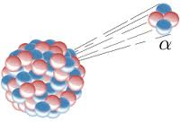

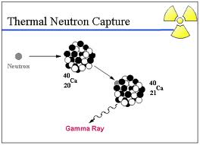
Reliability & HPC… …Silent & Soft errors…
Change the system state (external forces)
Alpha particles
Cosmic rays (High Energy Particles from space)
Thermal neutrons
Variation in voltage, temperature, etc.
They are at the origin of ECC…
To avoids bits flips in memory cells
There is also a rising of soft errors in arithmetic units !!!
The more we size down the more this problem increases.
Chip manufacturers spend money and silicon space to avoid this kind of errors
Soft errors are difficult to detect and reproduce – use spare time of Titan ?

Slide 7
Silent Data & Result Corruption
The integrity and the accreditation of the Science discoveries we want to make with computers is threatened (electrons speed above light speed…?!)
Soft errors are not only corrupting data, but they now affect calculations. (1 per month currently it could affect one per hour at Exascale !)
ECC is essential for memory, but is does not solve this problem. We also have to face this with O.S. systems, middleware, and programming models.
Indeed, soft errors will increase with the machine size and they also increase within modern arithmetic units.

Slide 8
Protecting state & logic (Reliability)
We can effectively protect correctness of state but correctness of logic poses special challenges.
State can be protected at about a 10% energy overhead.
Logic correctness requires more invasive approaches with some degree of redundancy that could well exceed the 10% overheads
Current R&D focuses on residue checking (self checking FPU) and redundant multi-threading. This approach has a significant energy overheads;
Due to the energy issues, we are going to be more limited than we should have been in protecting logic paths.
This will require a significant degree of cooperation between software and hardware engineers.

Slide 9
HW/SW Codesign (Reliability)
Can we identify at compile time certain critical regions which need stronger correctness guarantees?
We are already generating terabytes to petabytes of state per second. At exascale we will be generating exabytes of state each second.
A single wrong bit can vitiate the entire calculation.
For many scientific calculations: we should be able to gracefully tolerate many kinds of bit errors, and also the loss of many kinds of local resources.
For example: in many Monte Carlo simulations, the loss of a processor does not imply the inherent failure of the simulation.

Slide 10
Checkpointing (Reliability)
Limits of classical checkpointing will be reached : a fault every hour (or less) with current MTF – but an Exascale checkpoint could last 30 minutes at 1 Terabyte/s !!!
Without a radical change we are going to be much worse than we are today…
We have to build a much higher level of local check-pointing capability into our software and hardware systems.
Parallel Stochastic Simulations could checkpoint must faster with only intermediate results and all the pseudo-random number generator statuses.
Using raided non-volatile memory, we could checkpoint state very often by moving copies of needed application state to nearest neighbor nodes (they only draw power when in use, this would have minimal energy implications).

Slide 11

REPRODUCIBILITY

Slide 12

Reproducibility (contd.)
In Fomel and Claerbout 2009:
Reproducibility often means replication depending on scientists
In Drummond 2009¹:
“Reproducibility requires changes; replicability avoids them”
In Demmel and Nguyen 2013
“Reproducibility, i.e. getting bitwise identical results from run to run”
In Revol and Théveny 2013.
“What is called numerical reproducibility is the problem of getting the same result when the scientific computation is run several times, either on the same machine or on different machines, with different numbers of processing units, types, execution environments, computational loads, etc.”
1: http://www.site.uottawa.ca/ICML09WS/papers/w2.pdf

Slide 13
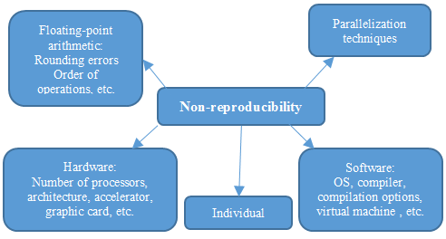
Some Reasons for numerical reproducibility failures

Slide 14
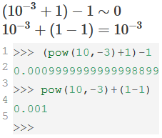
Zoom in « Out of Order Execution » of floating point instructions
Out-of-order execution is also known as dynamic execution. Most modern high-performance microprocessors optimize the execution of instructions based on the availability of input data to avoid delays.
The original order of instructions in a program is no more respected.
The micro-processor avoids having parts of its internal computing units being idle by processing the next instructions which are able to run immediately and “independently”.
It is the equivalent of the software dynamic recompilation (or just-in-time compilation JIT) which enables the improvement of instruction scheduling.
Remember: floating point arithmetic is not associative (for + & * ) ex: a+(b+c) != (a+b)+c.

Slide 15
Some requirements for Stochastic Applications using massive parallelism
Easier if they fit with the Independent bag-of-work paradigm.
Stochastic simulations can easily tolerate a loss of jobs, if hopefully enough jobs finish for the final statistics..
Must use “independent” Parallel random streams.
Statuses should be small and fast to store at Exascale (Original MT – 6Kb status – MRG32K3a 6 integers)
Should fit with different distributed computing platforms
Using regular processors
Using hardware accelerators (GP-GPUs, Intel Phi…)

Slide 16
A method for reproducible parallel stochastic simulations
A process or object oriented approach has to be chosen for every stochastic objects which has its own random stream.
Select a modern and statistically sound generators according to the most stringent testing battery (TestU01);
Select a fine parallelization technique adapted to the selected generator,
The simulation must be designed first as a sequential program which would emulate parallelism: this sequential execution – with a compiler disabling of “out of order” execution will be the reference to compare parallel and sequential execution at small scales.
[Hill 2015] : Hill D., “Parallel Random Numbers, Simulation, Science and reproducibility”. IEEE/AIP - Computing in Science and Engineering, vol. 17, no 4, 2015, pp. 66-71.

Slide 17
An object-oriented approach?
A system being of collection of interacting “objects” (dictionary definition – a simulation will make all those objects evolve during the simulation time with a precise modeling goal.
Assign an « independent » random stream to each stochastic object of the simulation.
Each object (for instance a particle) must have its own reproducible random stream.
An object could also encapsulate a random variate used at some points of the simulation. Every random variate could also have their own random stream.
[Hill 1996] : HILL D., “Object-oriented Analysis and Simulation”, Addison-Wesley, 1996, 291 p.

Slide 18
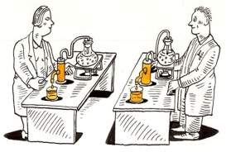
Back to basics for stochastic simulations Repeatable Par.Rand.Num.Generators
Quick check with some top PRNGs used with different hardware, different operating systems, different compilers…
Use same inputs
Execute on various environments
Compare our outputs achieved with author’s outputs (from publications or given files)

Slide 19
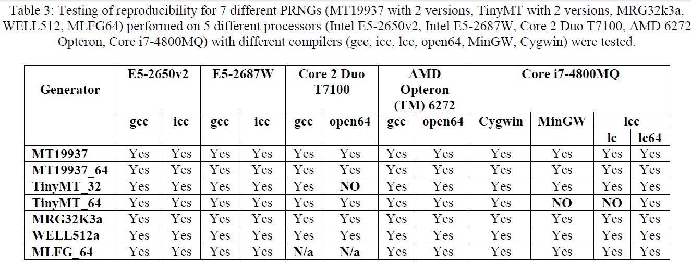
Numerical Reproducibility results 1/4
Errors found:
for different hardware,
different operating systems,
different compilers.

Slide 20
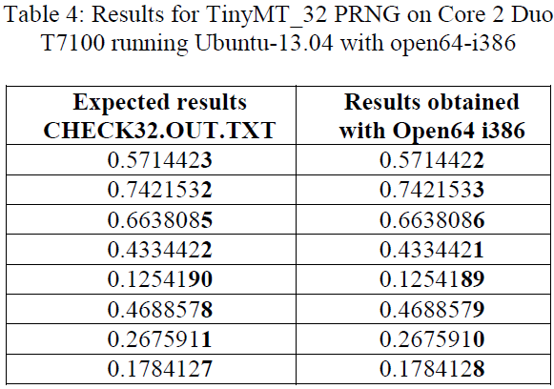
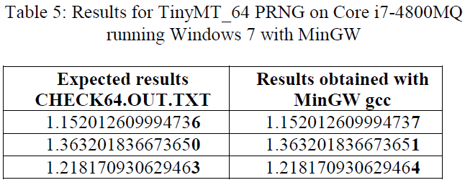
Numerical Reproducibility results 2/4
Errors found:
Different Compilers (2 cases)
With Identical Hardware (2 cases) and Operating Systems (2 cases)

Slide 21
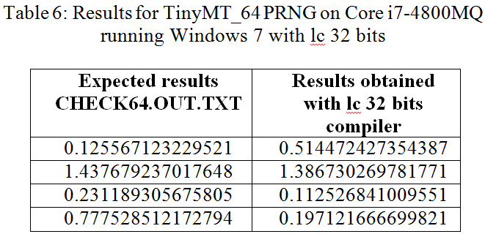
Numerical Reproducibility results 3/4
Errors found : Problems Encountered With 32 And 64 Bits Architecture For The Same Compiler (Lcc compiler 32 bits – ok for 64 bits)

Slide 22
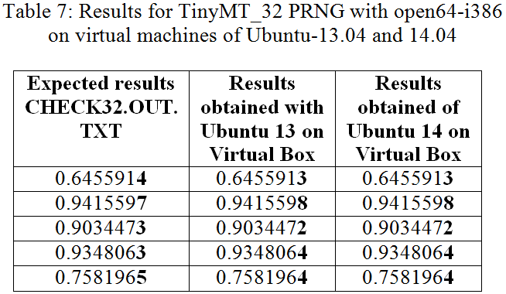
Numerical Reproducibility results 4/4
Errors found : when comparing between: a “Real” Core 2 Duo T7100 and a “Virtual Machine” (Virtual Box on top of Windows 7 with Intel(R) Core™ i7-4800MQ)

Slide 23
Some top PRNGs (Pseudo Random Number Generators)
Only Green PRNG are recommended:
LCG (Linear Congruential Generator) x_{i} = (a*x_{i-1} + c) mod m forget them for Sci. Computing
LCGPM (Linear Congruential Generator with Prime Modulus – could be Mersenne or Sophie Germain primes)
MRG (Multiple Recursive Generator) x_{i} = (a₁*x_{i-1} + a₂*x_{i-2} + … + a_{k}*x_{i-k} + c) mod m – with k>1
(Ex: MRG32k3a & MRG32kp – by L’Ecuyer and Panneton)
LFG (Lagged Fibonacci Generator) x_{i} = x_{i-p}  x_{i-q}
MLFG (Multiple Lagged Fibonacci Generator) – by Michael Mascagni MLFG 6331_64
L & GFSR (Generalized FeedBack Shift Register…) Mod 2
Mersenne Twisters – by Matsumoto, Nishimura, Saito (MT, SFMT, MTGP, TinyMT) – WELLs Matsumoto, L’Ecuyer, Panneton …

Slide 24
Quick survey of random streams parallelization (1) Using the same generator
The Central Server (CS) technique (avoid for flexible reproducibility)
The Leap Frog (LF) technique. Means partitioning a sequence {x_{i}, i=0, 1, …} into ‘n’ sub-sequences, the j^{th} sub-sequence is {x_{kn+j-1}, k=0, 1, …} - like a deck of cards dealt to card players.
The Sequence Splitting (SS) – or blocking or regular/fixed spacing technique. Means partitioning a sequence {x_{i}, i=0, 1, …,} into ‘n’ sub-sequences, the j^{th} sub-sequence is {x_{k+(j-1)m}, k=0, …, m1} where m is the length of each sub-sequence
Jump Ahead technique (can be used for both Leap Frog or Sequence splitting)
The Cycle Division or Jump ahead approach. Analytical computing of the generator state in advance after a huge number of cycles (generations)
The Indexed Sequences (IS) - or random spacing. Means that the generator is initialized with ‘n’ different seeds/statuses

Slide 25
Quick survey of random streams parallelization (2) Using different generators:
Parameterization:
The same type of generator is used with different parameters for each processor meaning that we produce different generators
In the case of linear congruential generators (LCG), this can rapidly lead to poor results even when the parameters are very carefully checked. (Ex: Mascagni and Chi proposed that the modulus be Mersenne or Sophie Germain prime numbers)
Explicit Inversive Congruential generator (EICG) with prime modulus has some very compelling properties for parallelizing via parameterizing. A recent paper describes an implementation of parallel random number sequences by varying a set of different parameters instead of splitting a single random sequence (Chi and Cao 2010).
In 2000 Matsumoto et al proposed a dynamic creation technique

Slide 26
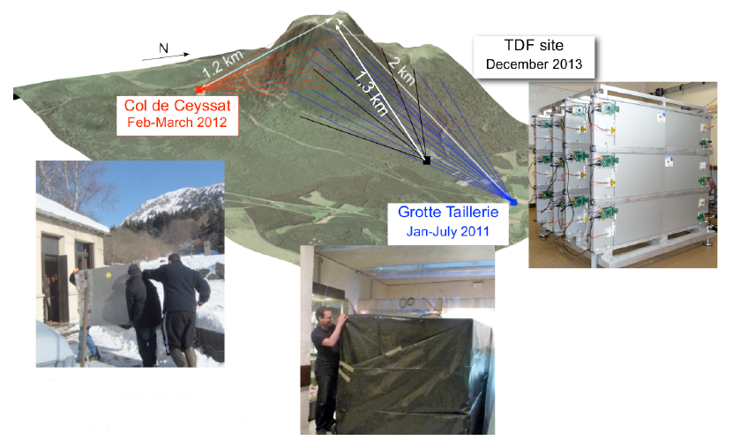

Reproducible HPC Application Muonic Tomography - billions of threads…
Puy de Dôme
Volcano
France
Places of atmospheric Muons sensors

Slide 27
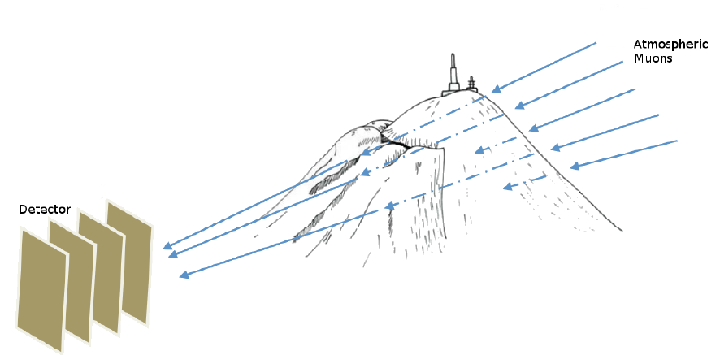
Principle of muonic tomography
Principle: atmospheric muons will go through matter. Depending on their energy and of the matter they traverse it is possible to reconstruct the 3D inner image of a large edifice with multiple sensors (figure by Samuel Béné)

Slide 28
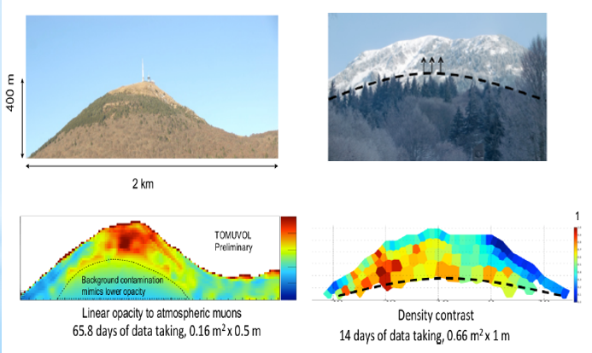
2D Tomographic rendering

Slide 29
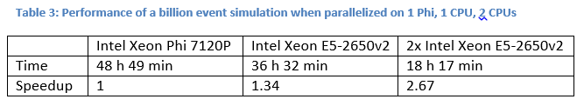
Optimization for a single « hybrid » node (Intel E52650 & Xeon Phi 7120P)
Parallel stochastic simulation of muonic tomography
Parallel programming model using p-threads
On stochastic object for each Muon
Multiple streams using MRG32k3a¹
A billion threads handled by a single node
Compiling flags set to maximum reproducibility
(1) P. L'Ecuyer, R. Simard, E. J. Chen, and W. D. Kelton, ``An Objected-Oriented Random-Number Package with Many Long Streams and Substreams'', Operations Research, Vol. 50, no. 6 (2002), pp. 1073-1075.
Notes:
The initial sequential simulation proposed by Physicians has been optimized sequentially (obtaining a speedup of 16x)
Then the parallelization was achived with a gain of 25 X on 32 logical cores.
With regular compiler flags – no hope of reproducibility. The use of « fp-model-precise » is mandatory.
The maximum speedup loss observed is around 15% but the results given are false with regular optimizing flags !!!
Particle position errors to 30 % (30 cm of errors on 1 m. – incredibly huge at particle scale).

Slide 30
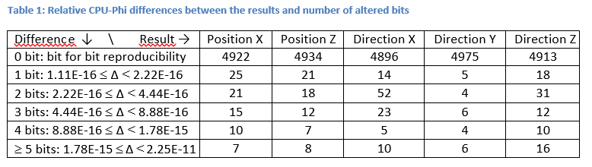
Bit for bit reproducibility
Do not expect bit for bit reproducibility when working on Intel Phi vs. regular Intel processors¹.
We observed bit for bit reproducibility in single precision but not in double precision (and with the expected compiler flags)
The relative difference between processors (E5 vs Phi) in double precision were analyzed and are shown below:
(1) Run-to-Run Reproducibility of Floating-Point Calculations for Applications on Intel® Xeon Phi™ Coprocessors (and Intel® Xeon® Processors) – by Martin Cordel https://software.intel.com/en-us/articles/run-to-run-reproducibility-of-floating-point-calculations-for-applications-on-intel-xeon
Notes:
Fact on Intel Phi bit to bit Reproducibility

Slide 31
Relative difference (Phi vs E5)
The results on the two architectures are of the same order,
Both of them have the same sign and the same exponent (even if some exceptions would be theoretically possible, they would be very rare).
The only bits that can differ between these results are the least significant bits of the significand.
For a given exponent e, and a result r1 = m × 2e, the closest value greater than r1 is r2 = (m + εd) × 2e, where εd is the value of the least significant bit of the significand: εd = 2⁻⁵² ≈ 2.22 10⁻¹⁶.
Intel Compiler flags:
“-fp-model precise -fp-model source -fimf-precision=high -no-fma” for the compilation on the Xeon Phi
“-fp-model precise -fp-model source -fimf-precision=high” for the compilation on the Xeon CPU.
Notes:
Difference Phi and E5

Slide 32


Conclusion
Software: Operating systems, middleware, programming models and applications need to become more and more fault & soft error aware, and tolerant.
Stochastic applications with independent computing will certainly be more suitable to less resilient systems, with such applications we can trade reliability for performance, power, or cost.
Get prepared with Fault Injection frameworks like (SEFI – Los Alamos National Library, USA)
Key elements of a method have been presented to produced numerically reproducible results for parallel stochastic simulations comparable with a sequential implementation (before large scaling on future Exascale systems) –
Numerical replication is very important for scientists in many sensitive areas, finance, nuclear safety, medicine…

Slide 33
Perspectives
The proposed method only solve a small part of the whole problem of scientific reproducibility, though it is a key element for numerically reproducible research for independent stochastic parallel computing comparable to sequential computing.
Simulation of parallel independent processes is “easy”, but simulating time-dependent entities or interacting entities, with numerical reproducibility across interactions will be tough if relying on Operating Systems threads (which could be depending on O.S. random choices for simultaneity handling, thus turning into a wreck any hopes of numerical reproducibility).
Software simulation of co-routines within the simulation application and synchronous communications will be required in addition to the assignment of a different random stream to each stochastic object.

Slide 34
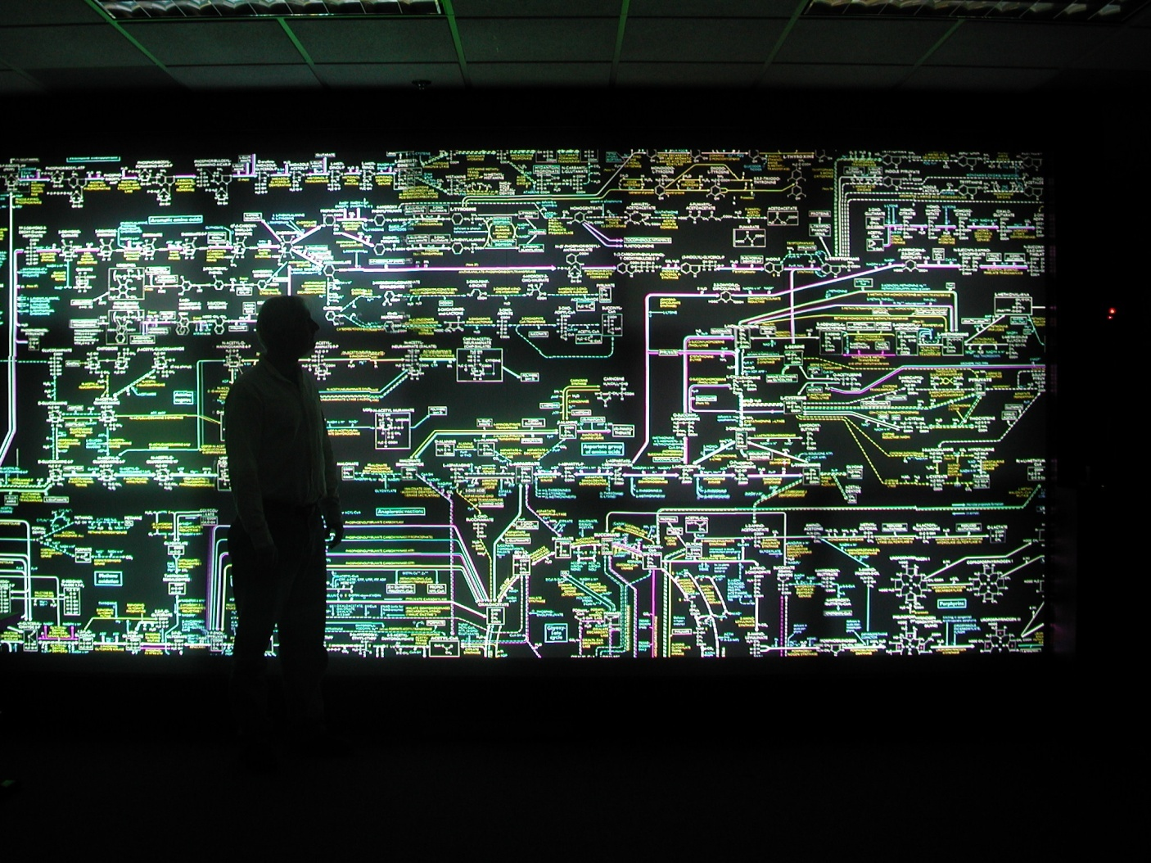
Questions?

