Slide 1
Introduction to Node.js for the SharePoint & Office 365 Developer

Slide 2






Andrew Connell
www.AndrewConnell.com
me@AndrewConnell.com
@andrewconnell
Independent Consultant, Developer, Speaker, Instructor
Hands-On SharePoint Training Critical Path Training - www.CriticalPathTraining.com
On-Demand SharePoint Training Pluralsight – www.Pluralsight.com

Slide 3


Want to Learn More?
www.CriticalPathTraining.com
Hands-On & Virtual Training
www.Pluralsight.com
On-Demand Training
SharePoint Courses for Everyone
SharePoint 2007, 2010 & 2013
Developers, Administrators & End Users
Get Training How You Like it
Hands-On (classroom with hands-on labs)
Online (live webcast with take-away labs)
Private Classes Available for Large Groups
SharePoint Courses for Everyone
SharePoint 2007, 2010 & 2013
Developers, Administrators & End Users
Individual, Small Business & Enterprise Plans
Monthly or Annual Subscriptions
Watch Online & Offline
Subscribers Have Access to Entire Catalog
me@andrewconnell.com

Slide 4
Topics
What is Node.js? … and io.js?
Developer Tooling for Node.js
Creating Websites & Web APIs with Node.js
Developing with Node.js
Node for Office & SharePoint Add-ins

Slide 5
What is Node.js?

Slide 6
What is Node.js
Cross platform environment for hosting JavaScript
Facilitates end-to-end JavaScript environment
Ideal for network & I/O based applications
Non-blocking, event driven
Open source
Managed by
Node.js Foundation
Joyent
https://nodejs.org

Slide 7
Who uses Node.js?
Microsoft Azure - http://aconn.me/1HZWEl2
Yammer - http://aconn.me/1Gxy9hL
Walmart - http://aconn.me/1HZWz0w
PayPal - http://aconn.me/1DsFZqx
LinkedIn - http://aconn.me/1NZNs1S
Trello - http://aconn.me/1OjCPsI

Slide 8
Node.js Components
Node
NPM
V8

Slide 9
Node.js vs io.js
Node.js – https://nodejs.org
Managed by Node.js Foundation (+Joyent)
Current (v0.12.2) uses V8 v3.28.73
io.js - https://iojs.org
Forked copy of Node.js in late 2014
Created out of community frustrations with decline in the pace of contributions & releases - http://aconn.me/1NZQvHl
Current version (v2.0.0) uses V8 v4.2
Contains many fixes & features not yet implemented in Node.js
Compatible with NPM
What will the future hold?
https://github.com/nodejs/dev-policy

Slide 10
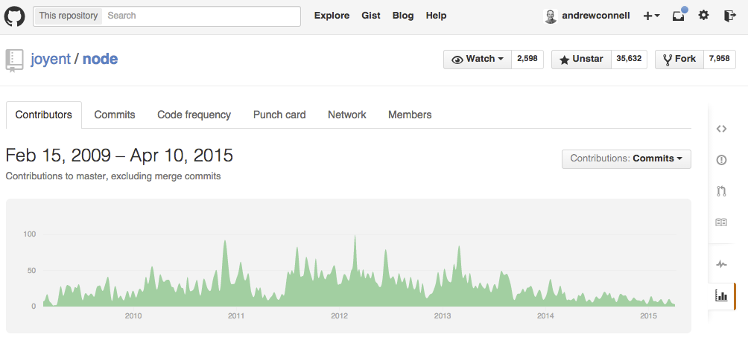
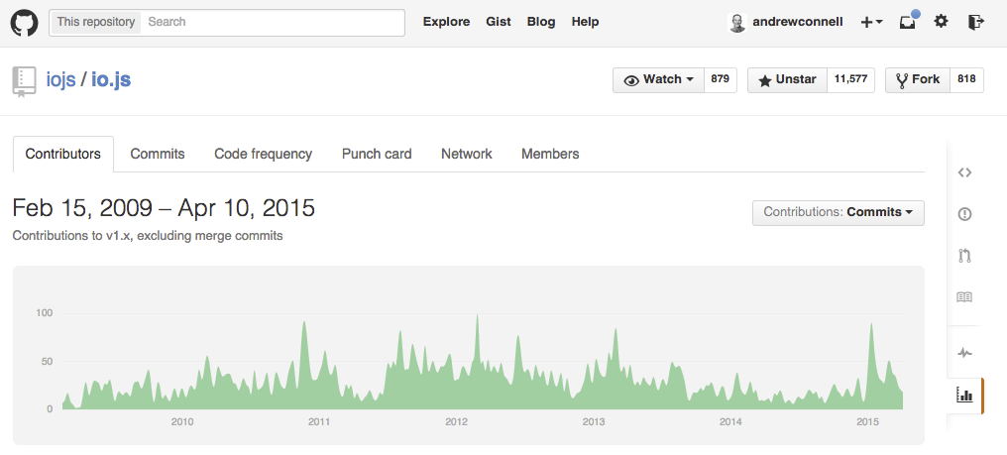

Slide 11
Appeal of Node.js & io.js
One language used from server to client
Same language used in projects & ecosystem around the projects
Build process
Developer tooling
System configuration
Cross platform
Built for network & I/O bound operations

Slide 12
Developer Tooling for Node.js

Slide 13
Node.js Developer Tooling Options
Visual Studio
https://www.visualstudio.com/en-us/explore/node-js-vs
Visual Studio Code
https://code.visualstudio.com
WebMatrix
http://www.microsoft.com/web/webmatrix
WebStorm
https://www.jetbrains.com/webstorm
Brackets
http://brackets.io
Any text editor

Slide 14
Developing Node.js

Slide 15
Node.js for Websites & Web APIs
Connect
Express
MVC
APIs

Slide 16
Express
Minimalist web framework
Built on Connect
Unopionated
Developers write all the plumbing code
Extensible – multiple MVC framework options

Slide 17
MVC Frameworks in Node.js
Jade
Unique HTML shorthand syntax
EJS
Embedded JavaScript
Vash
Similar to ASP.NET’s Razor syntax
Handlebars
Same as client-side syntax

Slide 18
Debugging Node.js Applications
Node --debug
node-inspector
Nodemon
spy.js

Slide 19
Thanks! Questions?
github.com/andrewconnell/pres-o365-node

