Slide 1
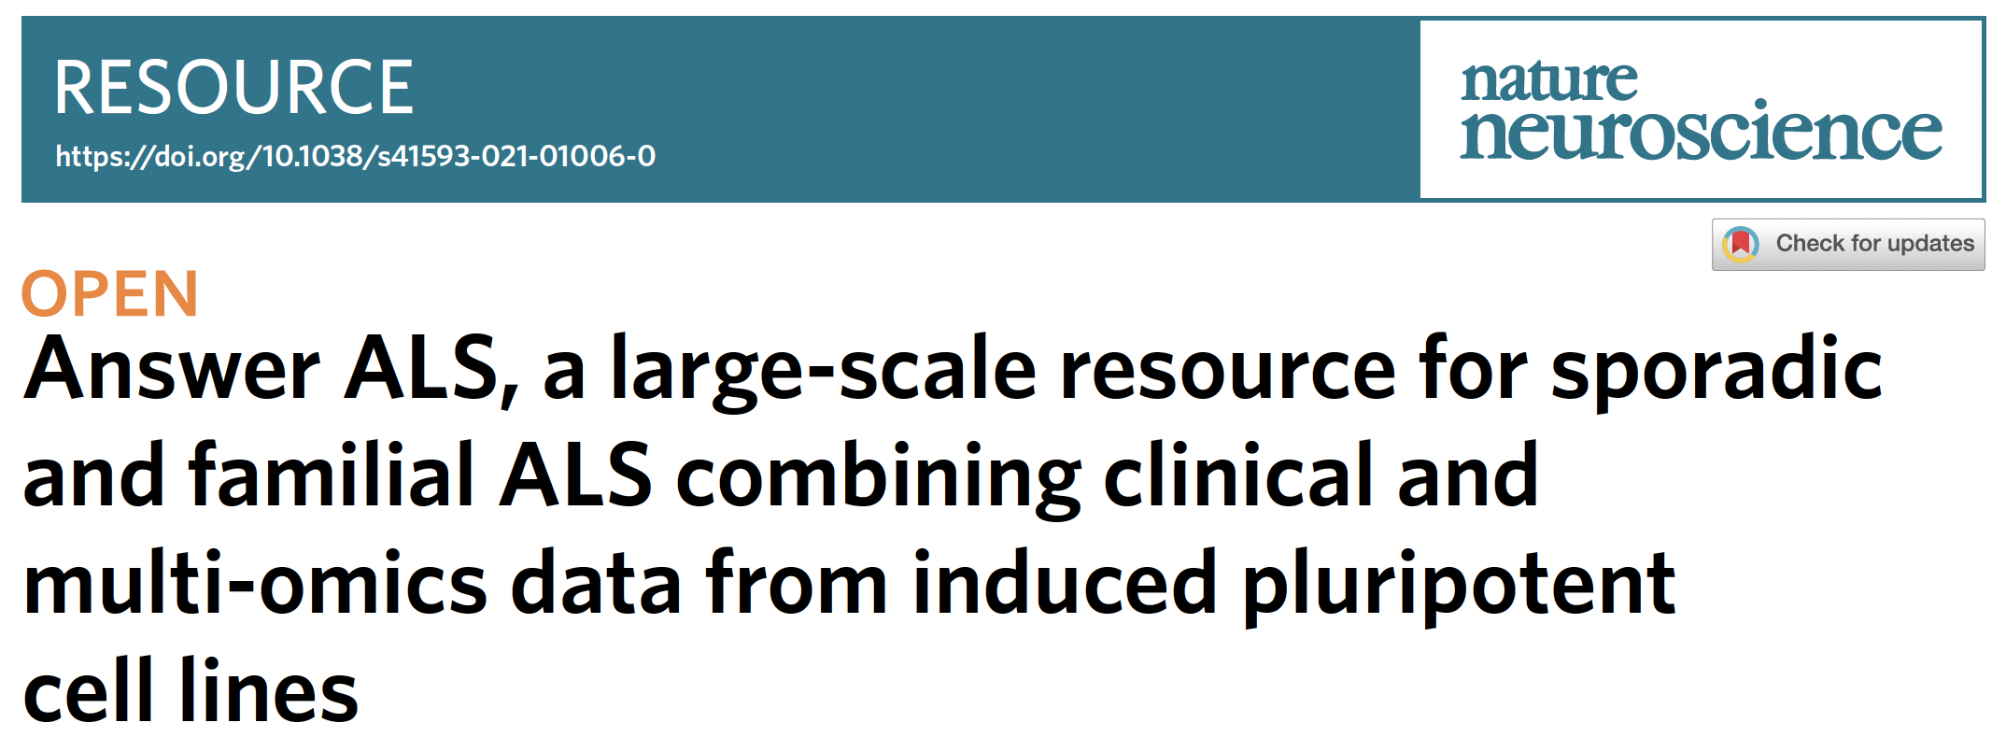

Slide 2
ALS - amyotrophic lateral sclerosis
Two types of ALS
  fALS –
    Inherited through family lines, typically involving specific mutations
    Can be studied using targeted approaches
  sALS –
    Occur randomly, without a clear family history or known genetic cause
    Causes not well understood
    More challenging to develop targeted treatments, no predictive model
  Subtypes of ALS
    Limb
    Bulbar
    Speech
Notes:
is a fatal neurological disorder that causes nerve cells in the brain and spinal cord to die, resulting in muscle weakness and paralysis
like gene therapy

Slide 3
Why is it hard to study ALS?
Cancer– biopsies performed at stages to deduce molecular & biological events
ALS, Alzhiemer’s – neurodegenerative diseases
Brain and spinal cord biopsies not feasible
No neural tissue – no effective therapeutic development
Alternative –
  Stem cell technology
  Infer disease pathways from cell lines derived from patient’s blood

Slide 4
Answer ALS program
Objective:
  Generate iPS cell lines from a large cohort of ALS patients
Focus:
  Aims to explore the differences in disease mechanisms and molecular profiles among sALS patients
  Analyzing spinal neurons derived from their cell
  Uncover distinct subtypes and potential therapeutic targets.
Data Used:
  Omics and Clinical data
Goal:
  Create a ‘biopsy-like’ model using iPS-derived neurons to study ALS at the cellular level

Slide 5
fALS and sALS
iPS spinal neurons from fALS patients led to first antisense based gene therapy
Most cases are sALS
fALS – known mutations but wide variability in symptoms
Maybe different underlying biological processes
ALS is highly heterogenous
Studying ALS biological subgroups is key
Notes:
ALSFRS is a clinical tool used to measure the functional status and progression of ALS patients. The scale evaluates various aspects of a patient's physical abilities, and changes in the score help doctors track how the disease is affecting a patient over time.

Slide 6
Demographic data
Clinical characteristics comparable to past sALS demographics
Slightly higher number of male than female
Mostly limb-onset ALS
Mean age of disease onset 57 years
Higher % of patients with rapid progression had bulbar-onset disease
fALS patients had C9orf72 and SOD1 mutations
Healthy controls – age matched participants w/o ALS

Slide 7
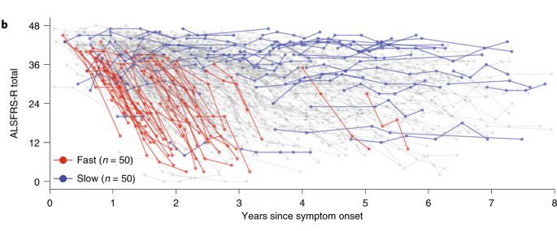
Heterogeneity in ALS progression
X-axis: Represents the years since symptom onset (0 to ~7 years).
Y-axis: Represents the ALSFRS-R total score, which measures the functional status of ALS patients.
A higher score indicates better function, while a lower score indicates more severe disease progression.

Slide 8
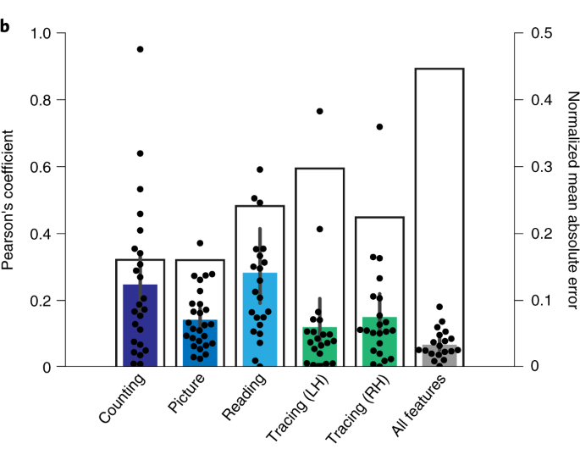
Data collection
Smartphone app to collect elements of
  motor activity,
  speech,
  breathing,
  voice and
  Cognition
Features from the finger tracing showed modest individual correlations with the ALSFRS-R total score
Combination of features from all these tasks correlated very highly with ALSFRS-R

Slide 9
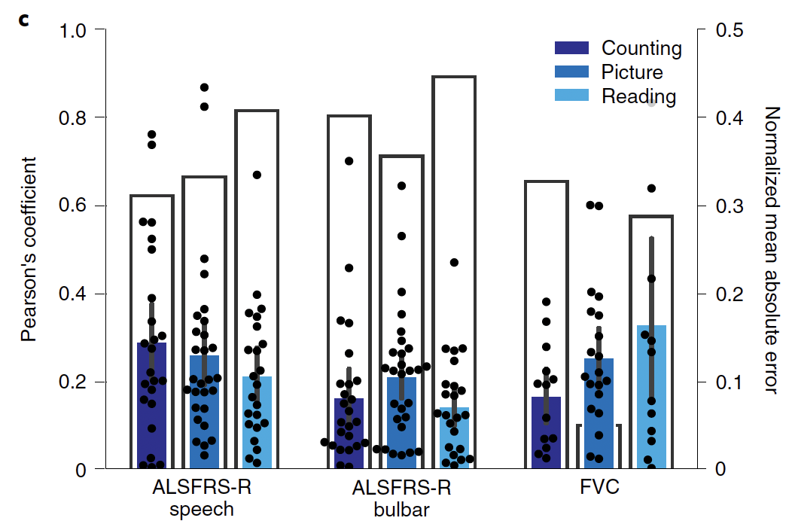
Data
Features from voice tasks correlated highly with bulbar subdomain of ALSFRS-R score (not shown)
Highest performance was using information from reading task for ALSFRS-R subscores
Counting task information produced best result to infer FVC score
Notes:
ALSFRS is a clinical tool used to measure the functional status and progression of ALS patients. The scale evaluates various aspects of a patient's physical abilities, and changes in the score help doctors track how the disease is affecting a patient over time.

Slide 10
Production of iPS cell line
> 1,000 patients with ALS and control
850 iPS cell lines generated and available for public use
Uniformity of generated cultures were evaluated
Used expression of five cell-identifying markers for neurons and glia
Carried out by Cedar-Sinai biomanufacturing center

Slide 11
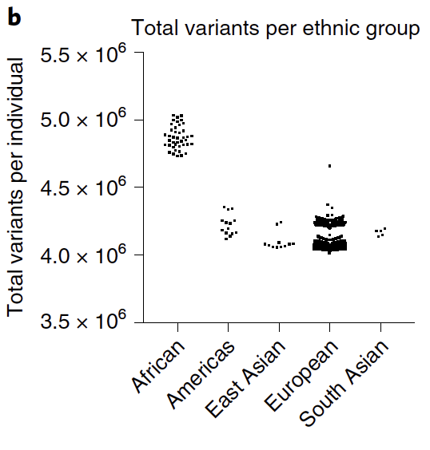
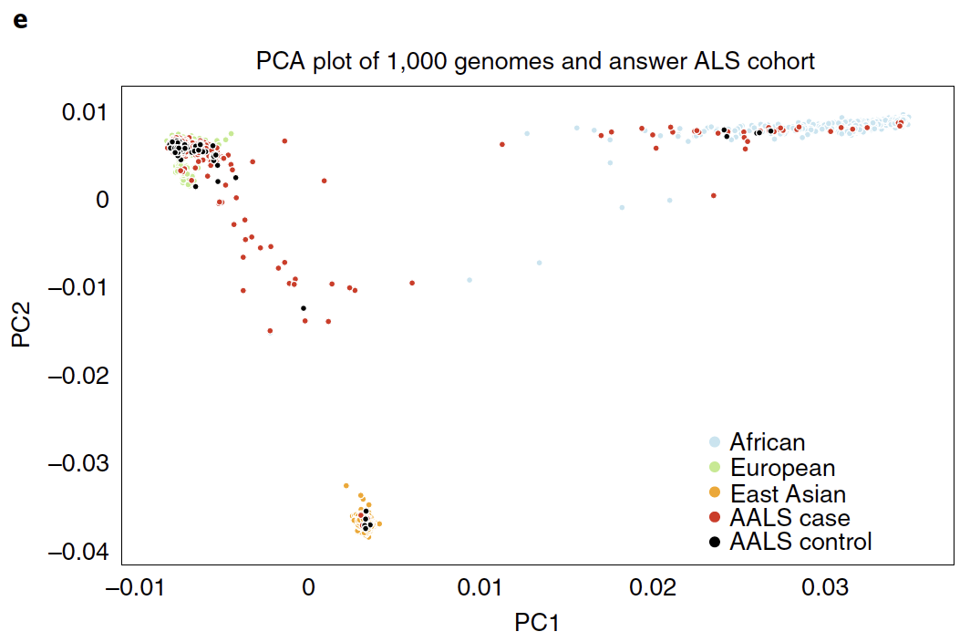
Multi-omics data
Genomics
  Cohort was evaluated using NYGC’s ancestry pipeline
  White and European descent (91.45%), Africa (4.94%), east Asia(1.33%) and south Asia (0.6%)
  The samples with African descent had a higher number of variants than other ethnic populations
Notes:
Notably, the samples with African descent had a higher number of variants than other ethnic populations, as expected

Slide 12
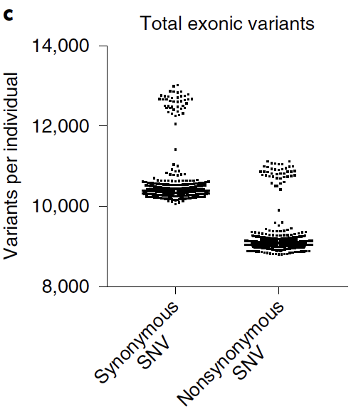
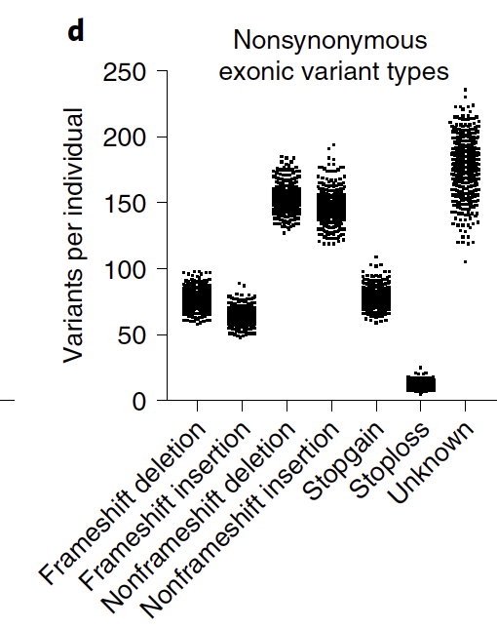
Multi-omics data
Variants
  In 830 samples, observed 440 exonic variants in 33-ALS genes
  33-ALS genes – curated list of genes associated with ALS
Rare variants (<1% frequency):79% were SNPs
  Other types: splicing, frameshift deletions/insertions, stop-gain mutations.

Slide 13
Pathogenic Variants in ALS Genes
12% of ALS patients harbored a known ClinVar pathogenic (CP) variant in ALS genes.
Examples of CP variants found:
SOD1 (5 variants in 8 ALS patients)
TDP43 (2 variants in 2 ALS patients)
FUS (1 variant in 1 ALS patient)
Some CP variants found in non-ALS individuals, including controls and pre-fALS subjects.

Slide 14
Rare High-Confidence ALS Variants
Identified pathogenic or likely pathogenic (P/LP) variants using multiple classification methods:
  InterVar (IP), in silico prediction (ISD), ACMG criteria, family-based segregation.
12 genes curated as high-confidence causal ALS genes, including:
  ALS2, CCNF, CHCHD10, FUS, OPTN, PFN1, SOD1, TARDBP, TBK1, UBQLN2, VAPB, VCP.

Slide 15
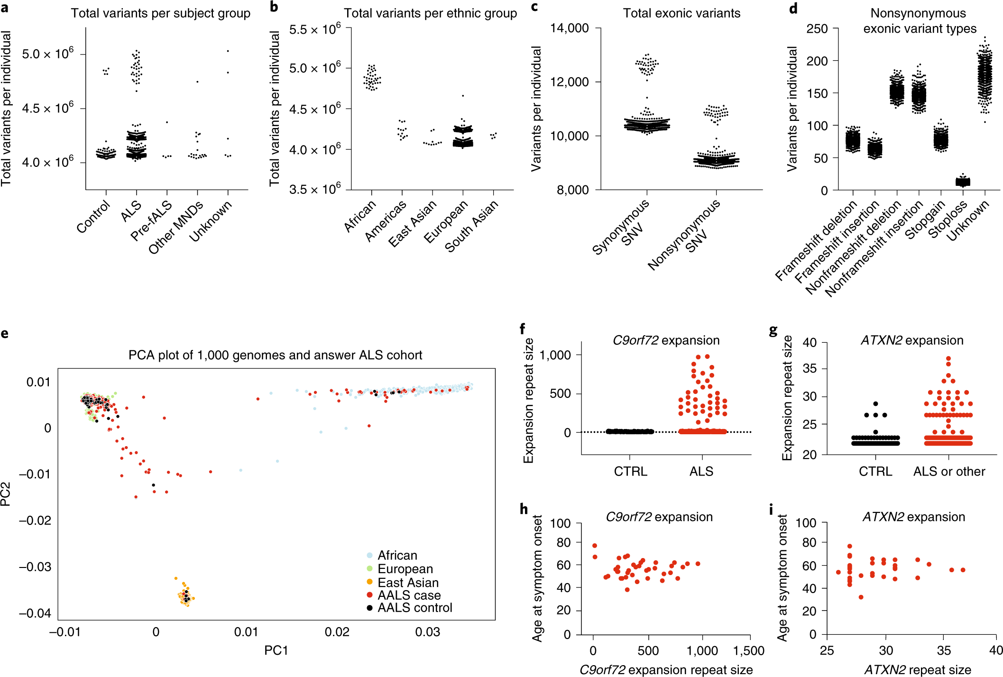
C9orf72 and ATXN2 Expansions
Repeat expansions in C9orf72 and ATXN2 linked to both familial (fALS) and sporadic ALS (sALS).
Findings from 830 samples:
  41 ALS patients & 4 pre-fALS individuals had >26 hexanucleotide repeats in C9orf72.
  35 ALS patients, 4 controls, 1 uncharacterized individual had >26 ATXN2 CAG repeats.
Notes:
Genomic expansions of both C9orf72 and ataxin 2 are associated with both fALS and sALS.

Slide 16
C9orf72 and ATXN2 Expansions
No correlation between ALS onset age and expansion size.
Future multi-omic studies may reveal new biological pathways in patients carrying both expansions.

Slide 17
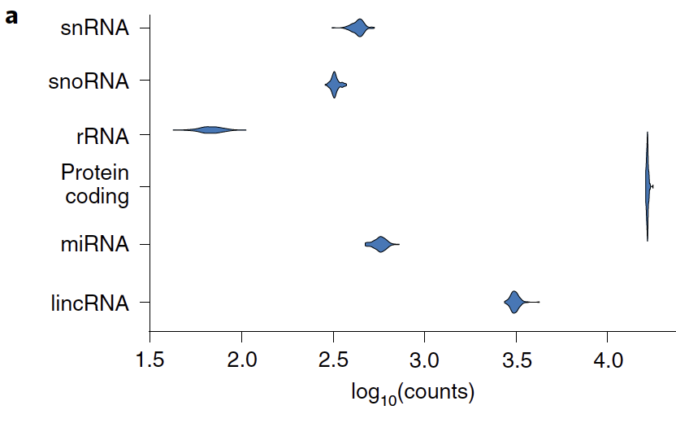
Multi-omics data
Transcriptomics
  Used the same batch of motor neurons for all omics
  Used batch differentiation controls and batch technical controls
  Minimal technical confounders
Notes:
to ensure fair comparison

Slide 18
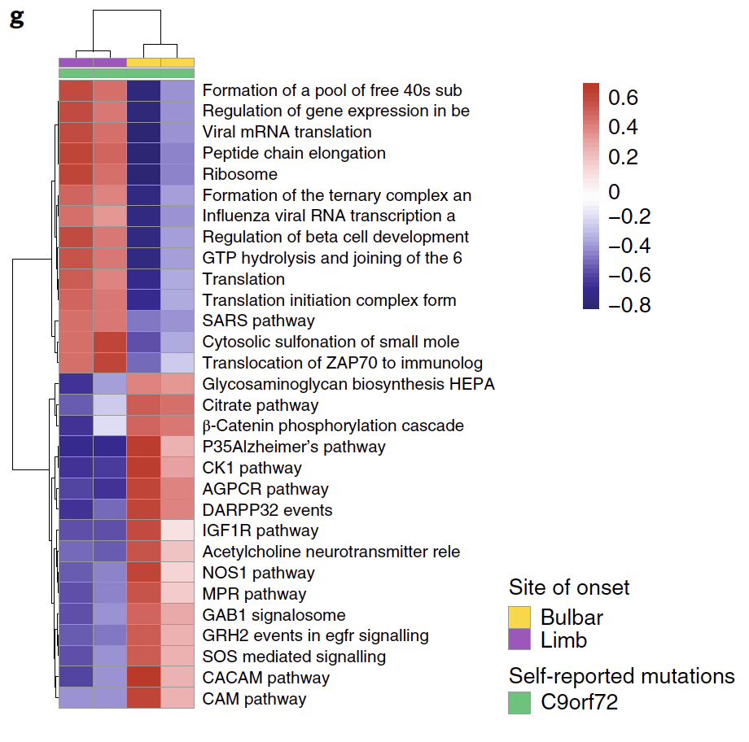
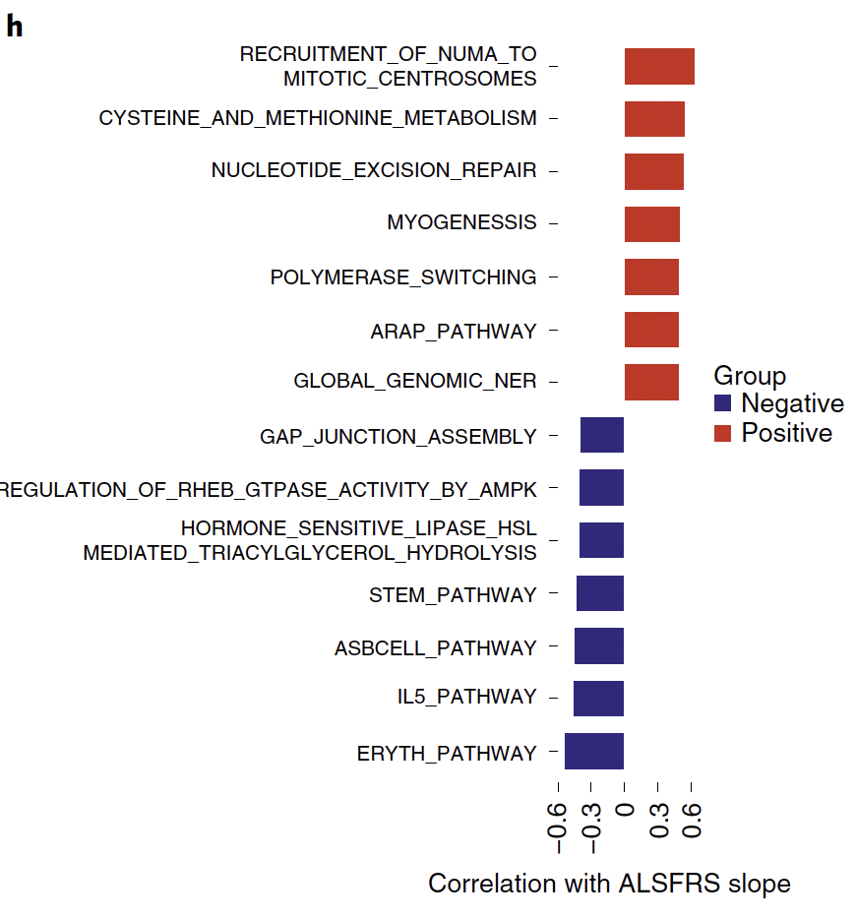
Multi-omics data
Transcriptomics
  Findings consistent with past work on ALS
Notes:
To assess pathway activities, they used gene set variation analysis to score samples against canonical KEGG pathways and identified pathways that are differentially regulated between bulbar and limb onset of ALS

Slide 19
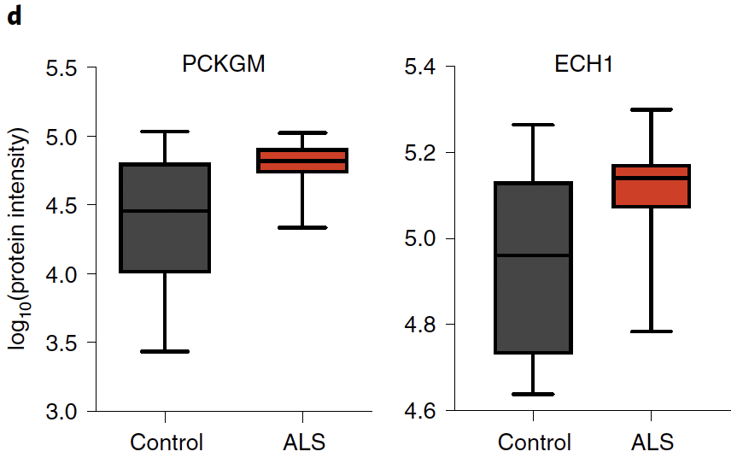
Multi-omics data
Epigenetics and Proteomics
  Minimal technical confounders
  For epigenetic data, many loci show strong differences between patients and controls
  Overrepresentation of TFs implicated in neuronal differentiation
  Proteomic data has many proteins showing DE between ALS and control

Slide 20
How did they use clinical data and omics data?
Instead of integration, they processed it separately for all samples
Then, validated each of the results obtained across clinical data and omics data
Discovered a new gene, Kif5A, involved in ALS
All the data is freely available for researchers on their portal
https://www.answerals.org/

Slide 21
Can reprogrammed human spinal neurons reflect adult-onset disease pathogenic cascades?
Multiple studies show that human iPS cells can replicate brain pathology seen in ALS.
iPS cells can be cultured in:
  2D models (traditional cell cultures).
  3D organoids (miniature brain/spinal cord models).
These models help study disease mechanisms in a controlled environment.

Slide 22
How are iPSC different from real patient cells?
iPSC cells are created from patients
They are differentiated to motor neurons and astrocytes which are cells affected in ALS
Real patient cells are hard to obtain because you can’t obtain neural cells to conduct biopsies
iPSC cells allow you to obtain tissue and organ biopsies without invasive methods

Slide 23
Any patient samples available for ALS?
http://www.alsa.org/research/focus-areas/biomarkers/biorepositories.html
https://www.cdc.gov/als/php/abstracts-publications-reports/prevalence-2022-2030.html
https://www.targetals.org/2024/02/05/biofluid-samples-from-natural-history-study-available-for-global-distribution/

Slide 24
Ideas for us?
Ideas
  Develop an omics informed predictive model for sALS?
  Use machine learning to find patterns that correlate with rapid or slow progression of disease?
  Use machine learning to identify a panel of biomarkers that can differentiate ALS patients from controls and predict disease onset in at-risk individuals?
  Predict disease using features captured in the smartphone application data?

