Slide 2
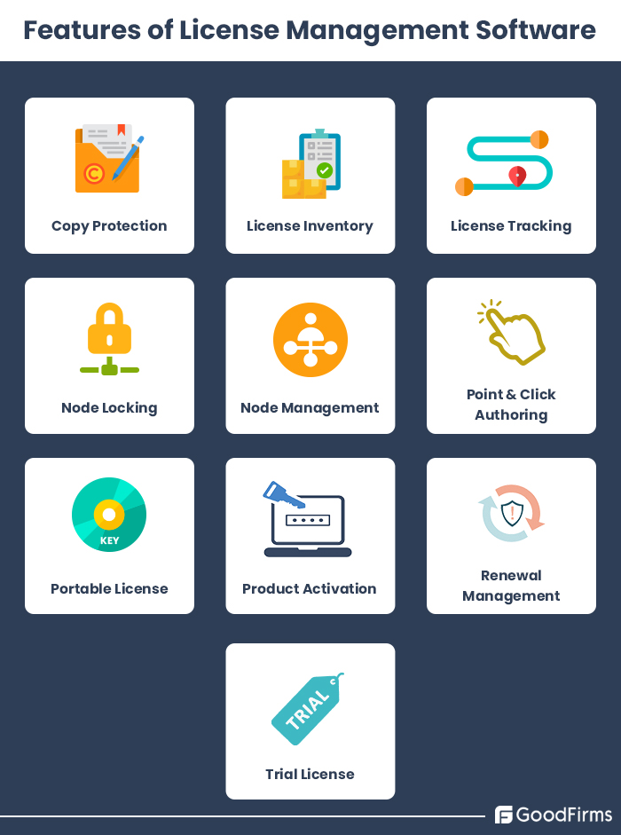
Features of License Management Software
Copy Protection
License Inventory
License Tracking
Node Locking
Node Management
Point & Click Authoring
Product Activation
Renewal Management

Slide 3
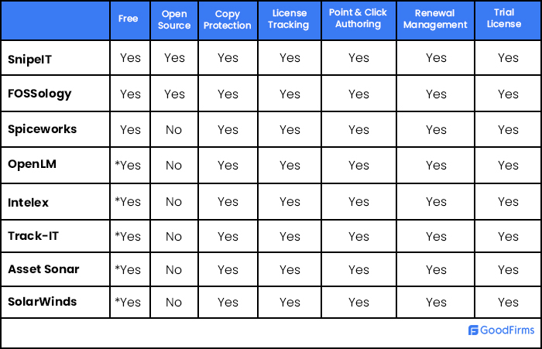
Top Free and Open Source License Management Software

Slide 4
License Types and Attributes
node-locked (runs on a specified node only)
floating (available anywhere on a network, up to a concurrent usage limit)
token or package-based
metered (i.e. a limited number of executions or limited time of execution).

Slide 5
Open iT - LicenseAnalyzer
builds information about trends and usage patterns across an organization
meters license usage across an enterprise
optimizes deployment of expensive license resources
minimizes the cost of purchasing licenses
generate license usage reports for chargeback accounting

Slide 6
Open iT – Features
Harvest licenses automatically
Suspend, resume and/or terminate sessions.
Prioritize resources
Schedule projects, teams usage based on internal needs.
Discover unused software
Highlight software and related module usage per department.
Automate license optimization
Streamline processes, people, licenses and contracts.

Slide 7
Reprise License Manager (RLM)
Automatic Server Discovery
RLM-enabled applications can automatically discover license servers over a LAN, simplifying software deployment for customers, and reducing support for you.
Straightforward Troubleshooting
Resolve license contention and setup problems swiftly since logs are unencrypted, licenses are clearly mapped to product names, and diagnostics from all licensed clients and license servers are always available.
Distributed Servers with High Availability
RLM transparently queues, in parallel, for busy licenses across multiple servers

Slide 8
Reprise License Manager (RLM) - Attributes
expiration date
highest available software version
start date
named-user (i.e., the license can only be used by a particular user)
allowed platform for the application.

Slide 9
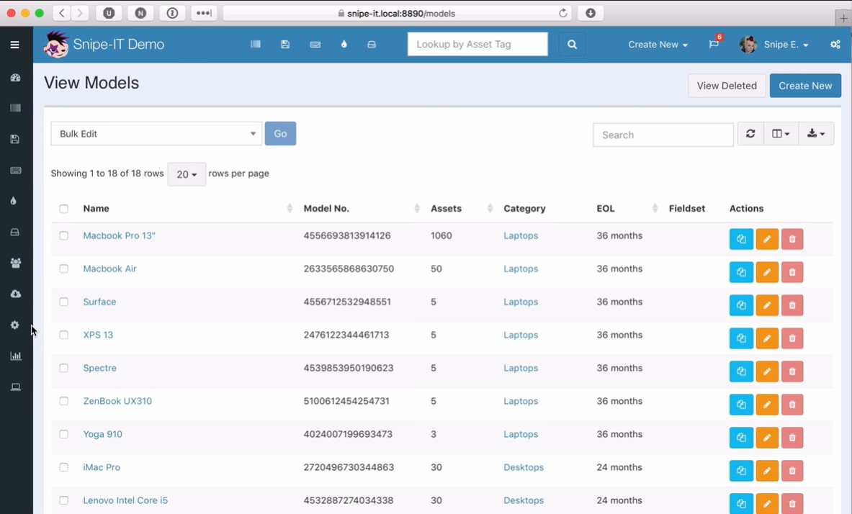
SnipeIT
☆ Star 5.9k
Most active project on GitHub
FOSS (Free and open source software)
web-based software
Powerful REST API
Frequent Updates
Built on PHP Laravel
Demo: https://demo.snipeitapp.com/

Slide 10
SnipeIT - features
Copy Protection
License Tracking
Node Locking
Point & Click Authoring
Product Activation
Renewal Management
Trial License

Slide 11
Licensecc
Copy protect, limit the usage of your C++ software with a license.
BSD 3 clauses
Linux / Windows

Slide 12
Licensecc – Features
Trial license with expiry date
Link software to “physical” hardware
Easy license retrieval

Slide 13
Licensecc
licensecc :
the C++ library with a C api (the part you have to integrate in your software) with minimal external dependencies. (github project licensecc )
lccinspector :
a license debugger to be sent to the final customer to diagnose licensing problems or for calculating the hardware id before issuing the license.
lccgen :
a license generator (github project lcc-license-generator ) to initialize the library and generate the licenses.

