Slide 1
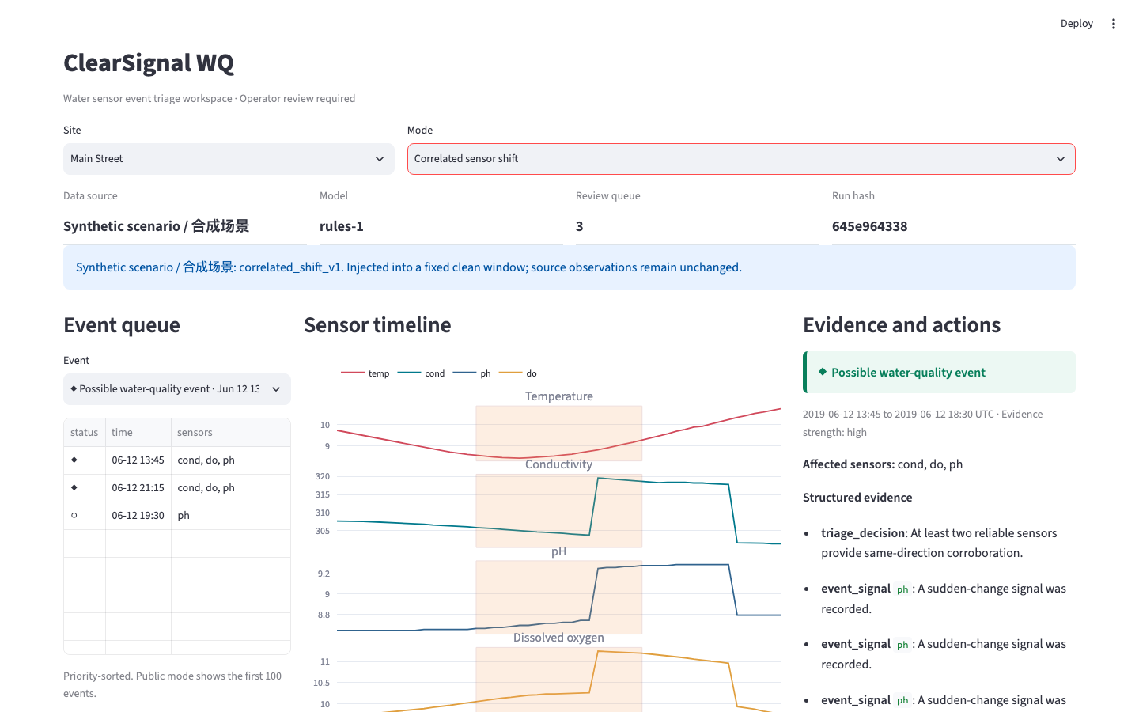
CLEARSIGNAL WQ
Evidence before
escalation
Explainable AI triage for water sensor events, drift, and data-integrity failures.
OPERATOR REVIEW REQUIRED
Four outcomes. One review queue. Every decision keeps its evidence and next human action.
Qizhong Deng | Xylem Global Student Innovation Challenge 2026
Notes:
Open with the operator problem: unusual sensor values do not explain what happened. ClearSignal WQ organizes the evidence before anyone escalates.

Slide 2
THE PROBLEM
One unusual signal can imply three different actions
Small monitoring teams need a defensible next step, not another unexplained alert.
Environmental change
Sensor drift
Data gap
Several reliable sensors move together. The operator should retest in the field and decide whether laboratory confirmation is justified.
A single sensor changes while reliability falls. The right response is maintenance, calibration, and an independent measurement.
Timestamps or telemetry fail. The operator should inspect the data link before treating missing information as a water event.
The cost of confusing them
alert fatigue | avoidable field work | delayed maintenance | inconsistent escalation
Notes:
Explain that identical-looking anomalies can require different operational responses. The product is designed around this triage decision.

Slide 3
HOW IT WORKS
One deterministic path from readings to review
01
02
03
04
05
06
Validate
Detect
Group
Assess
Triage
Act
timestamps, sensors, provenance
gaps, range, stuck, robust jumps
stable event windows and IDs
reliability and corroboration
fixed priority and explanation
retest, calibrate, inspect, escalate
Why deterministic?
The same evidence always produces the same category, explanation, limitation, and human verification action.
The UI never recalculates thresholds or changes triage decisions.
Notes:
Walk from validation through human action. Emphasize that there is one production path and the interface does not change model decisions.

Slide 4
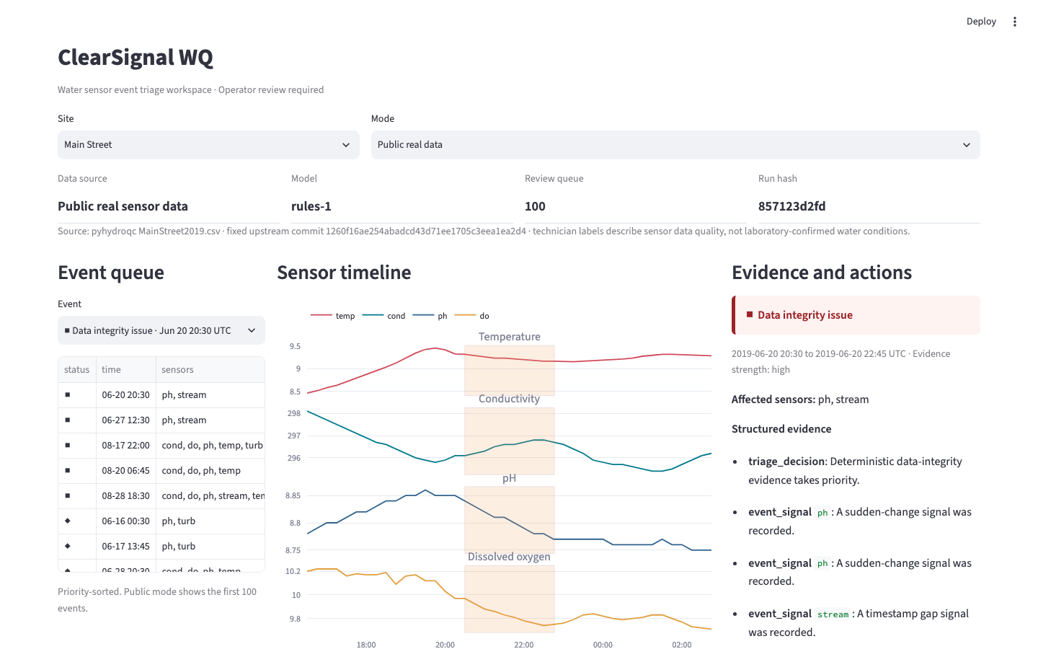
THE PRODUCT
A review workspace built for repeated operational decisions
Queue the event, inspect the signal context, and record the next verification action.
1. Prioritize
Stable event IDs and severity-aware ordering.
2. Explain
Four-sensor timeline plus structured evidence.
3. Verify
Retest, calibrate, inspect the link, or escalate.
Notes:
Demonstrate the three-column workflow: event queue, sensor timeline, and evidence with the next action.

Slide 5
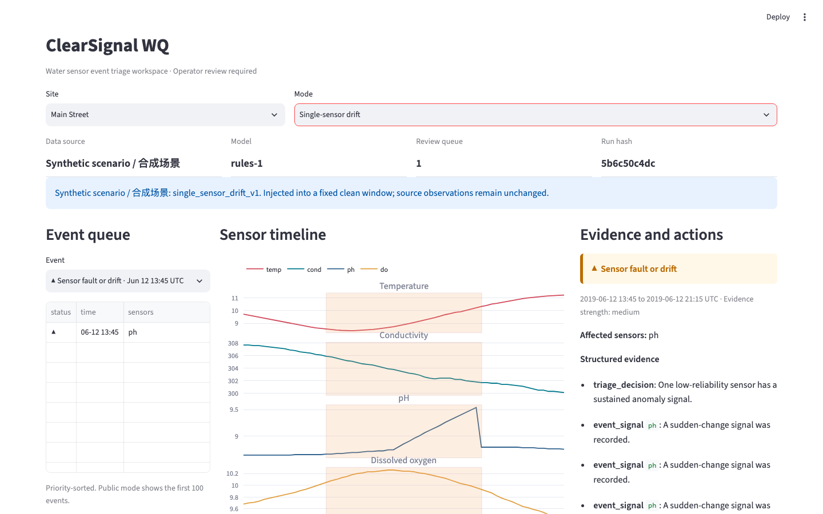
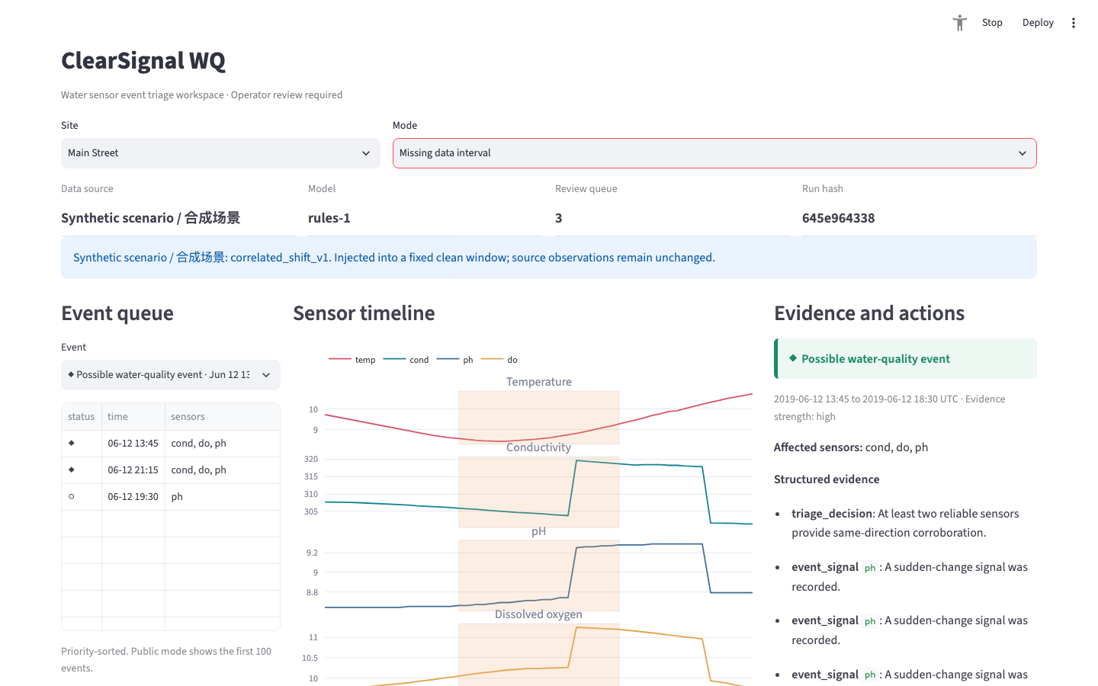
SCENARIO PROOF
The workflow changes when the evidence changes
Synthetic scenarios are explicitly labelled and test product behavior, not real-world accuracy.
Possible water-quality event
Sensor fault or drift
Data-integrity issue
Multiple reliable sensors move together
One sensor changes while reliability falls
Missing timestamps take priority
Notes:
Show that the same interface produces different operational responses from different evidence patterns. Synthetic labels remain visible.

Slide 6
EVALUATION
We kept the simpler model because the evidence said so
Validation on technician-labelled sensor data-quality events
7.30
93.50%
Model and split
Recall
Precision
Invalid/day
Decision
invalid alerts / day
on validation
package test
coverage
Rules / validation
1.000
0.0135
7.30
Selected
ARIMA / validation
0.800
0.0111
7.14
Rejected
The limitation is part of the result
Rules / frozen test
0.7368
0.0426
8.2895
Held out
Low precision and high alert burden make this unsuitable for unattended deployment.
311 automated tests | 3 browser flows | 3 target viewports
Notes:
Be direct about model selection and limitations. ARIMA missed the preregistered recall gate. The selected rule model still has a high false-alert burden.

Slide 7
RESPONSIBLE PATH
Decision support today. Field evidence next.
The prototype organizes evidence; it does not certify water safety or replace independent testing.
What it does
What it does not do
Next field pilot
Prioritizes sensor events
Preserves evidence and limitations
Makes the next human action explicit
Keeps synthetic scenarios clearly labelled
Confirm contamination
Declare water safe
Replace field or laboratory tests
Operate unattended at the current alert rate
Add maintenance and calibration records
Pair alerts with independent samples
Measure avoidable escalations and response time
Tune only on pilot evidence
github.com/Cedric-uxb/clearsignal-wq
Public code, data provenance, evaluation, and reproducible tests
Notes:
Close on the responsible deployment path. The next meaningful step is a small field pilot with maintenance context and independent samples.

