Slide 1
Perfect Toys
Daily report

Slide 2
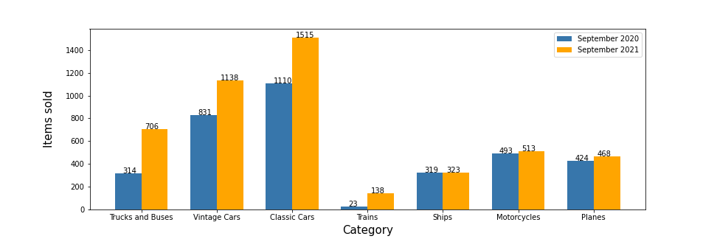
Items sold by category

Slide 3
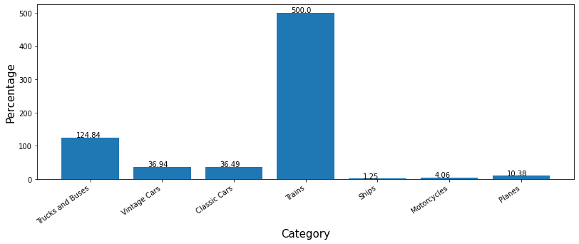
Rate of comparison by percentage

Slide 4
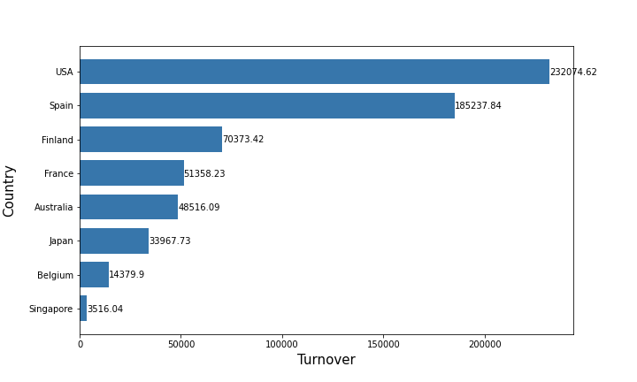
Turnover by Country - Last two months (€)

Slide 5
Clients with Outstanding Amount

Slide 6
Client | Orders(€) | Payments(€) | In Debt(€)
Mini Gifts Distributors Ltd. | 584188.24 | 500590.20 | 83598.04
Scandinavian Gift Ideas | 120943.53 | 48809.90 | 72133.63
Euro+ Shopping Channel | 715908.86 | 668843.50 | 47065.36
Reims Collectables | 126983.19 | 80326.25 | 46656.94
Land of Toys Inc. | 149085.15 | 107639.94 | 41445.21
Down Under Souveniers, Inc | 113195.27 | 79601.95 | 33593.32
FunGiftIdeas.com | 88627.49 | 58333.72 | 30293.77
Anna's Decorations, Ltd | 137034.22 | 107185.70 | 29848.52
Volvo Model Replicas, Co | 66694.82 | 43680.65 | 23014.17
Kelly's Gift Shop | 107207.04 | 84243.44 | 22963.60
Lyon Souveniers | 67659.19 | 49731.10 | 17928.09
Alpha Cognac | 60483.36 | 48051.04 | 12432.32
Mini Auto Werke | 51059.99 | 42252.87 | 8807.12
UK Collectables, Ltd. | 69351.78 | 61167.18 | 8184.60
GiftsForHim.com | 57989.42 | 56662.38 | 1327.04

Slide 7
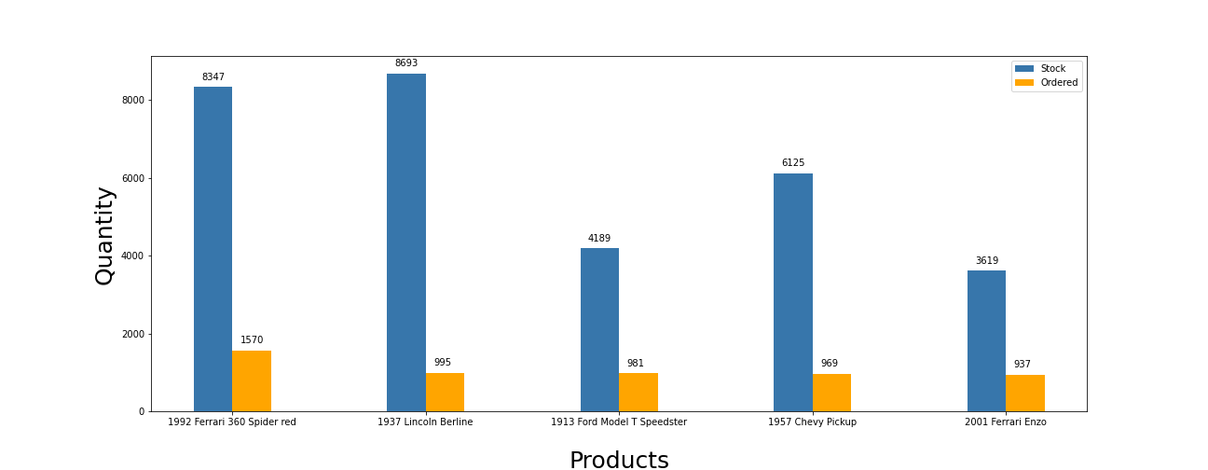
Stock of the most ordered products

Slide 8
Two sellers with highest turnover
September 2021
Gerard Hernandez with 169690.25€
Leslie Jennings with 148026.25€

Slide 9
Top 10 turnover of 2021
Name | Turnover in € | Month
Gerard Hernandez | 169690.25 | 2021 September
Leslie Jennings | 148026.25 | 2021 September
Larry Bott | 133954.51 | 2021 May
George Vanauf | 122323.55 | 2021 June
Gerard Hernandez | 117884.54 | 2021 July
Gerard Hernandez | 114825.97 | 2021 May
Pamela Castillo | 113114.3 | 2021 June
Barry Jones | 110017.53 | 2021 April
Steve Patterson | 106491.17 | 2021 March
Steve Patterson | 98211.02 | 2021 May

