Slide 1
Hostel Management System

Slide 2
Introduction
A desktop application for managing student hostels efficiently.
Built using Python and Tkinter GUI.
Stores and retrieves data using SQLite database.

Slide 3
Objectives
Simplify hostel administration tasks.
Provide an intuitive GUI for managing students and rooms.
Keep records of fees and room allocations accurately.

Slide 4
Tools & Technologies
Python
Tkinter - GUI Library
SQLite - Lightweight Database
GitHub - Version Control

Slide 5
System Features
Admin Login Authentication
Add, View, Update, Delete Students
Assign Rooms to Students
Record and Track Fee Payments

Slide 6
System Architecture
User Interface (Tkinter) interacts with database (SQLite).
Modules are connected: Login, Student, Room, Fee.
Admin manages all data through GUI.

Slide 7
Database Design
Tables: admin, students, rooms, fees.
Each student is assigned to a room.
Fee payments are linked to students.
Admin login details are stored securely.

Slide 8
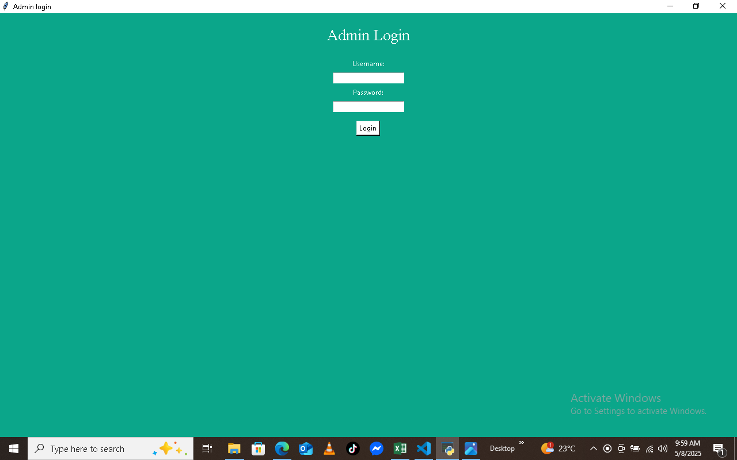
Admin Login window
This is the first GUI window of the application.
Admin is asked to put in the username and the password.
Click login to confirm and login.

Slide 9
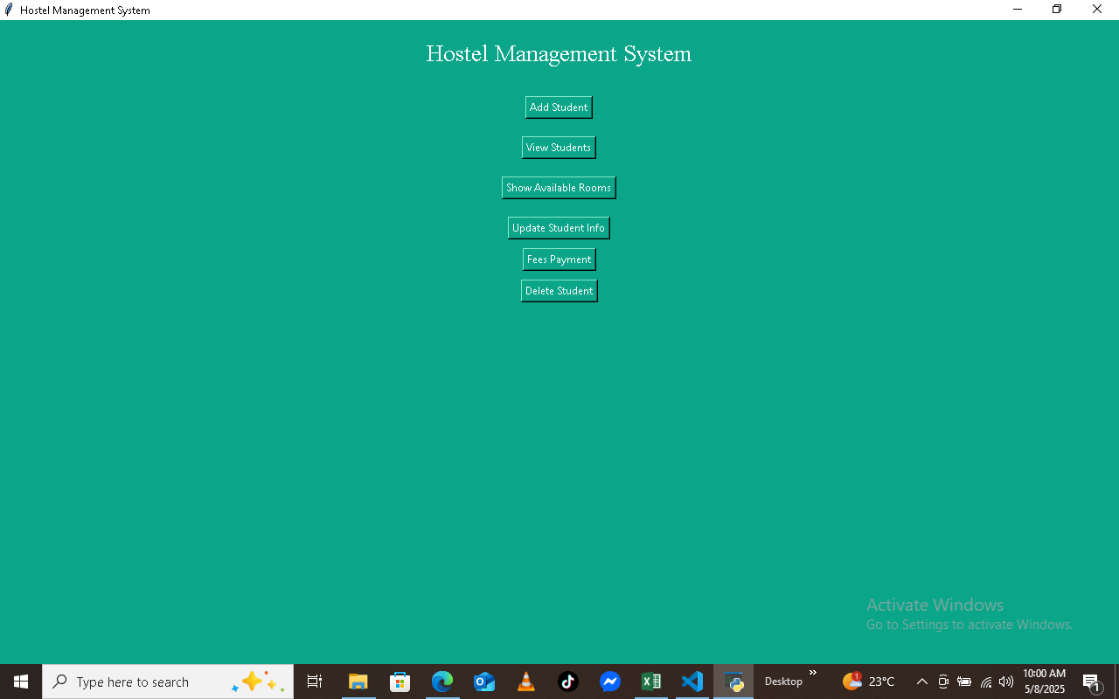
Main window
The main window contain buttons to help the user to interact with the system.
Student entry , update and deletion are done on this window.

Slide 10
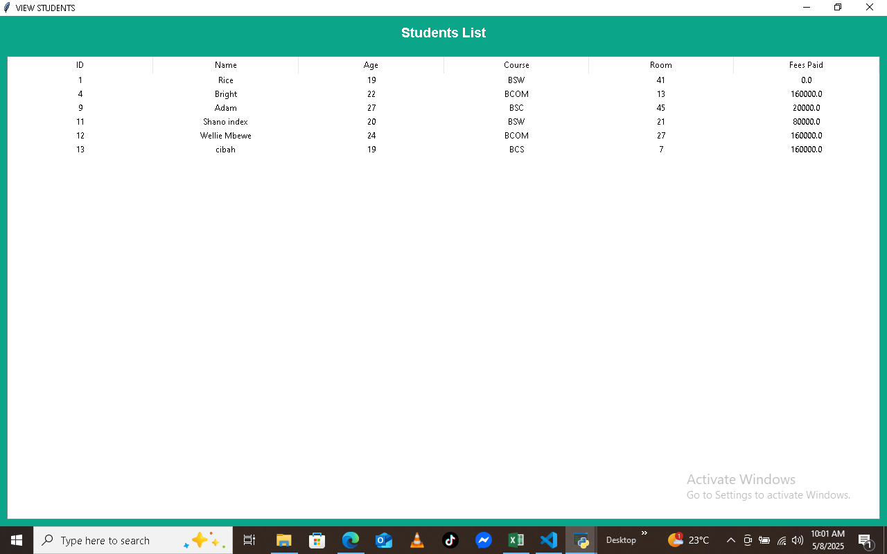
Student list window
This window displays student details in a table.
It contain student ID, Name, Age, Course, Room number and Fee details.

Slide 11
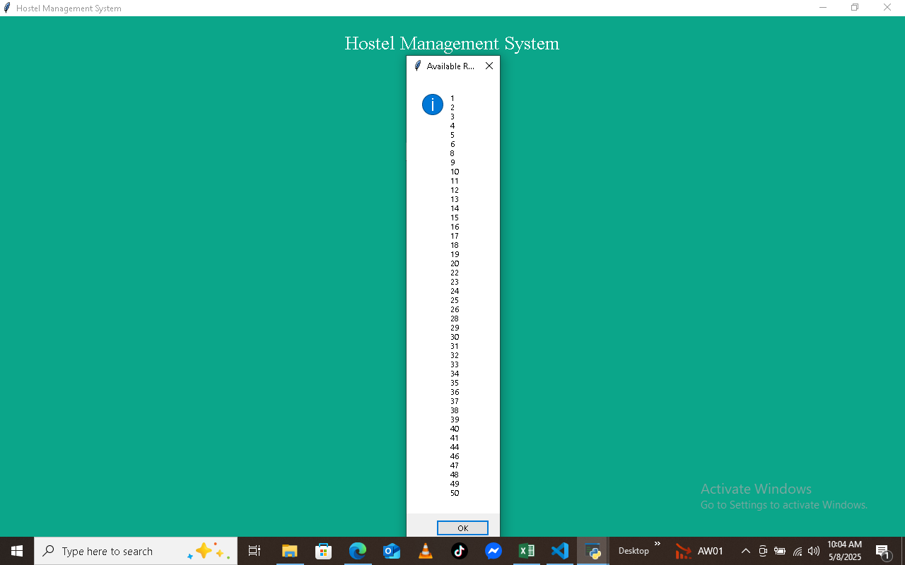
Rooms window
A small window which display available rooms.

Slide 12
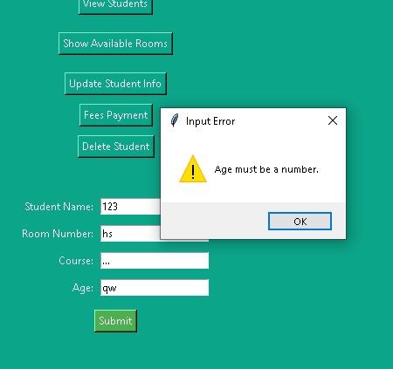
Error Handling.
Messagebox and showerror function , its some of tools I used to handle errors like : Input Validation Errors, Database Errors(Duplicate entries), Form Submission Errors.
Implementation of exceptions also work on error handling.

Slide 13
Challenges Faced
Handling layout and widget alignment in Tkinter.
Dealing with SQLite database errors.
Resolving Git version control issues during push/pull.
Validating user input properly.

Slide 14
Future ideas
Searching bar
Double or multi-booking
Scroll bar

Slide 15
Conclusion
The Hostel Management System is a user-friendly desktop application developed using Python, Tkinter, and SQLite. It streamlines hostel operations such as student registration, room allocation, and fee management.
The system improves efficiency, reduces manual errors, and offers reliable performance.

Slide 16
Thank You
Thank you for your attention.
Questions and Feedback are welcome.

