Slide 1

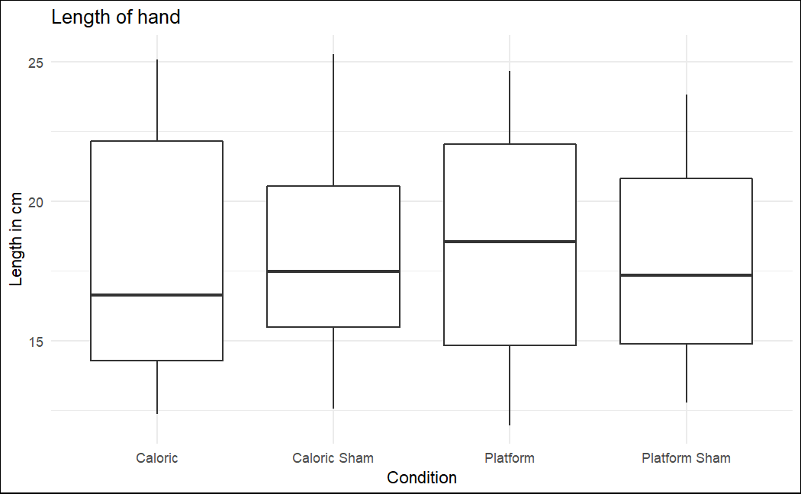
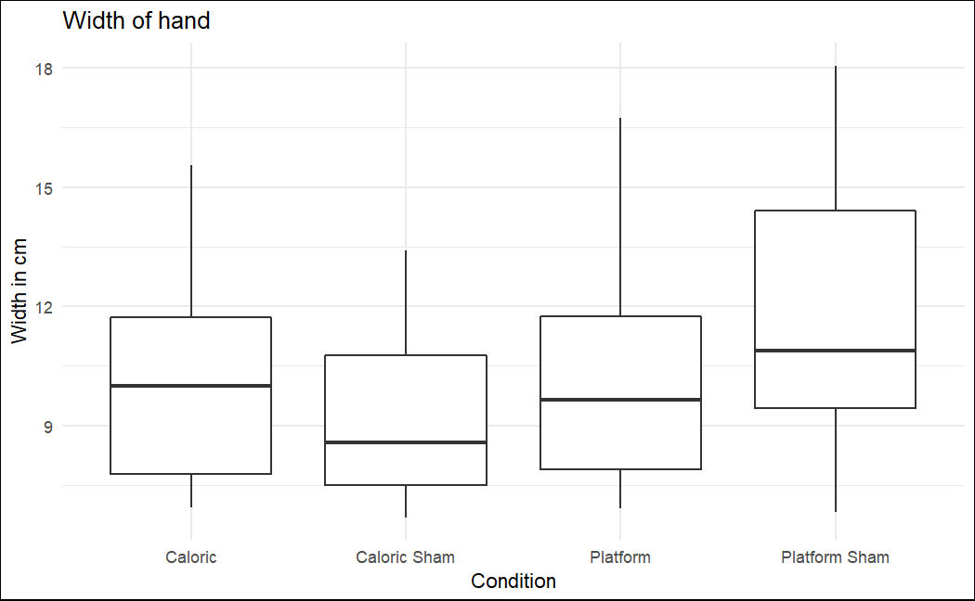
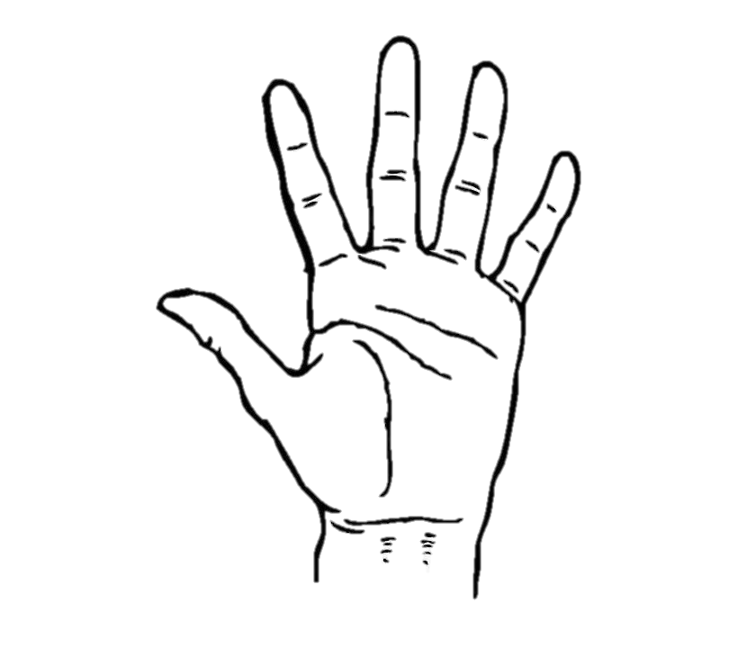
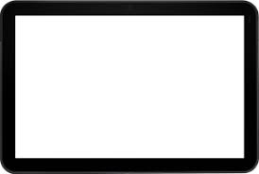
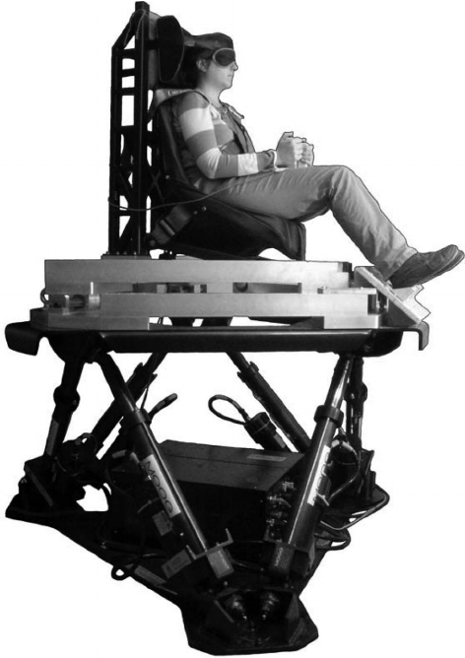

How well do you know your body?
Modifying the body schema by vestibular stimulation
BA Cedric Berther, PD Dr. Matthias Ertl, Prof. Dr. Fred Mast
University of Bern, Institute of Psychology, Department of Cognitive Psychology, Perception and Research Methods
1. Introduction
3. Results
Prior findings suggest significant effects of vestibular stimulation on hand representation. The Body Schema is assumed to change with vestibular stimulation^{[1,2]}. This study uses the same methods as Lopez et al. (2012) while also adding a motion platform.
Length:
2. Methods
N = 40, 10 participants for each order
40 items for each task
Questionnaire with 6 items
Width:
Task:
Conditions:
4. Discussion
Our findings indicate that vestibular stimulation does not influence hand representation. There is no significant difference in overall length or width, regardless of the conditions compared. Contrary to previous findings, our results do not support changes in body perception.
37°C
37°C
20°C
47°C
References
[1] Lopez, C., Schreyer, H. M., Preuss, N. & Mast, F. W. (2012). Vestibular stimulation modifies the body schema. Neuropsychologia, 50(8), 1830–1837. https://doi.org/10.1016/j.neuropsychologia.2012.04.008
[2] Lopez, C., Nakul, E., Preuss, N., Elzière, M. & Mast, F. W. (2018). Distorted own-body representations in patients with dizziness and during caloric vestibular stimulation. Journal of Neurology, 265(S1), 86–94. https://doi.org/10.1007/s00415-018-8906-8

