Slide 1
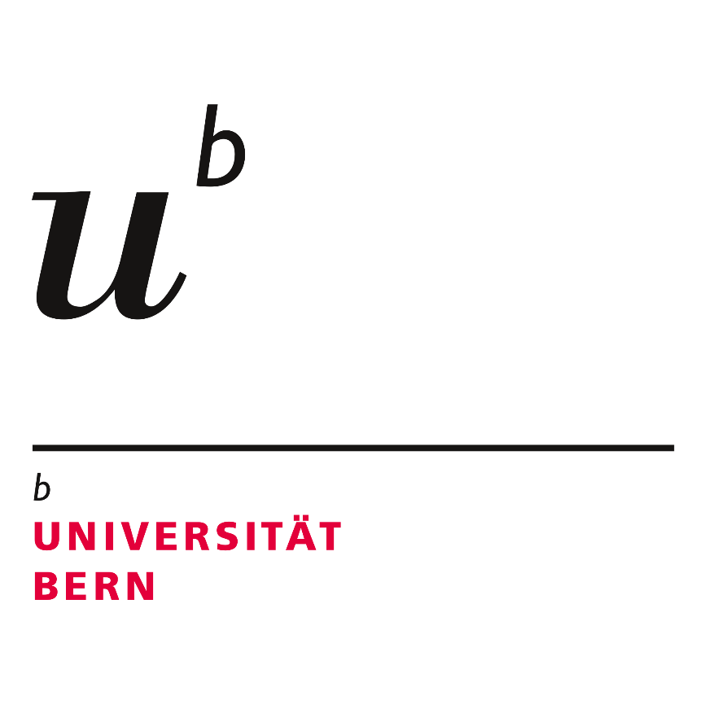
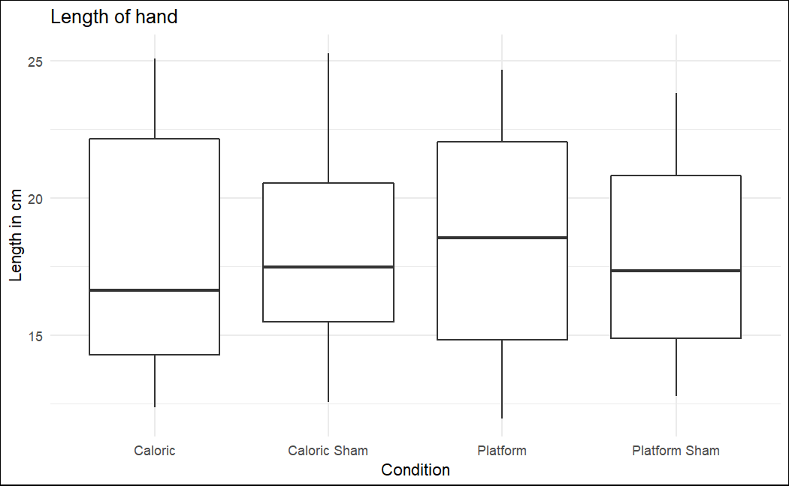
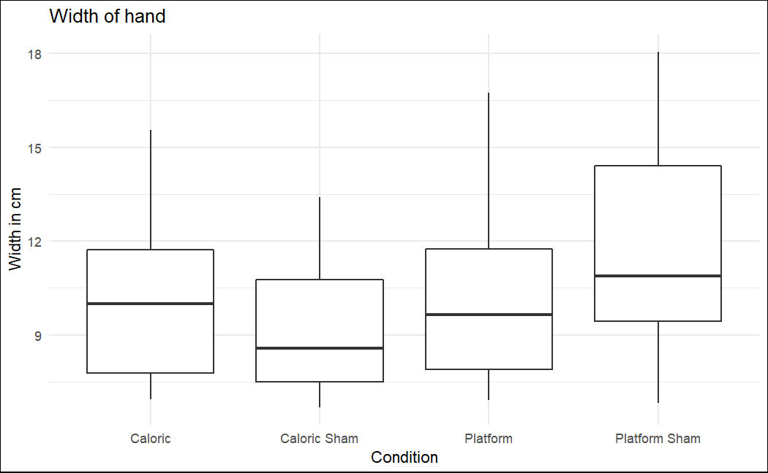
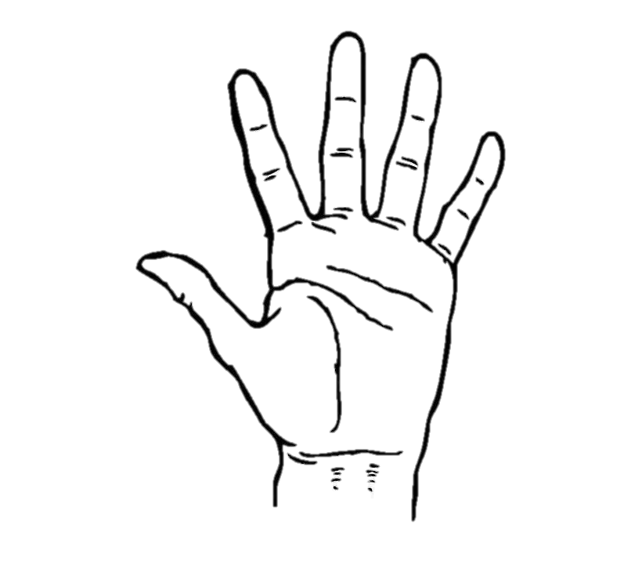
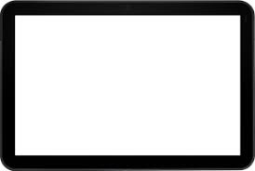
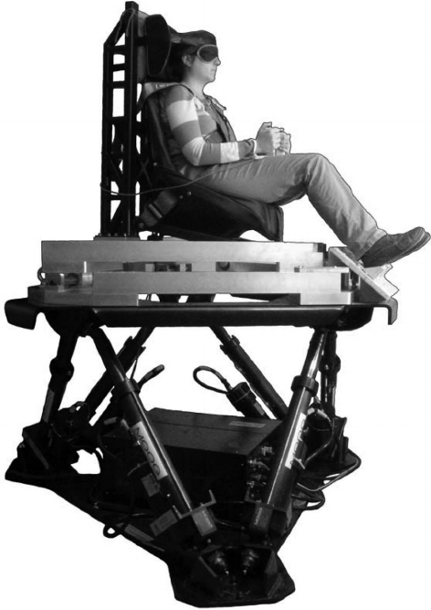
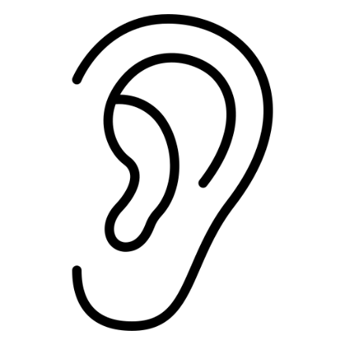
How well do you know your body?
Modifying the body schema by vestibular stimulation
BA Cedric Berther, PD Dr. Matthias Ertl, Prof. Dr. Fred Mast
University of Bern, Institute of Psychology, Department of Cognitive Psychology, Perception and Research Methods
Contact: cedric.berther@unibe.ch; kog.psy.unibe.ch
1. Introduction
3. Results
Prior findings found significant effects of vestibular stimulation on hand representation. It is assumed that vestibular stimulation changes the own body schema^{[1,2].} This study replicates the caloric stimulation and questionaire from Lopez et al. (2012) while also adding a motion platform as a condition. There are three hypothesis:
H1) Perception of the hands should change during the stimuli so that the hands are perceived to be larger
H2) The platform and caloric stimulation data should yield similar, as both stimulate the vestibular organ
H3) We additionally expect that there will be a significant difference in the questionnaire about the body schema that will be given to the subjects at different times during the experiment
2. Research Design
N = 40, 10 participants for each order
40 items for each task
Questionnaire with 6 items, given after each condition
Task:
Conditions:
Findings: No significant difference between the conditions. Significant difference in questionnaire items.
4. Conclusion
Our findings indicate that vestibular stimulation does not influence hand representation
There is no significant difference in overall length or width, regardless of the conditions compared
No significant change was found between the conditions with vestibular stimulation and the sham conditions
The answers on the questionnaires show, that the participants felt some sort of stimulation in the real conditions
Because of this, H1 and H2 are discarded
Contrary to previous findings, our results do not support changes in body schema
37°C
37°C
20°C
47°C
References
[1] Lopez, C., Schreyer, H. M., Preuss, N. & Mast, F. W. (2012). Vestibular stimulation modifies the body schema. Neuropsychologia, 50(8), 1830–1837. https://doi.org/10.1016/j.neuropsychologia.2012.04.008
[2] Lopez, C., Nakul, E., Preuss, N., Elzière, M. & Mast, F. W. (2018). Distorted own-body representations in patients with dizziness and during caloric vestibular stimulation. Journal of Neurology, 265(S1), 86–94. https://doi.org/10.1007/s00415-018-8906-8

