Slide 2
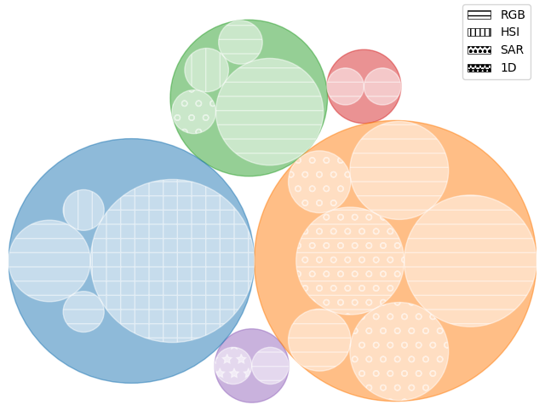
Deforestation detection
Air Quality monitoring
Safe UAV landing site detection
UAV obstacles detection
Oil spills feature extraction
Cloud detection
Navigation
Environmental Monitoring
Flying-object detection
Ship identification
Anomaly detection
Urban areas
Terrain identification
Ship detection
Diverse
General
Target detection
Aircraft detection
Military target identification
Landscape analysis
Redshift estimation
Railway defect detection
Diverse

