Slide 1
INTERNSHIP Presentation
NAME: uthayakumaar s/O KRISHNAN
BATCH FEBRUARY 2026
STUDENT ID: 012024971304

Slide 2

COMPANY BACKGROUND OG IT FORENSIC SERVICES (M) SDN.BHD
16+
Years in Practice
Pioneers in Malaysia
Established Expertise
Founded in 2010, OG IT Forensic Services is Malaysia's very first private digital forensic investigation firm.
Since 2010, the firm has reliably conducted court-ordered evidence seizures, corporate financial fraud investigations, and sophisticated cyber intrusion forensics.
We specialize in bringing fraud, identity theft, and complex cybercrimes to justice through meticulous, court-ready digital evidence analysis and retrieval.
We have a recognized courtroom track record, successfully providing expert testimony in highly critical, sensitive legal disputes globally.

Slide 3

Mission and vision of og it forensic services
Mission
Goal
To bring fraud, identity theft, and cybercrime to justice through the rigorous identification, collection, acquisition, and preservation of digital evidence.
To ensure absolute legal readiness by conducting every engagement with the strict purpose of producing admissible, court-ready digital evidence.
To maintain the highest standard of evidence integrity by operating in full compliance with ISO/IEC 27037 standards for digital forensic investigations.
To serve as the most reliable digital forensic service provider, supporting litigation, incident response, and complex investigations across diverse global jurisdictions with undisputed expert testimony.

Slide 4




Core Forensic Capabilities
Cyber & Fraud
Mobile & Cloud
Crypto Forensics
Investigating Business Email Compromise (BEC), insider threats, money laundering, intellectual property theft, and sophisticated corporate espionage.
Specialized extraction of crucial evidence from mobile devices, cloud storage, encrypted messaging apps, and recovery of digital assets.
Tracing and proving crypto-related crime, analyzing blockchain transactions, investigating DeFi exploits, and recovering stolen digital assets.

Slide 5


Advanced Investigation Domains
Multimedia & Dark Web
Emerging Technologies
Beyond traditional devices, we provide rigorous authentication and analysis of audio, video, and photographs.
The digital landscape is rapidly evolving. We examine digital footprints left by cutting-edge automated systems.
Our threat intelligence actively tracks malicious actors, data breaches, and illegal activity across hidden networks and the Dark Web.
This includes forensics on AI Agents, Internet of Things (IoT) devices, commercial drones, and satellite communications data.

Slide 6
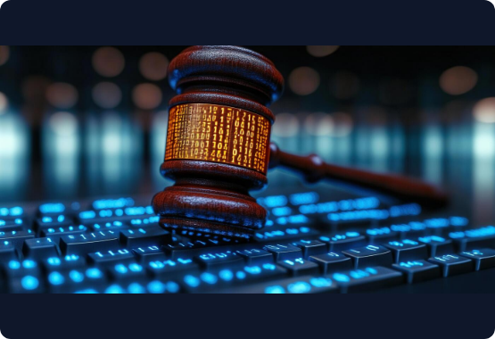
Uncompromising Legal Standards
ISO/IEC 27037 Compliant: Strict adherence to global standards for identifying, collecting, and preserving digital evidence.
Court-Ready Integrity: Guaranteeing the absolute authenticity and legal admissibility of extracted data in court.
Anton Piller Orders: Extensive experience in court-sanctioned, immediate seizure of digital evidence without prior warning.
Expert Witness Services: Independent forensic advisory and expert rebuttal services designed to support legal teams and challenge opposing evidence.

Slide 7
Organization chart of og it forensic (m) sdn. Bhd.
Ahmad Luqman Hanafi
(Digital Forensic Analyst)
Senior Digital Forensic Investigator
UTHAYAKUMAAR S/O KRISHNAN
(Junior Digital Forensic Analyst)

Slide 8
tasks and accountabilities of the roles in Digital Forensics
Senior Digital forensic Investigator
Digital Forensic Analyst
Junior Digital Forensic Analyst
Operational Command: Oversee the entirety of digital forensic operations, delegate tasks, and supervise the forensic unit.
Quality Assurance: Serve as the final review and approval authority for all forensic reports and findings to guarantee absolute quality and legal integrity.
Strategic Direction: Drive the overarching investigative strategy and make executive technical calls.
Mentorship: Act as a dedicated mentor to both analysts and junior analysts to elevate the team's overall capabilities.
Liaison Duties: Act as the primary point of contact coordinating with clients, legal counsel, and external stakeholders.
Active Investigation: Execute direct forensic examinations and drive end-to-end case investigations.
Evidence Processing: Handle the full lifecycle of digital evidence identifying, acquiring, recovering, preserving, and analyzing critical artifacts.
Case Management: Take ownership of assigned cases, guaranteeing they hit completion deadlines.
Documentation: Author comprehensive forensic reports and formal documentation.
Team & Case Support: Lend expertise to high-stakes, complex investigations, assist with compiling case presentations, and provide guidance to junior team members.
Technical Support: Provide foundational technical backing for ongoing forensic investigations.
Evidence Handling: Aid in the examination and analysis of digital evidence, while supporting its meticulous collection, preservation, and organization.
Operational Readiness: Prepare and maintain necessary forensic hardware, software tools, and documentation.
Reporting Support: Contribute to the drafting and preparation of formal forensic reports.
Continuous Development: Actively absorb and implement standard digital forensic methodologies and operational procedures.

Slide 9
Digital Forensic Software used
Mobile Acquisition
Computer and Storage Device Acquisition
Forensic Image Processing
Email Forensics
Oxygen Forensic Detective
Magnet AXIOM
Paraben E3: Universal
Oxygen Forensic Detective
SUMURI PALADIN
SUMURI RECON ITR
OpenText EnCase Forensic
Exterro FTK Imager
Logicube TX1 Forensic Imager
Oxygen Forensic Detective
Magnet AXIOM
OpenText EnCase Forensic
Paraben E3: Universal
Intella
FotoForensics
Intella
OpenText EnCase Forensic
Magnet AXIOM
Oxygen Forensic Detective

Slide 10
Digital Audio Forensic Analysis
Non tampered and tampered audio stream pic
Steps to do audio forensics
Metadata of the audio in forensic tools

Slide 11
Digital Video forensic analysis
Video Metadata Analysis Using Forensic Software and ExifTool
Metadata Verification and Authenticity Assessment
Video Frame Extraction Using FFmpeg on Kali Linux
Analysis of Video Metadata and Audio/Video Properties from FFmpeg Output
Frame-by-Frame Continuity Analysis to Identify Gaps, Blanks, or Inconsistencies and Assess Video Integrity
Audio Extraction and Continuity Analysis Using iZotope to Identify Cuts, Gaps, or Tampering

Slide 12

Digital Photo forensic analysis
Photo Metadata Analysis Using Forensic Software and ExifTool
Image Analysis Using FotoForensics to Assess Potential Alteration or Manipulation
Analysis using lab.fotoforensic
Upload pic and verification of ELA,Histogram, and more
Metadata using Exiftool and forensic software
Steps to be done
Error Level Analysis (ELA)
Histogram
Streogram
Metadata

Slide 13

Digital Mobile Forensic Analysis
ANDROID
Logical extraction
Physical Image
Full File System
Android Agent
ADB Backup
Using Oxygen
Acquisition
Process
Examine
Steps to do
Identification of the Device Make, Model, Operating System (Android/iOS)
Select the Appropriate Acquisition Method: Rooted/Non-Rooted (Android) or DFU/Recovery Mode (iOS)
Identification of the Corresponding Processor Model for the Device
Checkm8
SSH/Jailbreak-based extraction
iTunes/backup extraction
iOS Agent
Logical/public-data methods

Slide 14
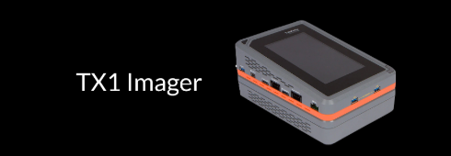
Logicube TX1
The Logicube TX1 is used to acquire a forensic image of digital storage media without altering the original evidence. The process involves connecting the source and destination drives, selecting the appropriate acquisition and verification settings, initiating the imaging process, and verifying the acquired data using hash values to ensure integrity.
1. Connect Source Drive Connect the original/source drive to the designated source port.
2. Connect Destination Drive Connect the destination drive where the forensic image will be stored.
3. Select Acquisition Mode Choose the appropriate imaging method and configure the required acquisition settings.
4. Configure Evidence Details Enter case/evidence identifiers and select the required verification and hashing options.
5. Start Acquisition Initiate the forensic imaging process. The TX1 creates a bit-for-bit copy of the source media.
6. Verification & Hashing The acquired image is verified using cryptographic hash values to confirm data integrity.
7. Review Results Check the acquisition status, hash values, errors, and completion report.

Slide 15

Social networking analysis (sna)
Maltego is an OSINT and link-analysis tool used to gather, visualize, and correlate information from various sources. It helps investigators identify relationships between people, organizations, domains, IP addresses, social media accounts, and other digital entities.
1. Define the Target Identify the person, organization, domain, IP address, or other entity to be investigated.
2. Create a New Graph Open Maltego and create a new graph for the investigation.
3. Add the Target Entity Select the appropriate entity type and enter the known information.
5. Analyse Relationships Review the connections between entities such as domains, email addresses, IPs, organizations, and social profiles.
6. Correlate & Verify Cross-check important findings against reliable sources to reduce false positives.
4. Run Transforms Run relevant Transforms to collect information from available data sources.
7. Document Findings Record relevant entities, relationships, sources, timestamps, and observations.

Slide 16

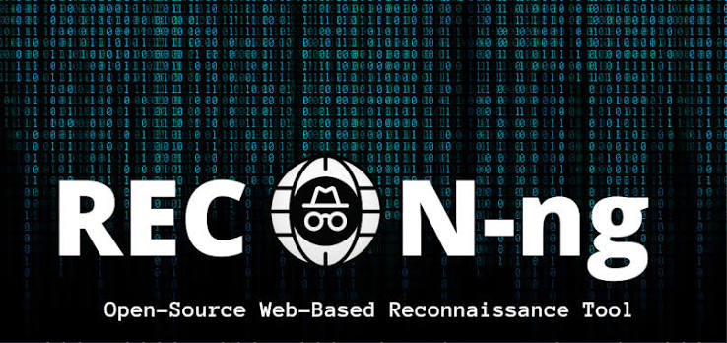






SOCIAL NETWORK ANALYSIS USING KALI LINUX
SpiderFoot — username searches across social platforms
Recon-ng— modular reconnaissance framework
Holehe — checks whether an email is associated with supported online services
Sherlock— username and account discovery
DNS tools— web crawling and information extraction
GHunt — Google-account-related OSINT
theHarvester— emails, domains, and related information
Google Dorks — targeted search-engine queries

Slide 17
On-SITE Collection
On-Site Collection involves identifying, documenting, preserving, and securing digital devices or media at the scene. The process ensures that evidence is properly handled, protected from alteration, and maintained with a documented chain of custody.
1. Identify the Evidence Identify the relevant device, media, or digital evidence at the scene.
2. Document the Evidence Record the device details, condition, identifiers, and scene information.
3. Preserve the Evidence Prevent alteration or contamination of the original evidence.
4. Secure the Evidence Package, label, and securely transport the evidence as required.
Digital Evidence Collection Workflow
5. Maintain Chain of Custody Record each transfer, handling activity, and person responsible.
Final Output: Documented + Preserved + Secured Digital Evidence

Slide 18
On-site Acquisition
On-Site Digital Forensic Acquisition
On-Site Acquisition involves the forensic extraction or imaging of digital evidence at the location of an incident. The process focuses on safely acquiring data from devices while preserving the original evidence, maintaining integrity, and documenting the acquisition for further forensic examination.
1. Identify the Source Select the device or storage media to be acquired.
2. Connect the Evidence Connect the source device to the appropriate forensic acquisition equipment.
3. Select Acquisition Method Choose the appropriate logical, file-system, or physical acquisition method.
4. Configure Acquisition Enter case details and enable required hashing and verification options.
Digital Evidence Acquisition Workflow
5. Acquire the Data Create a forensic copy or extraction of the source data.
6. Verify Integrity Calculate and verify cryptographic hash values to confirm data integrity.
7. Document Results Record acquisition details, hash values, errors, and completion status.
Final Output: Forensic Image/Extraction + Hash Values + Acquisition Report

Slide 19
Key Learnings and Skills Gained During My Internship

